Slide 1

ECOVISION: Deep Learning model for Seasonal Detection
by
Sharath V
Roll No. 224G1A0599
Sharath Kumar M
Roll No. 224G1A0598
Maneedeep M
Roll No. 234G5A0505
Under the guidance of
Dr. P Veera Prakash _{M.Tech.,} _{Ph.D}
_{Assistant Professor & HOD}
Department of Computer Science and Engineering
Srinivasa Ramanujan Institute of Technology
Autonomous
Rotarypuram Village, B K Samudram Mandal, Ananthapuramu – 515701.
Accredited by NBA & NAAC with “A” Grade,Affiliated to JNTUA,Ananthapuramu
2025-2026

Slide 2
Comments
Panel members raised comments like:
Can your project work with different geographical locations?
Suggested to compare results with existing seasonal detection methods?
3. How effective your model(Hybrid fusion Model) is?
4. What is Hybrid fusion Model Accuracy,Precision,Recall,F1 Score?
Can we automate the environmental parameters in real world cases?
Asked about tools in the project?

Slide 3

Contents
Abstract
Introduction
Literature Survey
Existing System
Proposed System
Planning
Design
Implementation
Research Paper
References
GitHub Link

Slide 4
Abstract
Seasonal changes play a critical role in plant growth, agricultural planning, and environmental monitoring, yet conventional seasonal identification methods rely heavily on manual observation or isolated climatic data, leading to inconsistent results. To address this challenge, this research introduces Ecovision, a deep learning–based seasonal detection system that predicts the current season using a plant/tree image combined with environmental parameters such as temperature, humidity, precipitation, pressure, wind speed, soil moisture, cloud visibility, and solar radiation. The main objective of the study is to develop a multimodal AI model that integrates Convolutional Neural Networks (CNNs) for image feature extraction with machine learning–based processing of climatic parameters to achieve high prediction accuracy.
The model was trained using a curated dataset linking plant phenological images with weather conditions, and the fusion of both data streams significantly improved classification performance. The results demonstrate that the hybrid model outperforms traditional single-input approaches, providing accurate and reliable seasonal predictions. This work concludes that Ecovision offers a scalable and intelligent solution for agriculture, ecological research, and climate-based decision-making, highlighting the potential of AI to enhance environmental understanding and sustainable practices.

Slide 5
Introduction
Seasonal Detection is crucial for agriculture, plant research, environmental monitoring, and biotechnology.
Traditional methods rely on manual plant observation or separate weather reports.
Manual approaches are prone to human error, subjectivity, and inconsistent results.
Image-based models capture visual features but ignore real-time environmental factors.
Weather-based models focus on climatic data but overlook important visual changes in plants.
Lack of integration between plant imagery and environmental data leads to incomplete seasonal detection.
Accurate seasonal detection is essential for crop planning, ecological analysis, and scientific research.
Ecovision uses deep learning to combine plant images and environmental parameters for reliable, automated seasonal detection.

Slide 6
Literature Survey
Singh et al. (2021): CNN-based season classification using plant leaf images. Proved visual features (color, texture, dryness) accurately reflect seasonal changes. [IEEE Xplore]
Zhou et al. (2021): ML model using environmental parameters (temperature, humidity, rainfall) for seasonal detection. Combined visual + environmental data improves accuracy. [MDPI]
Das & Sen (2020): Computer vision for plant phenology study. Demonstrated plant biological cycles directly correlate with seasonal transitions. [ScienceDirect]
Rai & Kaur (2022): CNN + LSTM deep learning for seasonal/weather prediction. Deep learning significantly outperforms traditional ML. [SpringerLink]
Ji et al. (2025): HydroSpot-YOLO for invasive species detection — higher mAP vs. baseline YOLO for ecological monitoring. [Ecological Indicators]
Oumaima et al. (2025): EnviScan+ CNN-based plant identification platform — ~90.18% accuracy with AR and chatbot support. [SoftwareX]

Slide 7
Existing System
Current seasonal detection systems mainly use image-based analysis or weather data separately.
Traditional Machine Learning and Convolutional Neural Network (CNN) models are used to classify seasonal patterns from images.
Some systems rely on environmental parameters like temperature, humidity, and rainfall.
These systems usually analyze only one type of data, which may reduce the prediction accuracy.
They may also struggle to work effectively in different geographical locations and changing environmental conditions.

Slide 8
Research Gap
Existing systems cannot effectively combine visual seasonal patterns and environmental parameters together.
Models that use single data sources may not provide accurate seasonal prediction.
Seasonal variations across different geographical regions are not handled properly in many systems.
There is a need for a Hybrid Fusion Model that integrates image features and environmental data to improve seasonal detection accuracy

Slide 9
Proposed System
The proposed system, Ecovision, uses a deep learning model that analyzes both the plant/tree image and environmental parameters to accurately predict the current season.
A CNN model extracts visual features such as leaf color, texture, dryness, and flowering patterns from the uploaded image.
A separate module processes environmental inputs like temperature, humidity, precipitation, wind speed, pressure, soil moisture, and cloud visibility.
Both image features and climatic data are combined (fused) to improve the accuracy and reliability of seasonal prediction.
The system includes a simple and user-friendly interface where users can upload an image and enter environmental values.
The backend processes the data and provides the predicted season with a confidence score, helping users make better agricultural and ecological decisions.

Slide 10
Extension & Novelty
Extended the system with a Fusion Hybrid Model integrated into a Flask web interface for real-time seasonal prediction.
Combines multiple deep learning architectures — CNN, VGG16, ResNet50, Xception, NASNetLarge — for superior feature extraction and classification accuracy.
Flask interface enables user-friendly input submission, secure SQLite authentication.
Enhances prediction accuracy by leveraging complementary features from multiple architectures simultaneously.
Supports integration of plant images and environmental features for comprehensive, context-aware, real-time classification.
Enables scalable deployment — users can access seasonal predictions securely across any device, anywhere.

Slide 11
Planning-Objectives of Project
Develop an AI-based system to detect seasons from plant images.
Integrate plant visual features with environmental parameters (temperature, humidity, etc.).
Improve prediction accuracy using multiple deep learning models.
Build a Fusion Hybrid Model that combines CNN, VGG16, ResNet50, Xception, and NASNetLarge.
Provide real-time seasonal prediction through a web application.
Help farmers, researchers, and environmental analysts understand seasonal changes.

Slide 12
Planning-Requirements
SOFTWARE REQUIREMENTS:
Anaconda 2023.03-1 | Python 3.10.9 | Flask (Web Framework)
Jupyter Notebook (Development) | SQLite3 (Database)
Front-End: HTML, CSS, JavaScript, Bootstrap 4
Operating System: Windows 10 and above
HARDWARE REQUIREMENTS:
Processor: Intel i5 9th Gen and above
RAM: 8 GB minimum (16/32 GB preferred)
Hard Disk: 100 GB free space minimum

Slide 13
Planning-System Requiremnts and Workflow
System Requirements
Plant image dataset with seasonal labels
Environmental parameters dataset
Deep learning frameworks (TensorFlow / Keras / PyTorch)
Python environment with required libraries
Flask framework for web application
SQLite database for user authentication
Workflow Planning
Data collection (plant images + environmental features)
Data preprocessing and dataset preparation
Model training using deep learning architectures
Fusion Hybrid Model development
Integration with Flask web application
Testing and real-time seasonal prediction

Slide 14
Design of the project
The design phase defines the overall structure and workflow of the proposed system.
It shows how different components of the system interact with each other.
Various UML diagrams are used to represent the system architecture and functionality.
System architecture explains how the web application, dataset, and prediction model are connected.
Data Flow Diagram (DFD) illustrates how data moves through the system from input to prediction output.
UML diagrams such as Use Case, Class, Activity, Sequence, Component, and Deployment diagrams describe system behavior and interactions.
This design helps in clearly understanding the system before implementation.

Slide 15
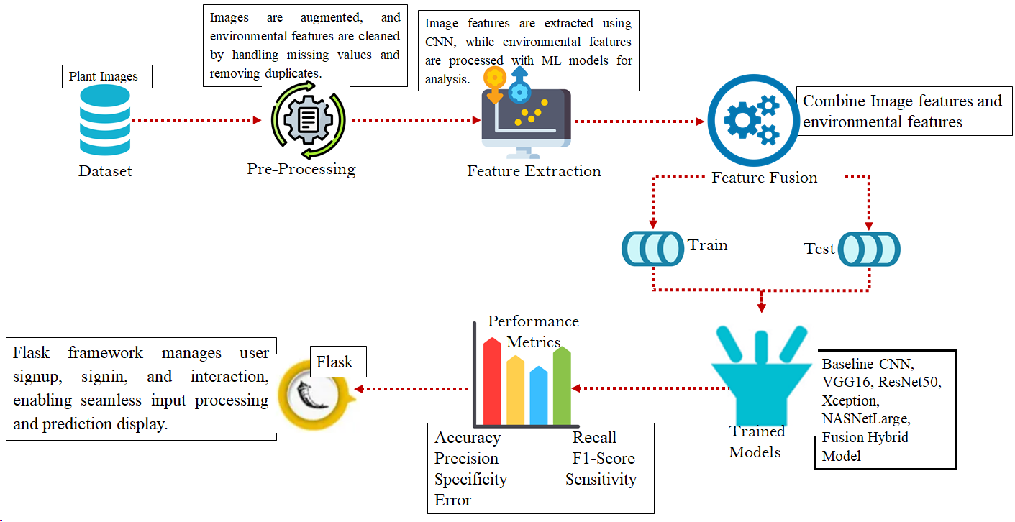
Design-System Architecture

Slide 16
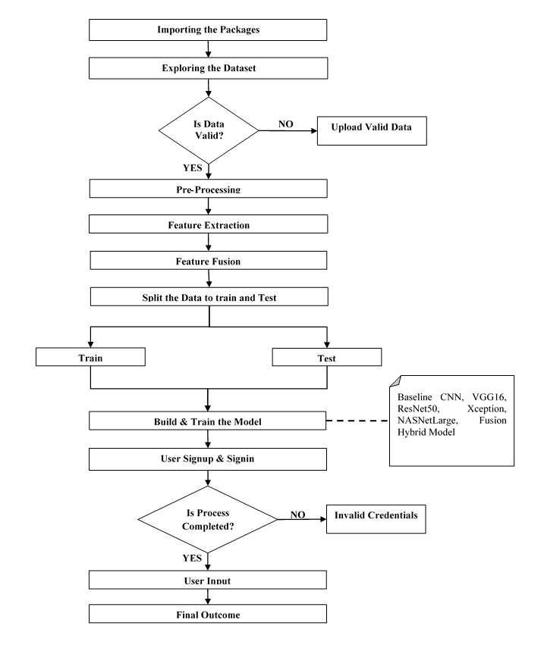
Design-Data Flow Diagram

Slide 17
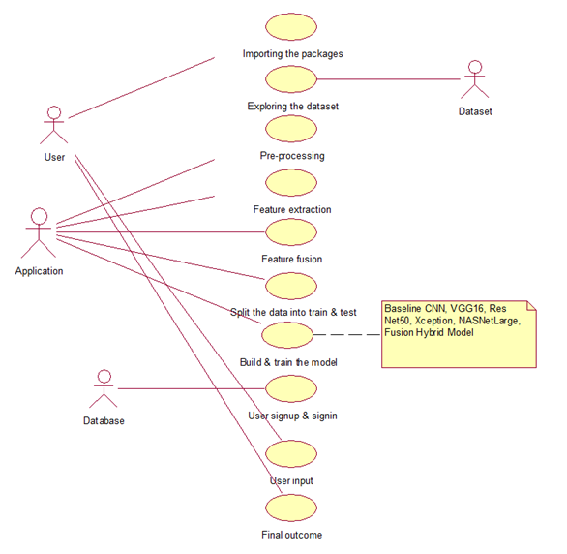
Use Case Diagram

Slide 18
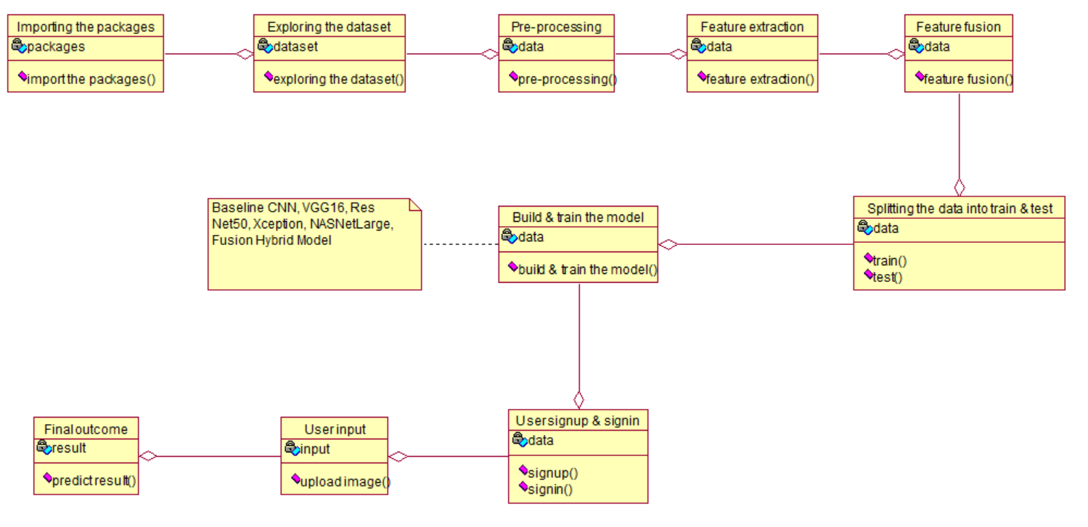
Class Diagram

Slide 19
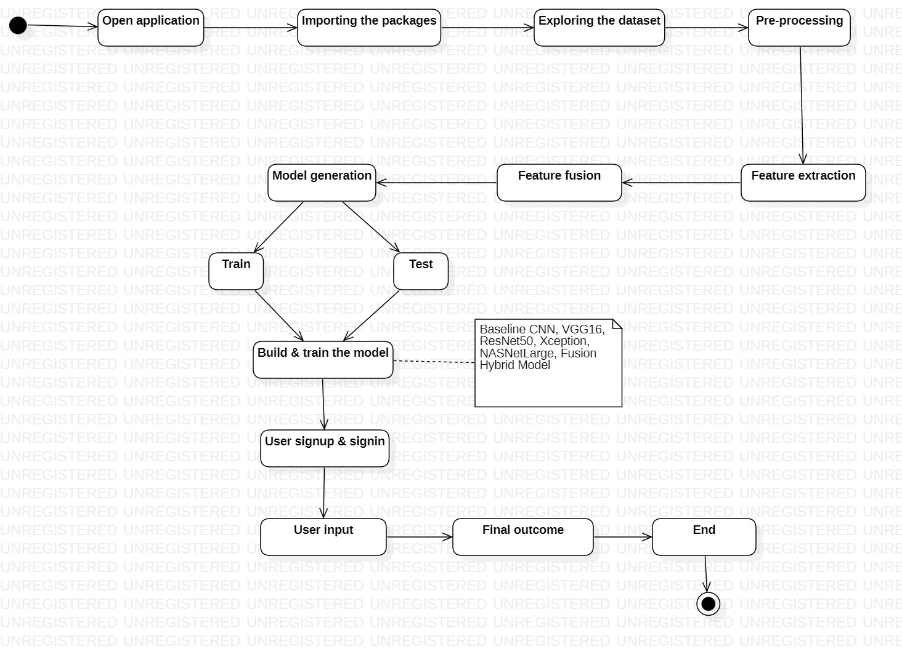
Activity Diagram

Slide 20
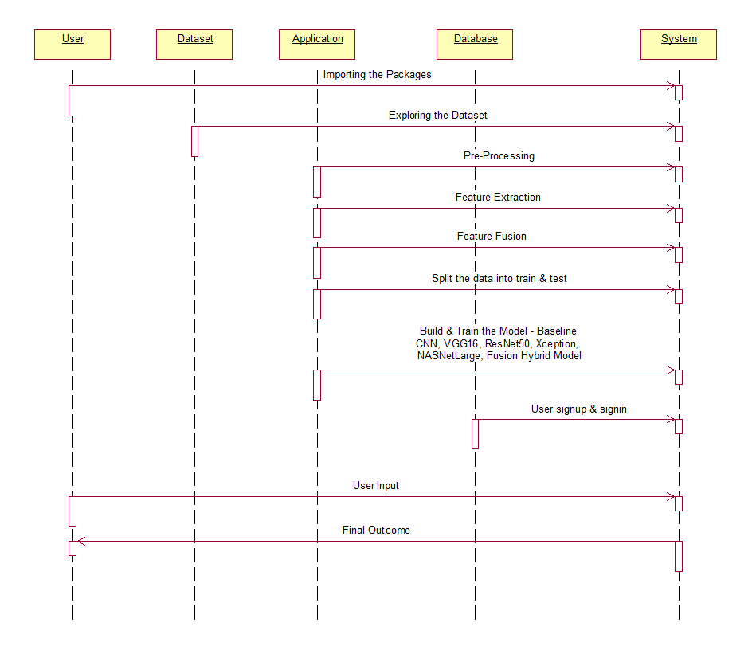
Sequence Diagram

Slide 21
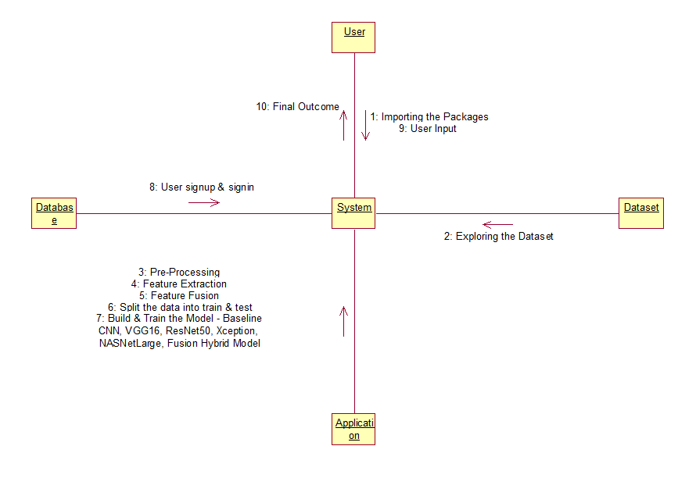
Collaboration Diagram

Slide 22
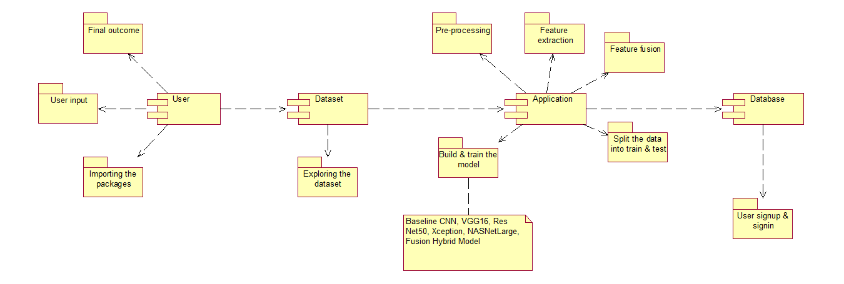
Component Diagram

Slide 23
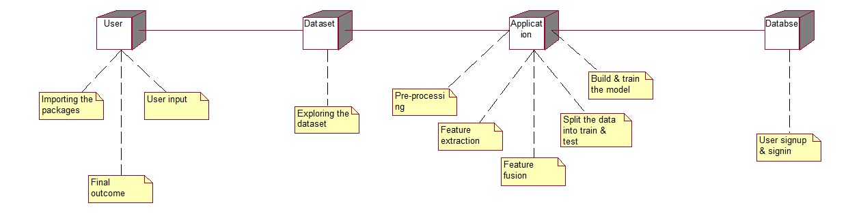
Deployment Diagram

Slide 24
Implementation
The implementation phase focuses on developing the proposed system using suitable tools and technologies.
The dataset is first imported and preprocessed to remove noise and prepare it for analysis.
Important features are extracted from the data to improve model performance.
Machine learning algorithms are applied for model training and prediction.
The trained model is evaluated to measure accuracy and performance.
The system is integrated into a web application with user authentication for secure access.
Finally, the system generates real-time predictions based on user input.

Slide 25
Implementation — Flow of work (Part 1)
Import Packages: All Python libraries for deep learning, data processing, image handling, and numerical computation are loaded.
Explore Dataset: Plant images mapped to seasons and environmental features are loaded and examined — image dimensions, distributions, missing values, duplicates.
Preprocessing: Images undergo augmentation (rotation, scaling, flipping); environmental features cleaned (missing-value handling, duplicate removal). Inputs standardized.
Feature Extraction: CNN, VGG16, ResNet50, Xception, NASNetLarge extract seasonal image features. Environmental features normalized for subsequent fusion.
Feature Fusion: Extracted image and environmental features combined at feature level — integrating visual and contextual cues into a unified representation.

Slide 26
Implementation —Flow of work (Part 2)
Train/Test Split: Dataset divided into training and testing subsets to prevent overfitting and validate generalization.
Model Training: All models (CNN, VGG16, ResNet50, Xception, NASNetLarge, Fusion Hybrid) trained on preprocessed data to learn seasonal patterns.
Evaluation: Models assessed using accuracy, precision, recall, F1-score, specificity, and sensitivity metrics.
Flask Deployment: System deployed via Flask handling HTTP requests, input submission, and model interaction through a browser-based UI.
User Auth: Secure account creation and login via SQLite for controlled, personalized access.
Final Prediction: Fusion model generates seasonal prediction with confidence score from user-submitted plant image and environmental inputs.

Slide 27
Implementation-Algorithms Used
Baseline CNN: Convolutional + pooling + fully connected layers. Learns spatial hierarchies for visual feature extraction. Serves as baseline for comparison.
VGG16: Sequential 3×3 convolutional layers + max-pooling. Captures low-level textures to complex patterns; robust for high-resolution image classification.
ResNet50: 50-layer residual network with skip connections. Overcomes vanishing gradient — enables deep feature learning without performance degradation.
Xception: Depthwise separable convolutions decouple spatial/channel learning — efficient fine-grained feature extraction with reduced computational cost.
NASNetLarge: Neural Architecture Search-optimized model with normal/reduction cells. Captures complex spatial patterns and high-level abstractions efficiently.
Fusion Hybrid Model: Integrates features from all five architectures + environmental MLP embeddings — comprehensive multimodal representation for superior seasonal classification.

Slide 28
Performance Evaluation
Model Comparison Results:
Baseline CNN: Accuracy 95.64% | Specificity 98.68% | Sensitivity 94.39%
VGG16: Accuracy 99.51% | Specificity 99.86% | Sensitivity 99.39%
ResNet50: Accuracy 99.93% | Specificity 99.98% | Sensitivity 99.89%
Xception: Accuracy 99.76% | Specificity 99.94% | Sensitivity 99.85%
NASNetLarge: Accuracy 99.87% | Specificity 99.97% | Sensitivity 99.86%
Fusion Hybrid: Accuracy 99.94% | Specificity 99.99% | Sensitivity 99.91% ★ Best
The Fusion Hybrid Model achieves highest accuracy, specificity, and sensitivity — validating the effectiveness of multimodal feature fusion.

Slide 29
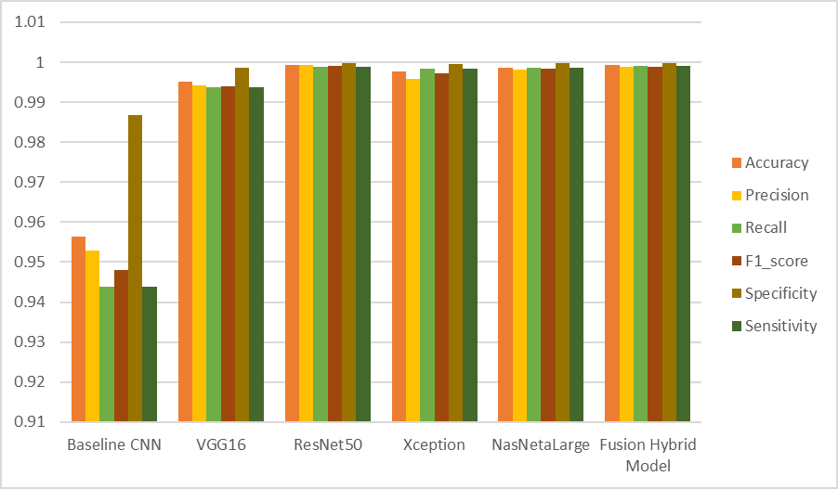
Performance Comparison Graph

Slide 30
Research Paper Overview
Title: EcoVision: Deep Learning Model for Seasonal Detection
Conference: Submitted to SCITEPRESS Conference Proceedings
Research Aim:
To develop a system that detects seasons using Tree images with the integration of environmental parameters.
Approach Used:
1. Image data collection and preprocessing
2. Deep learning model for classification
3. Integration of hybrid model for better prediction

Slide 31
Research Paper Contribution
Key Contributions:
1. Developed a deep learning-based seasonal detection system.
2. Integrated multiple models (hybrid approach) for improved accuracy.
3. Implemented the system in a web-based application for real-time prediction.
Benefits:
1. Helps in environmental monitoring.
2. Provides accurate seasonal pattern prediction.
Current Status:
1.Research paper prepared and submitted to SCITEPRESS for conference publication.

Slide 32
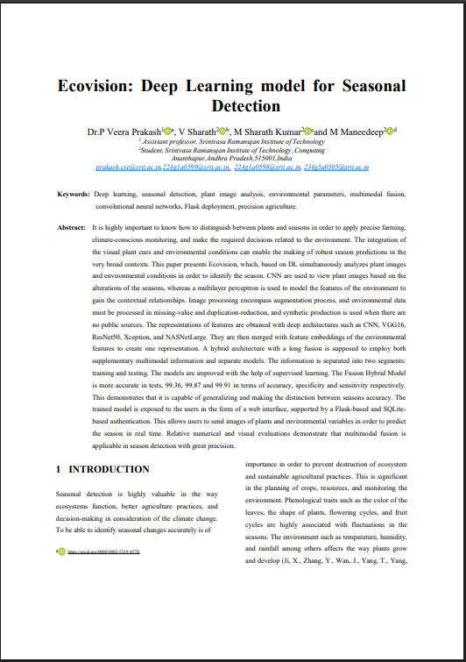
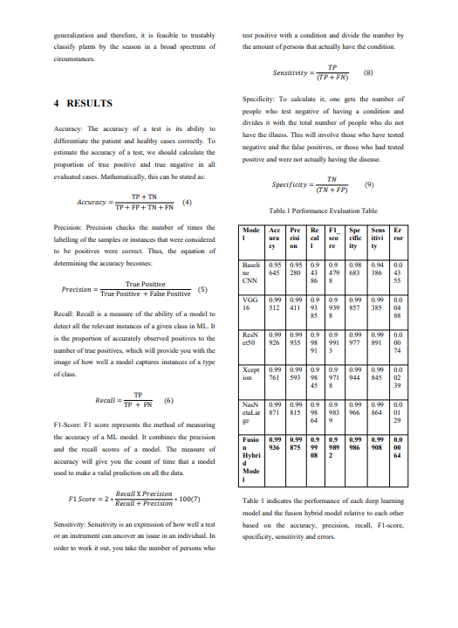
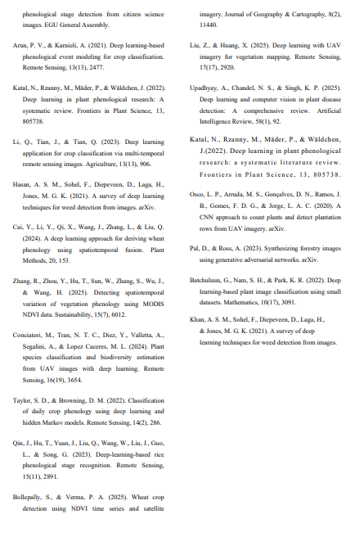
Research paper Document

Slide 33
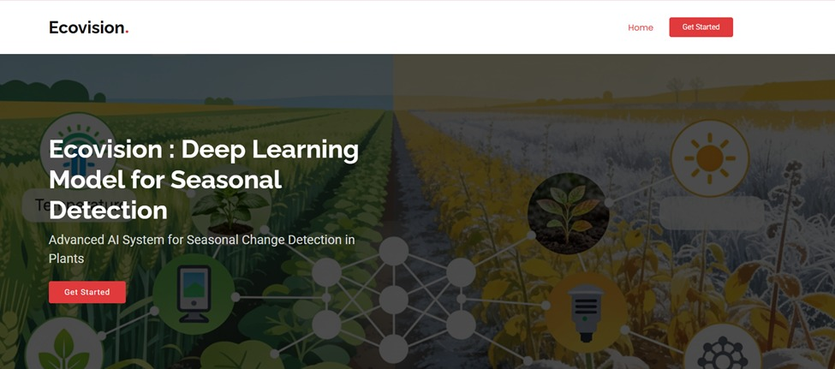
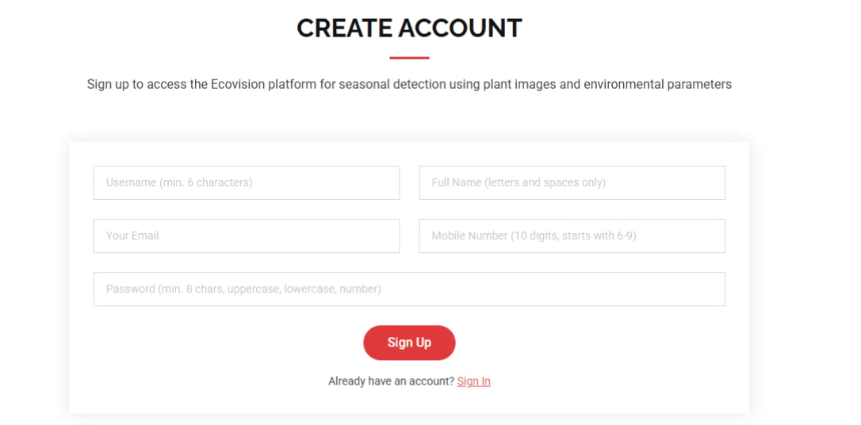
Execution

Slide 34
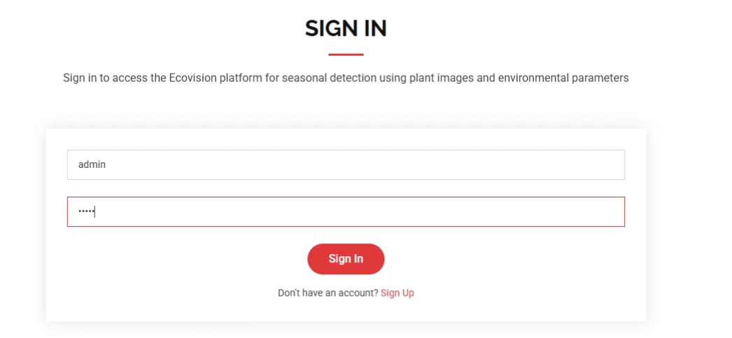
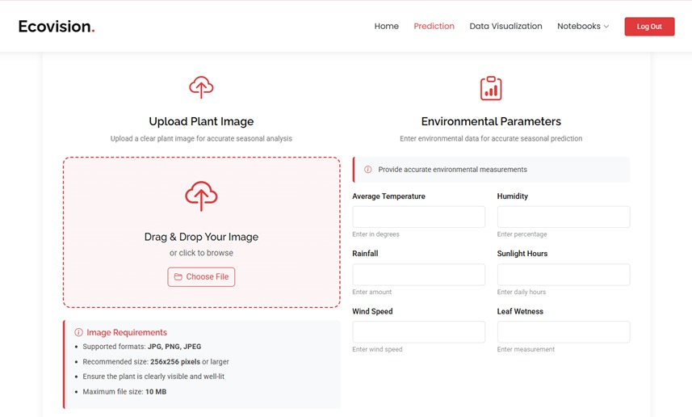
Execution

Slide 35
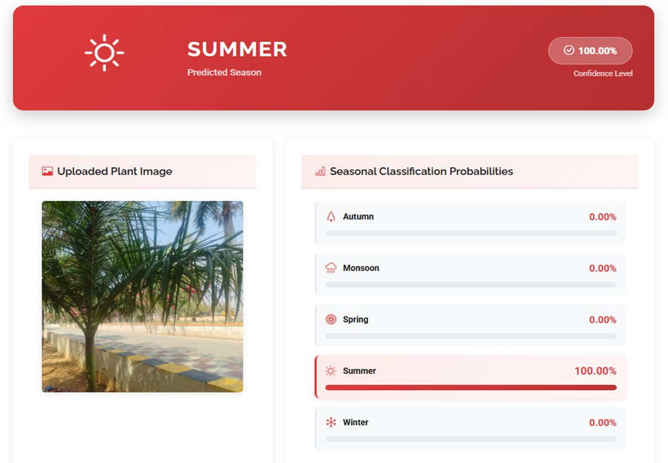
Execution

Slide 36
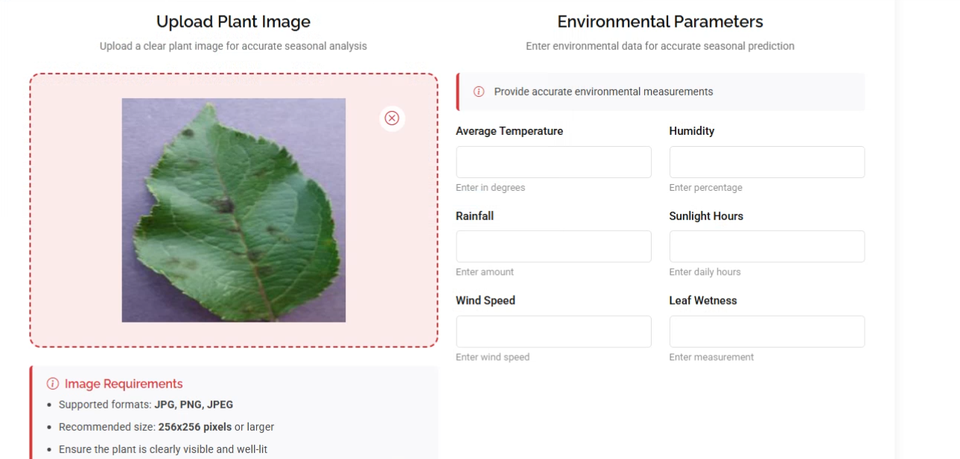
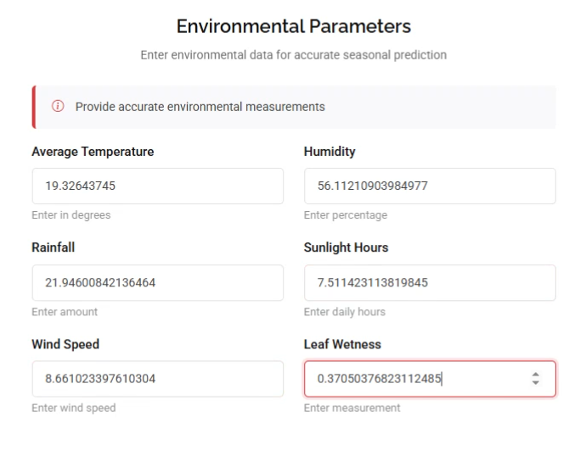
Execution

Slide 37
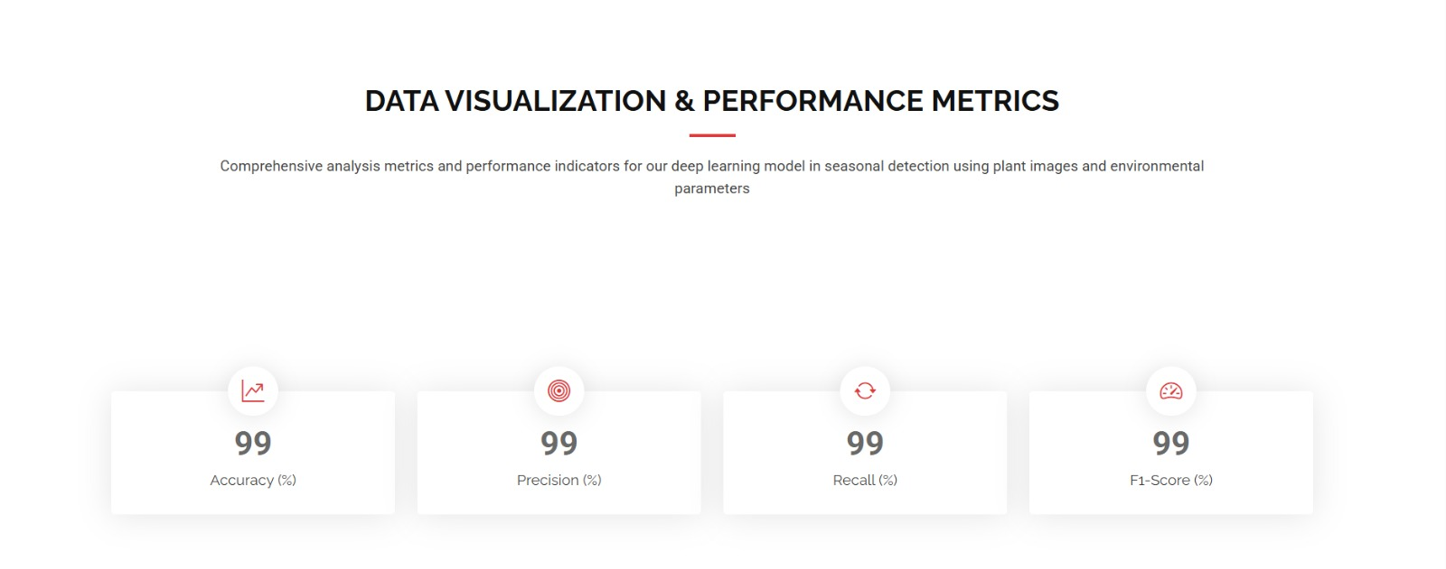
Execution - Results Dashboard

Slide 38
Conclusion
Integrating plant visual cues with environmental parameters significantly enhances seasonal detection accuracy and robustness.
The Fusion Hybrid Model delivers superior performance — 99.36% accuracy, 99.08% recall, 99.87% specificity, 99.91% sensitivity — validating multimodal feature fusion.
Multimodal learning captures both phenological patterns from imagery and contextual variations from environmental data, reducing ambiguity from visual similarities across adjacent seasons.
Flask deployment ensures practical usability: real-time seasonal prediction from user-uploaded images + environmental inputs, with secure SQLite authentication.
Establishes a scalable, accurate, deployable seasonal detection framework for precision agriculture, climate-adaptive planning, and automated decision-support systems.

Slide 39
Future Scope
Incorporate multi-temporal plant imagery to model gradual phenological transitions across seasons for improved robustness.
Integrate additional environmental modalities — soil moisture indices, solar radiation, satellite-derived climate variables — for richer contextual understanding.
Explore self-supervised and contrastive learning strategies to reduce dependency on labeled seasonal data and improve geographic generalization.
Investigate attention-based fusion mechanisms to dynamically weight visual and environmental features under varying conditions.
Enable real-time data assimilation from IoT sensors for adaptive seasonal prediction under changing climates.
Extend framework to fine-grained seasonal stages and crop-specific phenology analysis for advanced precision agriculture and long-term ecological forecasting.

Slide 40
References
[1] Singh, K.S. and Gupta, R., "Season Classification Using Plant Leaf Images and CNN Models," Int. J. Computer Vision Research, vol. 14, no. 3, pp. 112-120, 2021.
[2] Zhou, M., Li, Y. and Chen, X., "Environmental Feature-Based Season Detection Using ML," IEEE Access, vol. 9, pp. 78532-78545, 2021.
[3] Das, A. and Sen, N., "Plant Phenology Detection Using Computer Vision," Proc. ICSCV, pp. 233-240, 2020.
[4] Rai, P. and Kaur, S., "Deep Learning for Weather and Seasonal Pattern Prediction," J. Intelligent Systems, vol. 5, no. 2, pp. 54-63, 2022.
[5] Ji, X. et al., "Ecological monitoring of invasive species through deep learning-based object detection," Ecological Indicators, 175, 113572, 2025.
[6] Oumaima, S. et al., "EnviScan+: AI-driven plant identification for sustainable agriculture," SoftwareX, 30, 102182, 2025.

Slide 41
GitHub Link
Project Repository:
https://github.com/Sharath599/Batch-B02-2025-2026
Team Members:
Sharath V (224G1A0599) — GitHub: Sharath599
Sharath Kumar M (224G1A0598)
Maneedeep M (234G5A0505)

Slide 42
Thank You!!!

Slide 43
Any Query?

