Slide 1

ECOVISION : Deep Learning Model for Seasonal Detection
by
Sharath V
Roll No. 224G1A0599
Sharath Kumar M
Roll No. 224G1A0598
Maneedeep M
Roll No. 234G5A0505
Under the guidance of
Dr. P Veera Prakash _{M.Tech.,} _{Ph.D}
_{Assistant Professor & HOD}
Department of Computer Science and Engineering
Srinivasa Ramanujan Institute of Technology
Autonomous
Rotarypuram Village, B K Samudram Mandal, Ananthapuramu – 515701.
Accredited by NBA & NAAC with “A” Grade,Affiliated to JNTUA,Ananthapuramu
2025-2026

Slide 2
Title Explanation
The title “ECOVISION” represents an intelligent system developed to understand and identify various seasons using artificial intelligence techniques.
The word “Eco” refers to ecology and the natural environment, indicating that the project focuses on seasonal changes observed in plants and trees. The word “Vision” signifies the use of computer vision and deep learning methods to analyze visual data, particularly images of vegetation.
The phrase “Deep Learning Model for Seasonal Detection” clearly describes the main objective of the project, which is to automatically detect and classify different seasons by learning patterns from plant images. The model identifies visual characteristics such as leaf color, density, and texture that vary across seasons.
Overall, the title reflects the integration of environmental awareness and advanced deep learning technology to build an intelligent system capable of seasonal detection with practical applications in agriculture and environmental monitoring.

Slide 3
Contents
Abstract
Introduction
Software Requirements
Datasets/Modules
Implementation
Outputs
Conclusion
References

Slide 4
Abstract
Seasonal Detection significantly influence plant growth, agriculture, and environmental assessment, making accurate season identification essential.
Traditional seasonal detection methods rely on manual observation or isolated climatic data, leading to inconsistent and less reliable predictions.
A multimodal AI approach is employed, combining CNN-based plant image feature extraction with machine-learning analysis of environmental parameters.
The integrated model achieves higher seasonal prediction accuracy than single-input image-only or climate-only methods.
The study demonstrates that Ecovision is a scalable and intelligent solution for agriculture, ecological research, and climate-based decision-making.

Slide 5
Introduction
Seasonal Detection is crucial for agriculture, plant research, environmental monitoring, and biotechnology.
Traditional methods rely on manual plant observation or separate weather reports.
Manual approaches are prone to human error, subjectivity, and inconsistent results.
Image-based models capture visual features but ignore real-time environmental factors.
Weather-based models focus on climatic data but overlook important visual changes in plants.
Lack of integration between plant imagery and environmental data leads to incomplete seasonal detection.
Accurate seasonal detection is essential for crop planning, ecological analysis, and scientific research.
Ecovision uses deep learning to combine plant images and environmental parameters for reliable, automated seasonal detection.

Slide 6
Software Requirements
Software: Anaconda (2023.03-1)
Primary Language: Python (3.10.9)
Web Framework: Flask
Development Environment: Jupyter Notebook
Database: Sqlite3
Front-End Technologies: HTML, CSS, JavaScript and Bootstrap4

Slide 7
Datasets/Modules
The dataset consists of plant and tree images collected across different seasons such as summer, winter, monsoon, spring, and autumn. Images capture seasonal phenological changes including leaf colour variation, flowering stages, drying patterns, and canopy density. Each image is labelled according to its corresponding season.
Plant images are mapped to seasons based on the date, geographical location, and known regional seasonal calendars. This mapping ensures accurate association between visual plant characteristics and seasonal phases.
Environmental parameters include temperature, humidity, precipitation, wind speed, pressure, soil moisture, solar radiation, and cloud visibility. These features provide climatic context that influences plant growth and seasonal transitions.
Plant image data and environmental features are combined into a unified dataset using structured formats such as CSV or SQLite, enabling synchronized multimodal learning and effective seasonal prediction.
In cases where real-world environmental data is unavailable or incomplete, synthetic environmental datasets are generated using statistically realistic ranges and distributions to maintain data consistency and model robustness.

Slide 8
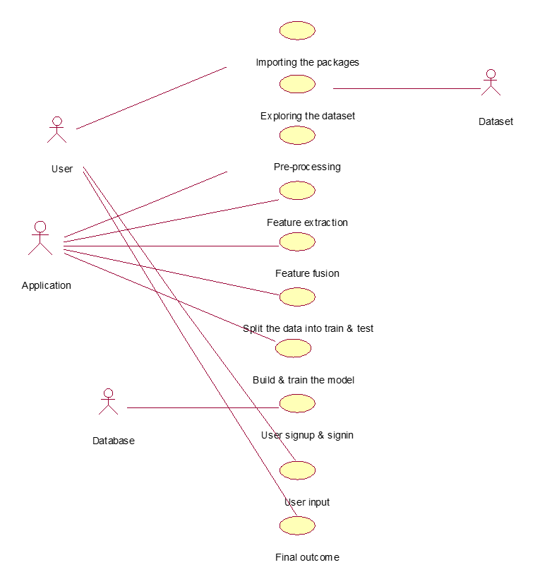
Implementation – Use Case Diagram
Use case diagram defines system functionality through actors and use cases, showing association between users and features like image upload, data entry, prediction viewing, and authentication within Ecovision interface flow.

Slide 9
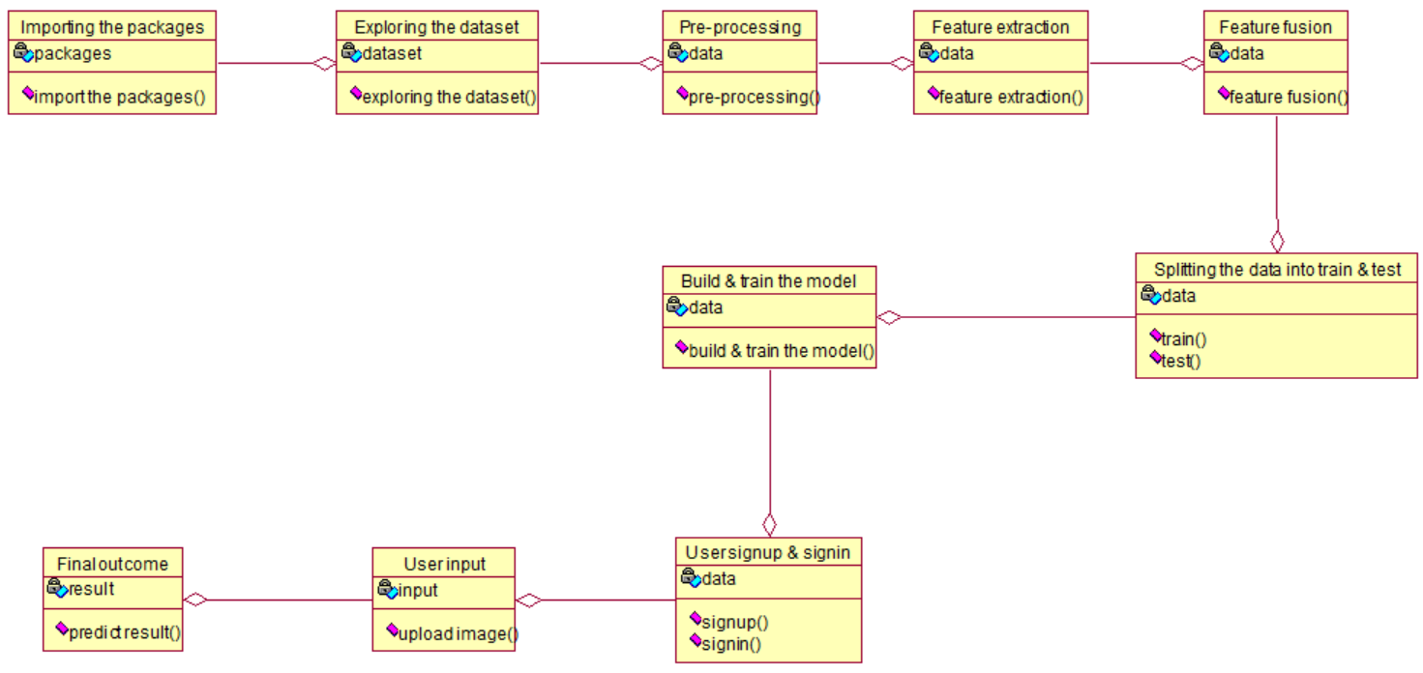
Implementation – Class Diagram
Class diagram represents system structure using classes with attributes and operations, illustrating aggregation among ImageData, EnvironmentalData, User, Model, and PredictionResult to support seasonal detection logic processing accuracy scalability and maintainability.

Slide 10
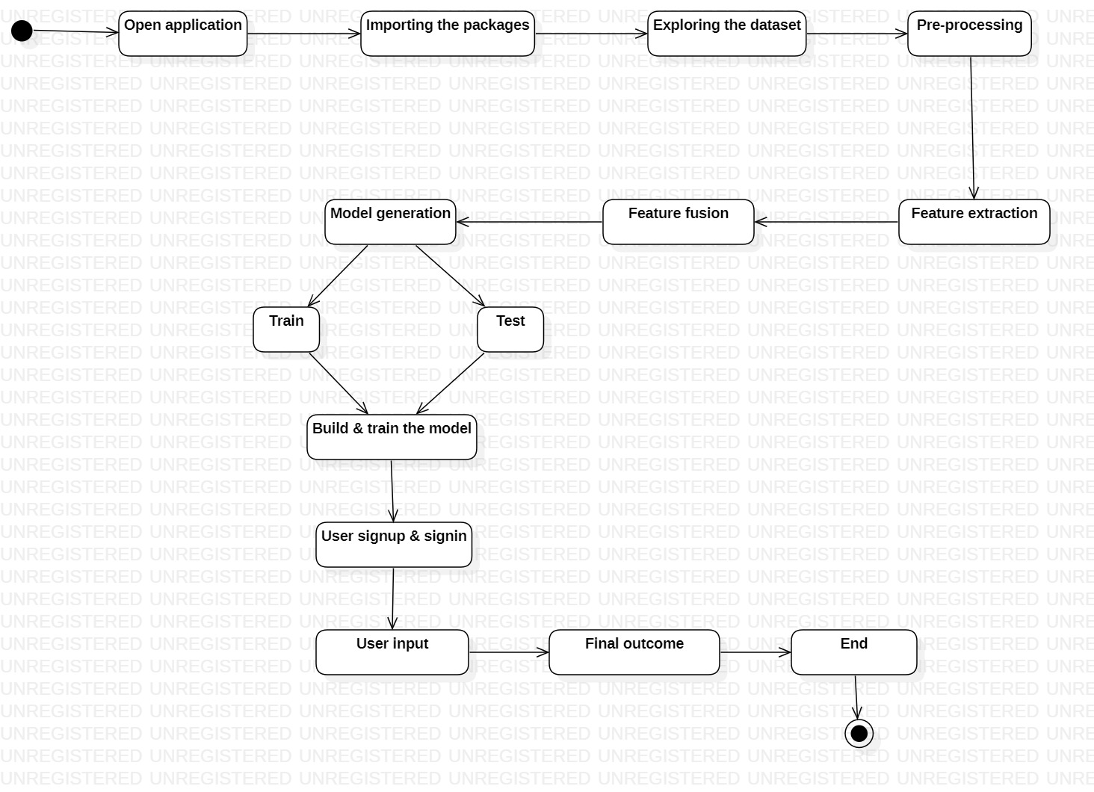
Implementation – Activity Diagram
Activity diagram models workflow using actions, decisions, and control flow, depicting steps from login, image upload, parameter input, preprocessing, prediction execution, and result display in Ecovision interface validation feedback handling.

Slide 11
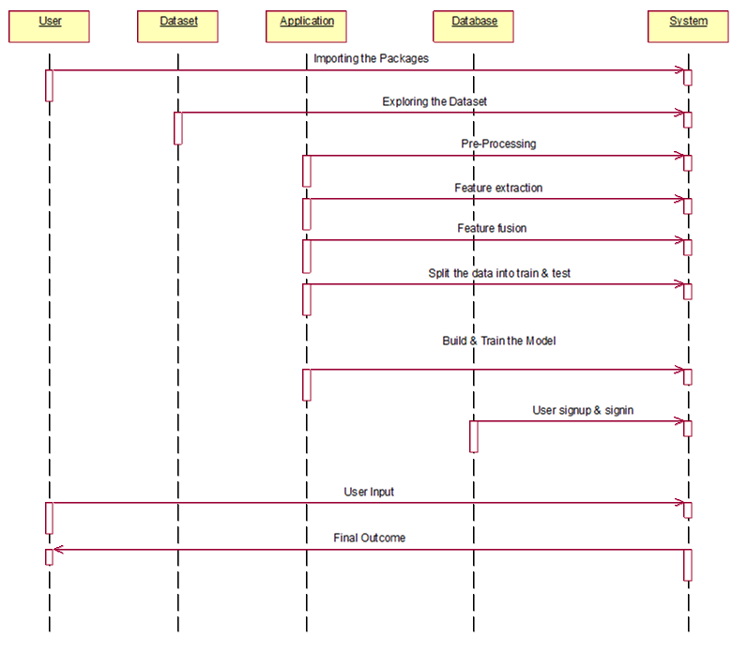
Implementation – Sequence Diagram
Sequence diagram explains runtime interaction by showing objects and object message flow among User Interface, Preprocessor, PredictionModel, and Database, ensuring ordered execution of requests, responses, and seasonal prediction delivery accuracy assurance.

Slide 12
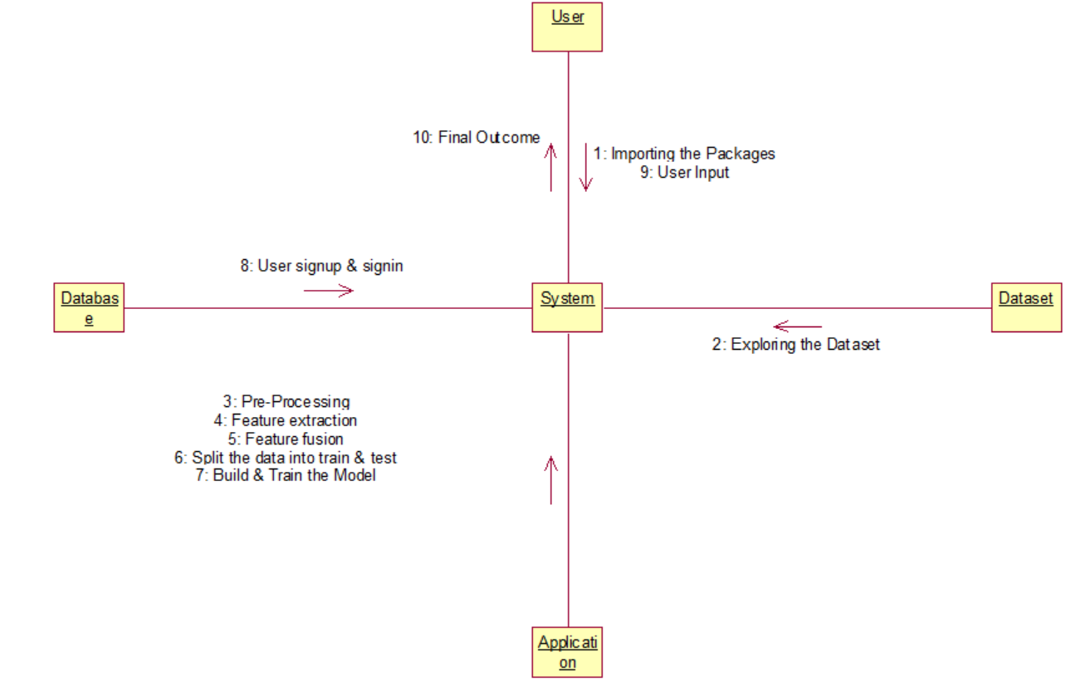
Implementation – Collaboration Diagram
Collaboration diagram emphasizes object interaction through link messages, illustrating how UserInterface, FeatureExtractor, FusionLayer, and PredictionModule cooperate to exchange data efficiently for accurate seasonal detection logic consistency reliability performance flow control.

Slide 13
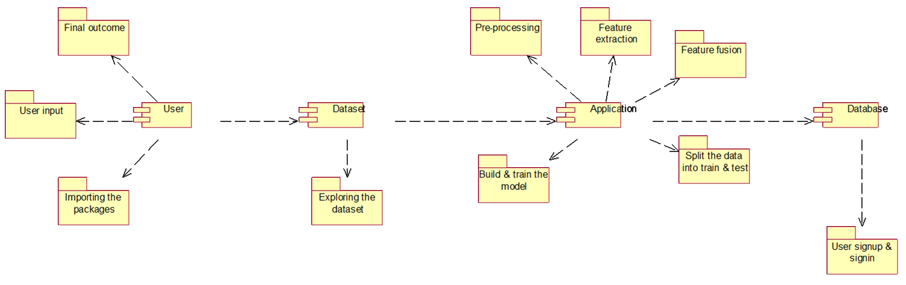
Implementation – Component Diagram
Component diagram shows system organization into components and packages such as frontend, preprocessing, model, and database, highlighting dependency relationships that enable modular development, maintenance, and scalable seasonal detection deployment flexibility.

Slide 14
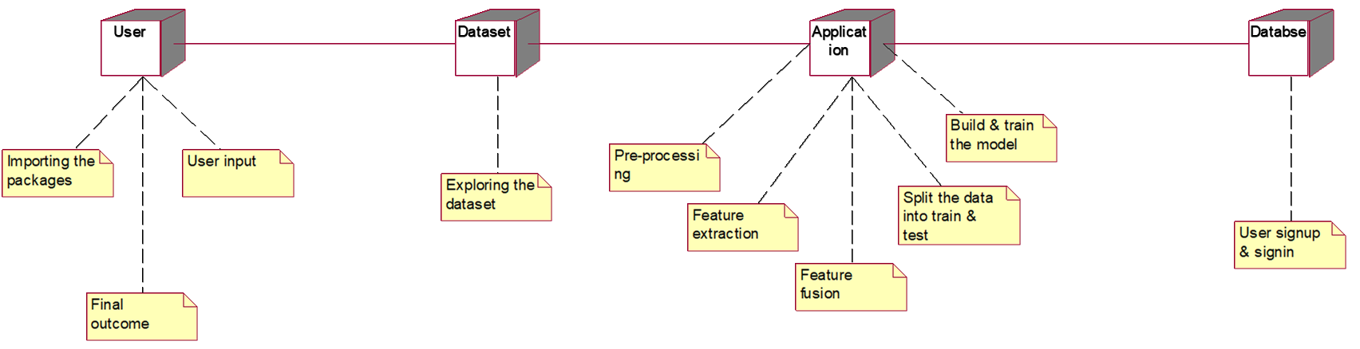
Implementation – Deployment Diagram
Deployment diagram describes physical architecture using nodes, connector, note, and anchor note to item, mapping web server, database server, and user device deployment for real time seasonal detection reliability monitoring.

Slide 15
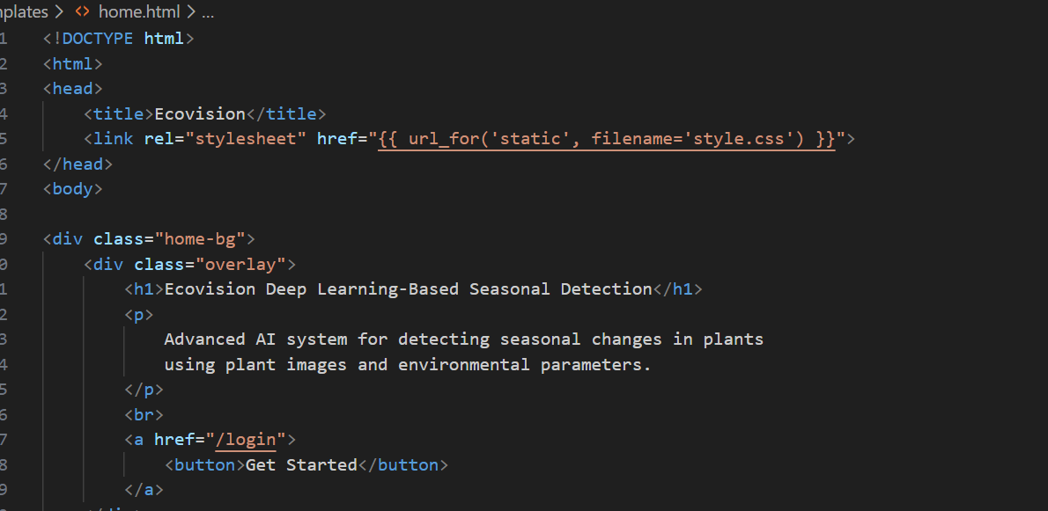
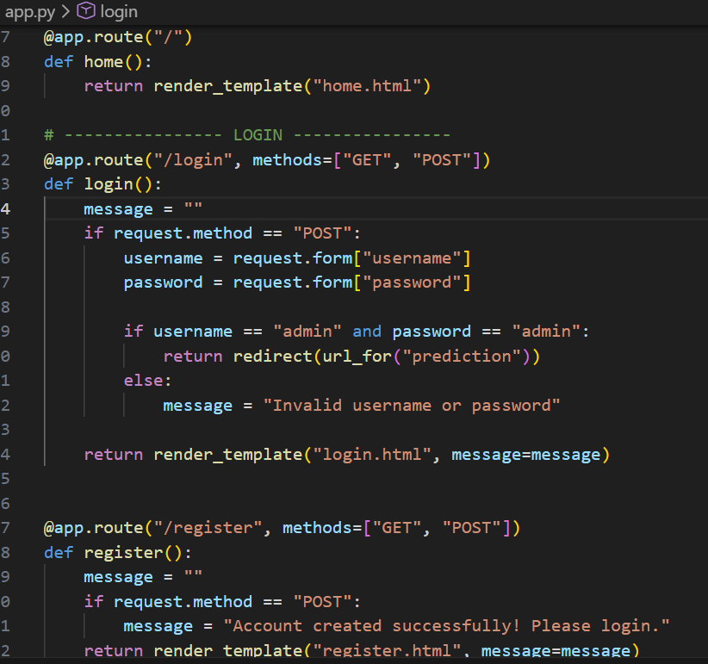
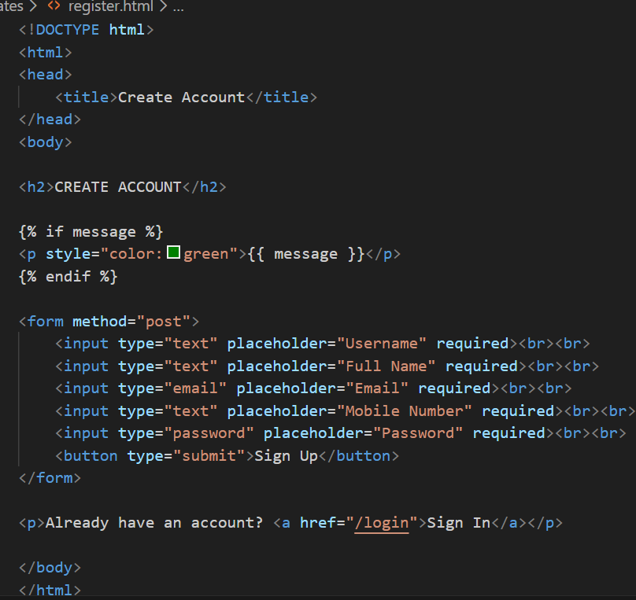
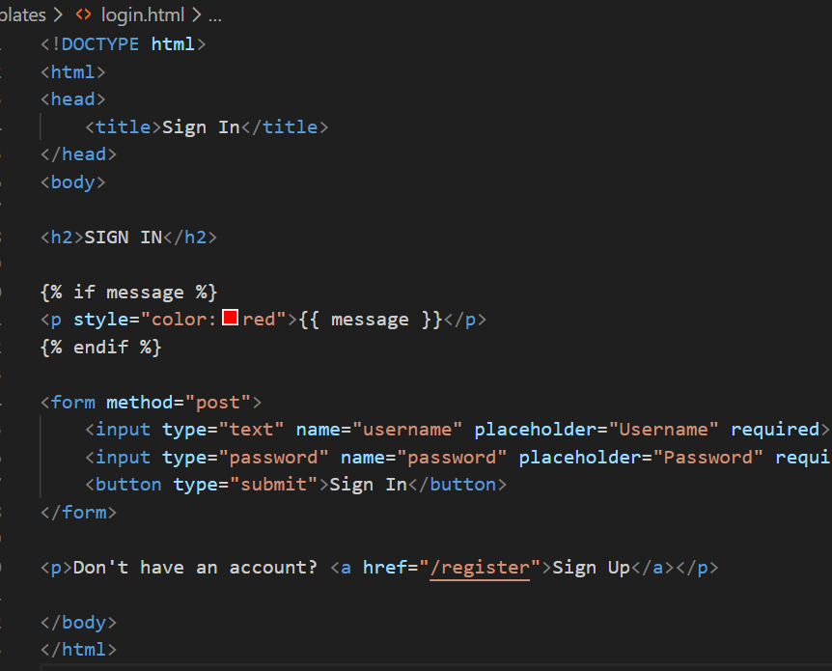
Outputs

Slide 16
Conclusion
Automated Seasonal Detection: Ecovision accurately identifies seasons by analyzing plant images along with environmental parameters, reducing the need for manual observation.
Multimodal Data Integration: The system combines visual plant features with real-time climatic data such as temperature, humidity, rainfall, and soil moisture for improved prediction.
Overcoming Traditional Limitations: It addresses the shortcomings of single-source methods, including image-only or weather-only approaches, ensuring more consistent results.
Deep Learning–Based Accuracy: Convolutional Neural Networks (CNNs) extract features from plant images, while machine learning processes climatic data, resulting in high prediction accuracy.
Wide Range of Applications: Ecovision can be used in agriculture for crop planning, in ecological research for monitoring plant phenology, and in biotechnology for experiments requiring seasonal context.
Sustainable Environmental Insights: By providing reliable seasonal information, the system supports environmental monitoring and sustainable practices.

Slide 17
References
[1] Dinov, I. D. (2023). Data science and predictive analytics: Biomedical and health applications using R (2nd ed.). Springer.
[2] Arun, P. V., & Karnieli, A. (2021). Deep learning-based phenological event modeling for classification of crops. Remote Sensing, 13(13), 2477.
[3] U.S. Environmental Protection Agency. (2025). Seasonality and observed climate change impacts across the United States: technical documentation summary. EPA, 12 May 2025.
[4] Plekhanova, E., Robert, D., Dollinger, J., Arens, E., Brun, P., Wegner, J. D., & Zimmermann, N. (2025). SSL4Eco: A global seasonal dataset for geospatial foundation models in ecology. arXiv.

Slide 18
Thank You

Slide 19
Any Queries

