Slide 1



NYPD_sk
View in Power BI
Last data refresh:
3/7/2025 12:59:58 AM UTC
Downloaded at:
3/7/2025 1:12:43 AM UTC

Slide 2
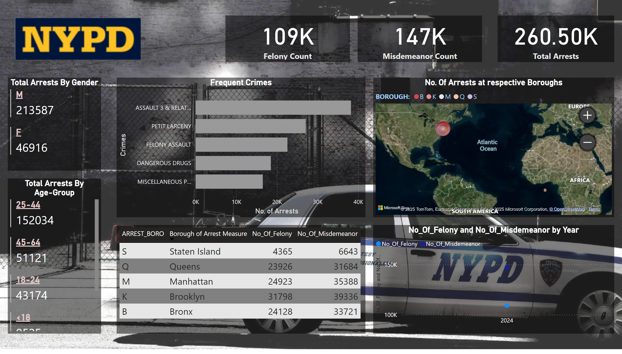
NYPD
Notes:
card
No alt text provided
card
No alt text provided
card
No alt text provided
Total Arrests By Age-Group
No alt text provided
tableEx
No alt text provided
Total Arrests By Gender
No alt text provided
No. Of Arrests at respective Boroughs
No alt text provided
Frequent Crimes
No alt text provided
image
Open Slicer
shape
No alt text provided
actionButton
No alt text provided
slicer
No alt text provided
slicer
No alt text provided
slicer
No alt text provided
lineChart
No alt text provided

