Slide 1
SAP ABAP CLOUD + RAP
Hospital Appointment
& Patient Visit
Management System
PAT
DOC
Patients
Doctors
APT
Appointments
Draft-enabled SAP Fiori Elements application built with the ABAP RESTful Application Programming Model
DEP
VIS
Departments
Visits
Sharath Chandra Chandrashekhar | Piyush Prabhakar
SRH University Munich | Applied Computer Science | SAP ABAP
Notes:
Introduce the project in one sentence: a hospital scheduling and visit-management solution built in ABAP Cloud.
Name both team members and state that the implementation uses RAP and SAP Fiori Elements.
Set the expectation that the demonstration will focus on draft editing, value help, validation, and a clean-core design.

Slide 2
CONTEXT
Project at a glance
02
5
3
5+
ABAP Cloud
BUSINESS DOMAINS
DRAFT-ENABLED APPS
VALUE HELPS
CLEAN-CORE IMPLEMENTATION
Business problem
Delivered solution
Hospital coordinators need one reliable workflow to maintain patients and doctors, schedule appointments, prevent invalid bookings, and capture visit outcomes. Manual UUID entry and conflicting bookings create avoidable errors.
A managed RAP solution with CDS entities, draft handling, behavior logic, validation, determinations, OData V4 UI services, Fiori Elements previews, readable IDs and names, and reusable value helps.
SRH University Munich | Applied Computer Science | SAP ABAP
Notes:
Frame the work as a business system, not only a technical exercise.
The five domains are appointments, patients, doctors, departments, and visits.
Appointment, patient, and doctor maintenance are draft enabled. Department and visit data support scheduling and follow-up.

Slide 3
ASSESSMENT
Requirements mapped to evidence
03
Assessment area
Implementation
Evidence to demonstrate
Outcome
Technical solution | 35%
RAP + CDS + OData V4
Create, edit, activate draft; trigger validation; use value help
Functional workflow
Clean Core | 25%
ABAP Cloud language and Z objects
Released framework classes; no modification of SAP standard
Upgrade-friendly
Documentation | 20%
50-page technical dossier
Architecture, object inventory, test matrix, runbook, KT
Submission-ready
Defense | 20%
15-slide walkthrough
Explain RAP layers, design choices, limitations, and next steps
Clear ownership
Submission position
The project is appropriate for academic demonstration. Production rollout would still require formal authorization roles, automated tests, deployment governance, and operational monitoring.
SRH University Munich | Applied Computer Science | SAP ABAP
Assessment weights from the supplied exam framework
Notes:
Connect each assessment category to something visible in the live system or report.
Be explicit that the evidence is academic and that production hardening remains a future activity.
This honesty strengthens the Clean Core and engineering discussion.

Slide 4
BUSINESS PROCESS
End-to-end hospital workflow
04
1
Register patient
2
Onboard doctor
3
Book appointment
4
Validate booking
5
Record visit
Maintain identity and contact data
>
Maintain specialization and status
>
Select patient, doctor, date and time
>
Reject past or overlapping schedules
>
Capture diagnosis and follow-up
System outcomes
Draft editing protects unfinished work and allows Save or Discard.
Value help replaces manual UUID entry with selectable business records.
Validation blocks historical appointments and doctor time-slot conflicts.
Readable IDs and names support fast scanning in list and object pages.
SRH University Munich | Applied Computer Science | SAP ABAP
Notes:
Walk left to right and explain which persona performs each action.
The core demonstration is the appointment booking step because it combines draft, value help, determination, and validation.
Visits complete the domain even though appointment scheduling is the main implemented UI focus.

Slide 5
TECHNICAL DESIGN
RAP architecture and responsibility
05
SAP Fiori Elements
Metadata-driven list and object pages
Managed implementation
RAP supplies standard transactional handling. Custom code focuses on rules such as scheduling conflicts, readable display data, and field validation.
OData V4 UI Service
Service definition + published service binding
Projection Layer
ZC_SHHMS_* transactional query and UI annotations
Behavior Layer
Managed BDEF, draft, validations, determinations
Why this structure matters
Each layer has one responsibility. UI metadata can evolve without rewriting persistence logic, while business behavior remains centralized and testable.
Interface Layer
ZR_SHHMS_* root view entities and value helps
Persistence Layer
Active and draft database tables
SRH University Munich | Applied Computer Science | SAP ABAP
SAP Help: ABAP RESTful Application Programming Model
Notes:
Define RAP as the ABAP Cloud programming model for transactional business objects and services.
Explain the difference between interface/root views and projection/consumption views.
Point out that Fiori Elements consumes metadata instead of requiring a hand-coded page for every field.

Slide 6
DATA MODEL
Domain model and persistence
06
PATIENT
DEPARTMENT
Identity, contact, allergy
Name, floor, contact
APPOINTMENT
Patient + Doctor + Department
Date + Time + Status + Priority
DOCTOR
Active tables
Draft tables
VISIT
Specialization, phone, active flag
ZSH_HMS_*
ZSHHMS_*_D
Diagnosis, treatment, follow-up
SRH University Munich | Applied Computer Science | SAP ABAP
Notes:
Explain that UUIDs are technical keys, while Patient ID, Doctor ID, and Department ID are business-facing identifiers.
The appointment is the coordination record that links the other master data.
Draft tables are separate persistence used only while users edit unfinished data.

Slide 7
RAP BEHAVIOR
Draft-enabled transactional behavior
07
Appointment draft
Patient draft
Doctor draft
Create or edit a booking without immediately changing the active record. Prepare runs validations before activation.
Maintain a patient with duplicate-ID, name, date-of-birth, phone, and email checks before activation.
Maintain doctor details with unique Doctor ID, title-case name formatting, phone and email validation, and an active flag.
Draft lifecycle
1
Create / Edit
2
Change
3
Prepare
4
Activate
5
Discard
Open draft
>
Autosave draft
>
Run rules
>
Persist active
>
Remove draft
Benefit: incomplete work is isolated, recoverable, and validated before it becomes active business data.
SRH University Munich | Applied Computer Science | SAP ABAP
SAP Help: Draft Business Object
Notes:
Draft is not a second business record. It is temporary transactional persistence for an unfinished change.
Prepare is the important point for draft validations; Activate moves a valid draft to the active table.
Show Create, Discard Draft, Edit, and Save or Activate during the live demo.

Slide 8
BUSINESS RULES
Validation protects scheduling integrity
08
01
Past date or time
Technical pattern
Reject an appointment earlier than the current date and time.
READ ENTITIES in local mode
-> evaluate current draft values
-> append failed key
-> return field-level reported message
Select a future appointment date and time.
02
Doctor time conflict
Reject another booking for the same doctor, date, and time.
Doctor is already booked with <patient>.
User experience
The user stays on the draft, sees the exact invalid field, understands why activation failed, and can correct the record without losing work.
03
Reference integrity
Require patient, doctor, department, reason, date, and time.
Missing mandatory information is highlighted.
SRH University Munich | Applied Computer Science | SAP ABAP
Notes:
Define validation as a business rule checked before data is saved or activated.
The conflict rule checks doctor, date, and time and excludes the current appointment UUID.
The enhanced message identifies the patient already occupying the slot so the coordinator can resolve the conflict quickly.

Slide 9
USABILITY
Value helps replace technical entry
09
Before
After
PatientUUID
Patient
9e9e2dbd-49f7-1fe1-9fc3-6dd98009d374
PAT-1003 | Rahul Verma
...
High error risk: users must recognize and copy a 36-character technical key.
The selected business record stores its UUID while the UI shows ID and name.
Implemented value helps
Patient
Doctor
Department
Priority
Status
Requirement satisfied: at least two filterable value helps are available, with additional value helps for operational fields.
SRH University Munich | Applied Computer Science | SAP ABAP
Notes:
Make the distinction between storage and display: the database keeps UUID relationships, while users work with recognizable IDs and names.
Open a Patient or Doctor value-help dialog during the demo.
Priority and Status use fixed values so users choose supported codes rather than free text.

Slide 10
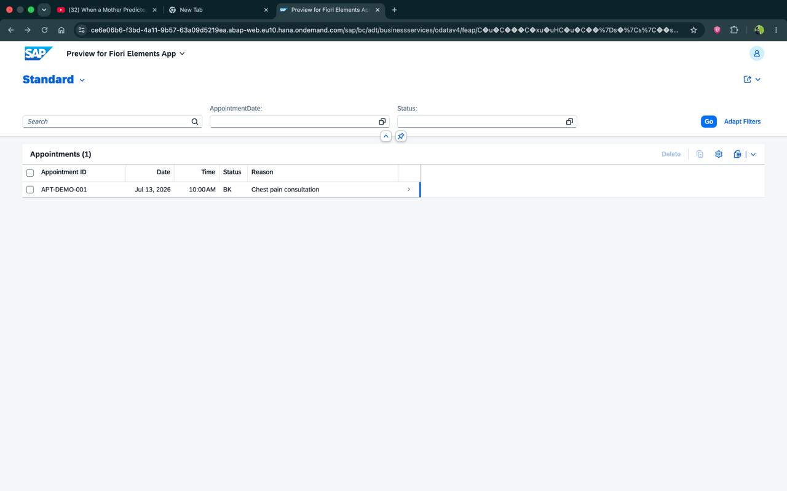
APPLICATION EVIDENCE
Fiori Elements list report
10
Search and filter
Date, status, ID, and additional fields can narrow the worklist.
Readable rows
Appointment ID, date, time, status, and reason support rapid scanning.
Draft actions
Create, Edit, Delete, Save, and Discard are generated from behavior metadata.
SRH University Munich | Applied Computer Science | SAP ABAP
Verified project screenshot
Notes:
This screenshot is evidence from the implemented Fiori Elements preview.
Explain that the list report is generated from CDS metadata and RAP behavior, not hard-coded UI controls.
In the current system, later refinements display patient, doctor, and department names and additional columns.

Slide 11
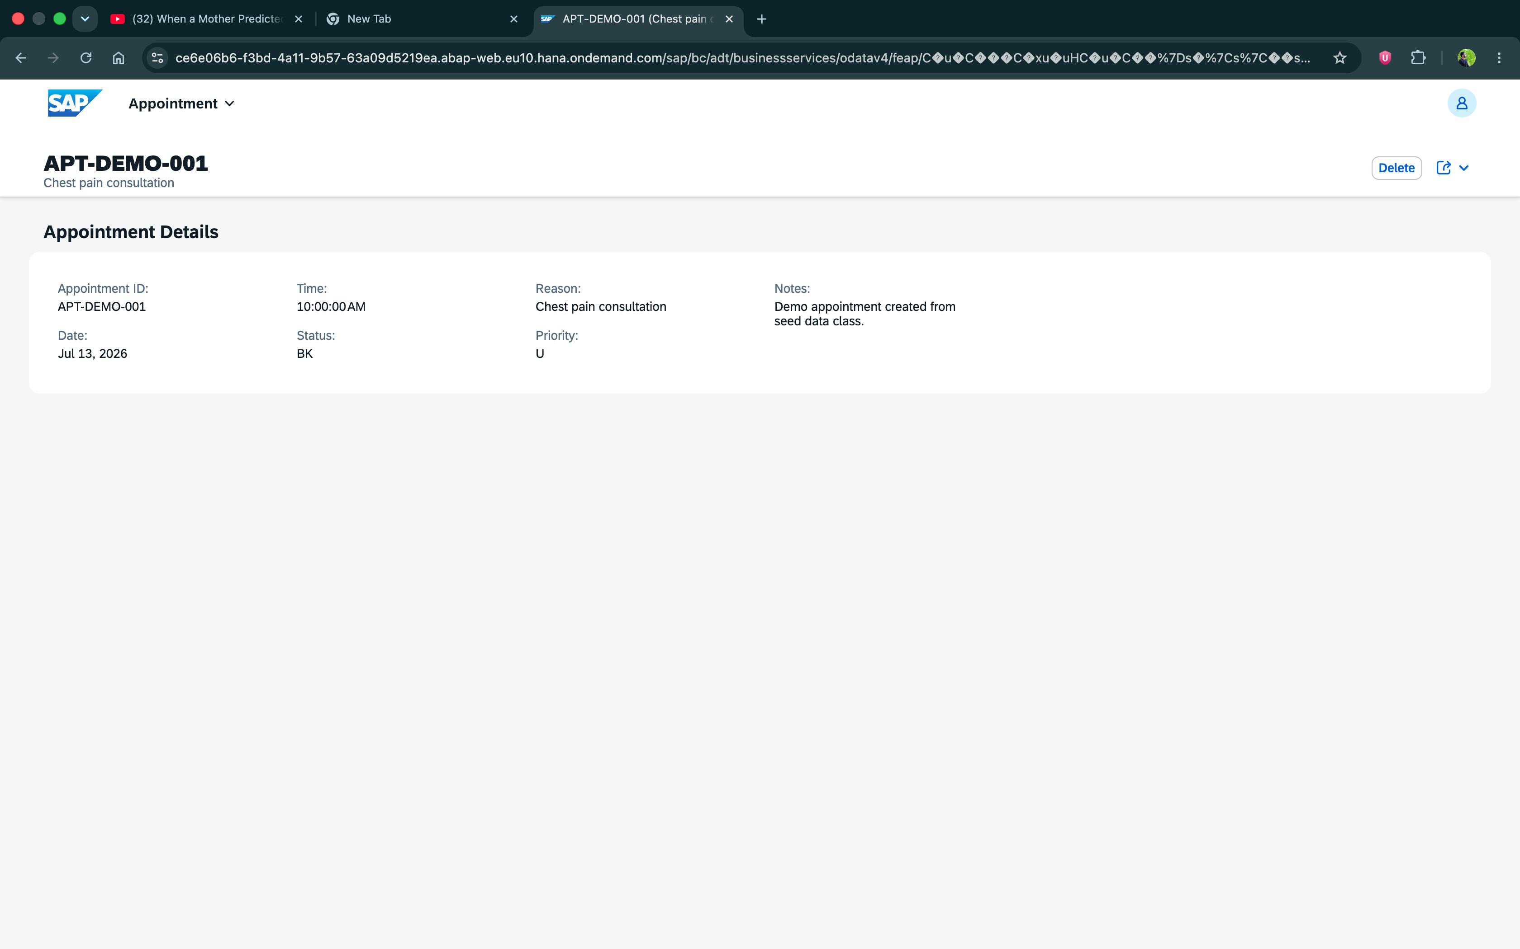
APPLICATION EVIDENCE
Appointment object page
11
Business header
Field grouping
Transactional controls
Appointment ID + reason
Single Appointment Details facet
Edit, Save/Activate, Delete, Discard Draft
SRH University Munich | Applied Computer Science | SAP ABAP
Verified project screenshot
Notes:
Open one appointment from the list during the live demonstration.
The object page provides focused detail and draft editing controls.
Point out the later enhancement: business IDs and names are shown while technical UUID fields are hidden from the normal presentation.

Slide 12
MASTER DATA
Patient and doctor maintenance
12
Patient application
Doctor application
Draft create and edit
Unique Patient ID
Title-case first and last name
Date of birth cannot be future
10-digit phone check
Basic email-format check
Critical-allergy capture
Draft create and edit
Unique Doctor ID
Title-case doctor name
Specialization maintenance
10-digit phone check
Basic email-format check
Active / inactive flag
Shared implementation principles
Managed RAP behavior keeps CRUD and draft semantics consistent.
Determinations normalize display data; validations reject invalid activation.
Separate UI service bindings keep preview authorization and ownership clear.
SRH University Munich | Applied Computer Science | SAP ABAP
Notes:
Explain why master data is maintained separately: patient and doctor records have their own lifecycle and validation rules.
The appointment value helps then reuse these trusted master records.
Department maintenance was intentionally left as a future enhancement; existing department data is available for selection.

Slide 13
ENGINEERING QUALITY
Service design, Clean Core, and security
13
Service exposure
Clean Core
Authorization boundary
ZUI_SHHMS_APPT_O4 exposes the appointment projection plus Priority and Status value helps. Patient and Doctor use their own OData V4 UI bindings for maintenance.
All custom artifacts use the Z namespace. The solution follows ABAP Cloud language restrictions, uses RAP framework APIs, and does not modify SAP standard objects.
Service-group start authorization is required for preview access. A previous 'return code 4' issue was resolved by using the correct published binding and authorization assignment.
Production hardening
Define business roles and instance authorization checks.
Automate regression tests and deployment transport checks.
Add monitoring, audit retention, and privacy controls for health data.
SRH University Munich | Applied Computer Science | SAP ABAP
SAP Help: ABAP Cloud; Released APIs; OData V4 Service Binding
Notes:
Clean Core means custom innovation stays within released extension points and does not change SAP standard code.
The preview authorization error was configuration-related, not a data-model failure.
Be clear that academic authorization stubs must be replaced by real roles and checks for production.

Slide 14
QUALITY
Verification results and roadmap
14
9
3
5+
0
CORE TEST SCENARIOS
DRAFT BUSINESS OBJECTS
VALUE HELP SOURCES
SAP STANDARD MODIFICATIONS
Scenario
Expected
Observed
Evidence
Create appointment draft
Draft opens
Pass
Create / Discard controls
Past date or time
Activation blocked
Pass
Field-level error
Doctor schedule overlap
Conflict blocked
Pass
Existing patient named
Patient / Doctor value help
Selectable records
Pass
ID + name displayed
Duplicate master-data ID
Activation blocked
Pass
Validation message
Next: unified launchpad navigation, department maintenance, visit draft flow, automated ABAP Unit tests, and production role design.
SRH University Munich | Applied Computer Science | SAP ABAP
Notes:
State that the main functional paths were manually verified in the Fiori preview.
Do not claim production readiness. The roadmap identifies the specific gaps.
The report contains the detailed test matrix, activation order, troubleshooting log, and object inventory.

Slide 15
LIVE DEMO + DEFENSE
Show the workflow.
Explain the model.
Defend the choices.
01
Open appointment list
10 sec
04
Trigger past-date validation
30 sec
02
Create a draft booking
45 sec
05
Trigger doctor overlap validation
40 sec
03
Use patient and doctor value help
35 sec
06
Correct, activate, and show object page
45 sec
Hospital scheduling with safer data, clearer choices, and a defendable RAP architecture.
Thank you
Notes:
Follow this sequence exactly to stay within six minutes including explanation.
Likely defense questions: What is RAP? Why draft? Why UUID plus business ID? Where are validations implemented? How does Clean Core apply?
Close by naming the measurable outcome: invalid appointments are blocked, master data is maintainable, and the UI is generated from a layered ABAP Cloud model.

