Slide 1

Transmission of data using Li-Fi

Slide 2
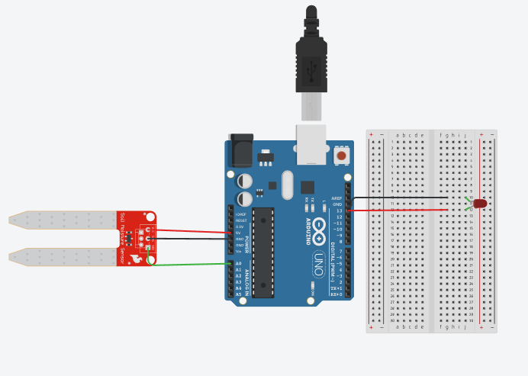
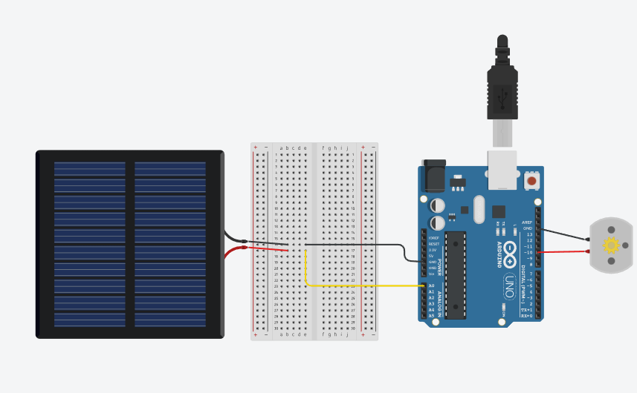
CIRCUIT DIAGRAM:
Transmission side
Receiving side

Slide 3
Idea of the project:
The sensor data in the transmitter side is collected by the arduino and it is sent to the receiver side using Light which is produced by the LED.
The solar panel in the receiver side receives the value that is sent by the transmission side and the arduino processes the value , as a response if the soil moisture value is less than the expected value it turns the motor on else the motor stays off.
This process runs on a loop until we manually stop it by killing it.

Slide 4
Algorithm:
Transmission side:
Pin number 13 is taken as the output led pin and A0 is taken as the soil input sensor pin.
The value from the sensor is converted to binary by checking for the value's remainder when it is divided by two and the values are stored in an array of 10 values which is our binary array.
If condition is used for checking the values of the binary array as 1 or 0 and turning on and off the led light respectively.
The time gap between each bits is 10ms and each set of binary data will be transmitted at an interval of 5000ms(5 secs).And before starting the transmission of data, a start bit will be produced for 10ms which informs the receiver side that the data bits will be transmitted.

Slide 5
Receiving side:
Solar panel is connected to the A0 pin and the normal ambient light value is taken.
The process of receiving bits starts once after the start bit is received in the receiver side.
The time period is matched in the receiver side similar to the transmission side's time period for grasping the bits accordingly and storing them in an array which is eventually converted to decimal value .
The converted decimal value is to be checked whether it matches with the transmission side value if not it should be corrected by adjusting time period.
Then the decimal value is compared with the threshold value to turn the motor on or off.

Slide 6
Code:
Transmission side
int decimalnumber = analogRead(A0);
int binaryarray[10];
Serial.print(decimalnumber);
Serial.println();
for(int i=0;i<10;i++){
binaryarray[i]=decimalnumber%2;
decimalnumber=decimalnumber/2;
}
digitalWrite(LASERPIN,HIGH);
delay(10);
digitalWrite(LASERPIN,LOW);
delay(38);
#define LASERPIN 13
#define SOIL_SENSOR A0
void setup() {
// put your setup code here, to run once:
pinMode(LASERPIN, OUTPUT);
pinMode(SOIL_SENSOR, INPUT);
Serial.begin(9600);
}
void loop() {
// put your main code here, to run repeatedly:

Slide 7
for(int j=9;j>=0;j--){
int binaryvalue=binaryarray[j];
Serial.print(binaryvalue);
Serial.println();
if(binaryvalue==1){
digitalWrite(LASERPIN,HIGH);
}else{
digitalWrite(LASERPIN,LOW);
}
delay(50);
}
digitalWrite(LASERPIN,LOW);
delay(5000);
}

Slide 8
Receiving side:
//LISTENING FOR THE START BIT
if(reading>ambientReading+THRESHOLD){
delay(50);
for(int i=0;i<10;i++){
if(analogRead(SOLARPIN)<ambientReading+THRESHOLD){
bits[i]=0;}
else{
bits[i]=1;
}
delay(50);
}
#define SOLARPIN A0
#define THRESHOLD 20
int ambientReading=0;
void setup(){
pinMode(SOLARPIN,INPUT);
Serial.begin(9600);
ambientReading=analogRead(SOLARPIN);
}
void loop(){
int reading=analogRead(SOLARPIN);
int bits[10];
int moisture=0;

Slide 9
for(int i=0;i<10;i++){
Serial.print(bits[i]);
moisture=moisture*2+bits[i];
}
Serial.println(" ");
Serial.println(moisture);
}
}

Slide 10
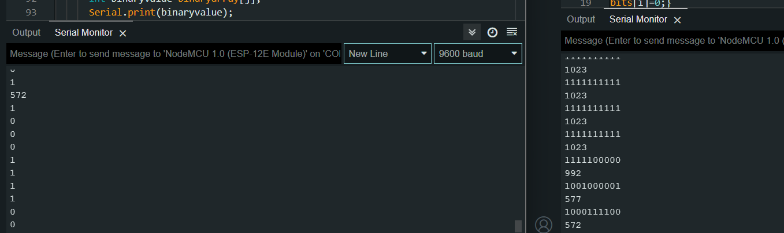
Output of the serial monitor:
Transmitter side
Receiver side

Slide 11
Problems faced while doing the project:
PROBLEM BECAUSE OF INTENSITY:
Since the data transmission is purely dependent on the light, the intensity of the light is very important for the transmission of data, the same lies as a problem in our case.
As we are using low power led light for the transmission of data , when the intensity of the surrounding light is high the light of the led tends to be neglected by the receiver side
And the distance between the transmission and receiving part is very important as the distance between the transmitter and receiver increases it leads to the receiving of corrupted data.

Slide 12
Solution for the problems:
The problem for the light intensity and the distance is by replacing the led with a powerful led which has a high intensity, thus the problem can be solved in that way.
***

