Slide 1
Contents
Introduction
Literature Survey
Problem Statement
Objectives
Flowchart
Dataset description
Algorithms
Results
Conclusion
Future Work

Slide 2
Introduction
An intrusion is somebody (“hacker” or “cracker”) attempting to break into or misuse your system. The word “misuse” is broad and can reflect something severe as stealing confidential data to something minor such as misusing your email system for spam.
An “Intrusion Detection System (IDS)” is a system for detecting such intrusions. There are two types of intrusion detection systems namely Host-based systems base their decisions on the information obtained from a single host and Network-based intrusion detection systems obtain data by monitoring the traffic in the network to which the hosts are connected.

Slide 3
Machine learning (ML) is a type of artificial intelligence (AI) that allows devices to become more accurate at predicting outcomes without being explicitly programmed to do so. ML methods can be used to train machines to identify attacks and provide required defensive policy. ML methods seem to be promising at detecting new attacks using learning skills and handling them intelligently. ML techniques including unsupervised learning, supervised learning and Reinforcement Learning have been widely applied to improve network security, such as malware detection, access control, authentication, and anti-jamming offloading
NIDS security technologies are ‘passive’ rather than ‘active’ in nature. This means that they are designed solely to alert on suspicious activity, and for this reason are often deployed alongside intrusion prevention systems (IPS) which are ‘active’.

Slide 4
Literature Survey
SL No | Title | Author | Year | Advantages | Disadvantages
1. | Robust Detection for Network Intrusion of Industrial IoT Based on Multi-CNN Fusion | Yanmiao Li, Yingying Xu, Zhi Liu, Haixia Hou, Yushuo Zheng, Yang Xin,Yuefeng Zhao, Lizhen Cui | 2019 | Predictive system 81% Higher accuracy than other predictive system | Not a detection system The accuracy is comparatively low when compared with detection system
2. | Towards a Scalable and Adaptive Learning Approach for Network Intrusion Detection | Alebachew Chiche and Million Meshesha | 2020 | Detection System with accuracy of 99% Dimensionality reduction | The obtained accuracy is still less when classifying or detecting intrusions As dimensions are reduced some information are lost

Slide 5
3 | Designing a Network Intrusion Detection System Based on Machine Learning | Abdulsalam O Alzahrani and Mohammed J F | 2021 | Predictive System Achieved a accuracy of 91% | Not a detection system The accuracy is low to detect intrusions
4 | Intrusion Detection in IoT Networks using Deep Learning Algorithm | Bambang Susilo and Riri Fitri | 2020 | The algorithm achieves mean accuracy of 90.87% Predictive model | As stated by the author the method needs some more alteration to be used as NIDS
5 | A Machine Learning Approach for Intrusion Detection System on NSL-KDD Dataset | Iram Abrar;Zahrah Ayub;Faheem Masoodi; Alwi M Bamhdi | 2020 | Performance of RF, ETC, and DT was above 99%. effective prediction rate reduces computational complexity by removing irrelevant features | Reducing dimensions means loss of some information.

Slide 6
Problem Statement
Threats and attacks in the IoT environment are increasing with the use increasing use of IoT infrastructure in every domain. Machine learning has opened many possible research windows to address ongoing and future challenges in IoT. ML is being used as a significant and potential technology to detect attacks and identify abnormal behaviors of smart networks and devices. Denial of Service, Probing, Root to Local, User to Root are some of the intrusions which can cause an IoT system failure. Here, the performance of several ML algorithms has been compared to avoid the intrusions on IoT systems precisely. The Machine Learning algorithms used are Random Forest (RF), Deep Neural Network (DNN), Logistic Regression (LR), Decision Tree (DT), XGBoost (XGB). The attributes used to evaluate these algorithms are Accuracy, Precision, Recall, F-Score, Classification Report and Confusion Matrix.

Slide 7
Objectives
To map different intrusions into 4 categories namely Dos, U2R, R2L and Probe.
To reduce the dimensions or features so that the complexity of the dataset is lowered.
To achieve higher accuracy.
To classify the intrusions accurately.
To create a intrusion detection system.

Slide 8

Flow chart

Slide 9
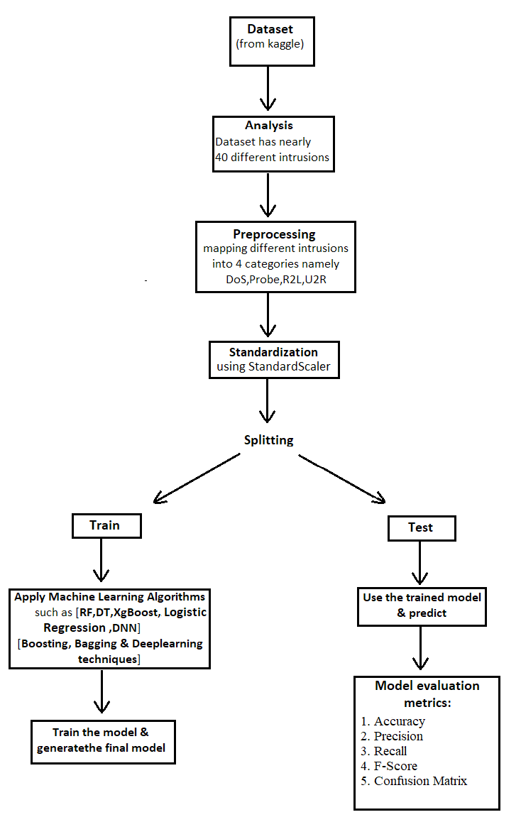

Slide 10
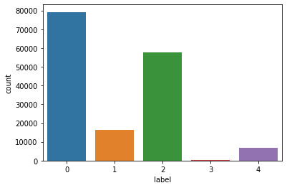
Dataset Description
The NSL-KDD dataset was generated in 2009 and it is widely used in network intrusion detection experiments. In the latest literature, all the researchers use the NSL-KDD dataset as an effective baseline dataset, that can help researchers compare different intrusion detection methods. It addresses the inherent problems of the KDD CUP 99 dataset which was generated in 1999 from the DARPA98 network traffic,.

Slide 11
 | SlNo | Features | Data Types
Basic Features | 1 2 3 4 5 6 7 8 9 10 | duration protocol_type service flag src_bytes dst_bytes land wrong_fragment urgent hot | Continuous Symbolic Symbolic Symbolic Continuous Continuous Symbolic Continuous Continuous Continuous

Slide 12
 | SlNo | Features | Data Types
Content Features | 11 12 13 14 15 16 17 18 19 20 21 22 | num_failed_logins logged_in num_compromised root_shell su_attempted num_root num_file_creations num_shells num_access_files num_outbound_cmds is_hot_login is_guest_login | Continuous Symbolic Continuous Continuous Continuous Continuous Continuous Continuous Continuous Continuous Symbolic Symbolic

Slide 13
 | SlNo | Features | Data Types
Time based Network traffic statistics features | 23 24 25 26 27 28 29 30 31 | count srv_count serror_rate srv_serror_rate rerror_rate srv_rerror_rate same_srv_rate diff_srv_rate srv_diff_host_rate | Continuous Continuous Continuous Continuous Continuous Continuous Continuous Continuous Continuous

Slide 14
 | SlNo | Features | Data Types
Host based Network traffic statistics features | 32 33 34 35 36 37 38 39 40 41 | dst_host_count dst_host_srv_count dst_host_same_srv_rate dst_host_diff_srv_rate dst_host_same_src_port_rate dst_host_srv_diff_host_rate dst_host_serror_rate dst_host_srv_serror_rate dst_host_rerror_rate dst_host_srv_rerror_rate | Continuous Continuous Continuous Continuous Continuous Continuous Continuous Continuous Continuous Continuous

Slide 15
Category | Attacks
Normal | Normal
DoS | worm,back, land, neptune, pod, smurf,teardrop, apache2, udpstorm, processtable, mailbomb (11)
Probe | ipsweep, nmap, portsweep,satan, saint,mscan (6)
R2L | ftp_write,guess_passwd,httptunnel,imap,multihop,named,phf,sendmail,snmpgetattack,snmpguess,spy,warezclient,warezmaster,xlock,xsnoop (15)
U2Rc u56\ | buffer_overflow, loadmodule, perl, rootkit,xterm, ps, sqlattack (7)

Slide 16



Algorithms

Slide 17
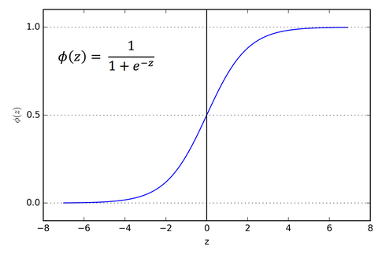
Logistic Regression
Logistic regression is one of the most popular Machine Learning algorithms, which comes under the Supervised Learning technique.
It is used for predicting the categorical dependent variable using a given set of independent variables.
Logistic regression predicts the output of a categorical dependent variable. Therefore the outcome must be a categorical or discrete value. It can be either Yes or No, 0 or 1, true or False, etc. but instead of giving the exact value as 0 and 1, it gives the probabilistic values which lie between 0 and 1.
Logistic regression is used for solving the classification problems.

Slide 18
Decision Tree
Decision Tree is a Supervised learning technique that can be used for both classification and Regression problems, but mostly it is preferred for solving Classification problems. It is a tree-structured classifier, where internal nodes represent the features of a dataset, branches represent the decision rules and each leaf node represents the outcome.
In a Decision tree, there are two nodes, which are the Decision Node and Leaf Node. Decision nodes are used to make any decision and have multiple branches, whereas Leaf nodes are the output of those decisions and do not contain any further branches.

Slide 19
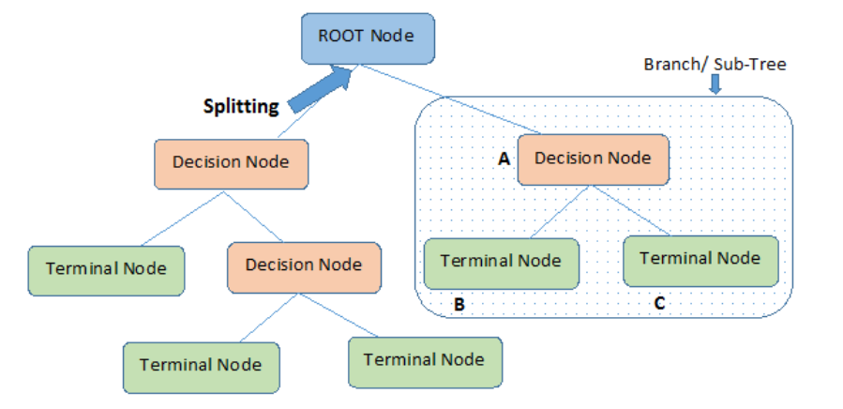

Slide 20
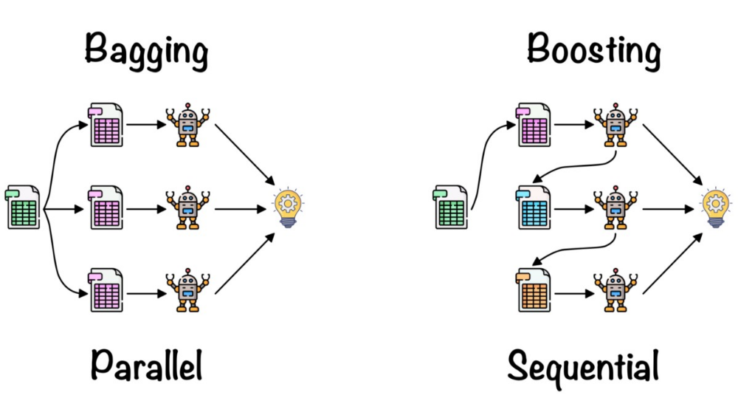
Random Forest
Random forest is a Supervised Machine Learning Algorithm that is used widely in Classification and Regression problems.
It builds decision trees on different samples and takes their majority vote for classification and average in case of regression.
One of the most important features of the Random Forest Algorithm is that it can handle the data set containing continuous variables as in the case of regression and categorical variables as in the case of classification.
It performs better results for classification problems.

Slide 21
XGBoost
XGBoost stands for Extreme Gradient Boosting, which was proposed by the researchers at the University of Washington. It is a library written in C++ which optimizes the training for Gradient Boosting.
In this algorithm, decision trees are created in sequential form.
Weights play an important role in XGBoost. Weights are assigned to all the independent variables which are then fed into the decision tree which predicts results.
The weight of variables predicted wrong by the tree is increased and these variables are then fed to the second decision tree.
These individual classifiers/predictors then ensemble to give a strong and more precise model. It can work on regression, classification, ranking, and user-defined prediction problems.

Slide 22
Neural Network
Deep Neural Network (DNN) is a machine learning technique which is the skeleton of different deep learning algorithms. We can train the DNN model using raw data. Compared to other classifiers it has a large number of parameters for tuning which makes it a complex structure. It also takes a long time to optimize error than other techniques.
Each single Neuron Node of DNN is trained with feature set
X = X1, X2, X3, ...,Xn (where, X1 − Xn = Distinct features).
The features are multiplied by some random weights,
W = W1, W2, W3, ...,Wn and added with bias values, b = b1, b2, ..., bn.
The values are then given as input in non-linear activation function.
𝑆𝑖𝑔𝑚𝑜𝑖𝑑 𝐹𝑢𝑛𝑐𝑡𝑖𝑜𝑛: 𝜎(𝑧) 𝑜𝑟 𝑎(𝑧) = 1 / 1+𝑒^−𝑧
𝑇𝑎𝑛ℎ 𝐹𝑢𝑛𝑐𝑡𝑖𝑜𝑛: 𝑎(𝑧) = 𝑒^z − 𝑒^−𝑧 / 𝑒^𝑧+ 𝑒^−𝑧
𝑅𝑒𝑐𝑡𝑖𝑓𝑖𝑒𝑑 𝑙𝑖𝑛𝑒𝑎𝑟 𝑈𝑛𝑖𝑡 (𝑅𝐸𝐿𝑈): 𝑎(𝑧) = 𝑚𝑎𝑥 (0, 𝑥)(10)
𝐿𝑒𝑎𝑘𝑦 𝑅𝐸𝐿𝑈: 𝑎(𝑧) = 𝑚𝑎𝑥 (0.001 ∗ 𝑧, 𝑧)
After applying Non-Linear function, a softmax function is applied to get initial predicted value which is shown in equation.
𝑃𝑟𝑒𝑑𝑖𝑐𝑡𝑒𝑑 𝑉𝑎𝑙𝑢𝑒: 𝑦̂ (𝑖) = 𝜎(𝑊𝑡𝑟𝑎𝑛𝑠𝑝𝑜𝑠𝑒𝑋(𝑖) + 𝑏)
𝐿 (𝑦̂ (𝑖) , 𝑦(𝑖)) = (𝑦(𝑖) 𝑙𝑜𝑔( 𝑦̂ (𝑖)) + (1 − 𝑦(𝑖))𝑙𝑜𝑔 (1 − 𝑦̂ (𝑖)))

Slide 23
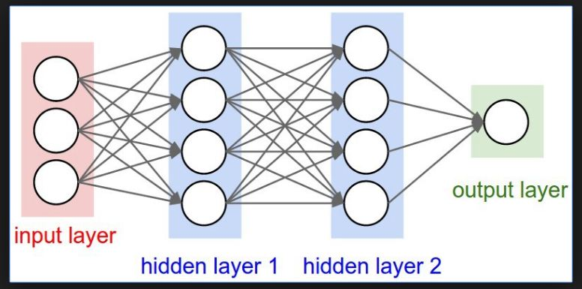

Slide 24
Results
Sl no | Algorithms | Accuracy | Precision | Recall | F-score | Time Taken (seconds)
1 | Decision Tree | 98.5% | 98.6% | 98.4% | 98.5% | 0.73
2. | Deep Neural Network | 97.92% | 97.95% | 97.89% | 97.92% | 119.77
3. | Logistic Regression | 92.6% | 92.6% | 92.6% | 92.6% | 7.7
4. | Random Forest | 99.6% | 99.6% | 99.6% | 99.6% | 7.3
5. | XGBoost | 98.5% | 98.5% | 98.5% | 98.5% | 44.5

Slide 25
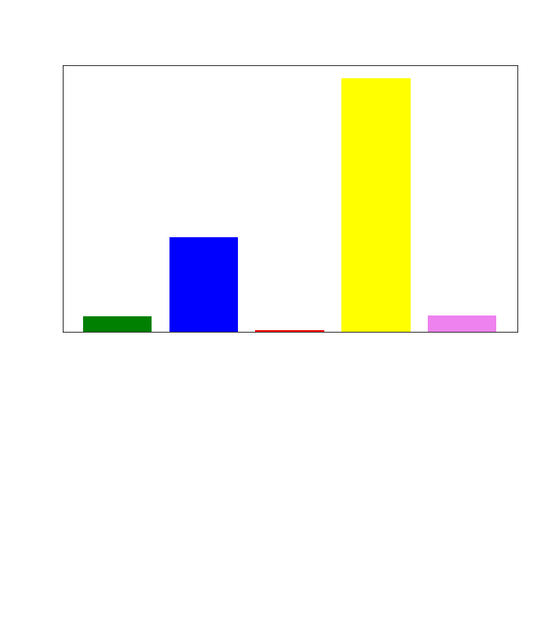

Slide 26



Slide 27



Slide 28
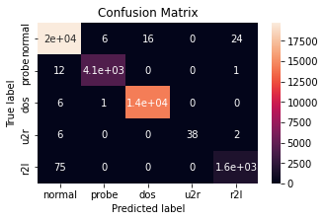
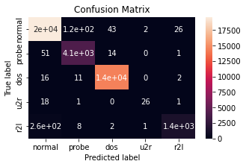
Confusion Matrix
XGBoost
Random Forest

Slide 29


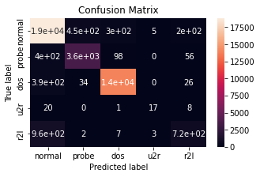
Decision Tree
Deep Neural Network
Logistic Regression

Slide 30
Conclusion
Network intrusion affects the services available through the internet since intrusions affects the CIA triad of information assurance (confidentiality, integrity, and availability). Such intrusions compromise online services and data that costs millions of dollars. Intrusion Detection Systems (IDS) is a measure against such network intrusion.
The Automation of IDS reduces human intervention and accuracy of IDS’s intrusion/attack detection makes it more reliable with respect to other measures against intrusions. Application of machine learning techniques in IDS can improve its accuracy.
In this project several machine learning algorithms have been used in order to detect the intrusions accurately.
In our project Random Forest has achieved the highest accuracy of 99.5 on test dataset and the time taken by this algorithm is third best lagging behind Decision Tree and Logistic Regression.
Alternatively if we can have a slight tradeoff in the accuracy we can use Decision Tree which takes lesser time and yields good accuracy of 99.34 on testing dataset.

Slide 31
Future Work
Build a model that can be deployed so that it can detect intrusions seamlessly.
Can build Intrusion detection systems along with intrusion prevention system so that the system can detect and prevent the intrusions hassle free thereby achieving both active and passive part of preventing intrusions.

Slide 32
Thank You

