Slide 1


SMART INDIA HACKATHON 2024
TITLE PAGE
Problem Statement ID – 1733
Problem Statement Title- Title-SAR image colorization for comprehensive insight using deep learning model(h).
Theme-Space Technology
PS Category- Software
Team ID- 38
Team Name (Registered on portal): SOLANA

Slide 2
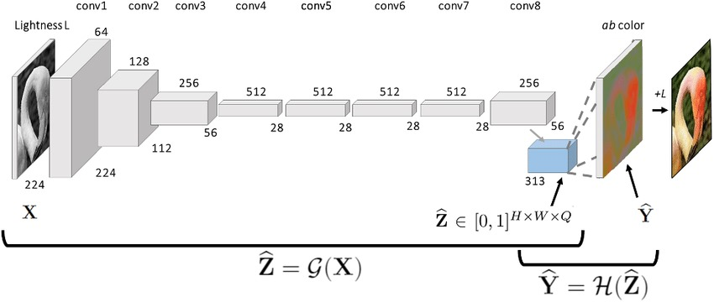
Enhancing SAR Imagery with Colorization Using Deep Learning
SOLANA
Proposed Solution
1) Detailed explanation of the proposed solution: A deep learning-based model is developed to colorize grayscale SAR images by leveraging paired SAR and optical datasets. This is achieved through:
Input
Image
Encoder
Decoder
LAB Colour Space
Output
Image
Logarithmic Normalization
2) How it addresses the problem:
Improves Interpretability
Noise Handling:
Bridges the Optical-SAR Gap
Unique Application of Deep Learning: Unlike traditional colorization models that focus on natural RGB images, this solution adapts deep learning for SAR-specific data with its unique noise and texture characteristics.
CNN representation

Slide 3
TECHNICAL APPROACH
Solana
Technologies to be used:
Programming languages: Python
Libraries: Keras, NumPy, OpenCV, scikit-image, Conda, Matplotlib, and PIL
Hardware: High-Performance Computing (HPC)
Methodology:
Data Preparation
Model Architecture
Training Process
Encoder-Decoder Design
Loss Function Design
(MSE)
Data Preprocessing (Normalization, Noise Reduction, Augmentation)
Scaling And Deployment
Training and Testing

Slide 4
FEASIBILITY AND VIABILITY
Solana
Analysis of the feasibility of the idea:
Publicly available paired SAR-Optical dataset
Well-established deep learning frameworks
Popular Encoder-Decoder Models
Potential challenges and risks
Data Complexity
Large Dataset Handling requires the need of HPC or GPU acceleration.
Strategies for overcoming these challenges
For large datasets: Distributed Training and mini-batch processing can be used.
Maintaining Image Quality: PSNR and SSIM as Metrics

Slide 5
IMPACT AND BENEFITS
Solana
Potential impact on the target audience
Remote Sensing Analysts and Scientists
Government Agencies and Disaster Management Authorities
Urban Planners and Infrastructure Developers
Benefits of the solution (social, economic, environmental, etc.)
Enhanced Environmental Monitoring
Improved Decision-Making for Public Safety
Cost-Effective Resource Management
Advancement in Image Processing Techniques

Slide 6
RESEARCH AND REFERENCES
Solana
Details / Links of the reference and research work
Dataset: https://drive.google.com/drive/folders/1W3iMpkehng7ADXmhz9pPvmgFQBayq22t
CNN: https://journalofbigdata.springeropen.com/articles/10.1186/s40537-021-00444-8

