Slide 1
Image Encryption and Decryption Using Triple DES

Slide 2
What is Encryption?
• Encryption
Encryption is a process which uses a finite set of instruction called an algorithm to covert original message, known as plain text ,into cipher text its encrypted form.
Cryptographic algorithms normally require a set of characters called a key to encrypt or decrypt data.
With the help of key and the algorithm we can encrypt or Decrypt the plain text into cipher text and then cipher text and then cipher text back into plain text

Slide 3
Image Encryption
Image Encryption
Now a days ,information security is becoming more important in data storage and transmission.
Images are widely used in different processes. Therefore the security of image data from unauthorized uses is important.
Image encryption plays a important role in the field of information hiding.
Encryption is the process of converting normal message(plain text) to meaningless(Cipher text).

Slide 4
Image Decryption
Image Decryption
Image Decryption is the process of converting meaningless message(Ciphertext) into its original form(Plaintext) i.e. Original image.
Image Decryption can be done with the same key which was used for Encryption of Image.
Decryption results the original image or file which is securely stored with a appropriate Key.

Slide 5
Triple DES(Data Encryption Standard)
Triple DES is the technology used for Encrypt and Decrypt the image.
Triple DES:
Triple Data Encryption Standard (DES) is a type of computerized cryptography where block cipher algorithms are applied three times to each data block.The key size is increased in Triple DES to ensure additional security through encryption capabilities.
It is used in order of increase key length and security.
It has 3 keys for encryption and decryption of data.

Slide 6
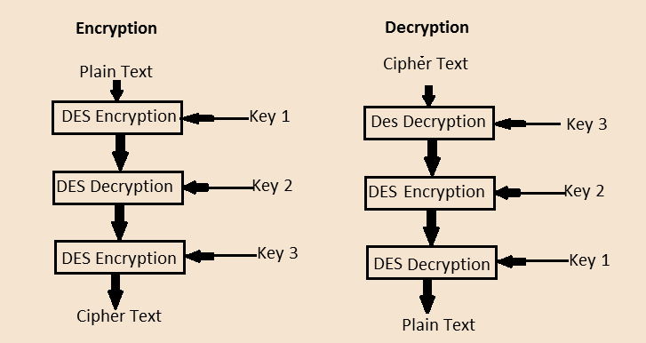
Triple DES

Slide 7
Algorithm of Encrypt and Decrypt:
Triple DES ha three keys K₁ , K₂ and K ₃ , each of 56 bits.
Step1: Choose Encryption || Decryption
Step2: Opening file name and image
Step3: Give password as Key
Step4: Process Below
Cipher Text = E_{K3}(D_{K2}(E_{K1}(plaintext)))
>>DES encrypt with K₁ , DES decrypt with K₂, then DES encrypt with K₃.
Plain Text = D_{K1}(E_{K2}(D_{K3}(Cipher Text)))
>> DES decrypt with K₃, encrypt with K₂, then decrypt with K₁.

Slide 8
Conclusion
I am Very excited by the vast future possibilities that this project has to offer. I have used Triple DES algorithm to encrypt and decrypt the data. This provides better process of secure encryption and decryption . It is more secure and faster than double DES. As it has lengthy key chances of attacking the data is less. So, it provides security in storage and transmission of data.

Slide 9
THANK YOU

