Slide 1
Predicting Hotel Reservation Cancellations

Slide 2
Agenda
Introduction
Problem Statement
Dataset Overview
Exploratory Data Analysis
Data Preprocessing
Model Building & Evaluation
Final Model Selection
Model Deployment
Conclusion

Slide 3
Problem Statement
Hotel booking cancellations cause revenue loss and inefficient resource planning for hotels. This project aims to develop a machine learning model to predict whether a reservation will be canceled or not based on booking and customer information, helping hotels improve decision-making and optimize room management.

Slide 4
Dataset Overview
The dataset contains 36,275 hotel reservation records with 19 features, including booking details, customer information, and pricing data. The target variable booking_status indicates whether a reservation is Canceled or Not_Canceled, which is used to train machine learning models for cancellation prediction.

Slide 5
Features in the Dataset
Lead Time
Average Price per Room
Market Segment Type
Number of Special Requests
Repeated Guest
Previous Cancellations
Number of Guests
Room Type Reserved
Booking Status (Target Variable)

Slide 6
Handling Missing Values
Before building the machine learning model, the dataset was checked for missing or null values to ensure data quality and reliability.
After analyzing the dataset, it was found that there are no missing or null values present in any of the columns. Since the dataset is already complete and clean, no null value treatment such as imputation or removal was required.
Therefore, the dataset was directly used for further preprocessing and analysis.

Slide 7
Exploratory Data Analysis (EDA)
Exploratory Data Analysis was performed to understand the structure of the dataset and the relationships between different features. Various visualizations were used to analyze booking patterns, customer behavior, pricing trends, and cancellation patterns.
This step helps in identifying important features that influence booking cancellations.

Slide 8
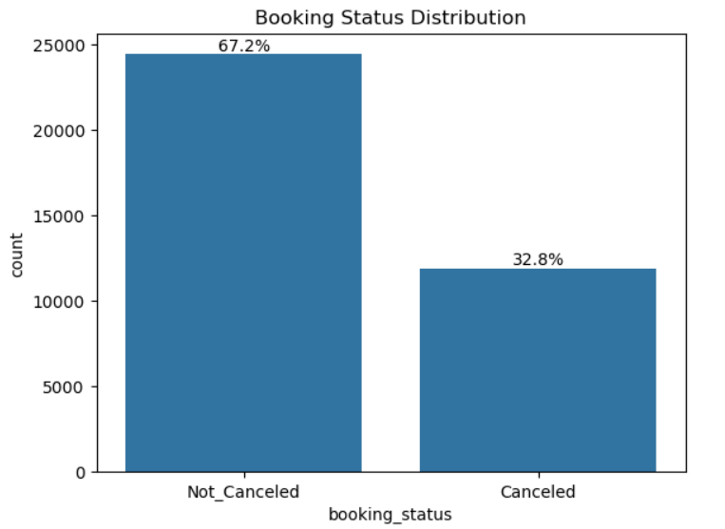
Booking Status Distribution
This bar chart shows the distribution of booking outcomes in the dataset. Approximately 67.2% of the bookings were not canceled, while 32.8% of the bookings were canceled, indicating that most reservations were successfully completed.

Slide 9
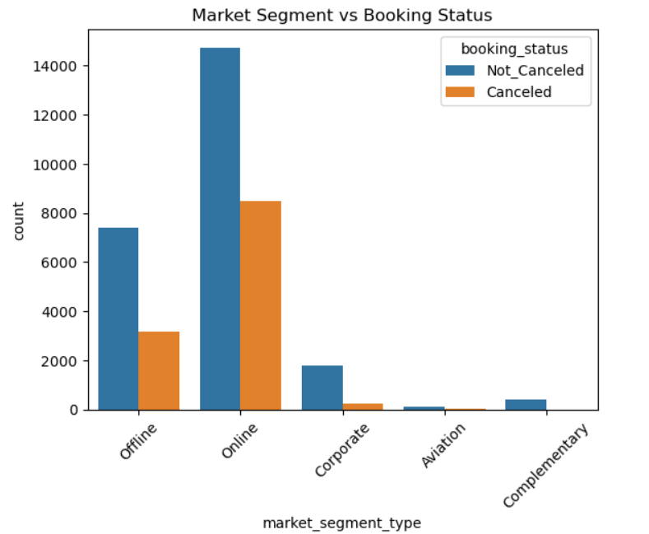
Market Segment Analysis
The analysis of market segment type in relation to booking status reveals noticeable differences in cancellation behavior across different customer segments. It can be observed that the Online segment has the highest number of bookings overall, and it also shows a relatively high number of cancellations compared to other segments. Similarly, the Offline segment contributes a significant number of bookings, but the proportion of cancellations is comparatively lower than the online segment. In contrast, segments such as Corporate, Aviation, and Complementary show much lower booking volumes, with cancellations being minimal in these categories

Slide 10
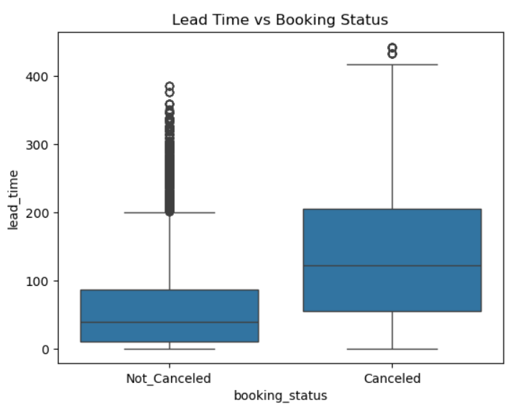
Lead Time Analysis
The boxplot comparing lead_time with booking_status shows a clear difference in booking behavior between canceled and non-canceled reservations. It can be observed that bookings which were canceled generally have a higher lead time compared to those that were not canceled.

Slide 11
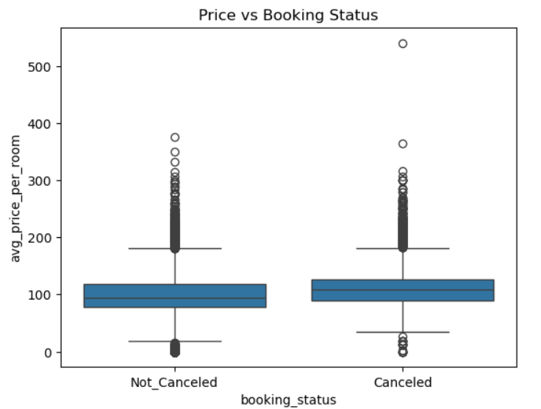
Price vs Booking Status
This box plot compares the distribution of average room prices for canceled and not canceled bookings. It shows the median price, spread of prices, and possible outliers, helping to understand whether room price has any influence on booking cancellations.

Slide 12
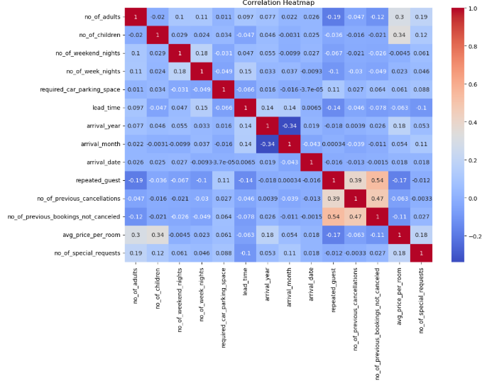
Heatmap
This heatmap visualizes the correlation between all numerical features in the dataset. The color intensity represents the strength and direction of the relationship, where values closer to +1 indicate strong positive correlation, values near -1 indicate strong negative correlation, and values around 0 indicate little or no relationship. This helps identify important relationships between features and detect potential multicollinearity before building the machine learning model.

Slide 13
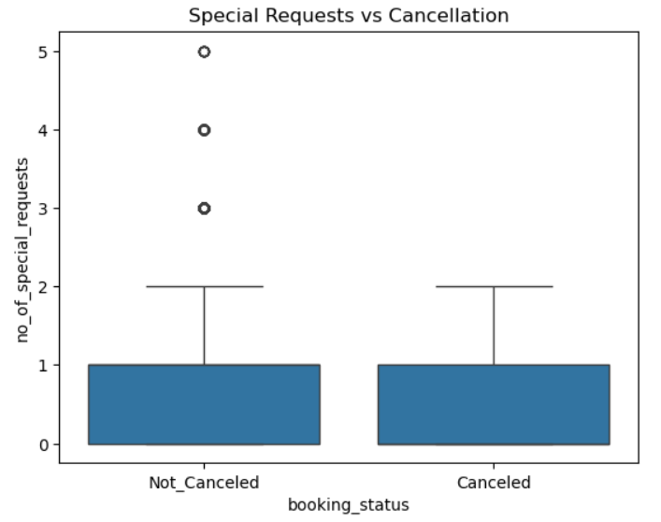
Special Requests Analysis
The relationship between the number of special requests and booking cancellation shows an interesting pattern in customer behavior. It can be observed that customers who make more special requests tend to have a slightly lower likelihood of canceling their bookings. The majority of both canceled and non-canceled bookings have a low number of special requests, typically between zero and one. However, higher values of special requests are more commonly associated with bookings that are not canceled.

Slide 14
Data Preprocessing & Feature Engineering
Data Preprocessing
Categorical variables such as type_of_meal_plan, room_type_reserved, market_segment_type, and arrival_month were converted into numerical format using One-Hot Encoding. The Booking_ID column was removed as it is only an identifier, and the target variable booking_status was converted into binary values (0 = Not_Canceled, 1 = Canceled) for machine learning modeling.
Feature Engineering – Creating New Features
Additional features such as total_nights, total_guests, price_per_person, total_previous_bookings, and is_family, lead_time_category, price_per_neight, and has_prev_cancellations were created to better represent booking characteristics and customer behavior. These engineered features help improve the predictive performance of machine learning models.

Slide 15
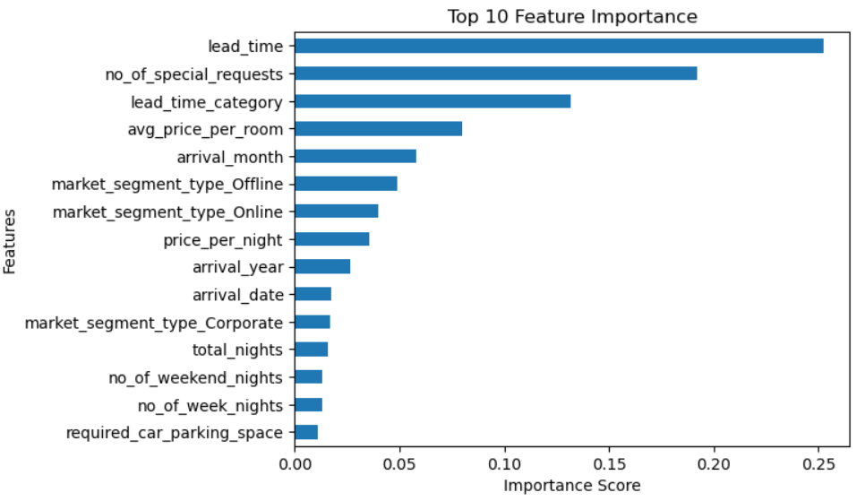
Feature Selection
Feature selection was performed to identify the most important variables that influence booking cancellations. A Random Forest model was used to calculate feature importance scores, and the top features with the highest importance values were selected to improve model performance and reduce unnecessary complexity.

Slide 16
Model Building
Multiple machine learning algorithms were used to build predictive models for booking cancellation prediction.
The following models were trained and tested:
Logistic Regression
SVC (“SVM”)
Decision Tree
Random Forest
Gradient Boosting
K-Nearest Neighbors (KNN)

Slide 17
Model Evaluation
Model Evaluation Metrics
The performance of each model was evaluated using several metrics:
Accuracy Score – Measures the overall prediction correctness
Confusion Matrix – Shows correct and incorrect predictions
ROC Curve – Evaluates classification performance
Cross Validation – Ensures model stability

Slide 18
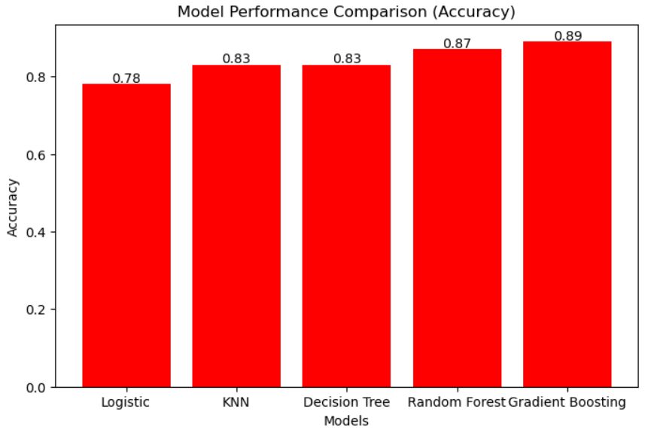
Model Comparison
This chart compares the accuracy of different machine learning models used for predicting hotel booking cancellations. Among all models, Gradient Boosting achieved the highest accuracy of 89%, followed by Random Forest with 87%, while KNN and Decision Tree achieved 83%, and Logistic Regression showed the lowest performance at 78%.
The results indicate that ensemble methods, especially Gradient Boosting, perform better in capturing complex patterns in the data compared to other models.

Slide 19
Final Model Selection
Based on model comparison results, Gradient Boosting was selected as the final model.
Reasons for selecting Random Forest:
Higher testing accuracy
Better generalization on unseen data
Reduced overfitting compared to Decision Tree
Strong performance in classification tasks

Slide 20
Model Deployment
The final trained model was deployed using Streamlit, an interactive web application framework.
The application allows users to:
Enter booking information
Predict whether the reservation will be Canceled or Not Canceled
This deployment demonstrates the real-world applicability of the machine learning model.

Slide 21
Future Improvements
Although the current model performs well, several improvements can be implemented in the future:
Use larger and more diverse datasets for better generalization
Apply advanced machine learning models such as XGBoost or Deep Learning
Integrate real-time booking data for continuous prediction
Develop a complete hotel management dashboard for business decision-making

Slide 22
Conclusion
This project successfully developed a machine learning model to predict hotel reservation cancellations using historical booking data.
Through data preprocessing, exploratory data analysis, and model training, several algorithms were evaluated to identify the best performing model.
Among all models tested, Random Forest achieved the best performance, providing accurate predictions for booking cancellations.
This model can help hotels reduce revenue loss, improve resource planning, and optimize room management strategies.

Slide 23
Questions ?

Slide 24
Thank You!

