Slide 1
Root Insurance Company
Technical Assessment – Work Sample
Role: Product Analyst

Slide 2
Problem Statement – Work Sample
In this work sample, you’ll be given:
A little background on an AB test that we ran
Access to two CSVs from which you can pull data about the test
Information about the rows and columns in those CSVs
A list of questions to answer about the test
2 CSV files – Referral_Promo_Participants and Promo_referrals and 1 PDF – containing Data Dictionary, problem statement and questions.

Slide 3
Background
Root has a referral program that allows customers to get paid for referring their friends to Root.
It’s a win for everybody because it’s typically cheaper for us to pay existing customers to refer their friends than it is for us to advertise on Google, Facebook, or anywhere else.
We allow our customers to refer other customers.
We usually pay $25 to both the sender and receiver when the receiver gets a quote. To get a quote, the receiver must complete the Root test drive, which typically takes 2-4 weeks.
We ran an AB test to try to increase referrals.
¾ of customers received a promotion after buying a policy that offered them more money per successfully referred quote ($50) for a limited 30-day window. To qualify for the promotion, the receiver has to create their account within the sender’s 30-day window and then eventually go on to get a quote. ¼ received the promo immediately after buying a policy, ¼ received it after 2 days, and ¼ received the promo 7 days after buying a policy. The promo lasts 30 days regardless of when it begins. The other ¼ did not receive the promo.

Slide 4
Product Analytics – Approach and Tools used
For my submission, I have submitted an Excel Workbook, R Notebook and PowerPoint presentation.
The timestamps are used in Short Date format, new columns – promo_startdate and promo_enddate are created, the excel workbook contains 5 worksheets, R Notebook with comments and 13 slides PPT.
I have anonymized my work meaning no personally identifiable information is mentioned in my submission.
The work sample was a fun task.

Slide 5
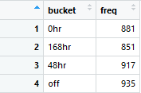


Question 1: What is the fairest way to compare the four buckets?
According to the background given, buckets be evenly split, but it is not. Actual split of buckets should be 896 counts in each bucket (25% each), of total 3584 customers.
The chi-square value is 4.493 and p-value <=0.20. We know that ¾ customers within the time period from February 2018 – May 5th, 2018, were considered in A/B Test.
So, I considered the conversion of promo referrals & no-promo referrals count to receiver account count.
Therefore, the accounts which received promo code irrespective of reception time, the conversion rate remained nearly the same for “0hr”, “168hr” & “48hr” buckets. For “off” bucket, there is a drop in the conversion rate by 10% when compared with other three buckets.
Thus, the fairest way to compare the buckets is how the referral activity affected the conversion of {account –> quote –> policy} changes and promo & cost trade-off insights.

Slide 6
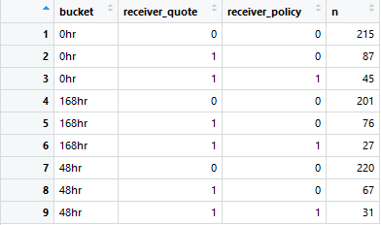





Question 2: In terms of generating referral activity (accounts, quotes, and policies) during the experiment, which variant of the test was most successful? Why do you think that is?
From the CSV file – promo_referrals, we get to know after receiving the referrals from senders, receivers always created an account and only after completion of quote within the promo period, both parties receive 50$ and 25$ for “off” bucket participants. In the below tables only combination of {1,0} and {1,1} are eligible for the amount.
In detail analysis, shows few anomalies regarding the amount received by senders and receivers within the promo period. After answering all the questions, I will show the anomaly rows.
Referral Activity percentage or utilization of promo period value and “off” bucket referral activity. (0hr = 38%; 168hr = 33.88%; 48hr = 30.87% and “off” = 37.33%).
“0hr” & “off” bucket participants have utilized referral activity well compared to other buckets. “off” even better as both parties have received 25$, thus without promo, Root is gaining profits & new customers through referral activity. The time difference in receiving promo has significance.

Slide 7


Question 2: In terms of generating referral activity (accounts, quotes, and policies) during the experiment, which variant of the test was most successful? Why do you think that is?
Root generates profits when receivers after passing the quote, buy the policies. The highlighted cells show that the policies have not been bought.
Below tables show how many people bought policies & what referral amount was credited. There are rows with anomaly records where referral amount is not transferred to sender or receiver.
Sender’s who received promo immediately have introduced more customers and Root customers seem to like Root approach towards Car Insurance as without promo too, there is a good introduction of new customers. Referral amount breakdown ({“0hr” = 13(325$) ; 31(1550$)} ; {“168hr” = 18(450$) ; 31(450$)} ; {“48hr” = 12(300$) ; 18(900$)} ; {“off” = 13(750$)})

Slide 8
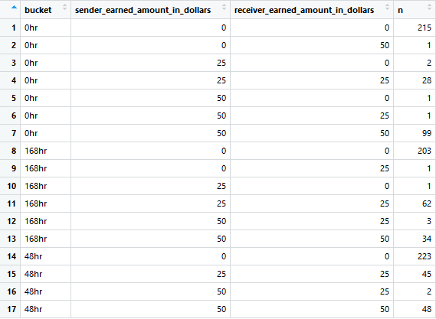

Question 3: Consider the fact that we’re paying more money per referred quote during the promo variants. How would you evaluate the tradeoff between more referral activity and more cost?
Please refer the previous slide for detailed referral cost breakdown and conversion of quote -> policy where receivers are buying in Root’s policies and are henceforth becoming customers.
Promotional 50$ and No Promo 25$ Referral Activities and number of observations.

Slide 9
Question 3: Consider the fact that we’re paying more money per referred quote during the promo variants. How would you evaluate the tradeoff between more referral activity and more cost?
The observations with anomaly records are the records where even when all criteria to receive referral amounts are satisfied, there is discrepancy in the amount received by sender or receiver.
Thus, in my calculation of cost-referral activity trade off. I am considering all records except anomaly records for each breakdown.
“0hr” – No Promo Referral Activity – Cost incurred = 1400$ (28 observations)
“0hr” – Promo Referral Activity – Cost incurred = 9900$ (99 observations)
“168hr” – No Promo Referral Activity – Cost incurred = 3100$ (62 observations)
“168hr” – Promo Referral Activity – Cost incurred = 3400$ (34 observations)
“48hr” – No Promo Referral Activity – Cost incurred = 2250$ (45 observations)
“48hr” – Promo Referral Activity – Cost incurred = 4800$ (48 observations)
“off” – No Promo Referral Activity – Cost incurred = 4200$ (84 observations)
There is a substantial amount tradeoff with promo and no-promo referral activities. But when we investigate the receivers’ who have bought policy count, it is 45 altogether for “0hr” bucket.
From the stats we have derived, I feel sending the promotional referral after two days i.e. 48 hrs bucket has a good customer churning rate and at the same time, is cost effective.
Yes, more money boosts referral activity but the trade-off with cost is severely affected.

Slide 10
Anomaly Records – Referral Activity
“0hr” Bucket
“168hr” Bucket
“48hr” Bucket
“off” Bucket

Slide 11
Question 4: Suppose today is 5/08/2018 at 2:15 PM (when the data was pulled). Based on your answers to questions 1-3, what should we do right now? Do you think we should roll out one of the four variants to everyone? Do you think we should have turned the test off earlier, should we turn the test off now, or should we leave it on to keep collecting more data? Why?
We can see that the referral activity has increased a lot for “0hr” bucket. So, yes increasing the referral amount has increased the number of referrals. But heavy cost is also incurred.
“168hr” & “48hr” buckets referral activity is at good trade-off with cost incurred by the company.
“off” bucket referral activity not only says that Root’s customers are happy referring others but also the conversion from quote stage to buying policy is great when compared with other buckets.
After product analysis, currently we should stick with normal referral policy of 25$ each for sender & receiver. The A/B test proved that there is not much significance growth in “0hr” bucket referral activity & “48hr” bucket is a good idea if the company decided to roll out a variant.
No, the test data set pulled gave a good chunk of information. Because the amount of data collected in 4 months (Feb, March, April and May) on which an executive decision can be made on referral activity.
I think the test can be turned off now and maybe start the test again post August 2018 till mid of December. Since after this month, we will be approaching holiday season(Thanksgiving, Black Friday, December month – Christmas), we can collect data with same buckets’ variant.
This is done to ensure, if customers have more time in their hands, we can easily distinguish which variant is appealing and get a sound knowledge of receiver’s conversion rate from quote to policy buyout.

Slide 12
Question 5: After seeing this data, what other kinds of things would you test in the future?
There are a few things in my mind about new features we can consider for our product analysis. Data Collection must be subjected to GDPR policy and regulation.
As the user should download the Root application, it would be great if we can analyze the current customer bracket or audience. Students who are mostly Tech Savvy, will try out the app to get an affordable insurance pricing and at the same time, they are also big into referring out to their friends. We can investigate group consisting of customers above 45 years old. This helps in analyzing the market trends of Root Insurance users.
Gaining valuable insights about cars’ telematics data can help us know how smart car features are affecting driving experience. To explain briefly, getting to know the car model, the team can get a better idea of pricing the insurance and at the same time know the current trend of car models sold.
Being part of the Product Team, GROWTH – ENGAGEMENT – MONETIZATION is our key focus and I assume GROWTH is what Root is shooting for. To spread across all states of US. Therefore, I am also interested in testing out advertising campaigns of Root over cable. Meaning we can test DMA scores of all major cities and how many of the folks in the cities are using Root. This gives us a brief overlook of how advertising or broadcasting helps us in welcoming a greater number of customers.

Slide 13
THANK YOU

