Slide 1

VELAMMAL ENGINEERING COLLEGE, CHENNAI - 66
DEPARTMENT OF MECHANICAL ENGINEERING
21ME406P - Project Work Phase II
Final Review Presentation
Development and analysis of pneumatic conveyor
By
Meganathan M (113221081043)
Rishi V (113221081055)
Rithish B (113221081056)
Thiyakavishnu p (113221081077)
Under the guidance of
Mr. Loganathan D
Assistant professor
Department of Mechanical Engineering
Velammal Engineering College

Slide 2
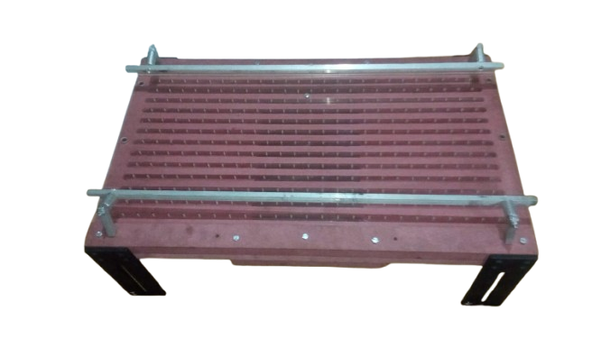
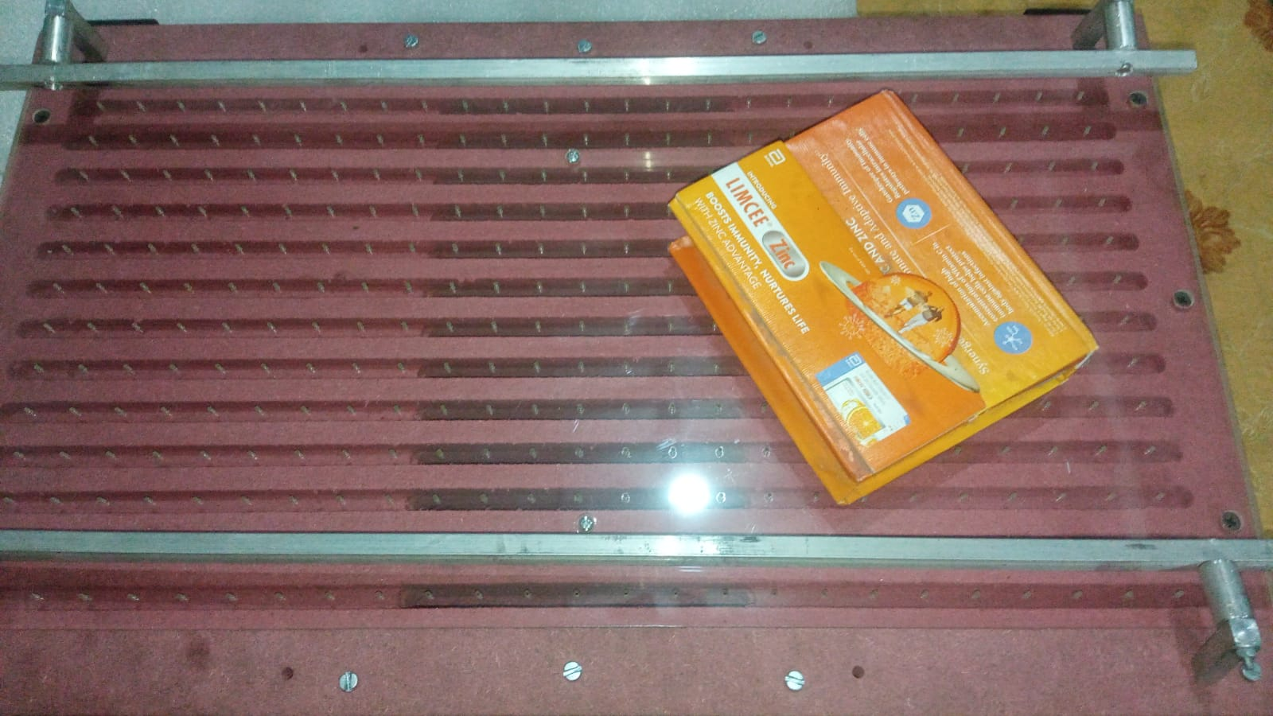
INTRODUCTION
Conveyors play a crucial role in manufacturing, packaging, and industrial goods movement.
Traditional conveyors rely on belts, rollers, and motors, which lead to wear and tear, maintenance issues, and speed limitations.
To overcome these challenges, we propose a Contactless Air Conveyor System that utilizes air pressure to transport goods without physical contact, ensuring high-speed and low-maintenance operations.

Slide 3
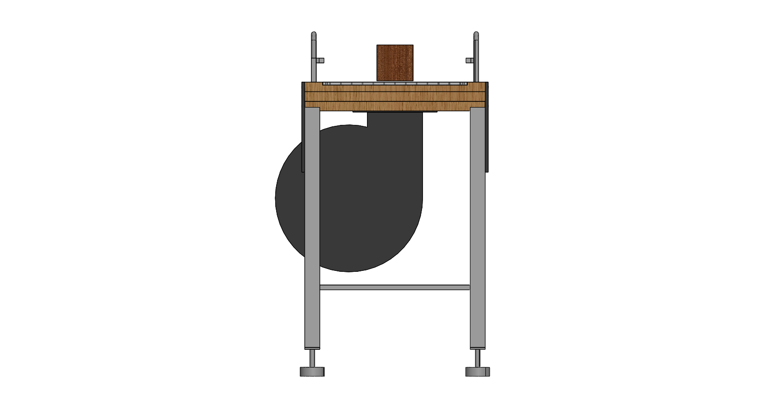
PROBLEM IDENTIFICATION
Traditional conveyors suffer from friction, wear and tear, and high maintenance costs.
Mechanical failures lead to downtime and reduced efficiency.
Speed limitations restrict the fast movement of goods.
Human errors in traditional conveyors can affect accuracy and reliability.
Conventional conveyors face frequent breakdowns due to mechanical wear.
High maintenance and operational costs burden industries.

Slide 4
LITERATURE SURVEY
Author | Journal /Year of publication | Title of the paper | Observation/Key findings
Parker, J.; Miller, T. | Pneumatic Conveying Design Guide, 2019 | Pneumatic Conveying Design Guide | Comprehensive reference for system design, including selection, layout, and practical operation of pneumatic conveyors.
Smith, A.; Johnson, L. | Int. J. Adv. Manuf. Tech., 2020 | Innovations in Contactless Transport Systems | Discusses modern developments in contactless systems, with emphasis on non-frictional transport for sensitive materials
Brown, R.; Davis, K. | Air Systems Engineering: Principles and Practice, Wiley, 2021 | Air Systems Engineering: Principles and Practice | Explores core concepts in pneumatic systems engineering, essential for optimizing airflow and energy use.

Slide 5
LITERATURE SURVEY
Author | Journal /Year of publication | Title of the paper | Observation/Key findings
Chen, Y.; Zhang, Q. | Journal of Mechanical Engineering, 2022 | Performance Analysis of Pneumatic Conveyors | Evaluates system performance under different configurations, offering data-driven insights to improve efficiency
Li, X.; Kawashima, K.; Kagawa, T | Exp. Therm. Fluid. Sci. 2008 | Analysis of vortex levitation | Discusses vortex levitation principles, useful for enhancing stability in air-based conveyor systems.

Slide 6
OBJECTIVES OF THE PROJECT
Design and develop a pneumatic conveyor system for efficient goods movement.
Achieve contactless transport to reduce wear and tear.
Minimize maintenance and operational costs while increasing reliability.
Analyze airflow dynamics to optimize conveyor performance.
Ensure the system's scalability for industrial-scale applications.

Slide 7
WORK METHODOLOGY
The project begins with identifying the objective and initiating the process.
A comprehensive literature review is conducted to understand previous research and existing technologies.
Using CAD software, a conceptual design of the system is created to visualize and plan the pneumatic conveyor.
Airflow parameters, bed hole configurations, and bed dimensions (length and breadth) are calculated for optimal system performance.
Based on design requirements, appropriate materials are selected to ensure efficiency and durability.
All necessary components and parts are procured from suppliers according to the design specifications.
The prototype of the system is assembled by integrating all the components as per the conceptual design.
The fully assembled prototype is tested to evaluate its functionality and performance under real-world conditions.
If any issues are found, modifications are made by going back to the design phase and improving the system accordingly.
If the system works as expected, the final product is prepared for implementation or presentation.
The process concludes with the finalized pneumatic conveyor system ready for deployment or submission.

Slide 8
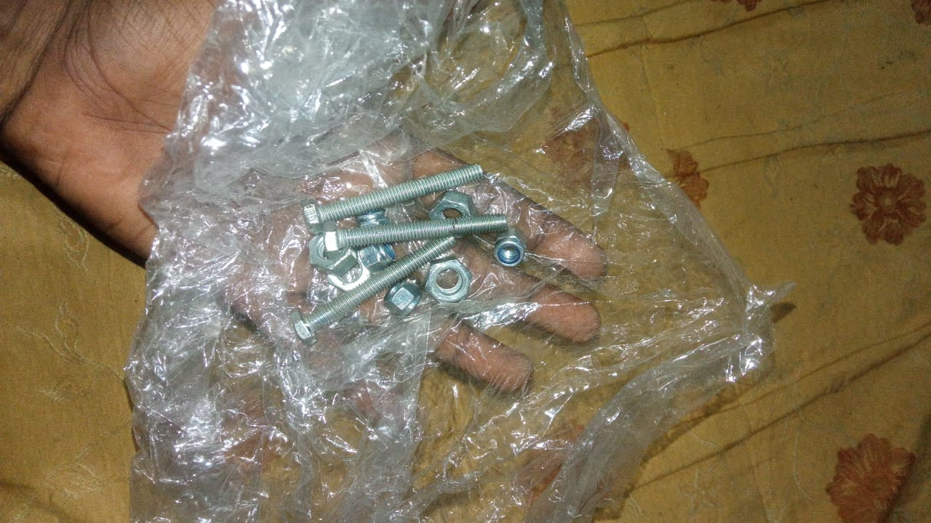
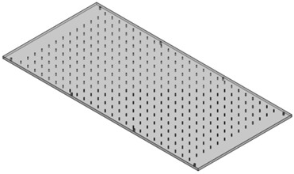
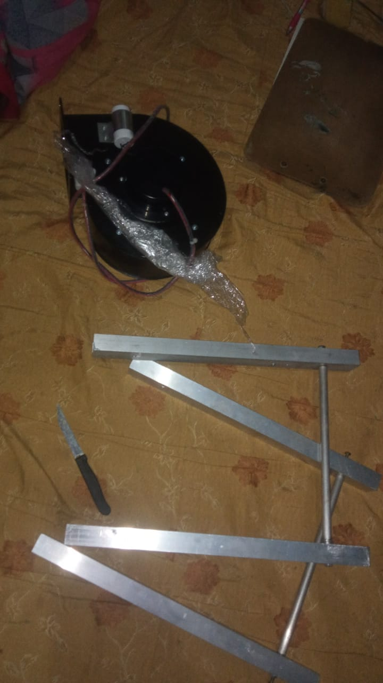
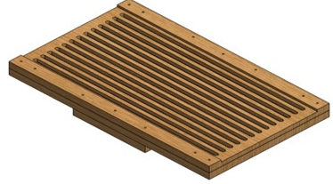
MATERIALS AND METHODS
List the components here:
Blower Fan 240V, 2550 RPM (DB150S2)
Air distribution plate
Conveyor Legs
Frame
Supporting Plate
Nuts and Bolts
Screws

Slide 9
ANALYTICAL WORK
Conducted airflow simulations to optimize pressure distribution across the conveyor.
Calculated hole size and spacing based on the weight and size of transported goods.
Studied the relationship between gap thickness and viscous force.
Used mathematical models to predict the conveyor's efficiency and stability.
Simulated various operating conditions to refine the system's design.
Lift Force Calculation:
Given Blower Pressure: 42 mmWC
Conversion: 1 mmWC=9.81 N/m²
Length = 50 cm = 0.5 m ,Breadth = 25 cm = 0.25 m
Bed Area = 0.5 × 0.25 = 0.125 m²
42×9.81= 412.02N/m² . Bed Area:0.5×0.25=0.125 m²
LiftForce:
Force=Pressure×Area
412.02×0.125=51.5 N
Since 1 kg = 9.81 N, the conveyor can lift:
61.8÷9.81=6.3 kg

Slide 10
Varying Pressure & Weight Capacity(theroretical) P=mg÷A Where: m = mass (kg) g = 9.81 m/s² (gravity) Length = 50 cm = 0.5 m Breadth = 25 cm = 0.25 m New Bed Area = 0.5 × 0.25 = 0.125 m²
Weight (kg) | Force (N) | Required Pressure (N/m²)
0.5 kg | 4.905 N | 39.2 N/m²
1.0 kg | 9.81 N | 78.4 N/m²
1.5 kg | 14.72 N | 117.7 N/m²
2.0 kg | 19.62 N | 157 N/m²
2.5 kg | 24.52 N | 196.2 N/m²

Slide 11
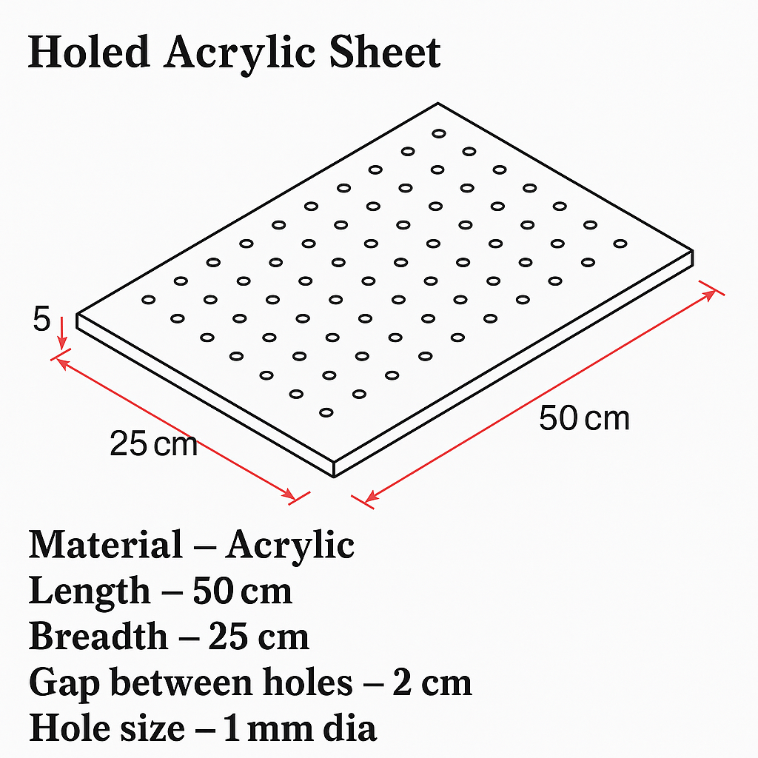
EXPERIMENTAL WORK
Builted a prototype of the pneumatic conveyor system for testing.
Conducted trials with objects of different sizes, weights, and shapes.
Measured stability, speed, and energy efficiency under varying loads.
Collected data to validate the theoretical predictions and optimize the system.

Slide 12
Power Efficiency Calculation : Formula η=( Pₒᵤₜₚᵤ /Pᵢₙₚᵤₜ)×100 Where Pₒᵤₜₚᵤₜ = 168 W Pᵢₙₚᵤₜ = 180 W η=(168/180)×100=94% Airflow Calculation : Blower Air Volume: 460 cubic meters per hour (m³/h) convert to m³/s 460÷3600=0.1278 m³/s Bed Area: 500 mm × 250 mm = 0.5 × 0.25 = 0.125 m² Hole Diameter: 1 mm (0.001 m) Airflow in m³/s: Airflow = (460 m³/h) ÷ 3600 Airflow = 0.1278 m³/s Air Velocity Calculation: Velocity = Airflow ÷ Bed Area Velocity = 0.1278 ÷ 0.125 Velocity = 1.022 m/s

Slide 13
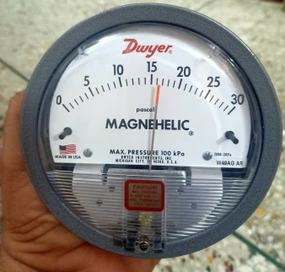
TESTING PROCEDURE
Connected the air pump to the holed sheet and calibrated pressure settings.
Placed test objects on the conveyor to observe movement behavior.
Adjusted the incline and air pressure to improve efficiency.
Monitored stability, speed, and energy consumption during operation.
Recorded results for different object sizes and analyzed performance trends.

Slide 14
Object Movement Test : Placed different objects (light, medium, heavy) and observe movement. Lighter objects moved smoothly, while heavier ones may require a stronger blower.
Weight (kg) | Required Pressure (N/m2)
0.5 | 39.24
1.0 | 78.48
1.5 | 117.7
2.0 | 157

Slide 15
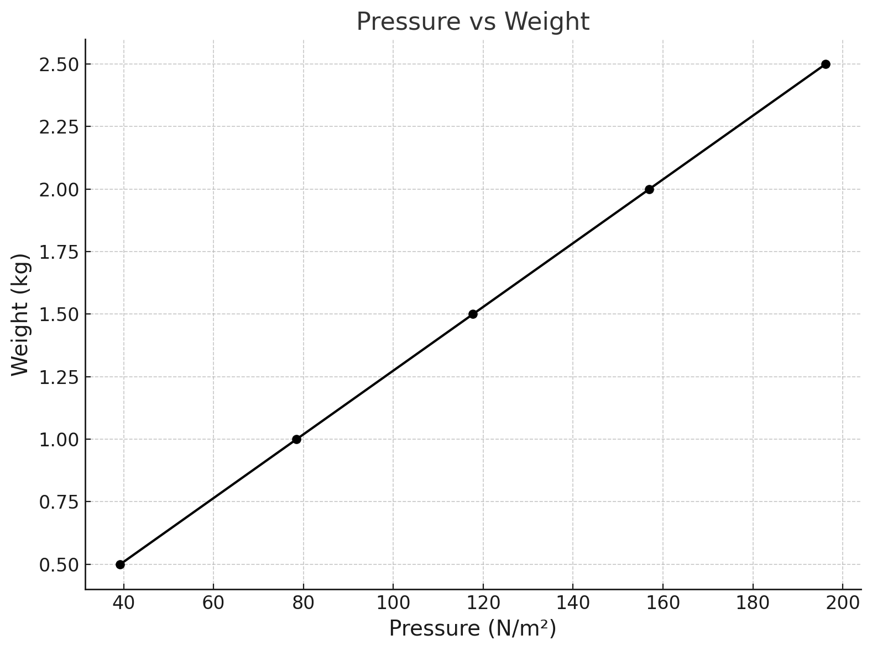
EXPECTED RESULTS
Achieved seamless, high-speed movement of goods without contact.
Reduced maintenance requirements compared to traditional systems.
Observed that optimal gap thickness and hole spacing improved airflow efficiency.
Larger objects required greater air pressure and larger holes for stability.
Demonstrated energy-efficient operation with minimal frictional losses.

Slide 16
CONCLUSION
The pneumatic conveyor system successfully addresses key issues in traditional designs.
It provides a contactless solution for high-speed and low-maintenance goods movement.
Experimental results validate its efficiency and scalability for industrial applications.
The system reduces friction, energy consumption, and operational costs.
Future enhancements include IoT integration and design improvements for heavier loads.

Slide 17
ANALYSIS WORK
CRITERIA | TRADITIONAL CONVEYORS | PNEUMATIC CONVEYORS
Mechanical Complexity | High complexity with many moving parts, leading to failures | Reduced complexity with fewer moving parts, minimizing failures
Maintenance Requirements | Requires regular maintenance and frequent inspections | Lower maintenance needs due to fewer components subject to wear
Flexibility | Limited flexibility; difficult and costly to change layouts | High flexibility; easily adapts to different layouts and configurations
Energy Consumption | Typically higher energy consumption due to mechanical operation | More energy-efficient, especially for lightweight materials
Space Requirements | Requires significant floor space and specific routing | Space-saving design; can be routed vertically and horizontally
Product Damage Risk | Higher risk of product damage due to mechanical handling | Gentle handling minimizes the risk of product damage

Slide 18
REFERENCES
Smith, A., & Johnson, L. (2020). Innovations in Contactless Transport Systems. International Journal of Advanced Manufacturing Technology, 107(1–2), 567–580.
Brown, R., & Davis, K. (2021). Air Systems Engineering: Principles and Practice. Wiley.
Chen, Y., & Zhang, Q. (2022). Performance Analysis of Pneumatic Conveyors. Journal of Mechanical Engineering, 68(3), 295–304.
Abe, M.C., Gelladuga, G.A., Mendoza, C.J., Natavio, J.M., Zabala, J.S., & Lopez, E.C.R. (2023). Pneumatic Conveying Technology: Recent Advances and Future Outlook. Engineering Proceedings, 56(1), 205.
Klinzing, G.E. (2018). A Review of Pneumatic Conveying Status, Advances and Projections. Powder Technology, 333, 78–90.
Verma, L.R., Tsang, M., & Chung, M. (n.d.). Pneumatic Conveying of Grains. University of Hawaii at Hilo.
Ramakrishnan, T., & Chen, Y. (n.d.). Experimental Studies on a Turbuflow System: A Pneumatic Conveying System with Economical Power Consumption. Source: ScienceDirect.
Grosshans, H., & Jantač, S. (2022). Recent Progress in CFD Modeling of Powder Flow Charging During Pneumatic Conveying. arXiv preprint arXiv:2212.04915.
Grosshans, H. (2022). Influence of Weak Electrostatic Charges and Secondary Flows on Pneumatic Powder Transport. arXiv preprint arXiv:2212.04956.
Klinzing, G.E. (2018). Historical Review of Pneumatic Conveying. KONA Powder and Particle Journal, 35, 2018010.
Pneumatic Conveying System – an Overview. ScienceDirect Topics. University of Hawaii at Hilo.
Dilute or Dense Phase Pneumatic Conveying? (2022). AIChE CEP Magazine, November 2022.

