Slide 1

COVID-19 Disease Detection
Minor Project(15ECSW302)
Team No :DA-10
Guide name: Prof. Umadevi F.M
Shreyas N B | 01FE19BCS005 | 104
Ramakrishna M Desai | 01FE19BCS024 | 120
Sharath S Shanbhag | 01FE19BCS029 | 124
Nikhil Kurane | 01FE20BCS423 | 469
‹#›

Slide 2
CONTENTS
Domain/Subdomain
Problem statement , Objectives and Scope
Review-01 Suggestions
Review-02 Suggestions
Dataset Description
Pre-processing
System Model
Results
References
‹#›

Slide 3
DOMAIN : MACHINE LEARNING
SUB-DOMAIN : AUDIO PROCESSING
‹#›

Slide 4
PROBLEM STATEMENT ,OBJECTIVES, SCOPE
Problem Statement:
Detection of Covid-19 from Audio samples using Deep Learning Techniques.
Objectives and scope:
Identification of features such as MFCCs, Spectral centroid, RMS and ZCR.
Applying Machine Learning models like Random Forest, KNN and SVM.
To classify the cough audio samples into COVID-19 and healthy.
Evaluate the model performance of the deep learning models against machine learning models.
Comparing with state of the art works.
‹#›

Slide 5
REVIEW-01 SUGGESTIONS
Objectives have to be more precise focusing on disease detection process
2. Advised to have clarity on how data imbalance problem is solved.
3. Requirement analysis is not done.
‹#›

Slide 6
REVIEW-02 SUGGESTIONS
Different class is to be considered ( For Ex Cough/Cold).
SVM, KNN, RF and Ensemble based approach to increase efficiency.
‹#›

Slide 7
COUGHVID: The COUGHVID dataset consists of cough recordings representing a wide range of subject ages, genders, geographic locations, and COVID-19 statuses.
1)there are 40145 segmented coughs in the format of .webm & .ogg formats.
COSWARA:Voice samples collected include breathing sounds (fast and slow), cough sounds (deep and shallow), phonation of sustained vowels (/a/ as in made, /i/,/o/), and counting numbers at slow and fast pace.
1) Breathing-deep audio samples 746(542 healthy & 204 covid positive sample)
2) Cough-heavy audio samples 765( 574 healthy and 191 covid positive audio)
3) Vowels audio samples 745(552 healthy & 193 covid positive voice).
DATASET DESCRIPTION

Slide 8
Machine Learning:
The features such as MFCC ,spectral centroid ,ZCR ,RMS are extracted from raw audio files (.wav and .webm) .
These extracted features used in different combinations are given to different models to to evaluate the performance.
PRE-PROCESSING

Slide 9
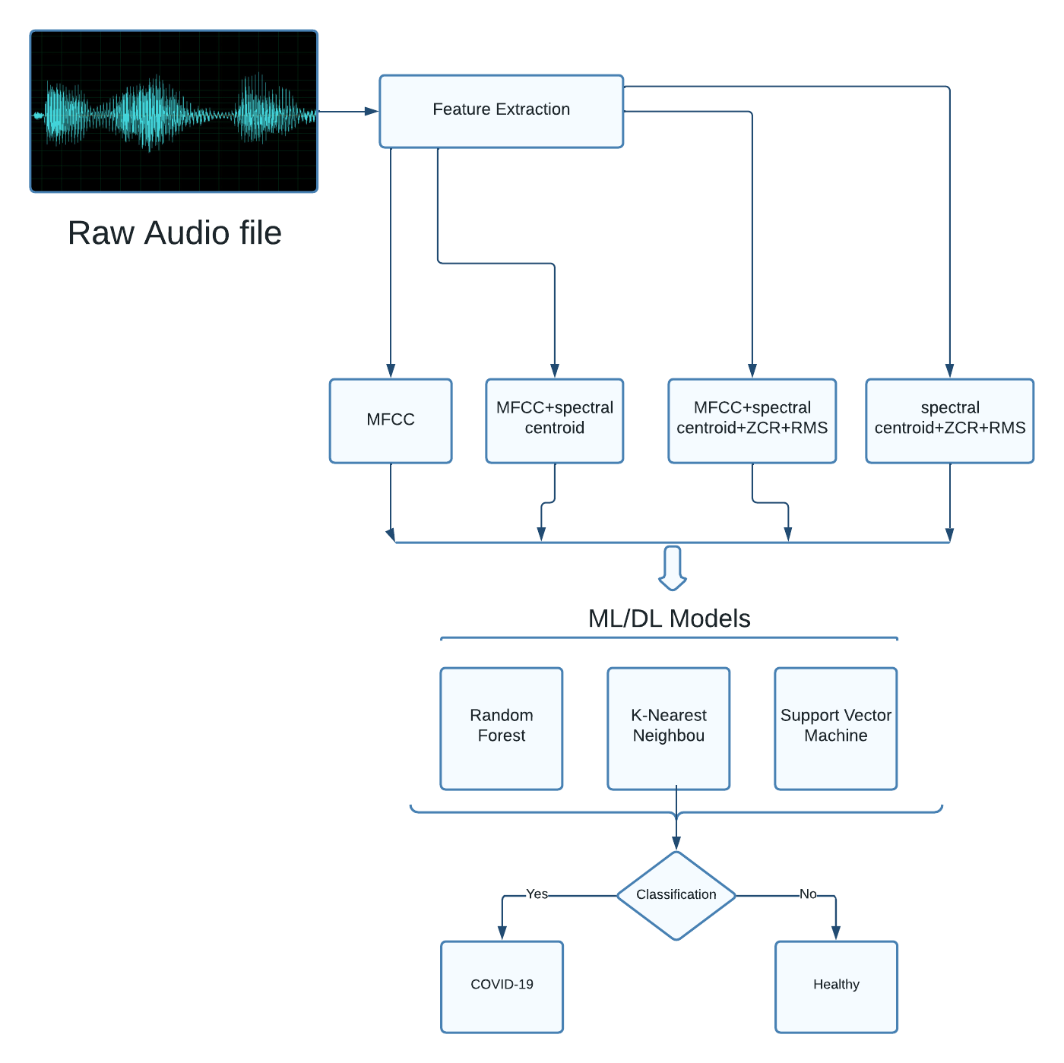
SYSTEM MODEL

Slide 10
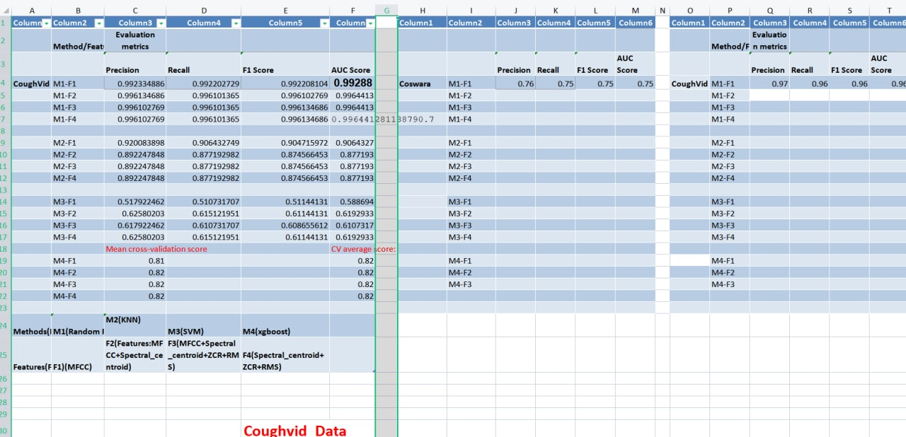
RESULTS
COUGHVID Dataset:

Slide 11
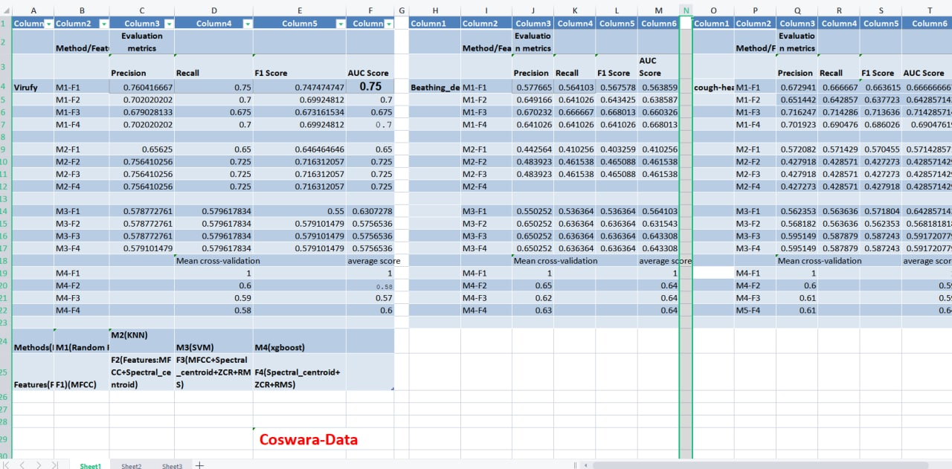
RESULTS
COSWARA Dataset:

Slide 12
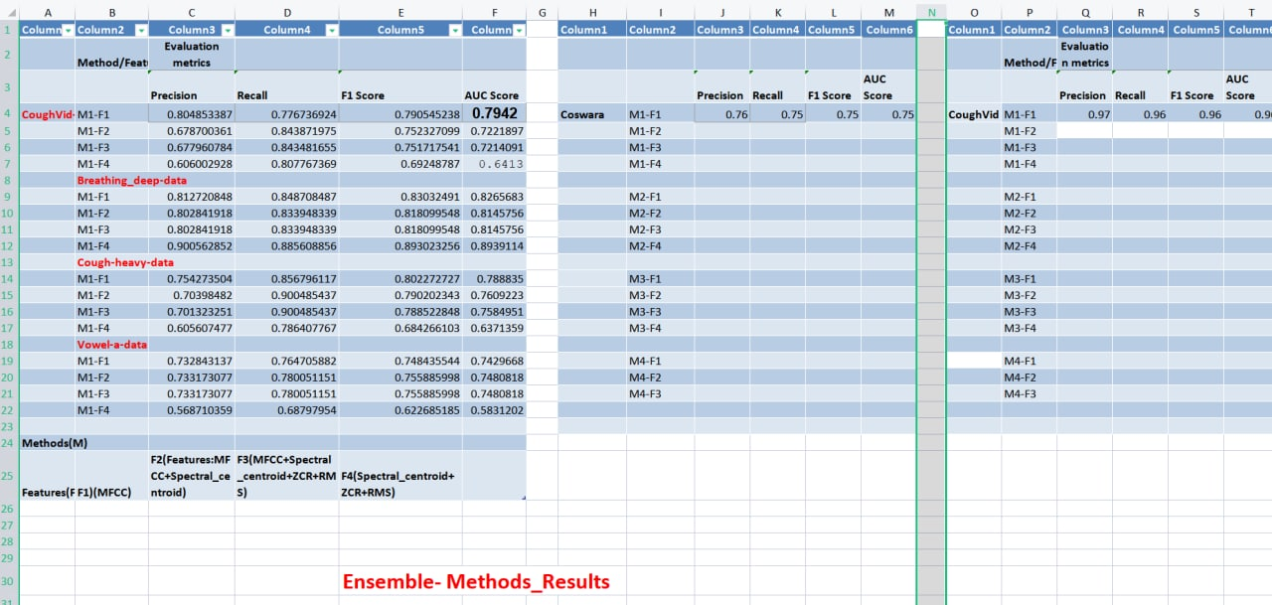
RESULTS-[Ensemble Methods]

Slide 13
REFERENCES
Detection of COVID-19 in smartphone-based breathing recordings: A pre-screening deep learning tool[Mohanad Alkhodari, Ahsan H. Khandoker; January 13,2022].
Rapid and Scalable COVID-19 Screening using Speech, Breath, and Cough Recordings.[2021 IEEE EMBS]
Automated detection of COVID-19 cough.[13 September 2021]
Pay attention to the speech: COVID-19 diagnosis using machine learning and crowdsourced respiratory and speech recordings.[23 August 2021]
CovNet: A Transfer Learning Framework for Automatic COVID-19 Detection From Crowd-Sourced Cough Sounds.[03 january 2022]
‹#›

Slide 14
PROJECT PLAN
Start date: 20th Jan 2022
R1 - 10th Feb 2022
R2 - 4th March 2022
R3 - 18th April 2022
Closure:
29th April 2022
Formulated the problem statement.
Investigating with existing works.
Design a deep learning model.
Classification and model evaluation.
Compare with state of the art works.
‹#›

Slide 15
THANK YOU
‹#›

