Slide 1

COVID-19 Disease Detection
Minor Project(15ECSW302)
Team No :DA-10
Guide name: Prof. Umadevi F.M
Shreyas N B | 01FE19BCS005 | 104
Ramakrishna N MutalikDesai | 01FE19BCS024 | 120
Sharath S Shanbhag | 01FE19BCS029 | 124
Nikhil Kurane | 01FE20BCS423 | 469
‹#›

Slide 2
CONTENTS
Introduction
Domain/Subdomain
Problem statement , Objectives and Scope
Functional Requirements
Non-Functional Requirements
Dataset Description
System Model
ML/Ensemble/Dl Pipelines
Results
References
‹#›

Slide 3
DOMAIN : MACHINE LEARNING
SUB-DOMAIN : AUDIO PROCESSING
‹#›

Slide 4
PROBLEM STATEMENT ,OBJECTIVES, SCOPE
Problem Statement:
Detection of Covid-19 from Audio samples using Deep Learning Techniques.
Objectives and scope:
Identification of features such as MFCCs, Spectral centroid, RMS and ZCR.
Applying Machine Learning models like Random Forest, KNN and SVM.
To classify the cough audio samples into COVID-19 and healthy.
Evaluate the model performance of the deep learning models against machine learning models.
Comparing with state of the art works.
‹#›

Slide 5
COUGHVID: The COUGHVID dataset consists of cough recordings representing a wide range of subject ages, genders, geographic locations, and COVID-19 statuses.
1)there are 19213 segmented coughs in the format of .webm & .ogg formats.
COSWARA:Voice samples collected include breathing sounds (fast and slow), cough sounds (deep and shallow), phonation of sustained vowels (/a/ as in made, /i/,/o/), and counting numbers at slow and fast pace.
1) Breathing-deep audio samples 746(542 healthy & 204 covid positive sample)
2) Cough-heavy audio samples 765( 574 healthy and 191 covid positive audio)
3) Vowels audio samples 745(552 healthy & 193 covid positive voice).
DATASET DESCRIPTION

Slide 6
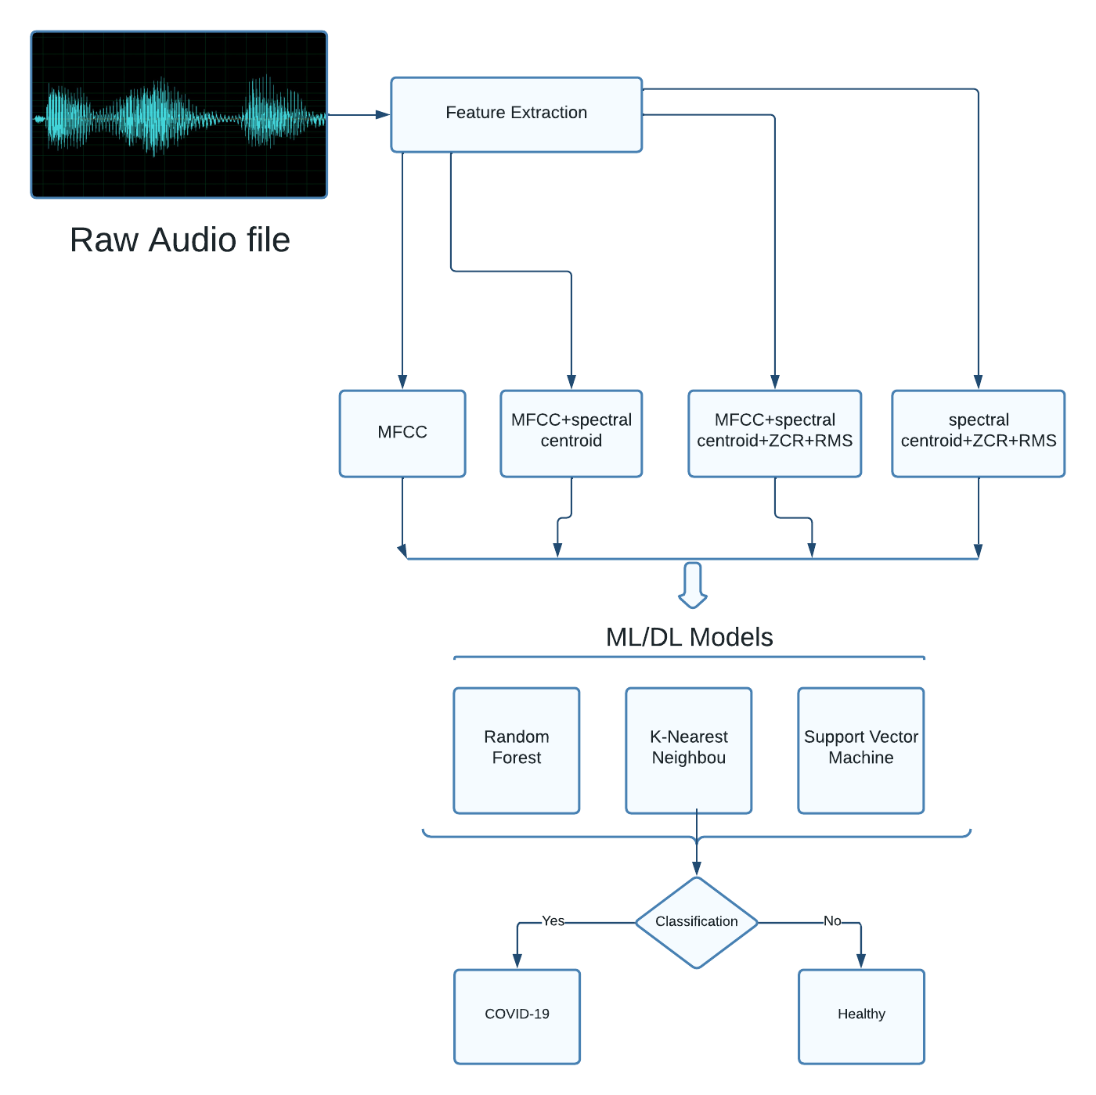
SYSTEM MODEL

Slide 7
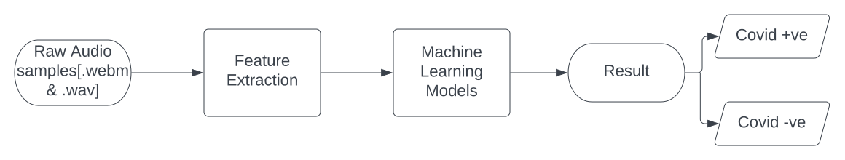
The most applicable audio features, such as MFCC, Spectral centroid, RMS, and ZCR, are retrieved from the raw audio samples from the datasets. With the use of python libraries, these collected features are fed into various machine learning models for the detection of covid-19.
Machine Learning

Slide 8
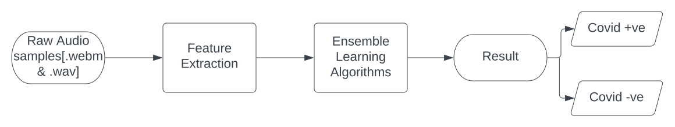
For the detection of covid-19, the most appropriate audio features are extracted, and fed into an ensemble of SVM, Logistic regression, and Decision tree layers.
Ensemble Learning

Slide 9
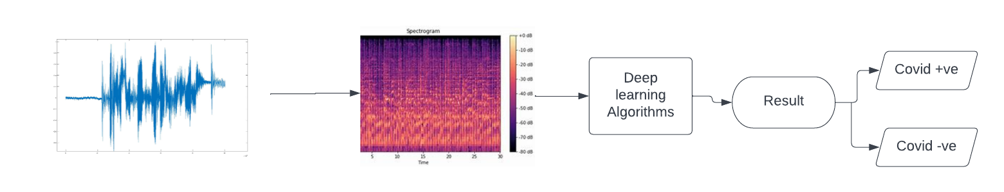
Because the mel spectrogram converts hertz data to mel scale values, the raw audio files are converted to mel-spectrograms. The mel spectrograms are better for situations where human hearing perception needs to be simulated. Deep learning methods are then used to detect covid-19 using these spectrogram images .
Deep Learning

Slide 10
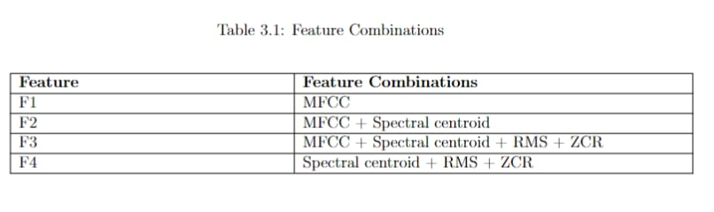
RESULTS
Feature Combinations

Slide 11
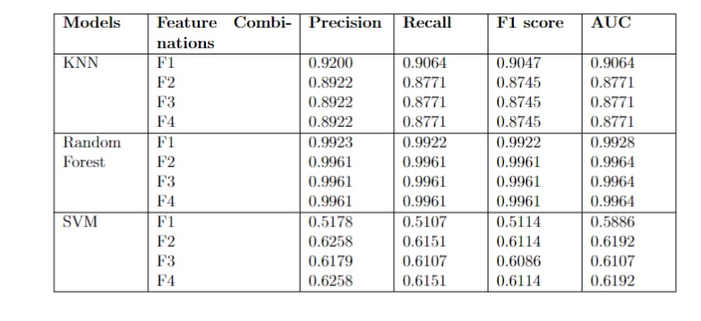
RESULTS
Machine Learning-Coughvid Results

Slide 12
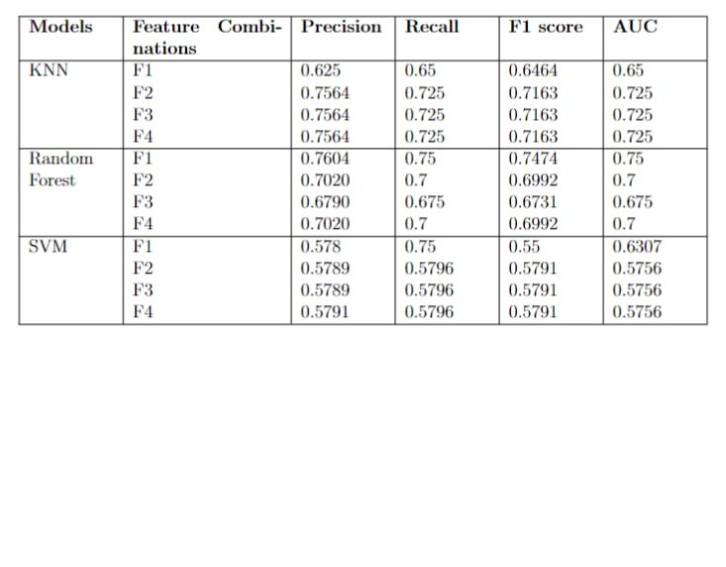
Machine Learning Coswara Dataset:

Slide 13
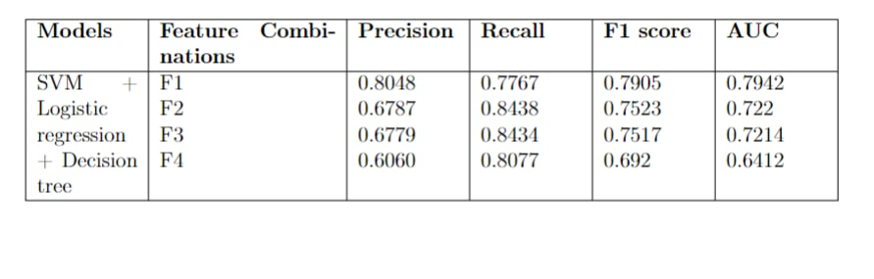
Ensemble Learning - Coughvid
‹#›

Slide 14
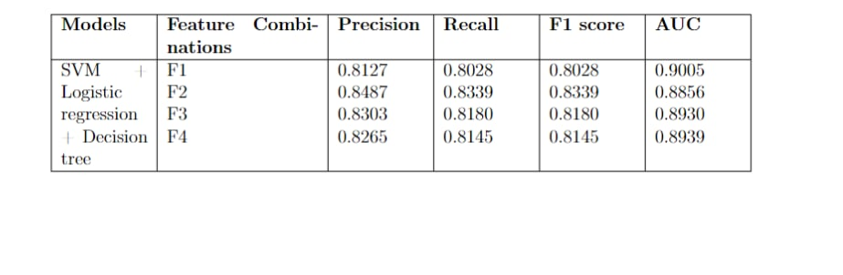
Ensemble Learning - Coswara
‹#›

Slide 15
Deep Learning
Models | Accuracy
DenseNet | 0.8133
ResNet | 0.9083
‹#›

Slide 16
CONCLUSIONS
To increase the prediction performance, such as higher classification accuracy, we explicitly use ensembled model.Deep learning relies on iterative learning methods that exposes the machines to large amounts of data and makes it extremely powerful when dealing with unstructured data .
Ensemble learning and Deep learning approaches have performed better than Machine learning techniques due to a lack of domain understanding for feature introspection. Since feature engineering is less of a worry in case of Deep Learning techniques outperform others.
‹#›

Slide 17
REFERENCES
Detection of COVID-19 in smartphone-based breathing recordings: A pre-screening deep learning tool[Mohanad Alkhodari, Ahsan H. Khandoker; January 13,2022].
Rapid and Scalable COVID-19 Screening using Speech, Breath, and Cough Recordings.[2021 IEEE EMBS]
Automated detection of COVID-19 cough.[13 September 2021]
Pay attention to the speech: COVID-19 diagnosis using machine learning and crowdsourced respiratory and speech recordings.[23 August 2021]
CovNet: A Transfer Learning Framework for Automatic COVID-19 Detection From Crowd-Sourced Cough Sounds.[03 january 2022]
‹#›

Slide 18
PROJECT PLAN
Start date: 20th Jan 2022
R1 - 10th Feb 2022
R2 - 4th March 2022
R3 - 18th April 2022
Closure:
29th April 2022
Formulated the problem statement.
Investigating with existing works.
Design a deep learning model.
Classification and model evaluation.
Compare with state of the art works.
‹#›

Slide 19
THANK YOU
‹#›

