Slide 1
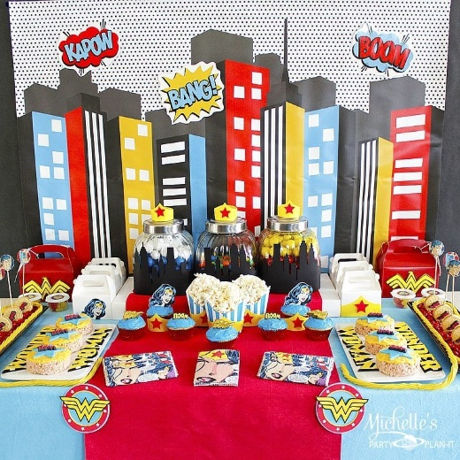
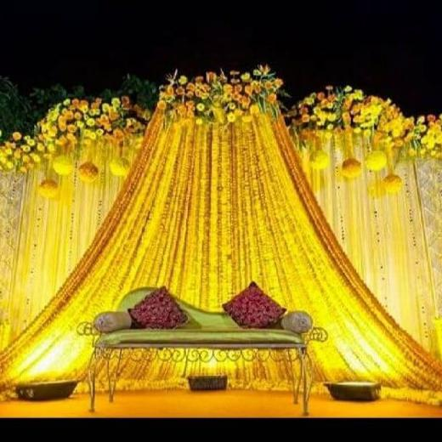
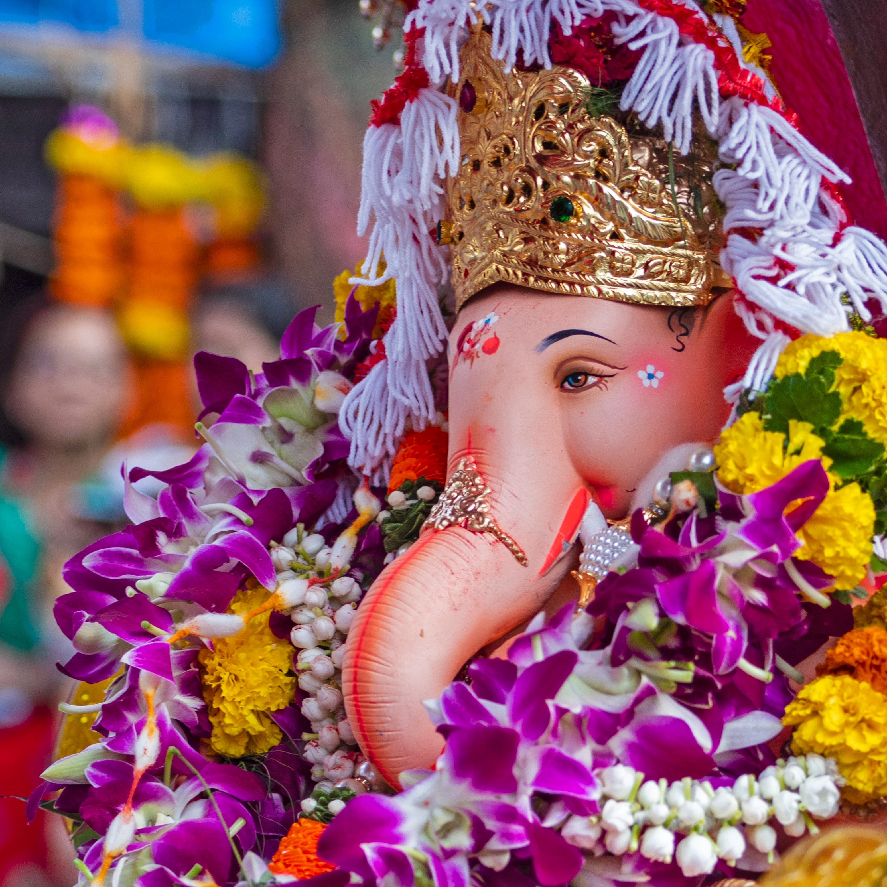
Celebration Scenario Image Classification

Slide 2

Course Code : 17ECSC306
Machine Learning
Course Project
Team A08
Sharad Shettar : 01FE19BCS008 (105)
Sairajath Nayak : 01FE19BCS020 (116)
Ramakrishna Desai : 01FE19BCS024 (120)
Sharath Shanbhag : 01FE19BCS029 (124)

Slide 3
INTRODUCTION
1

Slide 4
Image classification is the task of categorizing and assigning labels to groups of pixels or vectors within an image dependent on particular rules. The categorization law can be ap-plied through one or multiple spectral or textural characterizations. With billions of smartphones around the globe, wouldn’t it be great if the smartphone could be turned into a tool for recognizing the various Birthday Celebration scenarios from images it captures with its camera? Performing on-device im-age recognition makes it possible to overcome the limitations of the cloud in terms of privacy, real-time performance, efficacy, robustness, and more. Hence, the use of Edge AI for computer vision makes it possible to scale image recognition applications in real-world scenarios .

Slide 5
PROBLEM STATEMENT
2

Slide 6
We are provided with two tasks :
Our first task is to categorize the images into three sub-categories of the Birthday Celebration Scenario from the collected dataset.
Our second task is to classify different categories of celebration considering 5 categories and given the image of a celebration scenario, our task is to predict what category the pro-vided image belongs to.

Slide 7
UNDERSTANDING THE DATA
3

Slide 8
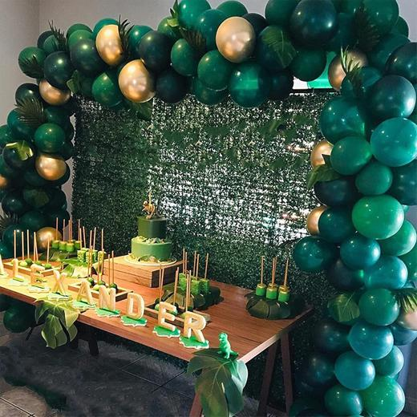
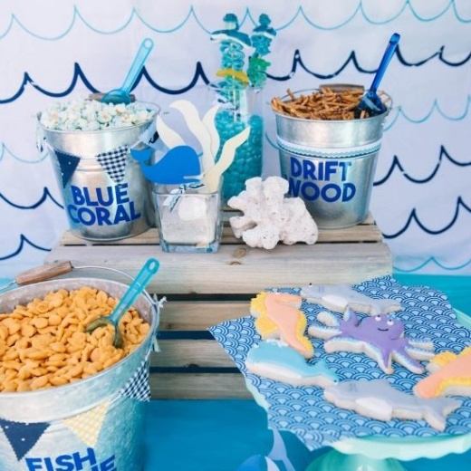
Understanding the Data
The aim was to collect different scenarios of Birthday celebrations. We collected a total of 685 images.
One image from each category is shown here. The three categories are 1. Green Theme, 2.Character Theme, 3. Surprise Parties.

Slide 9
DATA PRE-PROCESSING
4

Slide 10
All the collected images were first cleaned. The images with personal info, human faces, human centric, watermarks were either corrected or eliminated. The images were then converted to a default size(520x520) and all the images were normalized for submission.
All the celebration images collected after submission were converted to an array. The images were then converted to a default size(224x224) and all the images are normalized.

Slide 11
LEARNING MODEL
5

Slide 12
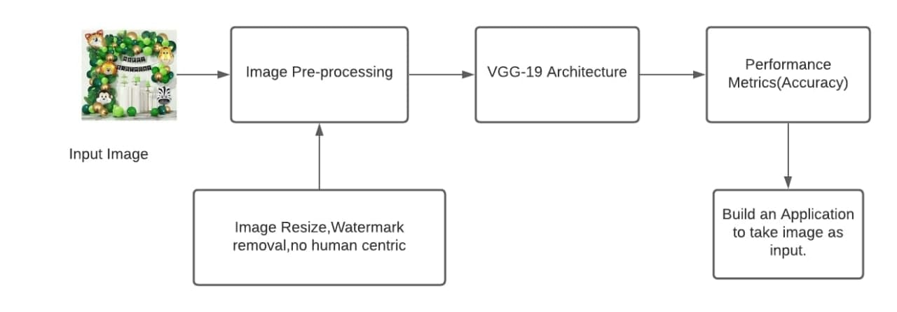
VGG-19 Architecture
In simple language, VGG is a deep CNN used to classify images
We have used two different datsets, one datset contains only birthday decorations, and the other dataset contains all the celebrations.

Slide 13
RESULTS
6

Slide 14
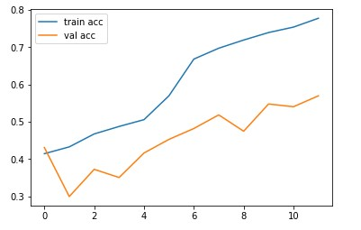
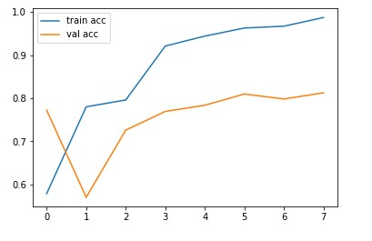
Accuracy of model
Birthday dataset
Complete celebration dataset

Slide 15
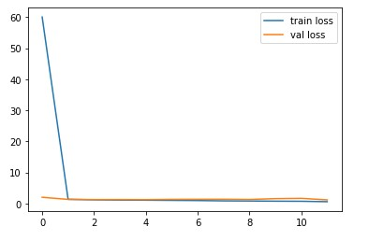
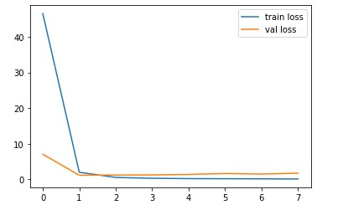
Model Loss
Birthday dataset
Complete celebration dataset

Slide 16
Application
6

Slide 17
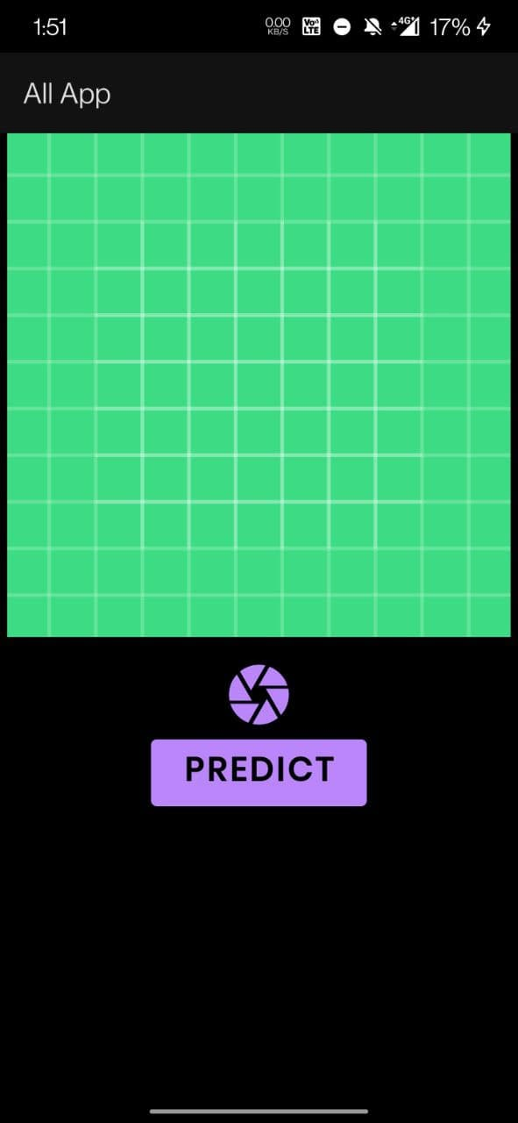
Application
Main screen of application

Slide 18
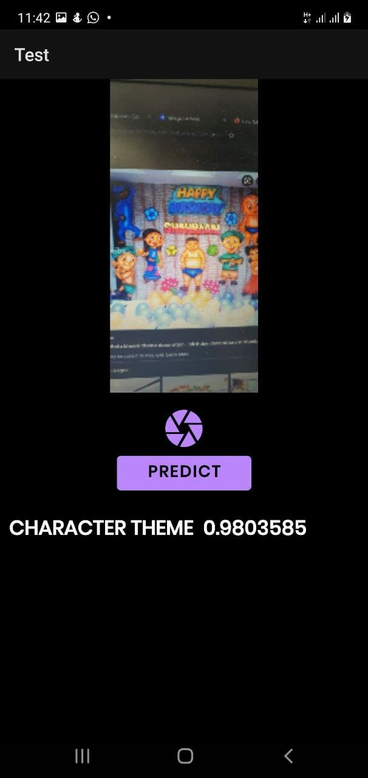
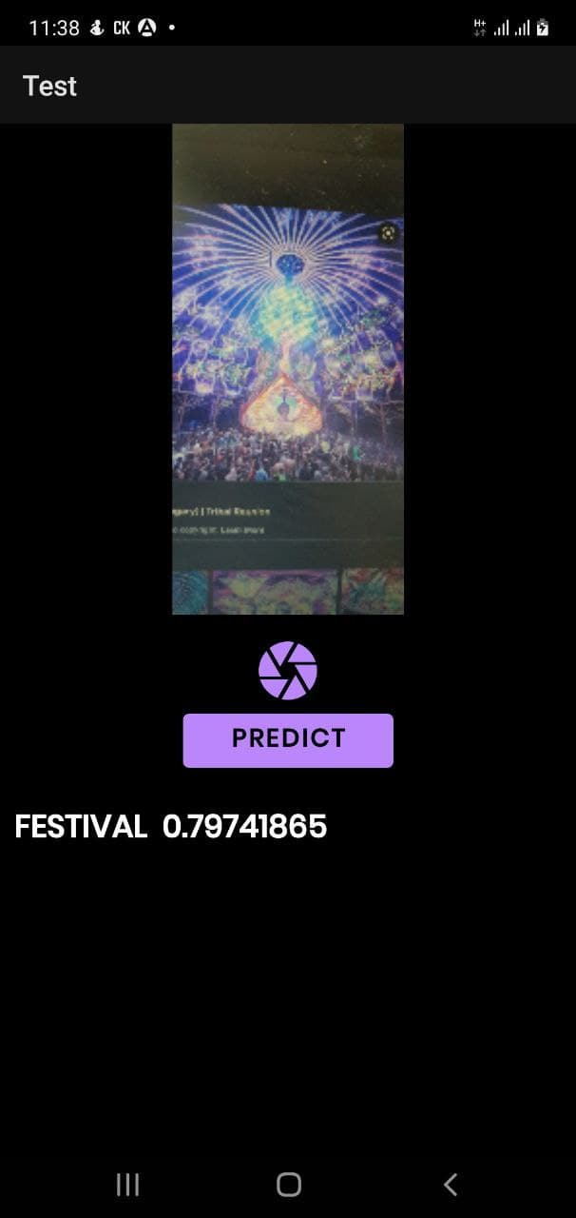
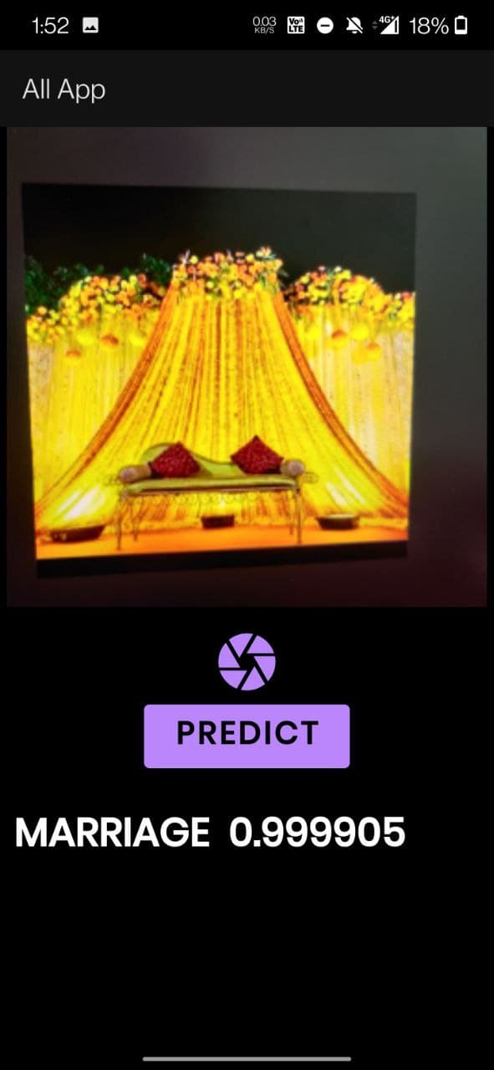
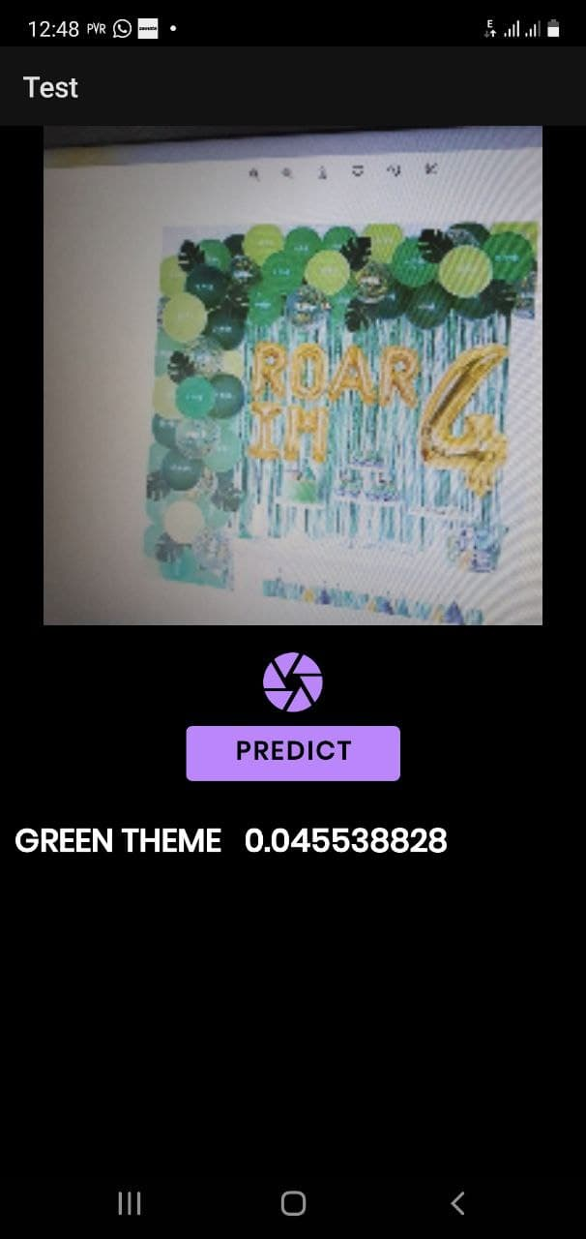
Application
Output for the respective inputs according to the category
Birthday dataset
Complete celebration dataset

Slide 19
CONCLUSION
7

Slide 20
With respect to the context of proposed learning model to categorize celebration scenarios, we proceeded with VGG-19 Architecture and it was trained to:•
“ To predict the category label of the given image “
Green Theme, Character Theme and Surprise Parties are the 3 Categories on which proposed method is tested. Therefore, related scenario images were taken for identification which spans over 3 classes. Five Celebration scenarios namely marriage ,Birthday, Festival, Baby shower and naming ceremony were also classified using VGG-19 architecture.

Slide 21
REFERENCES
7

Slide 22
References
[1]- https://medium.com/analytics-vidhya/python-based-project-covid-19-detector-with-vgg-19-convolutional-neural-network-f9602fc40b81
[2]- https://github.com/Sharathsshanbhag/CustomImage-CelebrationScenarios.git

Slide 23
THANK YOU

