Slide 1


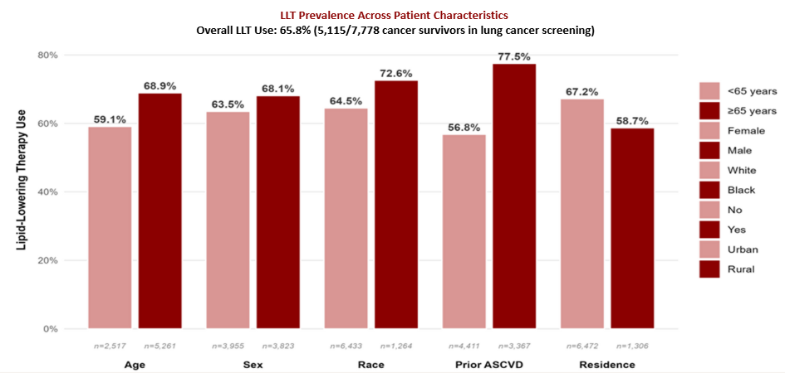
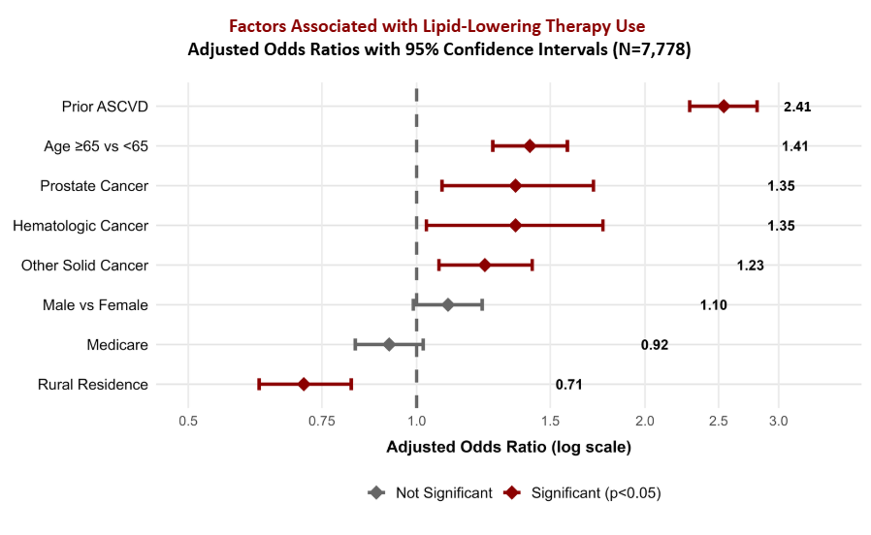
Lipid-Lowering Therapy Use Among Cancer Survivors Undergoing Lung Cancer Screening: A Cross-Sectional Analysis
Sridharan Gopalsamy Ramaswamy, Benjamin Bowe, Beryne M. Odeny
Background
Results
Table 2: Multivariable Associated factors of LLT Use Among Cancer Survivors in Lung Cancer Screening
Cardiovascular disease (CVD) causes 56% of non-cancer deaths among cancer survivors, yet lipid-lowering therapy (LLT) remains underutilized.
Lung cancer screening (LCS) populations have dual high-risk profile: heavy smoking exposure and cancer history.
National data show profound disparities: Black patients 48% less likely to be offered statins, rural residents 28% lower use, uninsured 3-4 fold lower odds.
Table 1: Demographic characteristics (N=7,778.)
Variable | OR | 95% CI | p-value
Demographics
Age ≥65 vs <65 | 1.41 | (1.26 - 1.58) | <0.001
Male vs Female | 1.10 | (0.99, 1.22) | 0.082
Race (Overall) | --- | --- | 0.601
Clinical Factors
Prior ASCVD (Yes vs No) | 2.54 | (2.29, 2.81) | <0.001
Cancer: Prostate vs Lung | 1.35 | (1.03, 1.76) | 0.013
Cancer: Hematologic vs Lung | 1.35 | (1.08-1.71) | 0.009
Cancer: Other solid vs Lung | 1.23 | (1.07-1.42) | 0.004
Social Determinants
Rural Vs Urban | 0.71 | (0.62-0.82) | <0.001
Insurance (overall) | --- | --- | 0.313
ADI Quintile (overall) | --- | --- | 0.292
Variable | Category | Count (%)
Age | Above 65 | 5,261 (68%)
 | Below 65 | 2,517 (32%)
Sex | Female | 3,955 (51%)
 | Male | 3,823 (49%)
Insurance | Medicaid | 8 (0.1%)
 | Medicare | 3,993 (51%)
 | Private | 3,785 (49%)
 | Multiple | 796 (10%)
Race | Black | 1,264 (16%)
 | White | 6,433 (89%)
 | Asian | 44 (1%)
 | Other | 37 (<1%)
Prior ASCVD | Yes | 3,367 (43%)
 | No | 4,411 (57%)
Cancer Type | Lung | 933 (17%)
 | Breast | 1,303 (10%)
 | Prostate | 575 (7%)
 | Hematologic | 343 (4%)
 | Colorectal | 216 (3%)
 | Other solid | 3,148 (40%)
 | Multiple | 1,398 (18%)
Rural/Urban | Rural | 1,306 (17%)
 | Urban | 6,472 (83%)
LLT status | On LLT | 5,115 (66%)
 | Not on LLT | 2663 (34%)
ADI | Q1 (Least) | 1,442(19%)
 | Q2 | 1,493 (19%)
 | Q3 | 1,579 (20%)
 | Q4 | 1,569 (20%)
 | Q5 (Most) | 1,695(22%)
Methods
Cross-sectional study of 7,778 cancer survivors (50–80 years) who underwent lung cancer screening in Barnes- Jewish Healthcare's LCS program between 2015-2023.
Primary outcome was LLT use (statins or statin-substitute) documented in electronic health records.
Associated factors included demographics (age, sex, race), clinical factors (prior ASCVD, cancer type), healthcare access (insurance, rurality via RUCA ) and Area Deprivation Index.
Analysis: Multivariable logistic regression, adjusted for demographics, insurance, smoking, indication, provider; stratified by race & sex.
Abbreviations: ADI = Area Deprivation Index, CI = Confidence Interval,
Table 3: Race-Stratified Analysis of Key LLT Predictors
Results: LLT Prevalence and associated factors
Variable | Black (n=1,264) |  | White (n=6,433)
 | OR | P | OR | P
Age ≥65 | 1.51 | 0.004 | 1.39 | <0.001
Male sex | 1.0 | >0.9 | 1.13 | 0.036
Prior ASCVD | 2.64 | <0.001 | 2.51 | <0.001
Rural | 0.54 | 0.3 | 0.81 | 0.005
Compared with lung cancer, prostate (AOR = 1.35; 95% CI 1.08–1.71), hematologic (AOR = 1.35; 95% CI 1.03–1.76), and other solid cancers (AOR = 1.23; 95% CI 1.07–1.42) were associated with higher LLT use.
Race-stratified: Among White patients only, male sex was associated with higher LLT use (AOR = 1.13; p = 0.036) and rural residence with lower LLT use (AOR = 0.81; p = 0.005); these were not significant among Black patients.
Prior ASCVD was the strongest associated factor (AOR=2.54, p<0.001), followed by age ≥65 years (AOR=1.41, p<0.001).
Contrary to robust national disparities, race showed NO association with LLT use (p=0.601).
Rural residence associated with 29% lower odds of LLT use (AOR=0.71, p<0.001) even after adjusting for all other factors.
Insurance status (p=0.313) and neighborhood deprivation (ADI, p=0.292) showed NO association with LLT use.
Discussion
Lipid-lowering therapy remains underused among cancer survivors at high cardiovascular risk, even during routine lung cancer screening.
Rural patients were less likely to receive therapy, underscoring persistent geographic gaps in preventive care.
Prior ASCVD strongly predicted use, suggesting LLT is still primarily used reactively rather than preventively.
Improving follow-up and care coordination during screening could help close prevention gaps and reduce heart disease deaths in cancer survivors.
Table 1 abbreviations: ADI = Area Deprivation Index, LLT = Lipid Lowering Therapy, ASCVD = Atherosclerotic Cardiovascular Disease, RUCA = Rural-Urban Commuting Area.
We thank the Alvin J. Siteman Cancer Center at Washington University School of Medicine and Barnes-Jewish Hospital in St. Louis, MO., for the use of the Biostatistics and Qualitative Research Shared Resource, which provided statistical service. The Siteman Cancer Center is supported in part by an NCI Cancer Center Support Grant #P30 CA091842.

