Slide 1

I2DB DATATHON 2026
Team Kickoff Meeting
Washington University School of Medicine · March 22, 2026
First Prize: $2,000

Slide 2
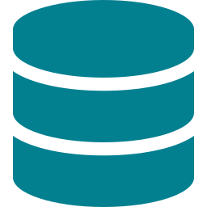
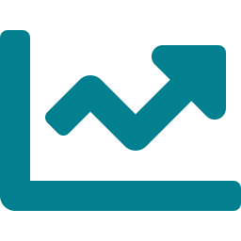


What Is This Competition?
In Simple Terms
We get a fake-but-realistic patient dataset (synthetic data about diabetes patients). Our job: build a model that can predict which patients will develop a complication — like kidney disease, eye damage, or hospital readmission.
How Are We Judged? (Equal Weight)
Model Performance
Innovation
Presentation Quality
How accurately does our model predict the outcome?
Did we do something clinically clever or creative?
How well do we explain and sell our work to judges?

Slide 3

Key Dates & Timeline
TODAY
Mar 22 (Sun)
~5 teams competing
Team kickoff meeting — you are HERE
Based on 2024 datathon: small field, 4–5 members each, mostly informatics & data science backgrounds. We don't need to beat 50 teams — just a handful.
TOMORROW
Mar 23 (Mon)
Dataset released to all teams — the clock starts
WEEKS 1–2
Mar 23 – Apr 5
Explore data, build features, train & refine models
WEEK 3
Apr 6 – 12
Finalize model, polish presentation, practice Q&A
FINAL DAY
Apr 13 (Mon)
Present at I2DB Symposium · Eric P. Newman Education Center

Slide 4



Why Our Team Can Win This
Our Clinical Edge
The Secret Weapon
4 doctors who understand diabetes pathophysiology — judges at a medical school value this above fancy code
The winning model in healthcare datathons is almost never the most technically complex.
It's the team that:
1. Finds a clinically meaningful angle
2. Builds a solid (not fancy) model
3. Presents it brilliantly
CS teams build complex models but can't explain WHY their predictions matter clinically.
We flip that — clean model, powerful clinical story.
We know which lab values, medications, and comorbidities actually matter clinically — a CS team doesn't
BRFSS, NHANES, and EHR data experience — we already know how messy health data works
We can tell a clinical STORY in the presentation, not just show charts

Slide 5
What We're Actually Doing
The entire process in 6 steps — think of it like a clinical research project
1
Get the Data
2
Explore & Understand
3
Engineer Features
→
→
Receive the synthetic diabetes patient dataset (arrives tomorrow)
What patients are in it? What variables? Any missing data? Think: reading a chart
Create smarter variables using our clinical knowledge (e.g., raw creatinine → eGFR)
4
Train Models
5
Evaluate & Validate
6
Present & Win
→
→
Feed the data into 3 algorithms
Check accuracy, make sure it works on unseen patients, test fairness across groups
Build slides, tell the clinical story, explain WHY our model matters

Slide 6

Wait — What Even Is Machine Learning?
The One-Sentence Version
You already know this. In traditional research (like BRFSS), you ask: "Is smoking associated with diabetes?" (looking backward at relationships). In ML, you flip the question: "Given this patient's data, will they develop diabetes?" (looking forward to predict). Same data, different goal.
The 3 Models We'll Use (That's It — Just 3)
Logistic Regression
Random Forest
XGBoost
FAMILIAR
INTUITIVE
POWERFUL
Like the diagnostic tests you already know — calculates probability of an outcome. You've done this before.
Like a panel of doctors voting. Each 'tree' looks at different features and the majority decision wins.
Like a student who takes an exam, reviews mistakes, retakes, reviews again — each round gets smarter.

Slide 7
How We Could Split the Work
Rough sketch — we'll finalize roles together today. The goal: everyone contributes, nobody does it all alone.
A
Clinical Lead
B
Clinical Support & Literature
Lead feature engineering — decide which clinical variables matter and why
Catch data leakage — spot variables that shouldn't be in the model
Drive the clinical narrative in the presentation
PubMed search — find what features other studies used for diabetes prediction
Help with subgroup analysis — does the model work across ages, genders, etc.?
Support clinical storytelling in presentation
C
Data Explorer & Presentation
D
Technical Lead
Help explore the dataset — visualize distributions, identify patterns
Design and build the presentation slides
Research past I2DB winning presentations for inspiration
Write and run the Python code — data loading, model training, evaluation
Run SHAP analysis for model interpretation
Handle technical Q&A from judges

Slide 8

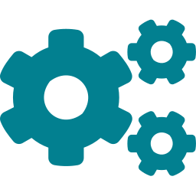
Key Things to Keep in Mind
Data Leakage = Our Biggest Risk
If a variable in the dataset was only recorded AFTER the outcome happened, including it is cheating. Example: a procedure code that only exists because the patient already had the complication. Our doctors can spot this — CS teams can't.
Feature Engineering = Our Superpower
Creating smarter variables from raw data using clinical knowledge. Example: instead of raw creatinine, we calculate eGFR (creatinine + age + sex). Instead of listing 40 medications, we create a 'treatment intensity score.' This is what wins.
AUC-ROC = Our Report Card
This is how we measure if our model is good. Think of it like sensitivity vs. specificity — it tells us how well the model separates patients who WILL get the complication from those who WON'T. Above 0.80 = good. Above 0.85 = competitive.

Slide 9


What Happens Next
TODAY — March 22
WHEN DATA ARRIVES — Mar 23
Finalize team roles after this meeting
Set up shared Google Drive folder
Technical lead: verify Python + libraries are installed and working
Clinical leads: start PubMed search for diabetes prediction ML papers
Presentation lead: look up 2024 I2DB datathon for inspiration
Everyone: check email frequently tomorrow for dataset release
Whole team meeting (1 - 2 hours) — read the data dictionary together
Technical lead loads data and runs basic exploration
Clinical team reviews: are values reasonable? Any red flags?
Identify the target variable — what are we predicting?
Start brainstorming feature engineering ideas
Begin the 3-week sprint toward April 13
First Prize: $2,000 · Our clinical expertise is our weapon · Let's win this.

