Slide 1
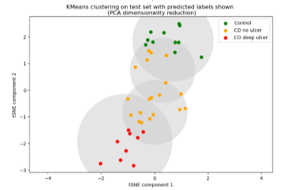
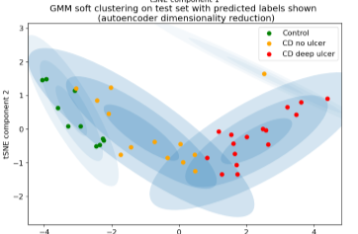
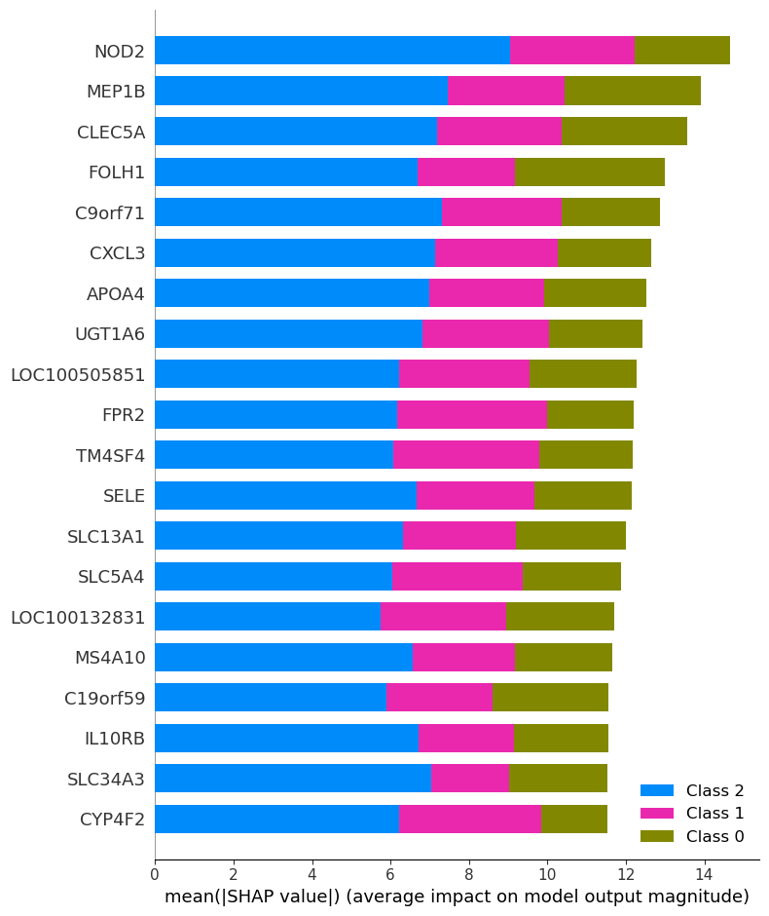
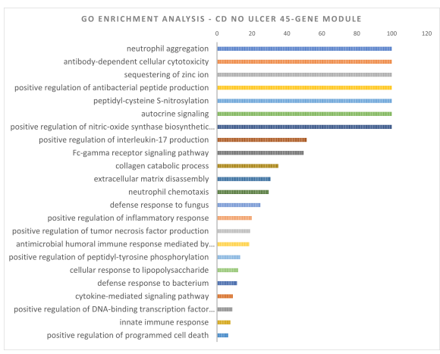
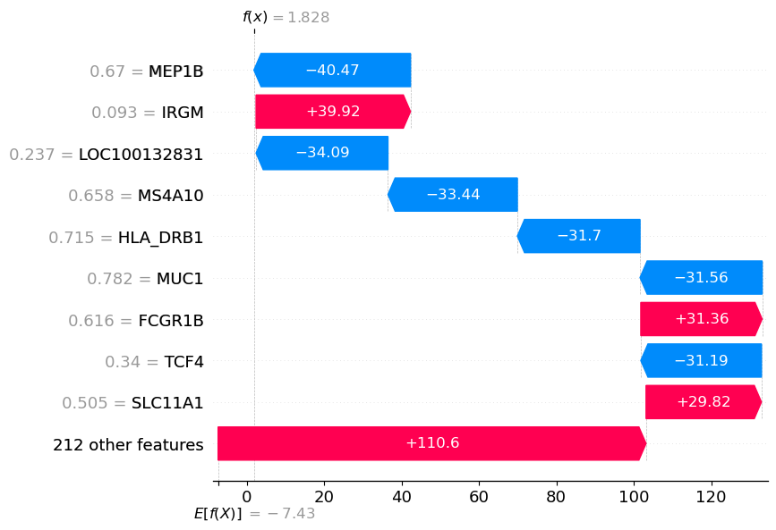
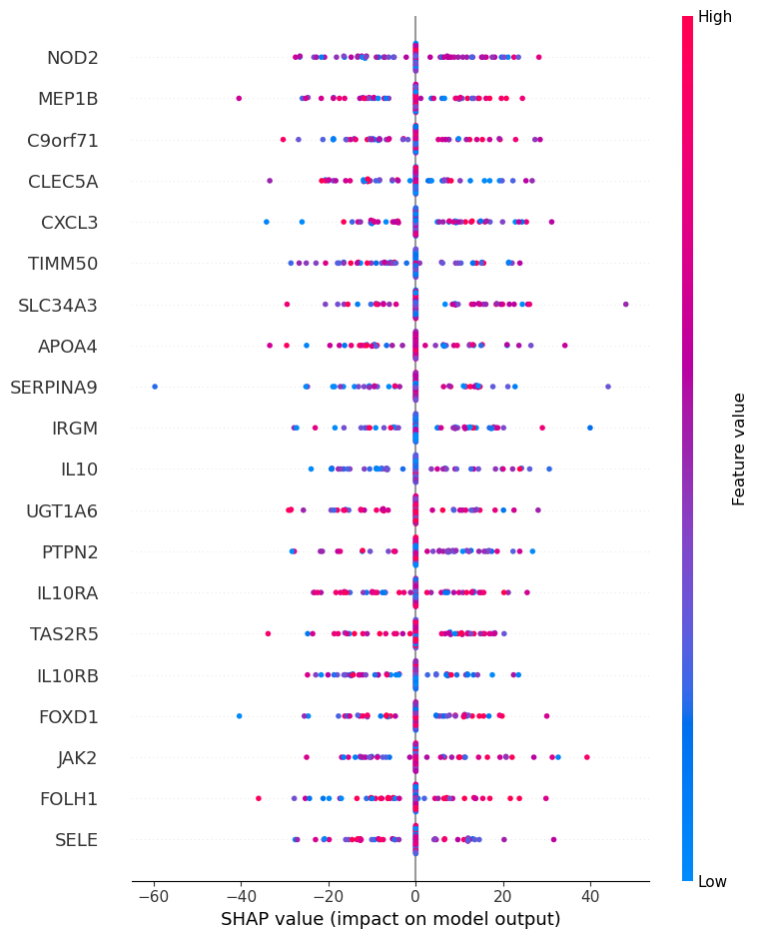
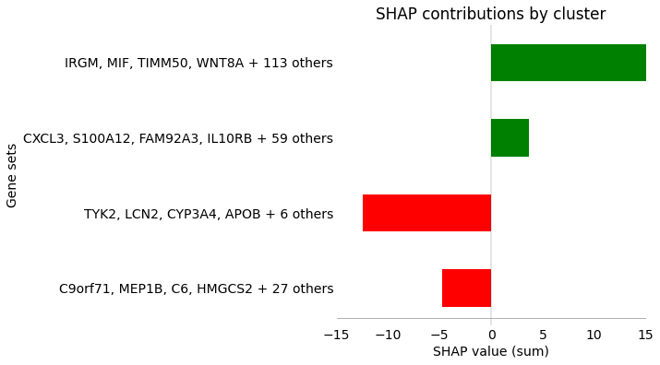
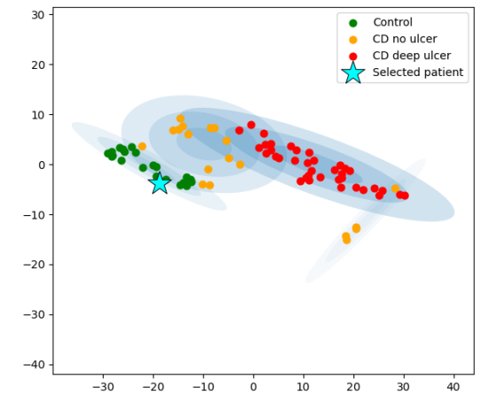
Patient stratification
KMeans
GMM
PCA
RNA-Seq dataset
Autoencoder
Probabilistic model
Explainability
SHAP adaptation – identifying risk genes
NOD2
IL10
Etc...
Class-contrastive explanations
Identifying and characterising gene modules
GO analysis – verifying functional relevance to IBD
Feedback to clinicians / patients / data scientists

