Slide 1
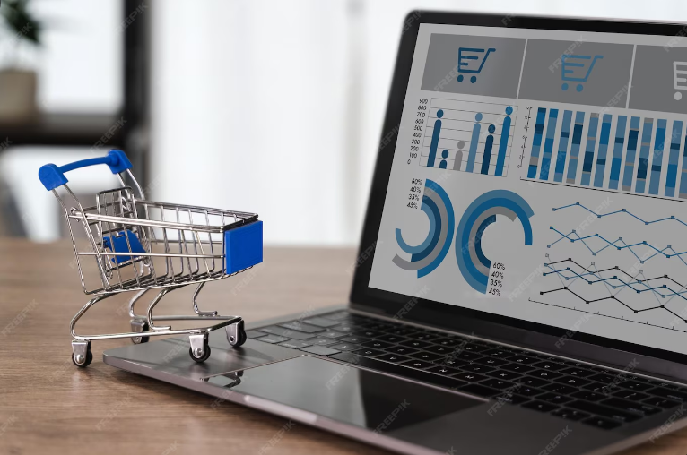
Market Basket Analysis (MBA) Project Uncovering Customer Purchase Patterns Using Apriori Algorithm
Name: Shardul Khode
Linkedin: www.linkedin.com/in/shardul-khode-683678216
Email: shardul.khode.we@gmail.com

Slide 2
Project Overview
Objective: Analyze transaction data to identify frequent itemsets and association rules, revealing products often bought together to inform marketing strategies like cross-selling and promotions.
Dataset: Assignment-1_Data.csv from an online retail archive, containing over 522,000 transactions.
Tools: Python (pandas, numpy, matplotlib, seaborn, plotly, mlxtend for Apriori), Jupyter Notebook for analysis and visualization.
Deliverables: Comprehensive Exploratory Data Analysis (EDA), Market Basket Analysis, Visualizations and Insights, Strategic Recommendations

Slide 3
Dataset Description
Source: Online retail transaction data (Assignment-1_Data.csv).
Columns: 7 key columns (BillNo, Itemname, Quantity, Date, Price, CustomerID, Country). Derived columns: TotalPrice.
Key Details:
Over 522,064 entries initially.
Cleaned to remove negative/zero quantities, zero prices, and null Itemnames (final ~510,000 rows).
Data spans Dec 2010 to Dec 2011.
Focus: UK transactions (majority).
Price converted from comma-separated format to float (e.g., '2,55' → 2.55).

Slide 4
Methodology
1. Data Preprocessing (Python):
Loaded data using pandas.
Handled missing values (dropped null Itemnames, ~1,455 rows).
Filtered invalid data (negative/zero Quantity: ~10,000 rows; zero Price: ~40 rows).
Converted Price to float and added TotalPrice (Quantity * Price).
Parsed Date to datetime for time-based analysis.
2. Exploratory Data Analysis (Python):
Analyzed top countries, items, customers by sales.
Visualized monthly sales trends and unique items per bill.
Used seaborn and plotly for bar charts, line plots, and histograms.
3. Market Basket Analysis:
Grouped data by BillNo to create transaction baskets.
Encoded items (1 if purchased, 0 otherwise).
Applied Apriori algorithm (min_support=0.02).
Generated rules with metrics: support, confidence, lift (>1), conviction.
Filtered rules (confidence >0.8, lift >1).

Slide 5
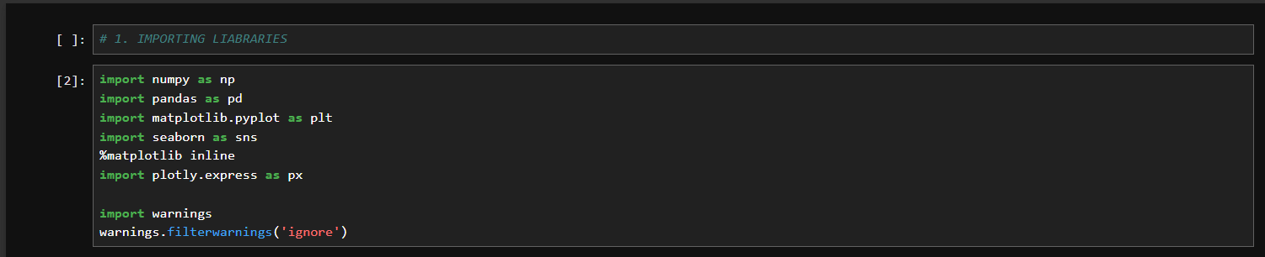
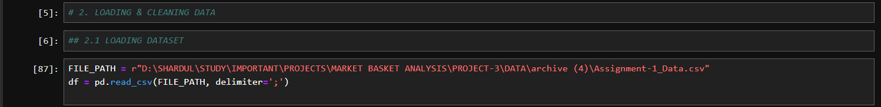
Imported Libraries & Loaded Dataset

Slide 6
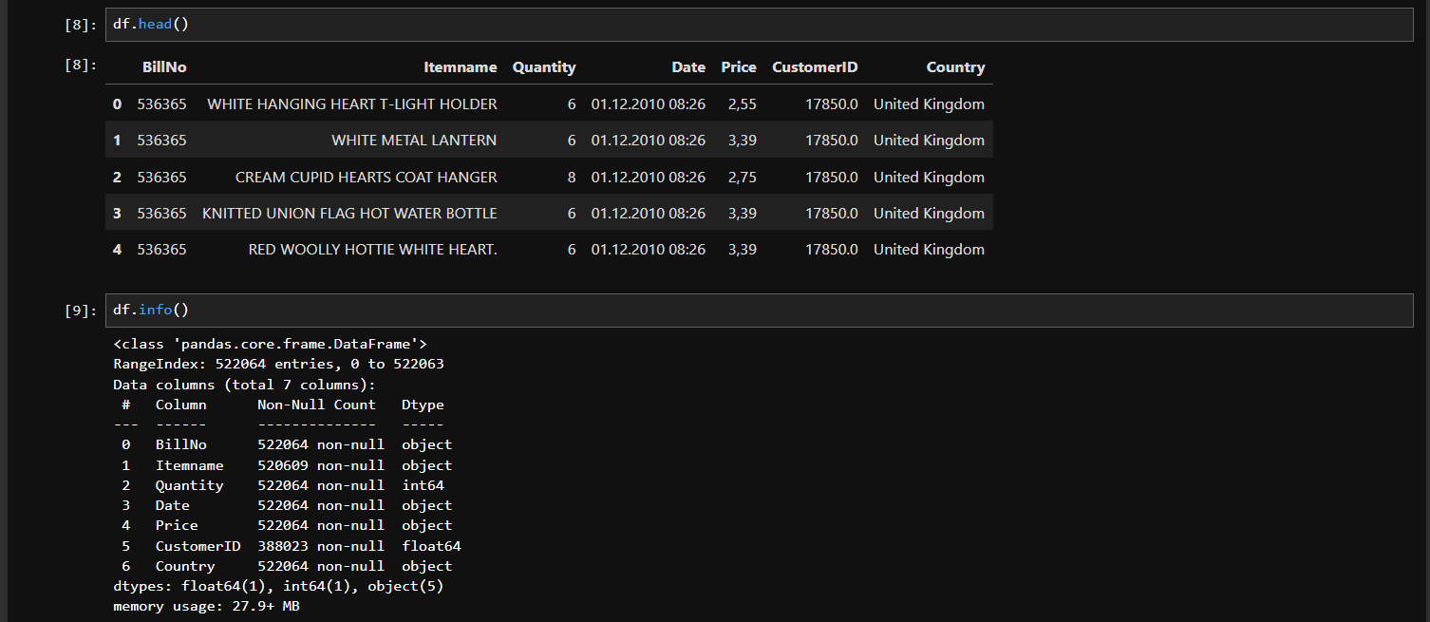
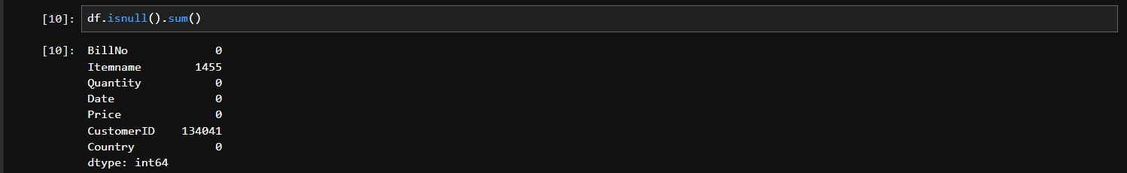
Data Information

Slide 7
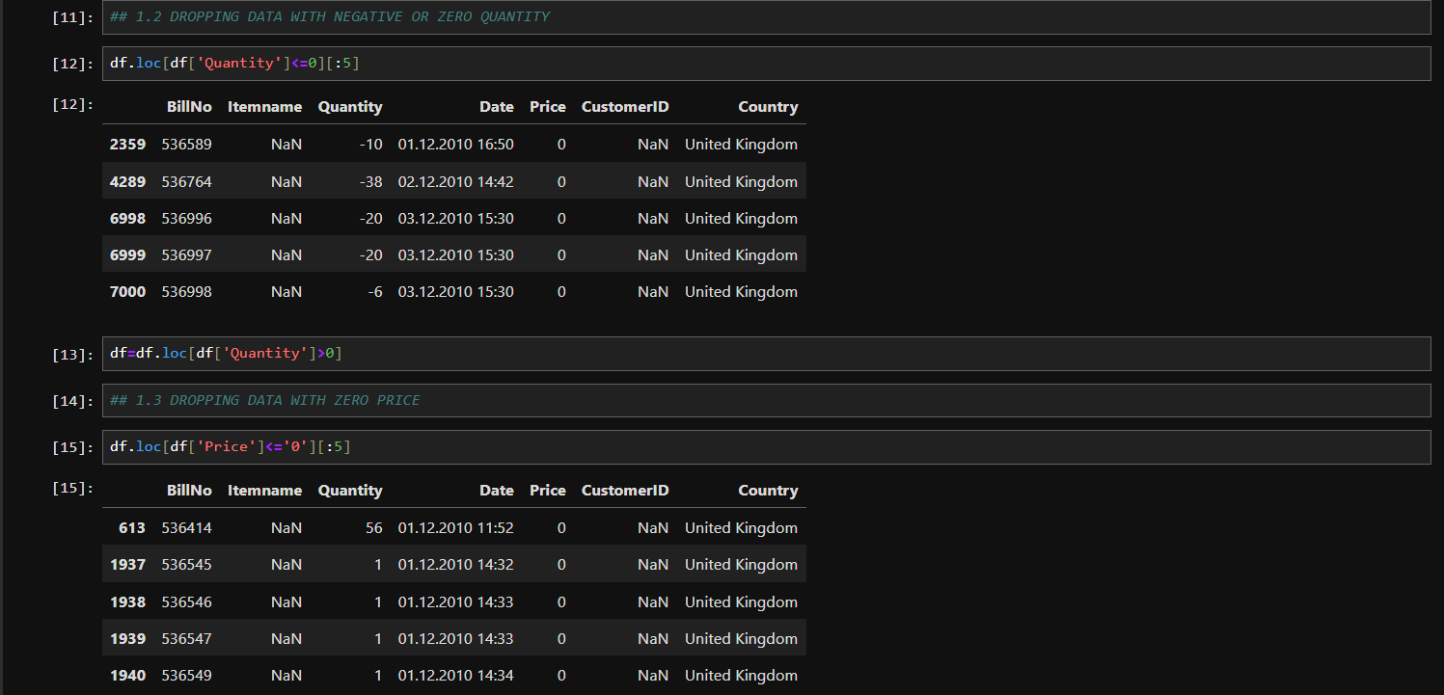
Step 1: Data Cleaning
Dropping invalid data (negative/zero Quantity, zero Price, null Item name).
Key Findings:
Removed ~10,000 rows with Quantity <=0 (e.g., returns/cancellations).
Removed ~40 rows with Price <=0 (e.g., free items or errors).
Dropped rows with null Item name (non-product entries like "POSTAGE").
Final dataset: ~510,000 valid transactions.
Insight: Ensures analysis focuses on valid sales for accurate associations.
Figure 1: Dropping Zero & Negative Values from Qty & Price

Slide 8
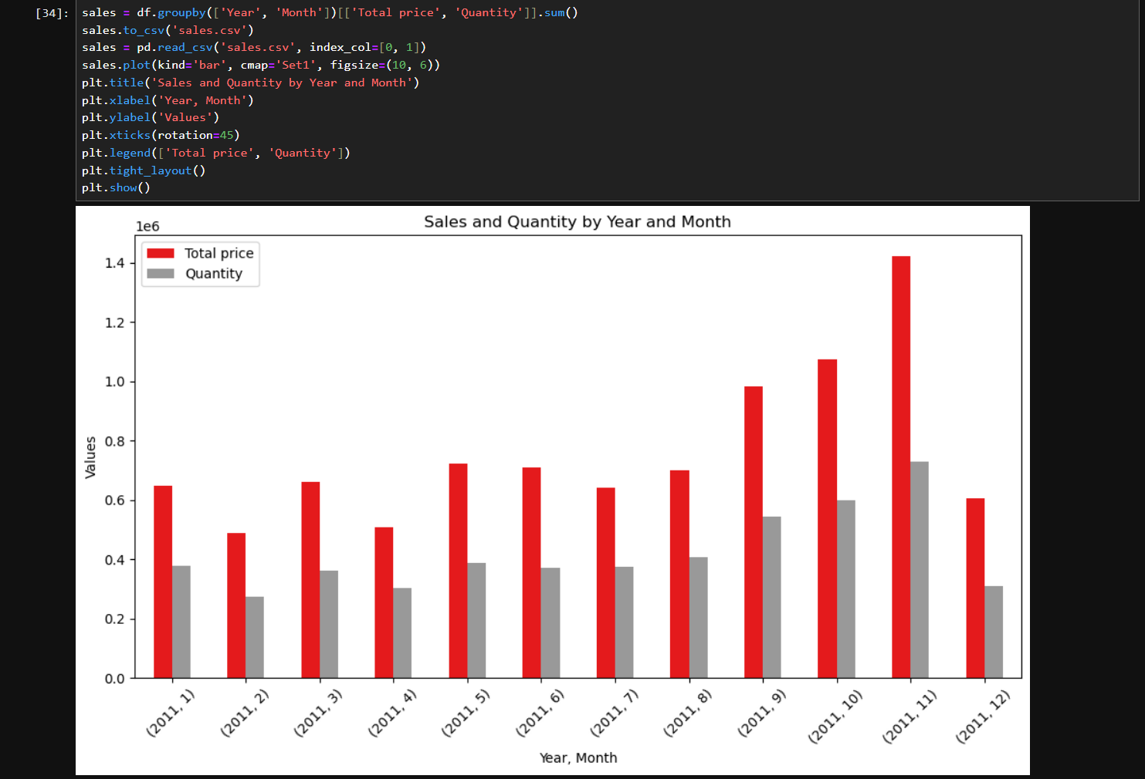
Step 2: Sales Amount & Quantity
This bar chart visualizes the total sales (in red) and quantity of items sold (in gray) across each month of 2011, derived from the cleaned dataset.
Key Findings:
The highest total sales occur in November 2011 (Month 11), exceeding 1.4 units, indicating a significant sales surge.
The highest quantity sold also occurs in November 2011, reaching approximately 1.0 unit, suggesting a high volume of transactions.
Sales and quantity show a general increase from January to November, with notable peaks in Months 5 (May), 9 (September), and 11 (November). December (Month 12) shows a decline.
Insight: The data highlights a strong seasonal trend, with November being the peak month, likely due to holiday shopping
Figure 2: Monthly Sales Amount & Quantity

Slide 9
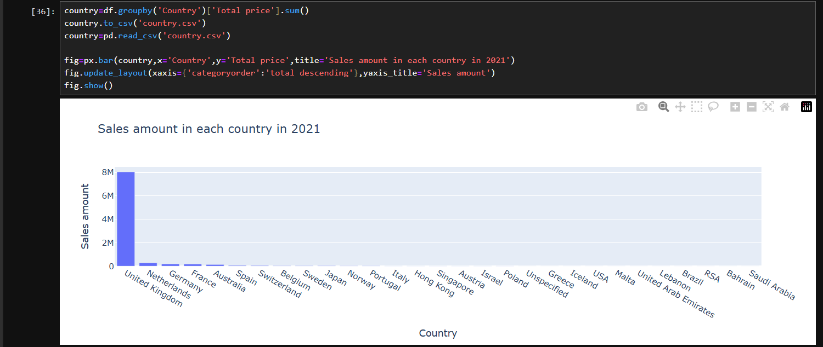
Step 3: Top 10 Countries by Sales
The bar chart displays total sales amounts for each country in 2011, aggregated using pandas and visualized with plotly.
Key Findings:
The United Kingdom leads with sales exceeding 8 million units, dwarfing other countries.
Germany follows with around 1 million, while France, Australia, and others (e.g., Switzerland, Japan) contribute less than 0.5 million each.
Most countries show sales below 0.2 million, with USA, Malta, and Brazil at the lower end.
Insight: Focus marketing efforts on the UK market to maximize revenue due to its dominant sales share.
Figure 2: Bar chart of top countries

Slide 10
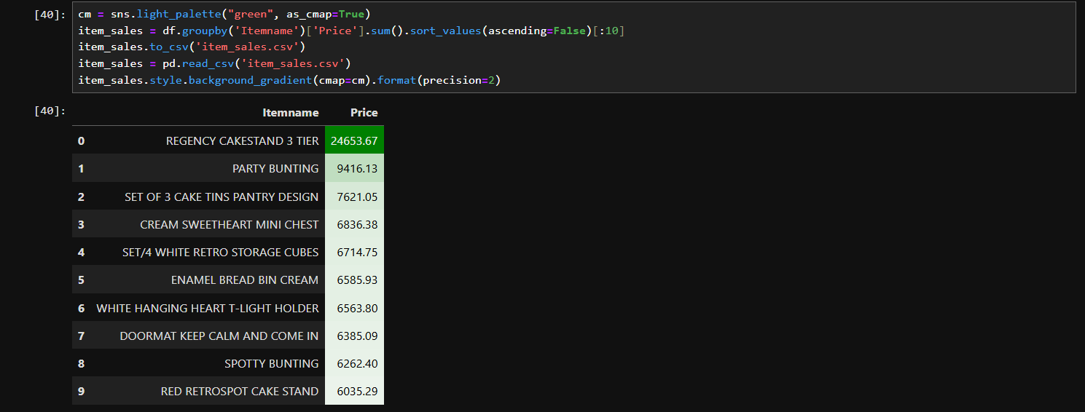
Step 4: Top 10 Items by Sales
This styled table lists the top 10 items by total sales price, sorted in descending order
Key Findings:
REGENCY CAKESTAND 3 TIER tops the list with 24653.67, followed by PARTY BUNTING at 9416.13.
SET OF 3 CAKE TINS PANTRY DESIGN and CREAM SWEETHEART MINI CHEST rank third and fourth with 7621.05 and 6836.38, respectively.
Other notable items include SET/4 WHITE RETRO STORAGE CUBES (6714.75) and ENAMEL BREAD BIN CREAM (6585.93).
Insight: High-value items like cake stands and storage solutions drive significant revenue, ideal for premium promotions.
Figure 4: Top 10 Items by Sales

Slide 11
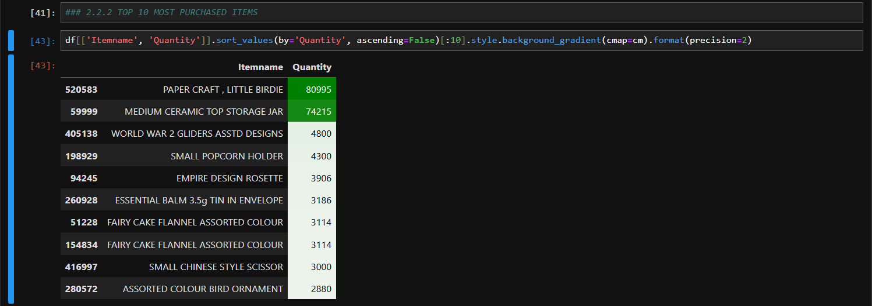
Step 5: Top 10 Most Purchased Items
This styled table lists the top 10 most purchased items by quantity, sorted in descending order
Key Findings:
PAPER CRAFT, LITTLE BIRDIE leads with 80995 units, followed by MEDIUM CERAMIC TOP STORAGE JAR at 74215.
WORLD WAR 2 GLIDERS ASSTD DESIGNS and SMALL POPCORN HOLDER rank third and fourth with 4800 and 4300 units, respectively.
Other notable items include EMPIRE DESIGN ROSETTE (3906) and ESSENTIAL BALM 3.5G TIN IN ENVELOPE (3186).
Insights: High-quantity items like crafts and storage jars indicate strong customer demand, perfect for inventory focus.
Figure 5: Top 10 Purchased Items

Slide 12
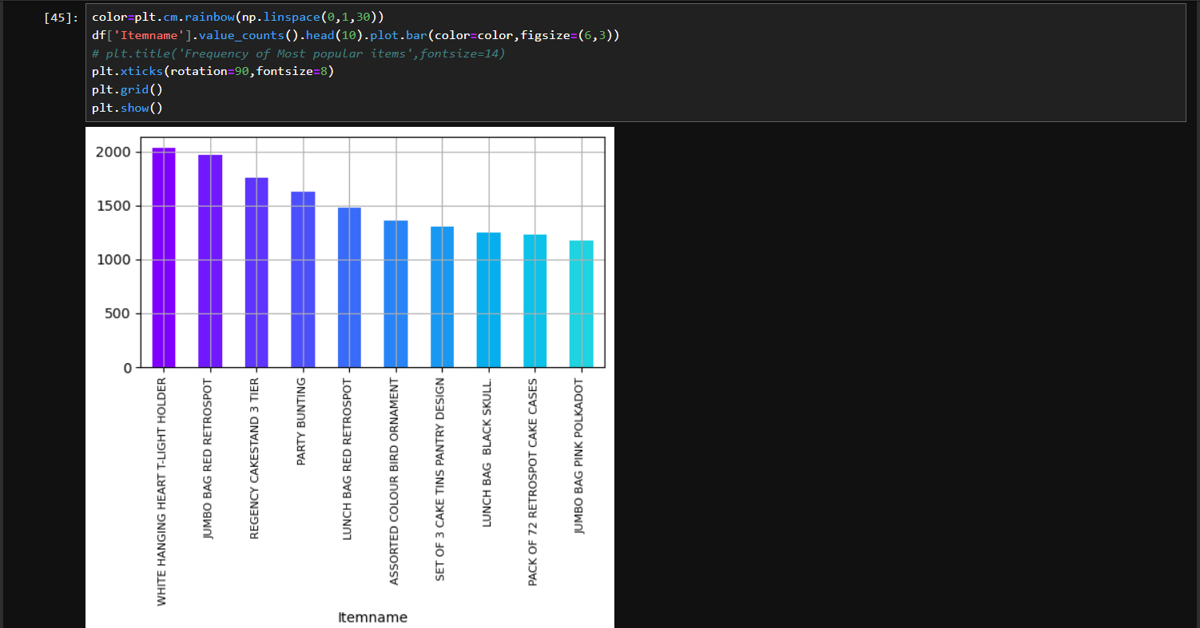
Step 6: Top 10 Most Frequently Purchased Items
This bar chart displays the frequency of the top 10 most common items, created using matplotlib
Key Findings:
WHITE HANGING HEART T-LIGHT HOLDER leads with over 2000 occurrences, followed by JUMBO BAG RED RETROSPOT at around 1800.
REGENCY CAKESTAND 3 TIER and PARTY BUNTING rank next with approximately 1500 and 1400 occurrences, respectively.
Other items like LUNCH BAG RED RETROSPOT and PACK OF 72 RETROSPOT CAKE CASES show frequencies around 1000 or less.
Insight: High-frequency items like heart t-light holders suggest strong customer preference, ideal for prominent display.
Figure 6: Frequency of Top Items

Slide 13
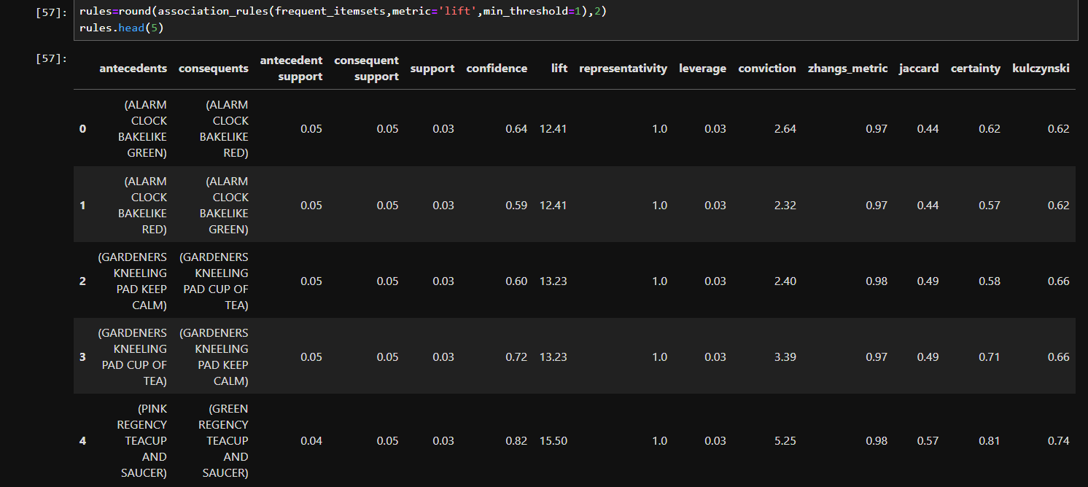
Step 7: Association Rule
This table displays top association rules with metrics like support, confidence, lift, and leverage, filtered for strong associations using pandas.
Key Findings:
CLOCK and BAKELIKE GREEN with ALARM CLOCK BAKELIKE RED show a confidence of 0.64 and lift of 2.64.
GARDENERS KNEELING PAD KEEP CALM with GARDENERS KNEELING PAD CUP OF TEA has a confidence of 0.72 and lift of 13.23.
PINK REGENCY TEACUP AND SAUCER with GREEN REGENCY TEACUP AND SAUCER exhibits a confidence of 0.82 and lift of 5.25.
Key Findings: High-lift rules like teacup combinations suggest strong cross-selling opportunities for targeted promotions.
Figure 7: Association Rules

Slide 14
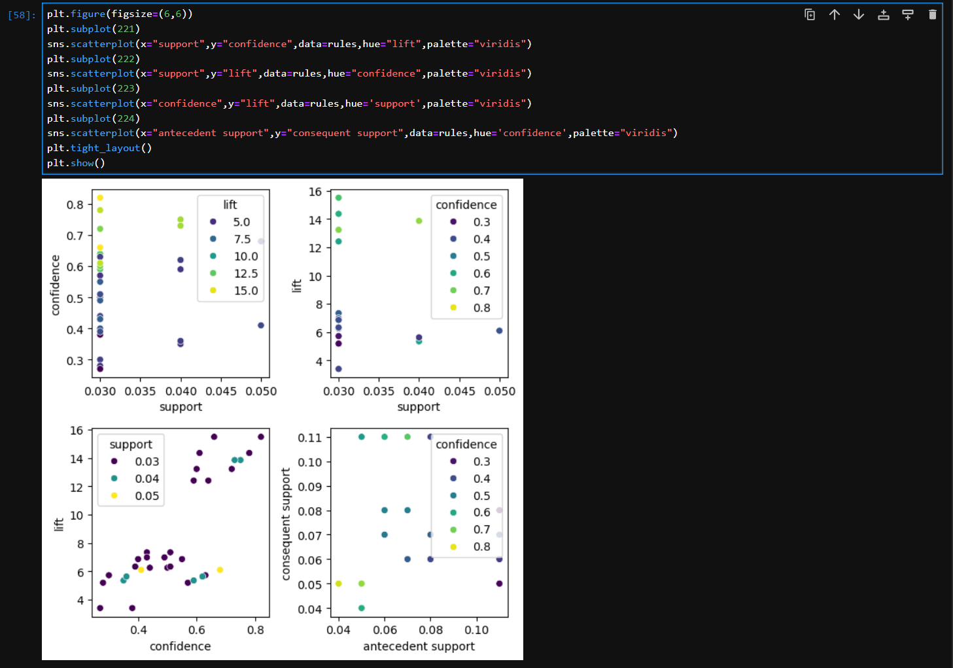
Step 8: Association Rules Visualization
This set of scatter plots visualizes association rule metrics (support, confidence, lift) using seaborn
Key Findings:
Support vs. Confidence shows clusters around 0.03-0.05 support and 0.3-0.8 confidence, with lift peaking at 15.0.
Support vs. Lift highlights lifts up to 15.0 with support around 0.03-0.05.
Confidence vs. Lift indicates higher lifts (up to 15.0) with confidence between 0.3 and 0.8.
Insight: High lift with moderate support and confidence suggests valuable rule combinations for targeted marketing.
Figure 8: Association Rules Visualization

Slide 15
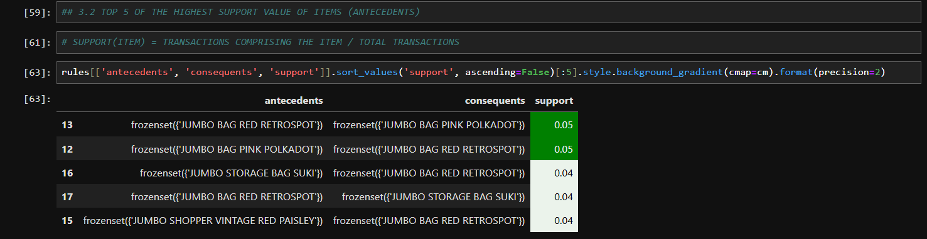
Step 9: Frequent Itemsets with Highest Support
The styled table lists the top 5 item antecedents with the highest support values, created using pandas
Key Findings:
JUMBO BAG RED RETROSPOT with JUMBO BAG PINK POLKADOT and vice versa both show a support of 0.05.
JUMBO STORAGE BAG SUKI and JUMBO SHOPPER VINTAGE RED PAISLEY with JUMBO BAG RED RETROSPOT each have a support of 0.04.
Insight: High support for jumbo bag combinations indicates frequent co-purchases, ideal for bundle promotions.
Figure 9: High Support Items

Slide 16
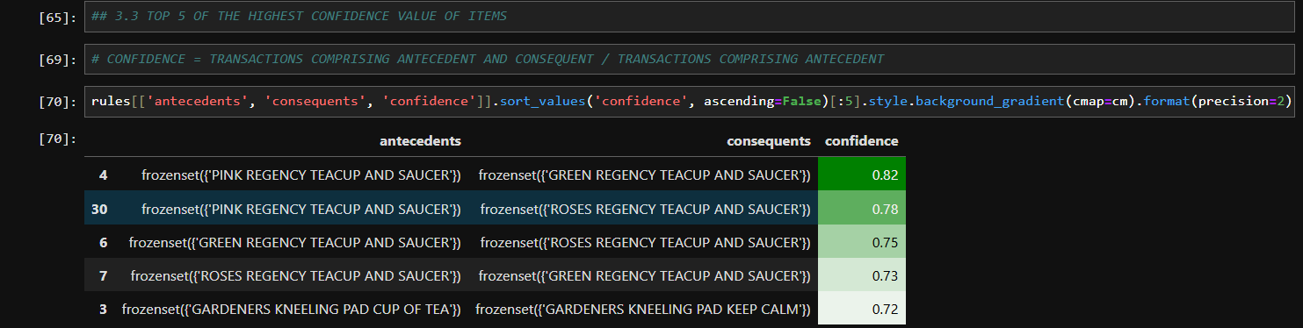
Step 10: Best Combinations by Confidence
The styled table lists the top 5 item combinations with the highest confidence values, created using pandas
Key Findings:
PINK REGENCY TEACUP AND SAUCER with GREEN REGENCY TEACUP AND SAUCER leads with a confidence of 0.82.
PINK REGENCY TEACUP AND SAUCER with ROSES REGENCY TEACUP AND SAUCER shows a confidence of 0.78.
GARDENERS KNEELING PAD CUP OF TEA with GARDENERS KNEELING PAD KEEP CALM has a confidence of 0.72.
Insight: High confidence in teacup and pad combinations highlights strong buying patterns for bundled offerings.
Figure 10: High Confidence Items

Slide 17
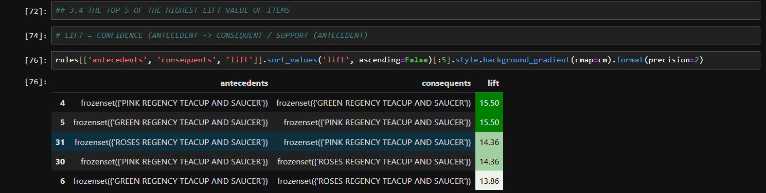
Step 11: Best Combinations by Lift
The styled table lists the top 5 item combinations with the highest lift values, created using pandas
Key Findings:
PINK REGENCY TEACUP AND SAUCER with GREEN REGENCY TEACUP AND SAUCER leads with a lift of 15.50.
GREEN REGENCY TEACUP AND SAUCER with PINK REGENCY TEACUP AND SAUCER also shows a lift of 15.50.
ROSES REGENCY TEACUP AND SAUCER with PINK REGENCY TEACUP AND SAUCER has a lift of 14.36.
Insights: Exceptional lift in teacup combinations indicates strong association, perfect for targeted cross-selling.
Figure 11: High Lift Items

Slide 18
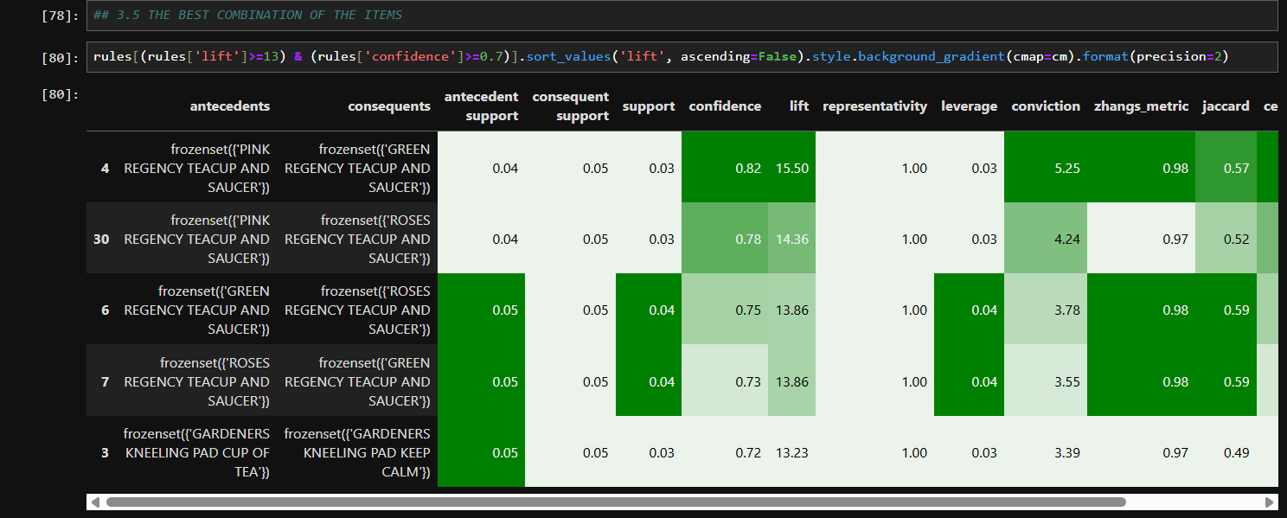
Step 12: Best Combinations of Items
This heatmap visualizes the strength of association between antecedents and consequents, created using seaborn
Key Findings:
Strongest associations (darker shades) appear between PINK REGENCY TEACUP AND SAUCER and GREEN REGENCY TEACUP AND SAUCER.
GARDENERS KNEELING PAD KEEP CALM and GARDENERS KNEELING PAD CUP OF TEA show notable association strength.
Weaker associations (lighter shades) are seen with items like JUMBO BAG RED RETROSPOT and other consequents.
Insights: High association strength in teacup and pad pairs highlights key opportunities for bundled marketing.
Figure 12: Combination Items

Slide 19
Recommendations Based on Analysis
Promote Teacup Bundles: Leverage high-lift and confidence associations (e.g., PINK and GREEN REGENCY TEACUP AND SAUCER) with bundled offers to boost cross-selling, especially in the UK market.
Highlight Top Sellers: Feature PAPER CRAFT, LITTLE BIRDIE and WHITE HANGING HEART T-LIGHT HOLDER prominently on the website or store, given their high purchase frequency and sales value.
Target Q4 Campaigns: Intensify marketing in October and November, capitalizing on the peak sales trend (e.g., 1.4M in November) to maximize holiday season revenue.
Optimize Inventory: Stock up on high-demand items like REGENCY CAKESTAND 3 TIER and GARDENERS KNEELING PADS to meet seasonal surges and frequent co-purchase patterns.
Encourage Customer Loyalty: Offer discounts to top-spending customers (e.g., ID 14646) to retain high-value buyers contributing over £100k each.

Slide 20

Thank you for reviewing my project!

