Slide 1
An introduction to cyber security for board members
Notes:
This presentation gives a brief introduction to cyber security for board members who don’t have much background in the topic or who perhaps aren’t sure how much they do know.
We’ll explain what cyber security is and dispel some common myths. There’s a brief case study of a cyber incident to help bring the information to life.
We also look at some headline figures about how cyber security is being tackled across a range of organisations.

Slide 2

Helping to make the UK the safest place to live and work online
The NCSC:
Understands cyber security and distils this knowledge into practical guidance that we make available to all.
Responds to cyber security incidents to reduce the harm they cause to organisations and the wider UK.
Uses industry and academic expertise to nurture the UK's cyber security capability.
Reduces risks to the UK by securing public and private sector networks.
Notes:
To set the scene, it’s helpful to understand what the National Cyber Security Centre is and what we do.
The NCSC was set up in October 2016 bringing together various parts of government.
We’re not a regulator but the UK’s technical experts in cyber security.
As you’ll see from our logo at the top of the slide, we’re a part of GCHQ.
NCSC’s strapline is ‘helping to make the UK the safest place to live and work online’ and this defines everything we do.
Our website at www.ncsc.gov.uk is full of information and guidance aimed at audiences from the general public to cyber security professionals.

Slide 3
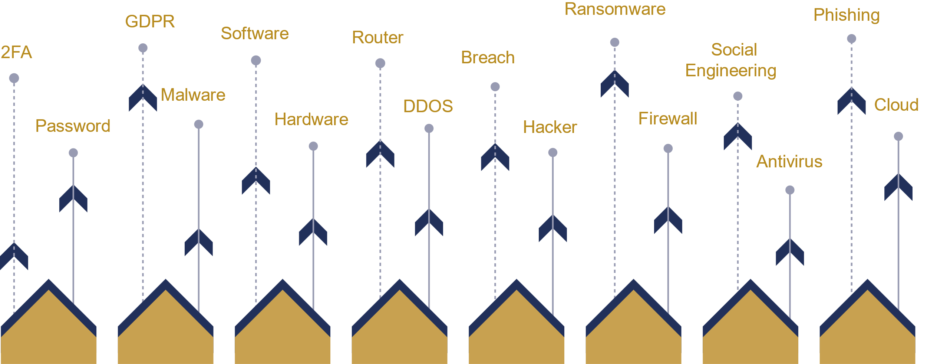
What is cyber security?
Notes:
We recognise that some board members may not feel confident about their knowledge of cyber security.
Indeed, the very term 'cyber security' isn't always well understood. So for starters, here are some of the many words associated with the topic.

Slide 4


Cyber security: a definition
“Cyber security is how individuals and organisations reduce the risk of cyber attack.
Cyber security's core function is to protect the devices we all use (smartphones, laptops, tablets and computers) and the services we access - both online and at work - from theft or damage.
It's also about preventing unauthorised access to the vast amounts of personal information we store on these devices, and online.”
Notes:
There are different definitions of cyber security but let’s look at the one from NCSC’s website: (see https://www.ncsc.gov.uk/section/about-ncsc/what-is-cyber-security )
“Cyber security is how individuals and organisations reduce the risk of cyber attack.
Cyber security's core function is to protect the devices we all use and the services we access - both online and at work - from theft or damage.
It's also about preventing unauthorised access to the vast amounts of personal information we store on these devices, and online”.

Slide 5

Cyber security: myths and reality
Cyber security is too complex for me to understand.
Cyber attacks are sophisticated. We can’t stop them.
Cyber attacks are highly targeted. Our organisation is unlikely to be interesting and/or valuable enough to attackers.
Notes:
There are some common myths about cyber security that we’d like to dispel because these can really hold people back from engaging with the topic.
1. Cyber security is too complex for most people to understand.
The reality is that you don't need to be a technical expert to make informed cyber security decisions.
After all, we make general security decisions every day without understanding all the details.
In our home life, for example, we don’t need to know how a house alarm works to decide whether to put it on when we go out.
And boards regularly make financial decisions without needing to know the details of every account or invoice. This principle extends to cyber security: the board should rely on its technical experts to provide the insight they need to then make informed decisions about managing cyber risk.
2. Cyber attacks are sophisticated: there’s little anyone can do to stop them.
In fact, the majority of attacks are still based upon well-known techniques such as phishing emails for example, many of which can be defended against, so taking a methodical approach to cyber security and enacting relatively small changes can greatly reduce an organisation’s risk.
That said, some threats can be very sophisticated, perhaps using advanced methods to break into extremely well defended networks, but we normally only see this level of expertise and tenacity in attacks by nation states.
3. Cyber attacks are highly targeted and people assume that their organisation is unlikely to be of interest to attackers.
Actually, the majority of cyber attacks are opportunistic and untargeted, with the perpetrator seeking to take advantage of a vulnerability in a system without being particularly interested in whose system it is.
The WannaCry ransomware attacks in May 2017 are a good example of this. They had a huge impact on organisations across the globe, including on parts of the NHS. The attack worked by exploiting a weakness in Microsoft operating systems that needed patching, but not all users had done so, some because they were using systems that were too old.
This shows that untargeted attacks can be just as damaging as targeted ones. And it’s worth noting that untargeted attacks are unlikely to stop any time soon because every organisation has some value to an attacker even if that is simply the money it might pay if faced with a ransomware demand.
(Note: There is also this brief video on WannaCry that might help: https://youtu.be/uahiEldI7YA)

Slide 6

British Library Cyber Attack: The Impact
Costs unconfirmed but expected to fall well into seven figures
Computerised catalogue offline for more than 2 months​
50% of physical collection inaccessible months later
Enquiries system and chat services severely disrupted​
​
Digitisation activities put on hold, impacting partnership projects and commercial income​
Notes:
That’s some of the background to cyber security. Let’s now look at an example of a real cyber incident and its impact.
On October 28, 2023, the British Library was hit by a significant ransomware attack. The Rhysida ransomware gang claimed responsibility for the attack, which compromised the majority of the Library's online systems. Data was stolen, servers were encrypted or destroyed, and all users were locked out of the network. The outage affected their website, online systems and services, as well as some onsite services.
The ICO and other relevant regulatory and law enforcement bodies were notified and the British Library communicated with users and staff about the disclosure of their personal data. NCSC provided advice on protecting affected individuals' data.
What was the impact on the British Library?
The costs are unconfirmed but expected to fall well into seven figures
The computerised catalogue was offline for more than 2 months
Approximately 50% of the total physical collection was inaccessible months later.
The enquiries system and chat services were severely disrupted.
Digitisation activities were put on hold, impacting partnership projects and commercial income.
Staff members access to the collections was severely limited.
The British Library have kindly published a paper detailing the cyber-attack to aid other organisations in their preparation and protection against such attacks. You can download here: british-library-cyber-incident-review-8-march-2024.pdf (bl.uk)

Slide 7
"It felt like it was an act of vandalism as well as theft.
We have significant lessons to learn about matters such as our historic reliance on a complex legacy infrastructure, which affected our ability to restore services as quickly as we would have wished, and the varying effectiveness of different security measures across our digital estate."
Chief Executive, Sir Roly Keating.
Notes:
Sir Roy Keating the Chief Executive of the British Library said:
'It felt like it was an act of vandalism as well as theft.
We have significant lessons to learn about matters such as our historic reliance on a complex legacy infrastructure, which affected our ability to restore services as quickly as we would have wished, and the varying effectiveness of different security measures across our digital estate."
All boards, can learn from this and should take away the following:
Develop a heightened awareness of the evolving cybersecurity landscape and the potential risks faced by the organisation
Adopt effective risk management strategies and board oversight to ensure the organisation's cybersecurity resilience.
Boards should make it a priority to have a regularly tested incident management plan in place, involving relevant internal and external stakeholders, including board members, to effectively handle cybersecurity incidents.
It is essential to take into account not only the individual risks but also the cumulative risks that may arise from a cyber-attack. This comprehensive assessment will enable a better understanding of the potential impacts and help in devising effective strategies to mitigate and manage the overall risks associated with the cyber-attack.

Slide 8
Cyber security as a board level responsibility
  Nearly all organisations depend on digital technology to function.
  The potential cost of remedying a cyber incident can be significant.
  The risk of reputational damage.
  Cyber security is therefore essential and needs to be understood as an enabler.
Notes:
To put it plainly, if your organisation is connected to the internet then it is exposed to cyber risk. And regulations such as GDPR make it clear that cyber security is not the responsibility of an individual but of the whole organisation.
This means that the board of directors, as the effective governing body of a company, has collective accountabilty for cyber security.
Beyond that, there are three inter-related reasons that board members need to take cyber security seriously.
1. Nearly all organisations depend on digital technology to function.
It’s worth considering how well your organisation could operate if, for example, it lost access to all the data that's held electronically, or if computers and other networked devices simply couldn't connect to the internet.
2. The potential cost of remedying a cyber incident
There are different facets to this. There is often a cost in terms of lost business but there’s also the financial impact of having to repair and clean up after a cyber incident. This cost varies significantly but in general, the larger the organisation, the larger the bill. If there has been a data breach, then there’s also the risk of a significant fine from the ICO.
3. The risk of reputational damage
It’s worth asking a few questions here such as:
Would customers still use you if your services had been offline for a significant period of time?
Would they continue to choose you over your competitors if you had had a well-publicised data breach?
Would a major incident affect relationships with those in your supply chain?
Taken together it’s clear that cyber security is essential and needs to be understood as an enabler as it enables organisations to function.
In other words, cyber security:
isn’t something that can be considered ‘just an IT issue’
It’s not a ‘nice-to-have’, perhaps something that can be indefinitely parked
Isn’t something that any one board member can assume is being looked at by someone else

Slide 9
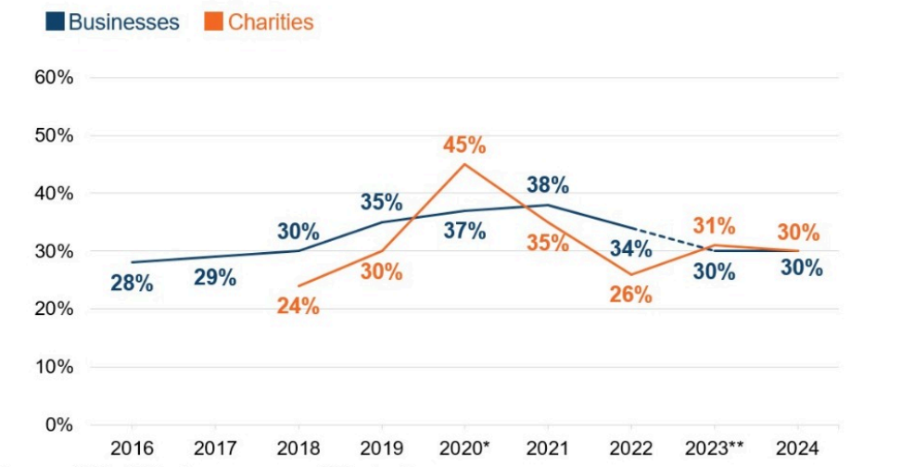
Organisations with board members taking on cyber security responsibilites
Cyber security breaches survey 2024 - GOV.UK (www.gov.uk)
Notes:
So how are boards across the UK addressing these challenges?
Every year the Department of Science Innovation and Technology (DSIT) runs a detailed survey of organisations’ approaches to cyber security and their experience of cyber incidents.
This table from the 2024 report shows the percentage of organisations with a board member or trustee with cyber responsibilities.
Three in ten businesses (30%) have board members or trustees taking explicit responsibility for cyber security as part of their job. Board-level responsibility is much more common in larger businesses, where the management board is likely to be larger. Around two-thirds of large businesses (63%) have a board member responsible for cyber security.
Large businesses are also more likely to have a formal cyber security strategy. With 66% large business and 58% medium businesses having one in place.

Slide 10
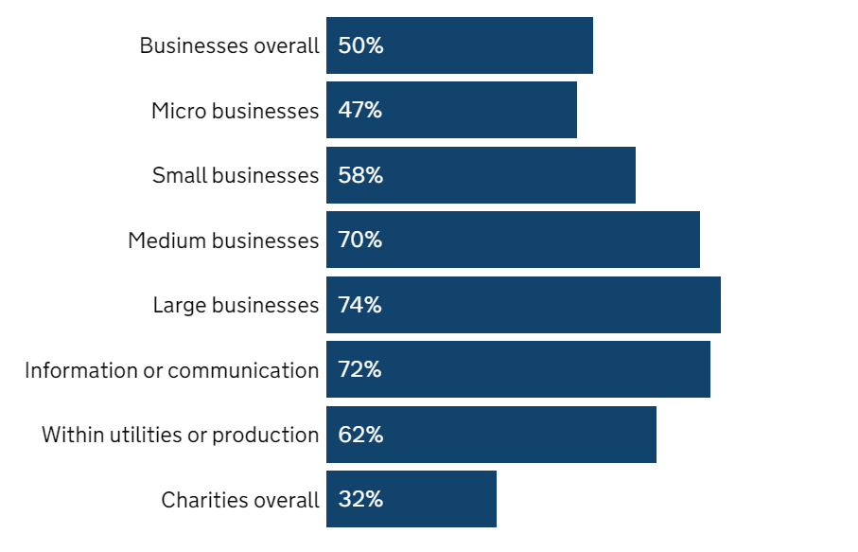
Organisations identifing breaches or attacks in last 12 months
Cyber security breaches survey 2024 - GOV.UK (www.gov.uk)
Notes:
The survey also looked at data breaches or attacks. Half of businesses (50%) report having experienced a cyber security breach or attack in the last 12 months
It’s also interesting to look at the types of incident experienced.
Among the organisations identifying breaches or attacks, just under half (46% of these businesses) say they have only experienced phishing attacks and no other kinds of breaches or attacks. Among organisations identifying any breaches or attacks, medium and large organisations are more likely to report:
phishing attacks (91% of large businesses and 88% of medium businesses vs 84% overall)
impersonation (80% and 67% respectively, vs. 35% overall)
malware (40% of large businesses, vs. 17% overall)
unauthorised access by people within the organisation (14% of large businesses, vs. 1% overall)
unauthorised access by people outside the organisation (7% of large businesses, vs. 1% overall)

Slide 11
Next steps:
The Cyber Security Toolkit for Boards:
Helping board members get to grips with cyber security.
Notes:
Wherever your organisation is on its cyber security journey, the NCSC’s Cyber Security Toolkit for Boards can help board members get to grips with the topic. It’s available online, just search for ‘NCSC Board Toolkit’. We’ve also got another presentation that introduces the toolkit and how it can be used. Boards have a crucial role to play in ensuring the resilience of the organisation and the toolkit provides them with the tools and resources to enable them to govern cyber risk more effectively.

