Slide 1
Introducing the Cyber Security Toolkit for Boards:
Helping board members get to grips with cyber security
https://www.ncsc.gov.uk/board-toolkit
Notes:
(Note for presenters: text in bold throughout the presentation indicates where the text relates to a specific line on the slide and/or an animation).
This presentation introduces the NCSC’s Cyber Security Toolkit for Boards which is freely available and designed to meet the needs of boards of medium and large organisations and in all sectors.
We start by focusing on boards’ roles and responsibilities for cyber security and then move onto the toolkit itself, showing how board members can work with their key staff to seek assurance and, where relevant, to help drive change in their organisation’s cyber resilience.
As this presentation is an introduction to the toolkit, we’ll be looking at its structure and themes rather than the detail of it. We don’t assume any detailed technical knowledge in what we cover today, not least because the toolkit itself is designed to be useful to everyone, no matter what their starting point with cyber security.

Slide 2
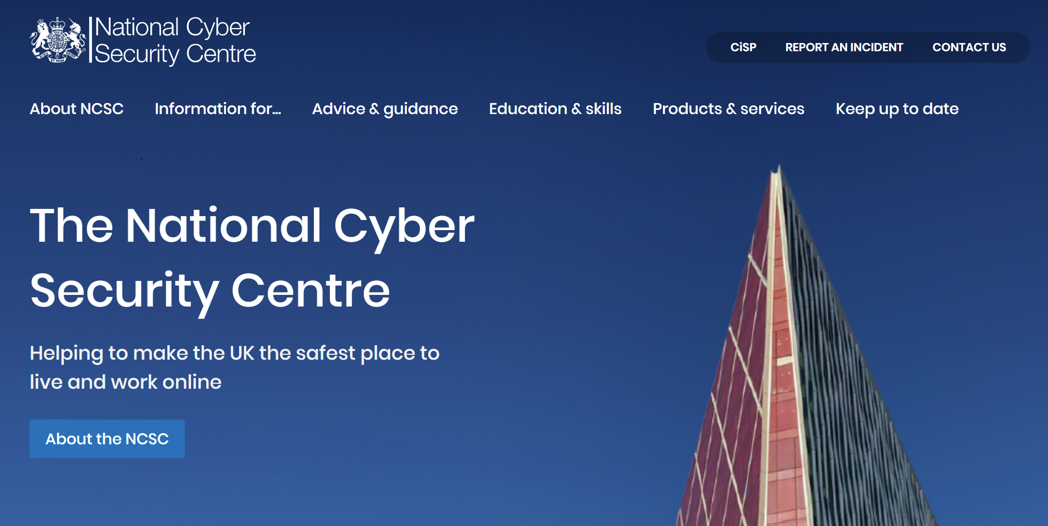
Helping to make the UK the safest place to live and work online
The NCSC:
Understands cyber security and distils this knowledge into practical guidance that we make available to all.
Responds to cyber security incidents to reduce the harm they cause to organisations and the wider UK.
Uses industry and academic expertise to nurture the UK's cyber security capability.
Reduces risks to the UK by securing public and private sector networks.
Notes:
(Note for presenters: if combining presentations, it is worth noting that slide is also included in slide deck 1).
--
To set the scene, it’s helpful to understand what the National Cyber Security Centre is and what we do.
The NCSC was set up in October 2016 bringing together various parts of government.
We’re not a regulator but the UK’s technical experts in cyber security.
As you’ll see from our logo at the top of the slide, we’re a part of GCHQ.
NCSC’s strapline is ‘helping to make the UK the safest place to live and work online’ and this defines everything we do.
Our website at www.ncsc.gov.uk is full of information and guidance aimed at audiences from the general public to cyber security professionals.

Slide 3

Cyber security as a board level responsibility
  Nearly all organisations depend on digital technology to function
  The potential cost of remedying a cyber incident can be significant
  The risk of reputational damage
Cyber security is therefore essential and needs to be understood as an enabler.
Notes:
(Note for presenters: if combining presentations, it is worth noting this slide is also included in slide deck 1).
We now look at why cyber security is a board level responsibility.
To put it plainly, if your organisation is connected to the internet then it is exposed to cyber risk. Critically for the Board, responsibility for incidents or data breaches sits with the organisation and not an individual.
This means that the board of directors, as the effective governing body of a company, has collective responsibility for cyber security.
Beyond that, there are three inter-related reasons that board members need to take cyber security seriously.
1. Nearly all organisations depend on digital technology to function.
It’s worth considering how well your organisation could operate if, for example, it lost access to all the data that's held electronically, or if computers and other networked devices simply couldn't connect to the internet.
2. The potential cost of remedying a cyber incident
There are different facets to this. There is often a cost in terms of lost business but there’s also the financial impact of having to repair and clean up after a cyber incident. This cost varies significantly but in general, the larger the organisation, the larger the bill. And as we’ve seen in the case of TalkTalk, if there has been a data breach then there’s also the risk of a significant fine from the ICO.
3. The risk of reputational damage
It’s worth asking a few questions here such as:
Would customers would still use you if your services had been offline for a significant period of time?
Would they continue to choose you over your competitors if you had had a well-publicised data breach?
Would a major incident affect relationships with those in your supply chain?
Taken together it’s clear that cyber security is essential and needs to be understood as an enabler as it enables organisations to function.
In other words, cyber security:
isn’t something that can be considered ‘just an IT issue’
It’s not a ‘nice-to-have’, perhaps something that can be indefinitely parked
Isn’t something that any one board member can assume is being looked at by someone else

Slide 4

The Cyber Security Toolkit for Boards: the basics
Guidance to support board members get up to speed on a topic they may or may not be familiar with
Designed primarily for corporate boards but relevant to any board in any sector
(e.g. school governors, charity trustees).
Available online.
Pdf can be downloaded for those who prefer a hard copy
Notes:
The background to us creating this resource is that board members told us that whilst they had the skills and knowledge to ask second- and third- level questions on issues such as finance and risk, they didn’t always feel qualified to discuss cyber security. Perhaps they weren’t quite sure what they should be asking or what sort of answers they should be expecting to their questions and so this is what we have sought to address.
The toolkit can be seen as guidance to support board members get up to speed on a topic they might not be familiar with. It’s effectively a quality assured reference library for you to dip in and out of. It introduces key cyber security topics and explains why these are important to every organisation.
The toolkit was originally conceived to meet a need identified from large corporate organisations such as FTSE 350 companies, but we soon realised that the key messages are pertinent to boards of all shapes and sizes such as charity trustees, perhaps, or school boards of governors.
Board members had also told us that they are quite often overwhelmed with paperwork and would prefer to access a resource like this online so that’s what we’ve produced. This also means that we can easily edit it and add to the toolkit over time. Some people like a hard copy to work through so there is a pdf of the toolkit to download from the website if you’d prefer.

Slide 5

How the toolkit can help
  Enabling board members to ‘get just a little bit technical’
  Supporting board members in asking the right questions to gain assurance on cyber security
  Encouraging crucial conversations to take place between the board and its key staff
Notes:
There are three main aims of the toolkit:
1. Enabling board members to get ‘just a little bit technical’.
We recognise that few board members are cyber security experts so the toolkit is written in a way that enables them to learn about key issues as they go. We’re not asking anyone to become a technical specialist but to learn enough to be able to have fluent conversations with those who are.
2. Supporting board members in asking the right questions to gain assurance on cyber security.
We understand that board members’ role is a strategic one and so they need to be confident that the organisation has a high-level and integrated approach to cyber security and that this is being enacted. The toolkit therefore focuses on how board members can seek assurance on and, where relevant, how they can drive change. We do this through the provision of questions they might want to ask, and suggestions of the answers they might hear.
3. Encouraging crucial conversations to take place between the board and its key staff
We know that the best way to improve cyber security in any organisation is to talk about it, and the toolkit gives board members a framework for these conversations.

Slide 6

What the toolkit isn’t
  A ‘how to’ guide
  A checklist
  A manual telling you how to achieve a one-off task
Notes:
It’s also important to clarify what the toolkit isn’t and why that’s the case.
First, the toolkit isn’t a ‘quick fix’ or a ‘how to do cyber security’ guide.
We haven’t provided you with a checklist of actions to complete.
Nor is the toolkit a manual that an organisation can work through and then consider the topic dealt with.
There are several reasons why this is the case but largely it’s because what ‘good’ cyber security looks like will be different for every organisation. It will depend on the nature of their business, the sector they are operating in, the organisation’s size, and how dependent they are on networked services and data. Crucially, it will also depend on that organisation’s risk appetite, something that has to be discussed and decided upon by the board.
Also important is that cyber security, like with any aspect of risk management, is an iterative and continual process. Any organisation needs to regularly review how the threat they face is changing and assess the effectiveness of the current measures they already have in place.
The key message is therefore that when it comes to cyber security, there is no ‘one size fits all’. Boards need to manage the risks of cyber security in a way that works for them and for their business. This approach also extends to making a decision about which sections of the toolkit to prioritise and which may be less pressing.

Slide 7

Toolkit structure
Introduction to cyber security
Nine core modules
Cyber Security Regulation in the UK
Notes:
We now look at how the toolkit is structured.
Introduction to cyber security.
This gives some background information on threats, vulnerabilities and how attacks work, for example. It’s useful background to get up to speed with the general themes of cyber security and some readers might find out they know more than they thought they did.
Nine core modules
Then there are nine core modules on specific cyber security topics such as risk management and planning for incidents. We’ll see the list of these in a moment.
For each of module we provide:
a summary of the module that explains what it is, and why it’s important
essential activities for the organisation' covering the good practices boards should expect to see in the organisation
‘indicators of success’ - a series of questions with possible answers that boards can use to help evaluate your organisations performance
Cyber Security Regulations
Finally we summarise the relevant cyber security regulations that boards need to be aware of.

Slide 8
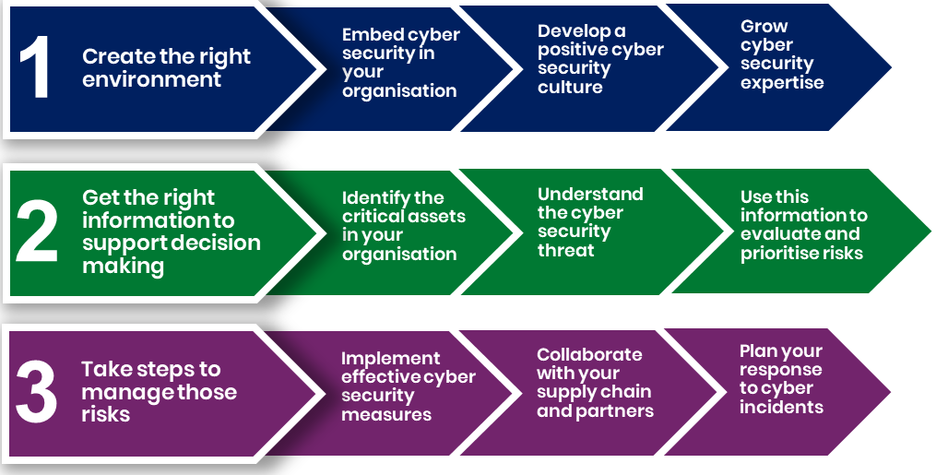
Toolkit modules
Notes:
As mentioned, there are nine modules that make up the core of the toolkit: nine key cyber security topics.
Organisations should create the right environment so that cyber security can flourish by:
• Embedding cyber security in your organisation
• Developing a positive cyber security culture
• Growing cyber security expertise
They then need to get the right information to support decision making, by:
• Identifying the critical assets in your organisation
• Understanding the cyber security threat
• Use this information to evaluate and prioritise risks
This allows them to take steps to manage those risks:
• Implementing effective cyber security measures
• Collaborating with your supply chain and partners
• Planning your response to cyber incidents
As the toolkit is modular you really don’t need to work through it in order.
In fact, we invite you not to, but instead to prioritise the areas that are most pressing for your organisation.

Slide 9


The questions
Each module concludes with questions
Designed to help evaluate your organisations performance and help prompt discussion at board level
The questions don’t always have easy answers
Notes:
Feedback shows that for most users, what has made the toolkit particularly useful is the questions given at the end of every module in the ‘indicators of success’ section.
The questions (and suggested answers) have proved so popular that there is now a separate document of these available for board members to download.
The questions pull together the information given in each module and show how to apply this to your organisation. In other words, the questions make the toolkit actionable. You’ll see some examples of the questions on the next slide.
There is an important point about the questions, they don’t always have easy answers!
We’ve talked about how effective cyber security is about applying principles to your own organisation and making decisions in light of your own priorities. This means that we can’t give ‘right’ answers to each of the questions. What we can do is suggest a range of answers that you might expect to hear.
In fact, sometimes the ‘answers’ given are actually more like follow-on questions. This is because we know that the conversations the questions lead to are often as important as the answers.

Slide 10
Sample questions on ‘planning response to incidents’
Does your organisation have an incident response plan in place and do you regularly exercise it?
Does every board member understand what's required during an incident?
Are cyber incidents considered in the design of your Disaster Recovery (DR) and Business Continuity Plans (BCP)?
As an organisation, do we know where we can go for help in an incident?
Notes:
These are an example of the questions that are included in the board toolkit.
These relate to the ninth and final module, ‘planning your response to cyber incidents’.
Cyber security incidents can have a huge impact on an organisation in terms of cost, productivity, reputation and loss of customers. Being prepared to detect and quickly respond to incidents is paramount to prevent the attacker from inflicting further damage, reducing the financial and operational impact.
When thinking about planning your response to cyber incidents:
One of the issues we suggest board members will want to seek assurance on is that there is incident response plan in place and that it has been exercised. The board should expect to see reporting on the exercise conducted and lessons learned.
Board members must also consider their own responsibility, whether they understand their personal role in an incident and whether they’ve had training to support them to make decisions potentially out of hours, and under time pressures.
A ransomware attack could compromise the availability of assets in a similar way to a fire, flood, or theft, and recovery in all these cases will depend on some combination of contingency plans, alternative sites, and backup systems.
An incident response plan covers the immediate response to a cyber-attack:
a BCP addresses how your organisation will continue to operate
a DR plan details how your organisation will get systems up-and-running
It’s important to know where to go to in the event of an incident. That may be NCSC Certified Incident Response companies, the NCSC Incident Management team, or if you believe you have been the victim of online fraud, via ActionFraud.

Slide 11
How is the toolkit being used so far?
As the basis for a ‘deep dive’ into two modules at a board away day
Providing a starting point to enable board members to ask key staff reporting to the board questions on cyber security
Particular modules looked at in detail at a sector-specific governance session:
Representatives from different organisations sharing their experiences and approach in a closed environment
Internal auditors using some of the questions as part of their audits
Notes:
You’ll have got the sense that there’s a lot of information in the toolkit and a lot of questions the board members might want to ask in due course, so what’s the best way to get started?
Here are a few examples of how the toolkit has been used so far.
1. As the basis for a ‘deep dive’ looking at two modules at a board away day with the Deep Dive - We’ve seen Boards take two of the modules that they see as most pressing and use them as a basis for a Board 'away day' usually with a technical report by an expert that can be considered, then all the issues raised in that module discussed in the away day. ‘Briefing pack 3’ will help facilitate these discussions
2. Starting point: the key message from the toolkit is that board members are able discuss cyber security with key staff, and understand the right questions to ask. The board toolkit supports the board by providing the questions to gain a good understanding of the cyber risk profile of the organisation.
3. Some organisations choose to collaborate on cyber security despite being competitors. We know that some trade bodies, have got members together to discuss ways different companies are meeting cyber security challenges so they are able to learn from each other. Good cyber security practice across a sector benefits everyone within in.
4. Finally, we’ve had a number of internal auditors looking at the toolkit and selecting the questions they feel are most relevant.
5. Please also see the bite sized videos of the board toolkit modules which will provide an insight into the role boards play in fostering the resilience of their organisation.

Slide 12
The Cyber Security Toolkit for Boards:
Helping board members get to grips with cyber security.
https://www.ncsc.gov.uk/board-toolkit
Notes:
This brings us to the end of this introduction to the Cyber Security Toolkit for Boards. Do take some time to explore the toolkit online and see the supporting resources we’ve got for it.

