Slide 1

Project Title - Seasonal Agriculture Performance Analysis
Student Name- Shardul Ananda Jadhav
College Name- Nutan Maharashtra Institute of Engineering and Technology (NMIET)
AICTE STU ID : STU6a61d929b4a971784797481

Slide 2

PROBLEM STATEMENT
Agricultural performance varies across seasons due to differences in environmental conditions, farming practices, resource availability and market conditions.
The raw agricultural data does not clearly show:
How agricultural performance changes across seasons
Which seasonal patterns and trends are important
How resource usage differs between seasons
How environmental conditions relate to agricultural outcomes
How economic performance varies across seasons
Goal: Analyze the agricultural dataset to identify meaningful seasonal patterns, relationships, variations and data-driven insights that can support better agricultural planning.

Slide 3
PROJECT DESCRIPTION
This project analyzes the performance of agricultural activities across different seasons using farm-level data.
The analysis covers:
Seasonal and crop-wise performance
Environmental conditions such as rainfall, temperature and soil moisture
Fertilizer, pesticide, irrigation and water usage
Crop yield and production
Revenue, cost and profit
Disease and pest risk
Relationships between environmental, resource and economic variables
The project uses exploratory data analysis, statistical analysis and data visualization to identify meaningful seasonal patterns and support evidence-based agricultural planning.

Slide 4

WHO ARE THE END USERS?
Farmers
Understand seasonal crop performance
Compare resource usage
Support crop and irrigation planning
Agricultural Planners
Compare regional and seasonal performance
Identify important agricultural patterns
Agricultural Researchers
Study environmental and farming relationships
Investigate unusual seasonal variations
Government & Policy Stakeholders
Support evidence-based agricultural planning
Identify areas requiring further investigation

Slide 5

Technology Used
Programming Language
Python
Development Environment
Jupyter Notebook
Libraries
Pandas
NumPy
Matplotlib
Seaborn
SciPy
Techniques
Data Cleaning
Exploratory Data Analysis
Statistical Analysis
Correlation Analysis
Data Visualization
Seasonal Comparison
Dataset
Seasonal Agriculture Performance Dataset (CSV)

Slide 6
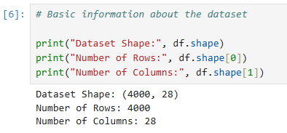
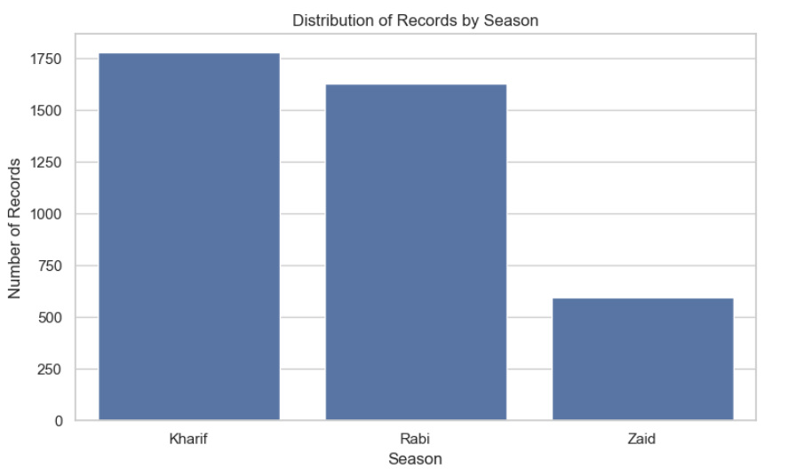
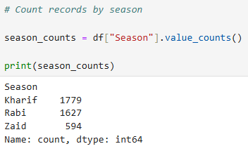
RESULTS
Distribution of Records by Season :
DATASET OVERVIEW :

Slide 7
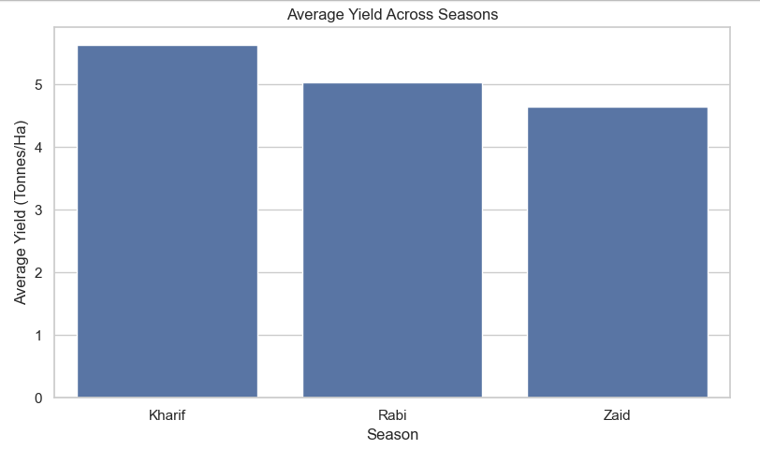
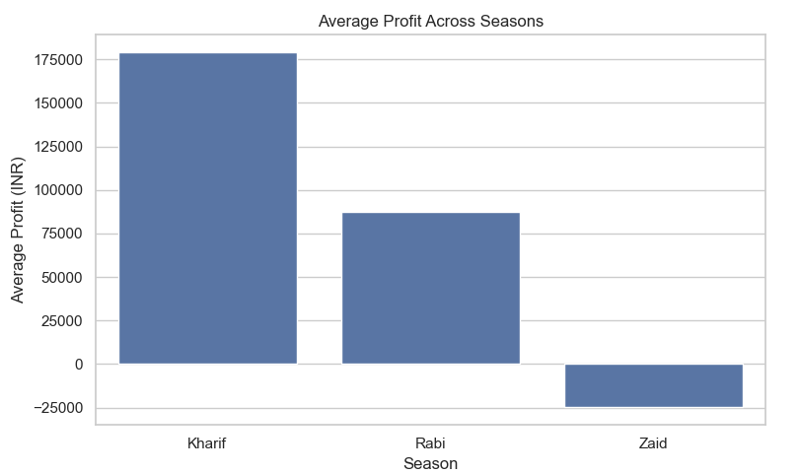
RESULTS
SEASONAL PERFORMANCE
Average Yield Across Seasons
Average Profit Across Seasons
Key Finding: Agricultural yield and profitability vary across seasons, indicating meaningful seasonal differences in agricultural performance.

Slide 8
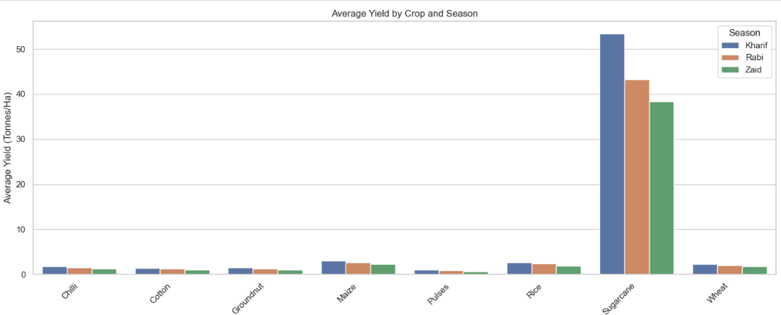
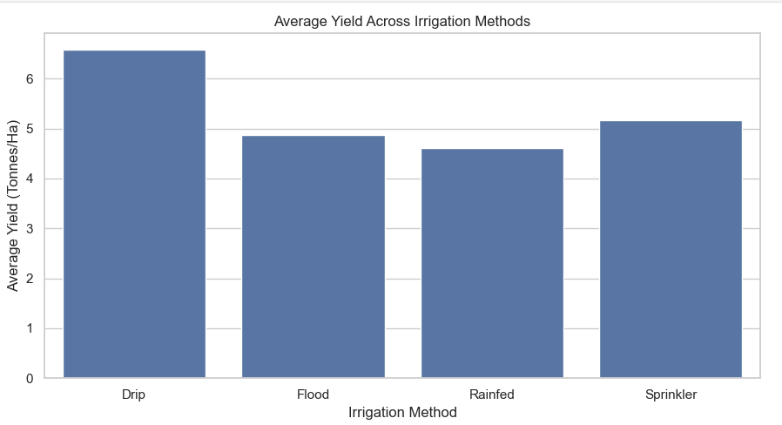
RESULTS
CROP AND IRRIGATION ANALYSIS
Average Yield by Crop and Season :
Crop performance differs across seasons, while irrigation methods also show differences in yield and water usage.
Average Yield Across Irrigation Methods :

Slide 9
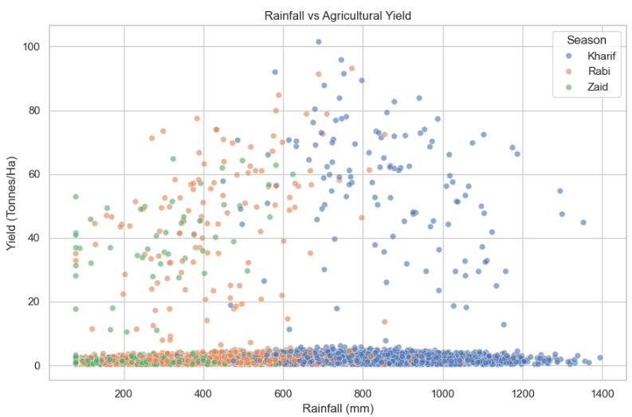
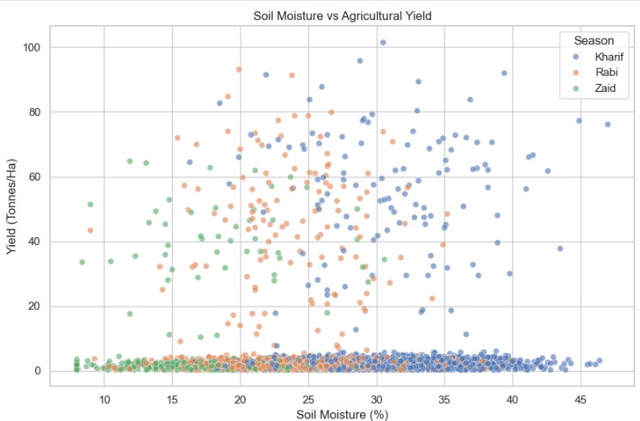
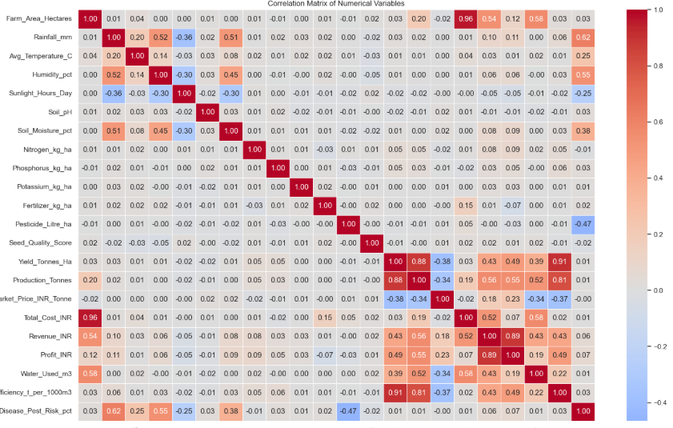
RESULTS
ENVIRONMENTAL AND RESOURCE ANALYSIS
Rainfall vs Yield :
Soil Moisture vs Yield
Correlation Heatmap
Environmental conditions such as rainfall and soil moisture show measurable relationships with agricultural performance, although these relationships should not be interpreted as proof of causation.

Slide 10
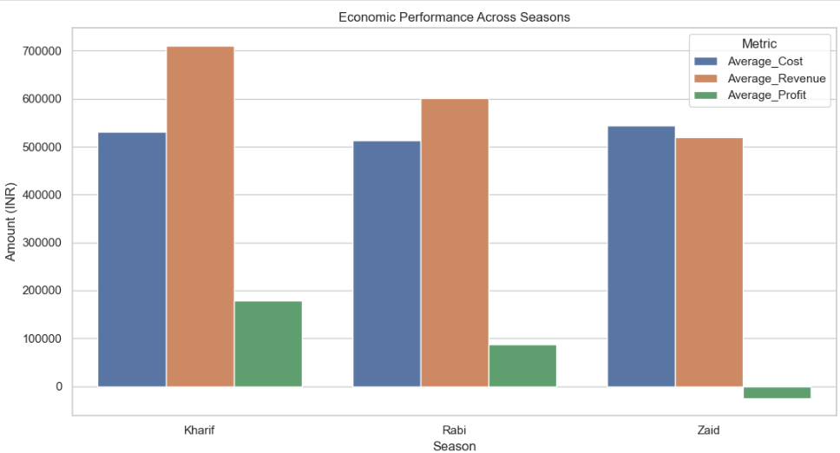
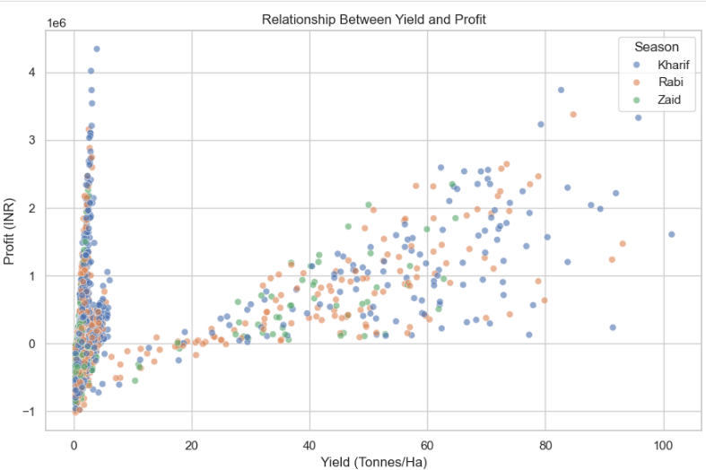
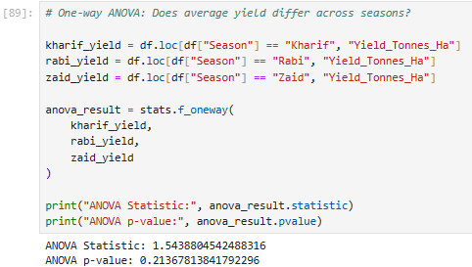
RESULTS
ECONOMIC AND STATISTICAL ANALYSIS
Economic Performance Across Seasons
Yield vs Profit
One-Way ANOVA – Seasonal Yield Comparison :
F-statistic = actual value p-value = actual value

Slide 11
Future scope
Use multi-year agricultural data to study long-term seasonal trends.
Build machine-learning models for crop yield prediction.
Develop crop recommendation based on season and environmental conditions.
Develop irrigation and water-use optimization models.
Add real-time weather and market-price information.
Develop an interactive dashboard for farmers and agricultural planners.
Perform deeper regional analysis using more detailed geographical data.

Slide 12
GitHub Link
https://github.com/ShardulJadhav8778/seasonal-agriculture-performance-analysis

Slide 13

VOIS Course completion certificate - Course name- Data Visualization

Slide 14
Thank you
Seasonal Agriculture Performance Analysis
.
.

