Slide 1


BUSINESS ANALYTICS · PRODUCT ANALYTICS · DECISION INTELLIGENCE
Customer 360°
& Product Growth
Intelligence
MEESHO MARKETPLACE
Consumers
Sellers
360°
INTELLIGENCE
Logistics
Content /
Discovery
A Meesho marketplace case study that connects customer value, revenue leakage, product behaviour and prioritised growth actions.
DATA → INSIGHT → ACTION
50,000 orders
10,000 customers
500 SKUs
Find the leak. Quantify the impact. Prioritise the fix.
Core stack
SQLite / SQL · Python / Pandas · Power BI / DAX · RFM / Cohorts · PRD / RICE
Case-study data period: Jan 2025 – Jan 2026

Slide 2
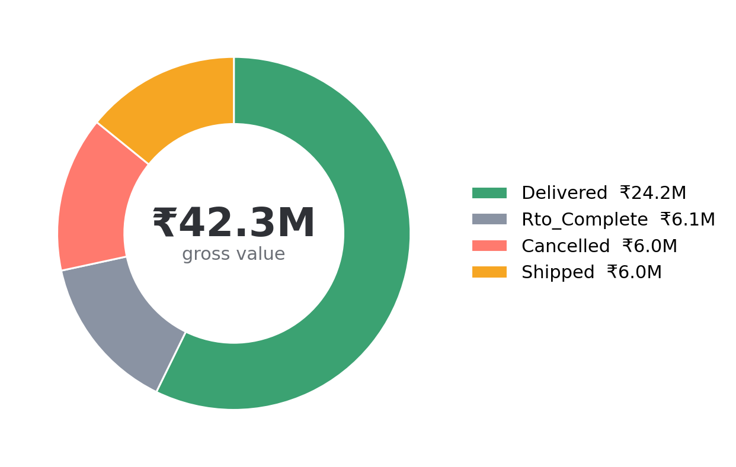
EXECUTIVE READOUT
The main problem is value leakage, not lack of demand.
The sample shows meaningful revenue tied up in RTO + cancellation, plus clear margin pressure from deep discounting.
GROSS VALUE
DELIVERED VALUE
RTO VALUE
CANCELLED VALUE
MODELED MARGIN
₹42.29M
₹24.20M
₹6.08M
₹6.02M
35.4%
50,000 marketplace orders
57.2% of gross value
14.38% of gross value
14.25% of gross value
Revenue less supplier cost after discount
1 · RTO is a material operational leak
₹6.08M of gross order value is tagged RTO in the sample. That is large enough to justify a targeted verification / address-quality intervention.
2 · Discounting has a measurable margin trade-off
Modeled gross margin falls from 43.4% at 0% discount to 23.9% in the 25–30% band.
3 · Customer value is concentrated
Champion + Loyal customers represent ~52% of transacting customers in the RFM file and ~₹29.05M of monetary value.

Slide 3
WHY MEESHO
A marketplace is a multi-sided system — customer value depends on the whole chain.
Public Meesho disclosures provide the operating context; this project uses synthetic customer-level data for the analytics case.
PUBLIC BUSINESS CONTEXT
ANALYTICS QUESTION
274M+
1.04M+
Where does marketplace growth
create — or destroy — value?
annual transacting users
annual transacting sellers
2.83B+
Customer
Who is valuable? Who is at risk?
placed orders · LTM to Jun 2026
Product
Which behaviours / features correlate with repeat?
Stakeholders visible in the business model
Operations
Where is value lost before delivery?
Consumers
Sellers
Logistics
Content creators
Growth
Which intervention should be prioritised?

Slide 4
SCOPE & DATA MODEL
One analytical layer connects customer, order, product and event data.
The design mirrors a Meesho-style marketplace: consumers, sellers, products, orders, behavioural events and operational outcomes.
CUSTOMERS
10,000
ORDERS
50,000
LINE ITEMS
70,032
customer profile · acquisition · RFM
order status · payment · city · pincode
SKU · category · units · revenue
PRODUCTS
500
EVENTS
150,000
RFM
9,933
price · discount · rating · stock
feature · device · session · conversion
recency · frequency · monetary
ANALYTICAL ARCHITECTURE
RAW FILES
WAREHOUSE
ANALYTICS
BI
DECISION
CSV / PBIX / docs
SQLite / SQL views
Python / Pandas / RFM
Power BI / DAX
Customer · Order · SKU · Session
The fact table is order-line grain; customer and product dimensions are joined for analysis.
Decision grain
Insight → PRD → Roadmap

Slide 5
DATA QUALITY
A senior analyst should flag what the data can and cannot support.
The project documentation identified two reconciliation gaps; the deck uses source CSVs as the primary quantitative basis.
CHECK
STATUS
WHAT THE SOURCE SUPPORTS
ANALYST TREATMENT
RTO definition
Supported
RTO = RTO_COMPLETE revenue / gross revenue → 14.38%
Good
Gross-to-status
Supported
Delivered + Shipped + Cancelled + RTO = gross → ₹42.29M
Good
COD share of RTO
Open issue
CSV shows ~20.2% of RTO revenue; a documented 68% planning assumption conflicts with the sample.
Recheck
Sequential funnel
Open issue
Feature events are independently generated per session; they should be treated as adoption signals, not a causal sequence.
Re-instrument
Retention cohorts
Supported with method change
Cohorts are based on first-order month because 2024 sign-ups precede the sales window.
Good
Analyst takeaway
I would not publish the 68% COD-attributed RTO figure or a sequential conversion funnel until the underlying event definitions are reconciled. The current deck keeps those as planning / instrumentation items.

Slide 6
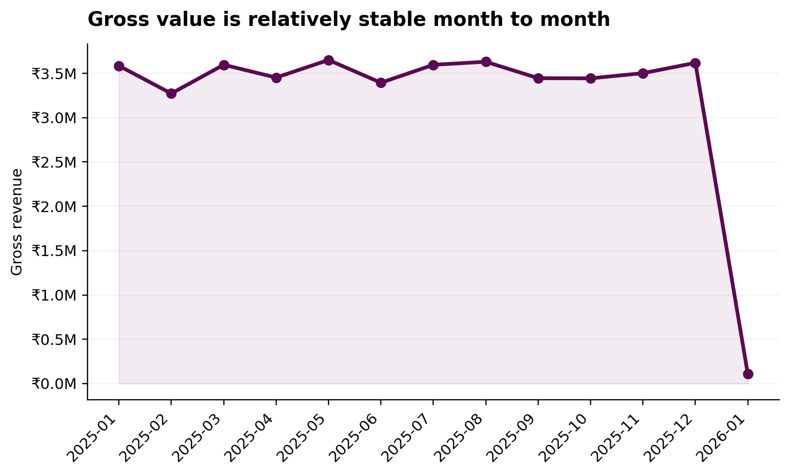
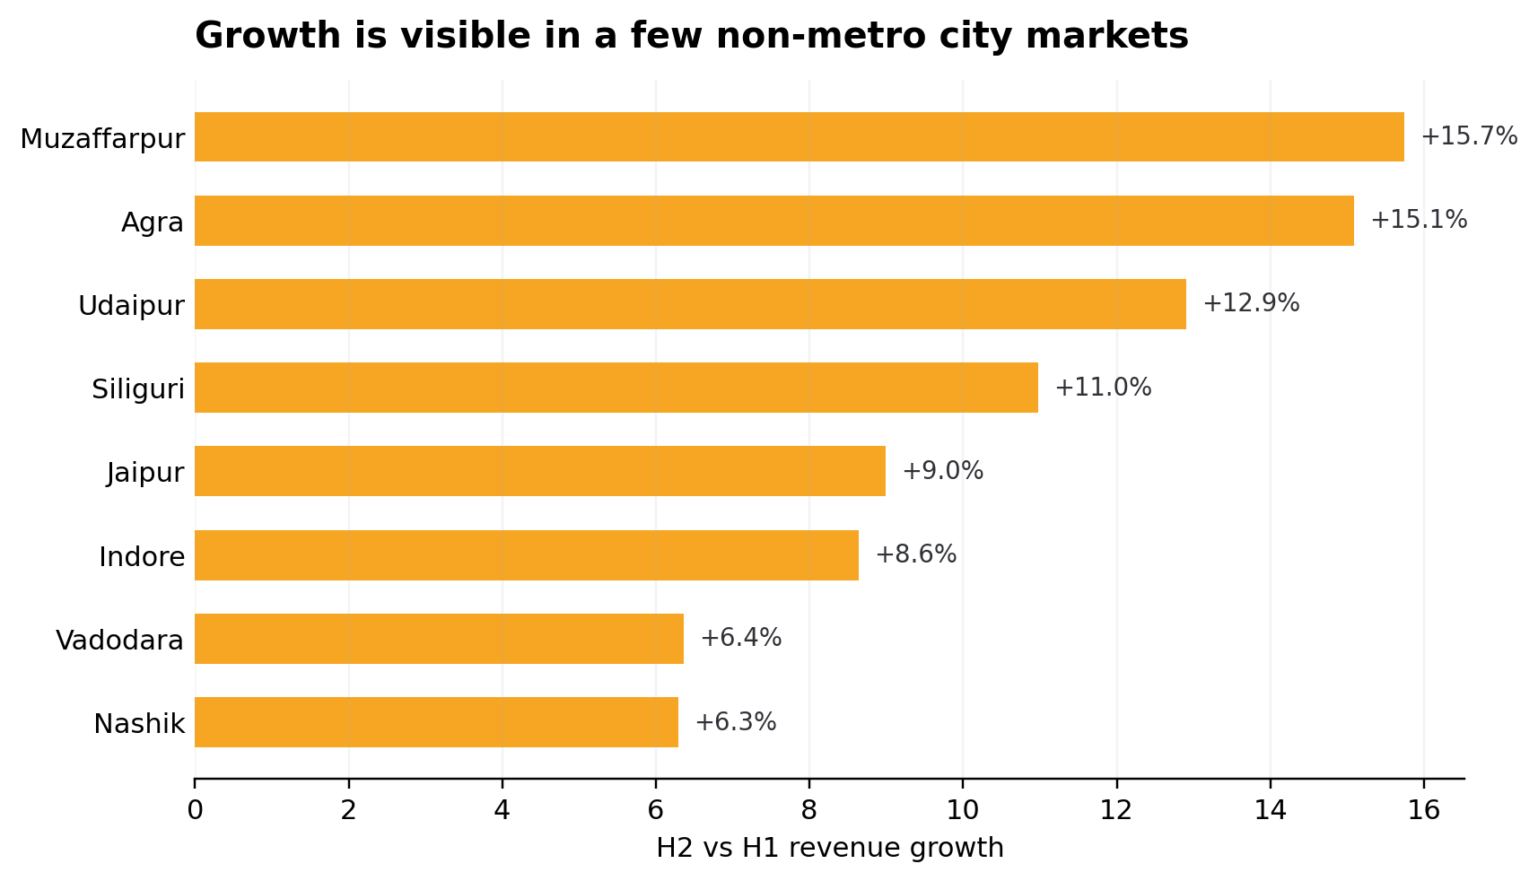
EXECUTIVE KPI LAYER
The operating baseline can be read in under 30 seconds.
Designed as the landing page for a Power BI management view.
ORDERS
GROSS VALUE
DELIVERED SHARE
RTO RATE
M1 RETENTION
50,000
₹42.29M
57.2%
14.38%
33.1%
Full-year sample
Order-line revenue
Delivered / gross
RTO revenue / gross
Pooled complete cohorts
READ THE CHARTS AS:
1) demand is broadly stable → 2) value leakage is persistent → 3) growth pockets exist in a subset of cities

Slide 7
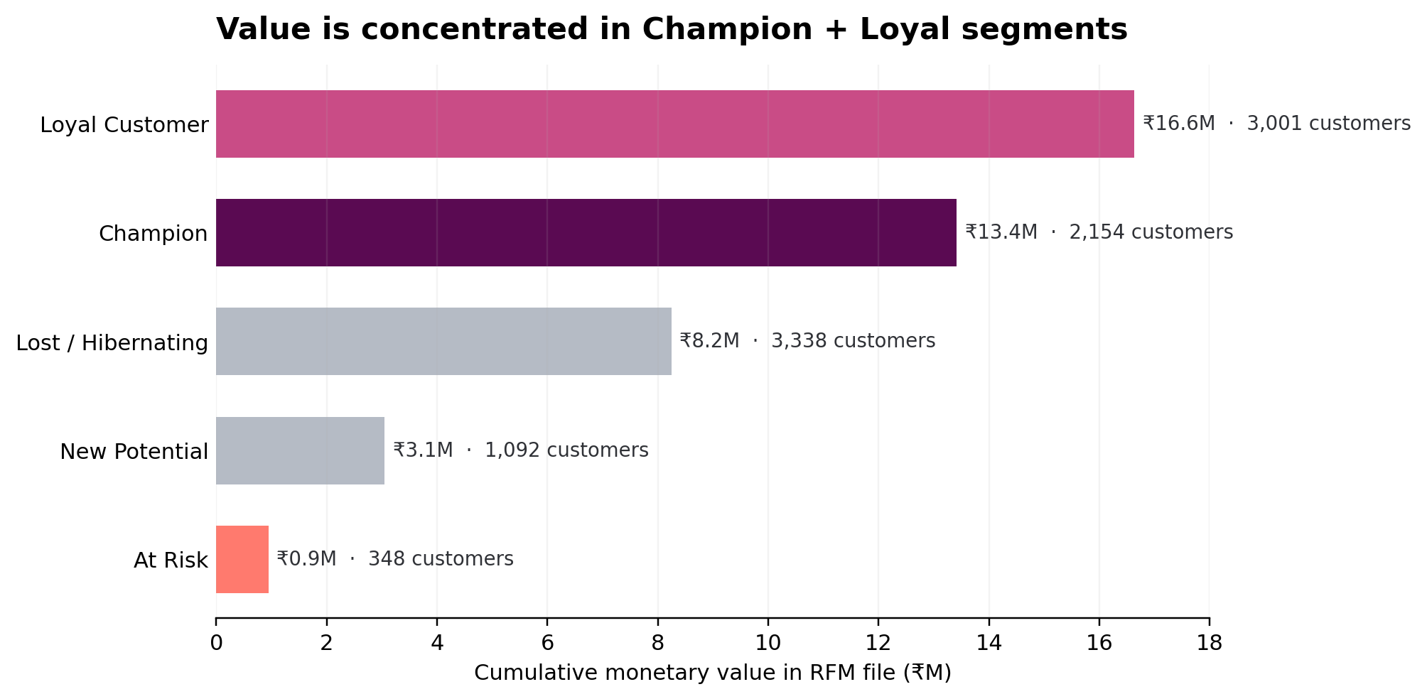
CUSTOMER 360°
A smaller high-value base creates a clear retention and cross-sell opportunity.
RFM helps connect customer behaviour to monetary value without requiring a heavy ML model.
CHAMPION CUSTOMERS
LOYAL CUSTOMERS
AT-RISK CUSTOMERS
LOST / HIBERNATING
CHAMPION + LOYAL VALUE
REPEAT-BUYERS PROXY
2,154
3,001
₹29.05M
9,579
348
3,338
21.7% of RFM file
30.2% of RFM file
~69% of RFM monetary value
Frequency ≥ 2 (RICE input)
3.5% of RFM file
CUSTOMER ACTIONS
Champions
Protect
Loyalty / early access / cross-sell
Loyal Customer
Grow
Bundled offers / reorder journeys
At Risk
Win back
Targeted reminder + value-led incentive
Lost / Hibernating
Re-activate
Low-cost re-engagement, test before scale

Slide 8
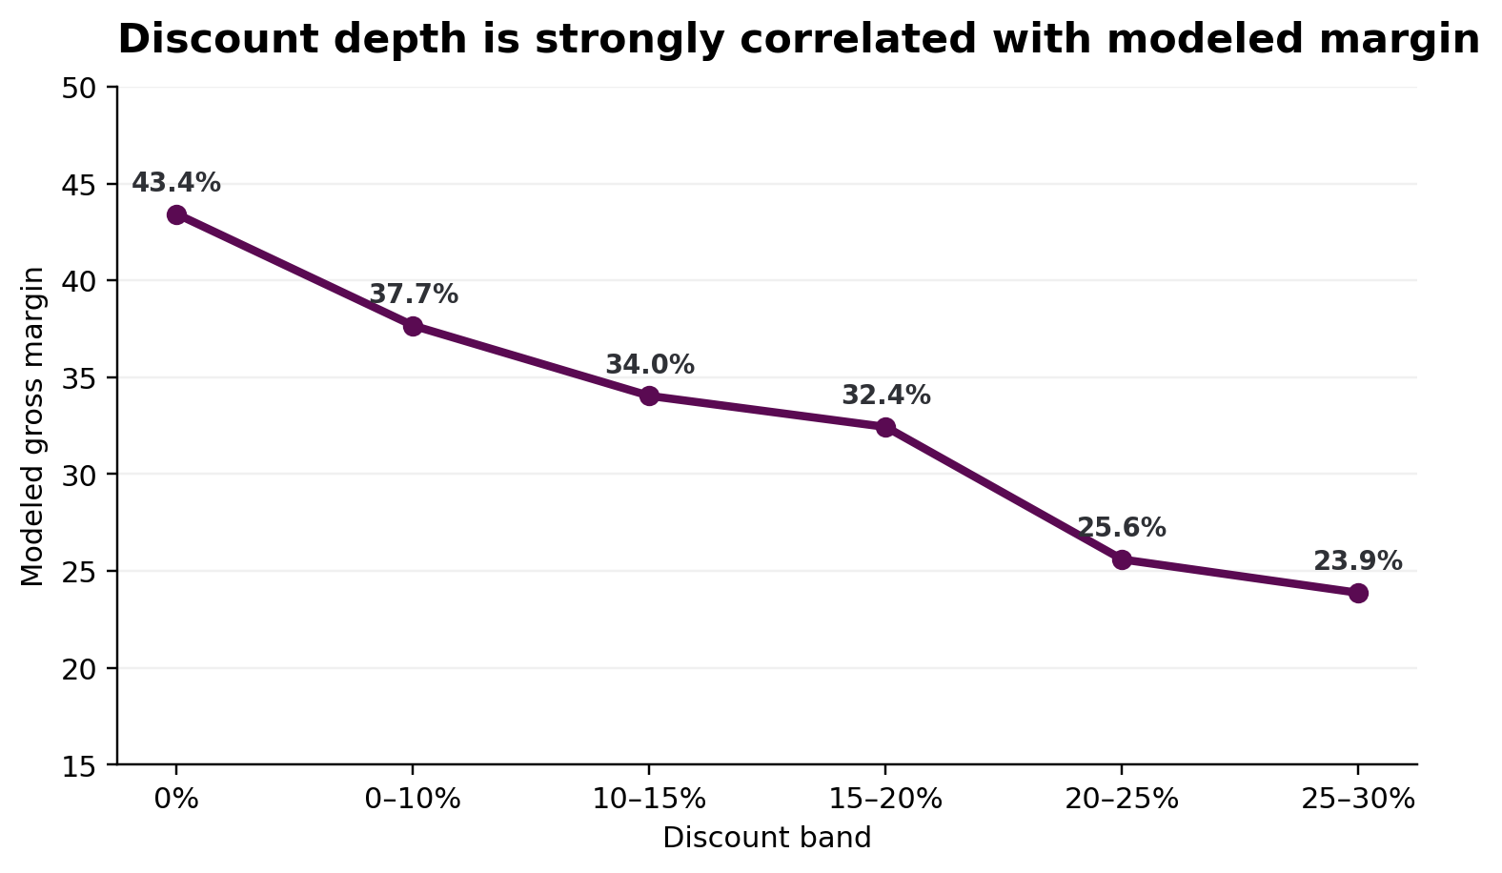
REVENUE INTELLIGENCE
Deep discounting buys volume, but the margin trade-off is visible.
This is the type of relationship a business analyst should surface before recommending blanket promotions.
CATEGORY ECONOMICS
Home & Kitchen
₹9.24M
38.0%
Beauty & Footwear
₹8.41M
36.4%
Jewelry & Accessories
₹8.38M
36.2%
Ethnic Wear
₹8.26M
32.1%
Western Wear
₹8.00M
34.0%
Business implication
Use margin-aware promotion rules. A 25–30% discount band models at 23.9% margin vs 43.4% at no discount.

Slide 9
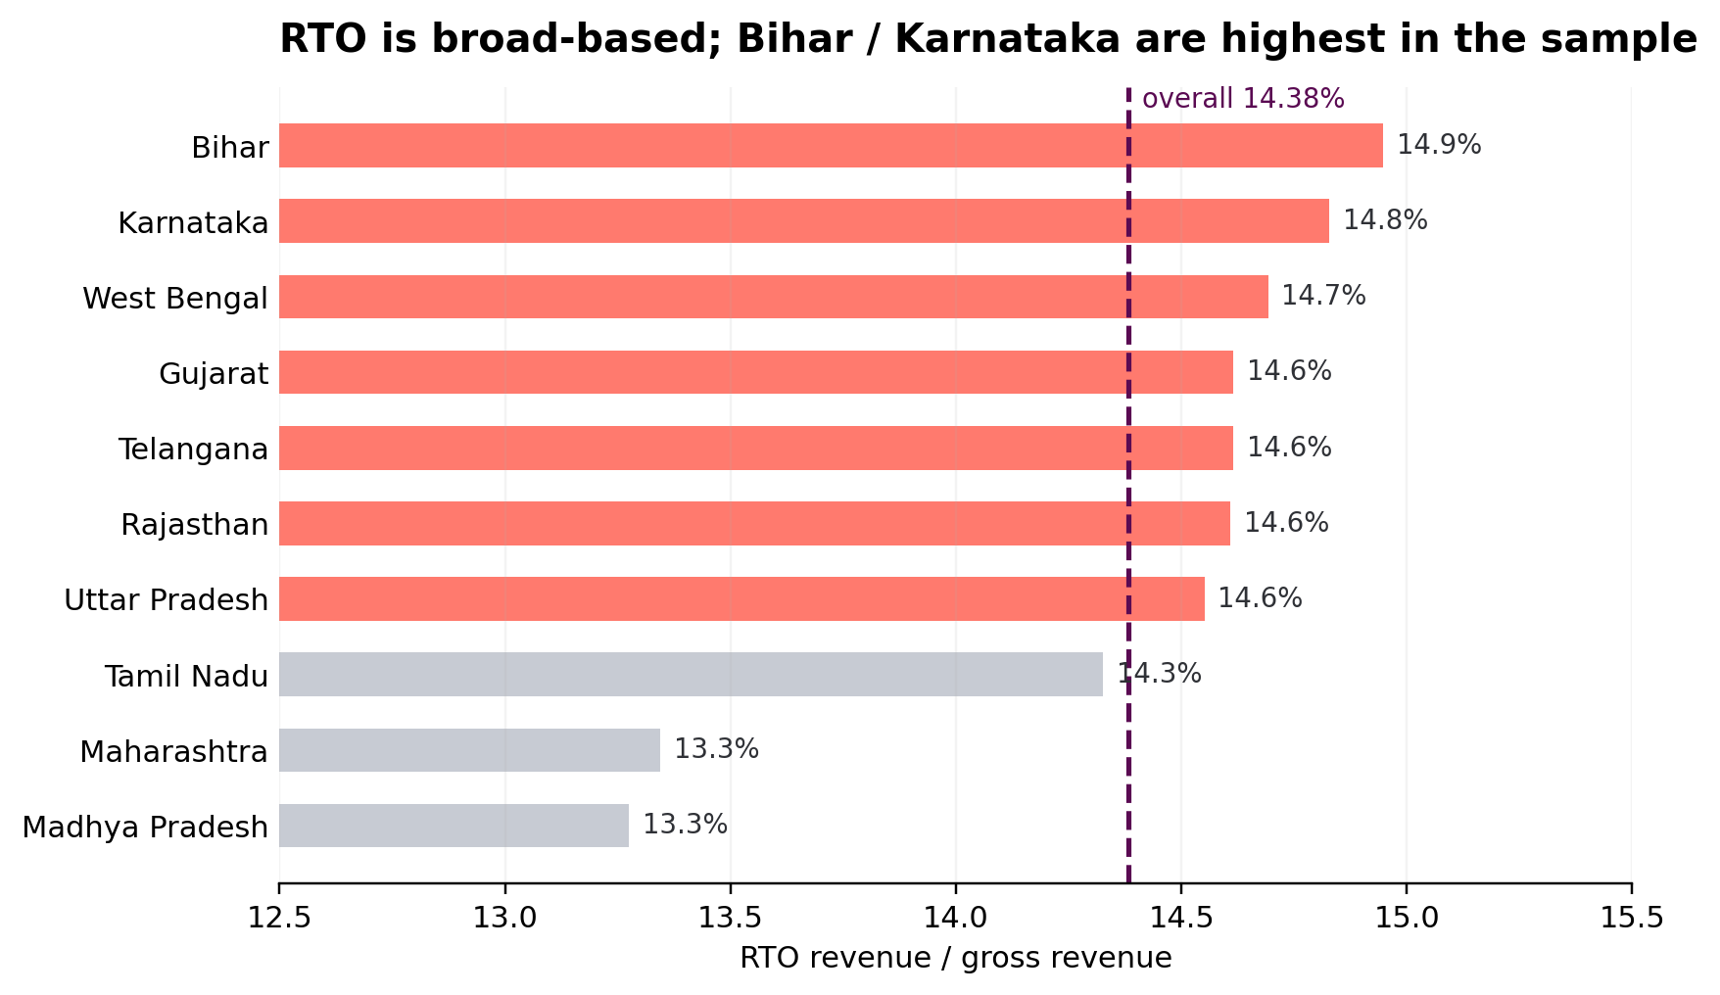
RTO & FULFILLMENT
RTO is broad-based across regions — the intervention should be systematic, not city-specific.
The sample’s overall RTO rate is 14.38%; the spread by state is comparatively narrow.
STATUS BRIDGE
Delivered
₹24.20M
Shipped
₹5.98M
Cancelled
₹6.02M
RTO
₹6.08M
28.6%
of gross value sits in RTO + cancellation
Recommended response
Address quality + proactive confirmation + fee transparency

Slide 10
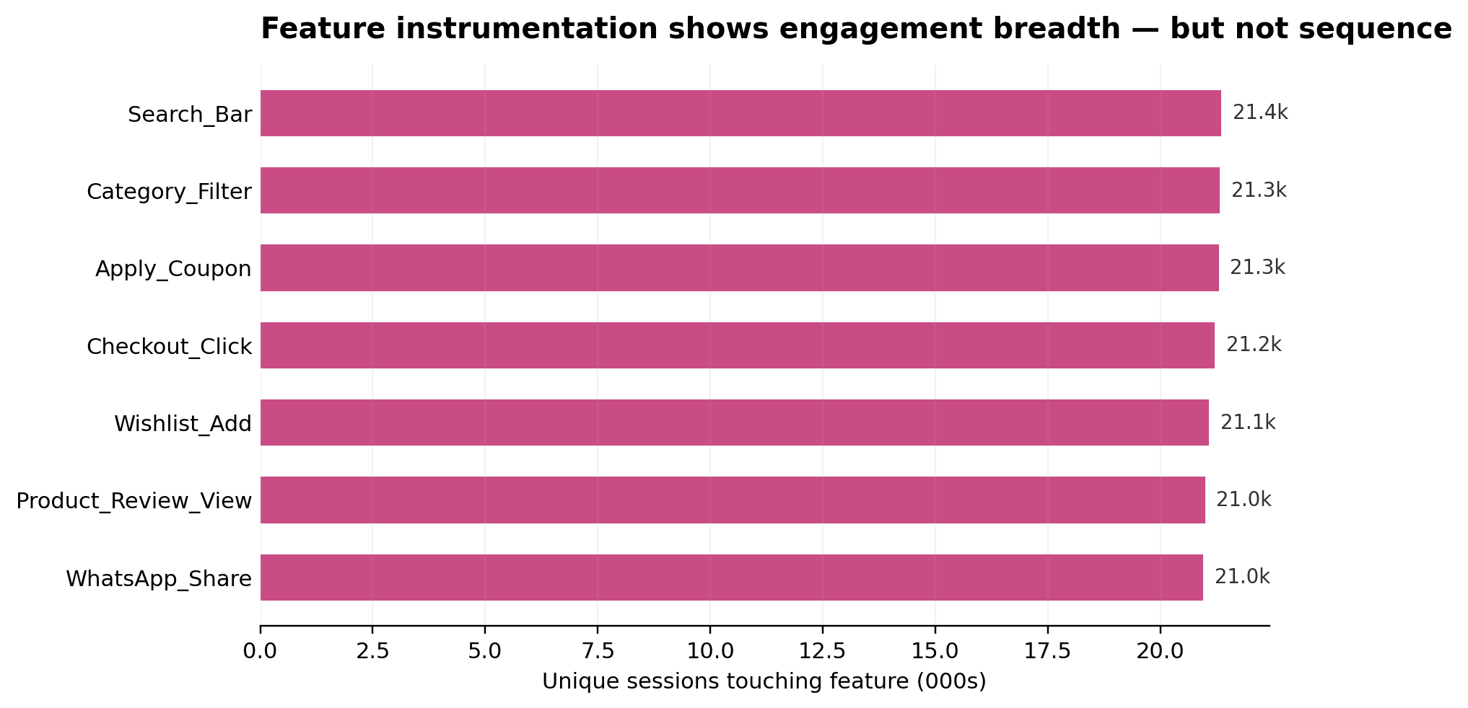
PRODUCT ANALYTICS
Feature adoption is measurable; the current event grain is not sufficient for a true sequential funnel.
That limitation is itself a product analytics insight: instrumentation quality determines decision quality.
WHAT THE DATA CAN SUPPORT
Feature reach
~21k unique sessions per feature
Device mix
Android dominates event volume
Conversion flags
Present, but not stage-sequenced
Next instrumentation
Event ID + session step + timestamp sequence
Product analytics recommendation
Instrument Browse → PDP → Cart → Checkout → Purchase as ordered event states before using drop-off as an optimisation KPI.

Slide 11
SALES & PROFITABILITY
Monthly revenue is relatively stable; the bigger swing is in mix and realisation
The uploaded model covers Jan 2025–Jan 2026; Jan 2026 is a partial month.
Gross revenue by month
Modeled gross margin
₹4.0M
Jan
35.2%
Feb
35.2%
₹3.0M
Mar
35.2%
Apr
35.4%
May
35.4%
₹2.0M
Jun
35.7%
Jul
35.7%
Aug
35.4%
₹1.0M
Sep
35.3%
Oct
35.2%
Nov
35.6%
₹0.0M
Dec
35.1%
Jan
Mar
May
Jul
Sep
Nov
Jan
Jan
33.8%
Insight
Revenue does not show a sustained upward trend in the current period; growth strategy should focus on quality of demand and repeat behaviour.
Data note
Jan 2026 is partial, so it should not be used as a full-month trend comparison.
11

Slide 12
CATEGORY & DISCOUNT ECONOMICS
Category revenue is balanced; discount depth creates the sharper margin risk
The current portfolio does not have a single dominant category—so margin discipline is a cross-category lever.
Revenue and modeled margin by category
Margin compression by discount band
Western Wear
₹8.0M
34.0%
≤5%
43.4%
Ethnic Wear
₹8.3M
32.1%
5–10%
37.7%
10–15%
34.0%
Jewelry & Accessories
₹8.4M
36.2%
15–20%
32.4%
Beauty & Footwear
₹8.4M
36.4%
20–25%
25.6%
Home & Kitchen
₹9.2M
37.9%
25%+
23.9%
Margin opportunity
Category opportunity
No-discount modeled margin is 43.4%; at 25%+ discount it is 23.9%. Discount governance should be linked to contribution economics, not just conversion.
Home & Kitchen has the highest modeled margin (37.9%); Beauty & Footwear and Jewelry also sit above the portfolio average.
12

Slide 13
GEOGRAPHIC GROWTH
Growth is distributed across cities; smaller-city momentum is a practical expansion signal
Growth here is calculated by comparing the first and second halves of the observed period—not a forecast.
Half-over-half city revenue growth
Where to focus
Agra
12.8%
• Agra and Udaipur show the strongest observed growth in the supplied model.
• Muzaffarpur and Siliguri also show positive momentum, supporting a test-and-scale playbook for Tier-2 / Tier-3 markets.
• Use city-level growth together with RTO, margin and repeat rate before reallocating acquisition spend.
Udaipur
11.8%
Muzaffarpur
11.1%
Siliguri
8.4%
Indore
6.7%
Jaipur
6.7%
Vadodara
5.0%
Nashik
4.1%
Recommended market rule
Kanpur
4.0%
Scale where growth + repeat + delivered revenue improve together. Avoid scaling on GMV growth alone.
Nagpur
3.8%
13

Slide 14
STRATEGIC DIAGNOSIS
Three tensions explain most of the current value leakage
A management-friendly way to frame the dashboard is to connect each symptom to a controllable business lever.
1
Demand vs. delivery
2
Conversion vs. margin
3
Acquisition vs. retention
₹42.29M gross revenue
Deep discounts can lift demand
10K customers in RFM base
₹24.20M delivered
25%+ discount margin ≈ 23.9%
Large Lost/Hibernating pool
Fix failed-delivery economics before adding expensive demand.
Move from blanket discounting to targeted, contribution-aware offers.
Make the second purchase a designed product experience.
Management implication
The operating model should be optimised around delivered, repeatable and profitable orders—not gross order creation.
14

Slide 15
STRATEGIC PRIORITIES
Four workstreams translate the dashboards into an executable growth agenda
Prioritisation combines value leakage, customer impact, data evidence and implementation complexity.
P0
Smart-Confirm
RTO / cash conversion
14.38% RTO
Product + Ops
Validate → pilot → scale
P0
Checkout transparency
Conversion quality
Fee shock hypothesis
Product + Growth
Validate → pilot → scale
P1
Retention engine
Second purchase
M1 ≈ 31%
CRM + Product
Validate → pilot → scale
P1
Margin-aware offers
Contribution margin
25%+ discount ≈ 23.9%
Growth + Merch
Validate → pilot → scale
Rule
No initiative scales without a measured control group or before/after KPI definition
15

Slide 16
CONVERSION INITIATIVE
Remove the checkout surprise before asking the customer to pay
The project brief identifies delivery-fee visibility as a controllable checkout-friction hypothesis.
PRODUCT PAGE
CART
Target from project brief
Kurti / Ethnic Wear
Reduce cart→checkout drop from 42% to 32%.
At the planning assumptions in the brief, that could add ~1,745 orders per 100K searches.
This is a scenario estimate; instrument and validate before using it for a business case.
Item total
₹499
₹499
Delivery
₹49
Enter pincode
411001
Free-shipping progress
Delivery by 14 Oct
Add ₹149 to unlock free shipping
Shipping + handling ₹49
PAY ₹548
16

Slide 17
RETENTION INITIATIVE
Make the second purchase a designed journey, not a hope
The cohort matrix suggests a steep first-month drop followed by a stable retained base.
DAY 0
DAY 3
DAY 7
DAY 14
DAY 30+
Delivery
Relevance
Incentive
Urgency
Win-back
CSAT + order
experience
Category-based
cross-sell
Time-boxed
welcome-back
Wishlist / price
drop alert
RFM-driven
reactivation
COHORT M1
M12
AT RISK
LOST / HIBERNATING
31.5%
1.7%
348
3,338
Current matrix average
Current matrix average
Customers in RFM base
Largest segment
17

Slide 18
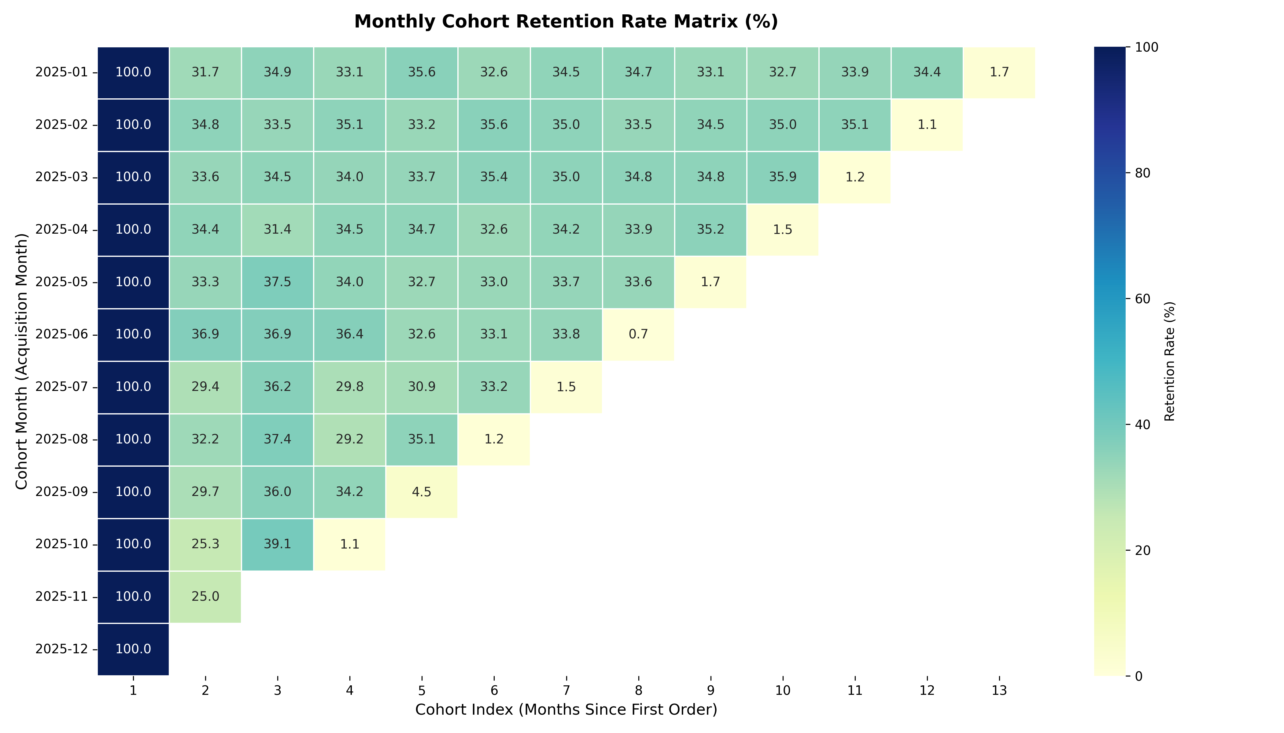
RETENTION & COHORTS
The repeat-purchase baseline is stable around one-third after month 1.
Cohorts are keyed on first order month, which keeps the analysis inside the sales window.
RETENTION READOUT
33.1%
M1 pooled retention
34.1%
overall retention KPI in the model
What to do next
• Protect high-value cohorts
• Test one-click reorder
• Measure win-back by segment
• Separate “retention” from “reactivation”

Slide 19
FROM ANALYTICS TO ACTION
Three bottlenecks connect directly to measurable business outcomes.
This is the bridge between a dashboard and a product/business recommendation.
01
RTO / address quality
02
Cart-to-checkout drop
03
Repeat-purchase growth
14.38% RTO rate
42% documented drop
M1 retention ~33%
WHY IT MATTERS
WHY IT MATTERS
WHY IT MATTERS
Reduce avoidable failed delivery
Make cost / delivery expectations transparent
Reduce friction for the next purchase
PRODUCT RESPONSE
PRODUCT RESPONSE
PRODUCT RESPONSE
Smart-Confirm
Fee + pincode
One-click reorder
Decision chain
Observation → Root cause → Impact → Intervention → KPI

Slide 20
PRODUCT RECOMMENDATION
Smart-Confirm turns an operational leak into a measurable product intervention.
The concept combines pincode validation, address quality and proactive COD confirmation.
SMART-CONFIRM
TARGET METRIC
GUARDRAILS
Automated COD verification
& address hygiene
14.38% → 11.0%
✓
<200 ms p95 AQI scoring
overall RTO rate in 2-quarter scenario
✓
WhatsApp queued within 60 sec
Pincode check
serviceable?
Planning case
✓
SMS fallback on API failure
~₹1.45M protected value
AQI score
0–100
✓
Consent + opt-out respected
This impact uses the documented 68% COD-attributed RTO assumption and ₹100 freight / RTO assumption; both should be validated against live event data.
WhatsApp confirm
YES / CANCEL / EDIT
✓
A/B holdout to watch conversion
Dispatch gate
release / hold

Slide 21
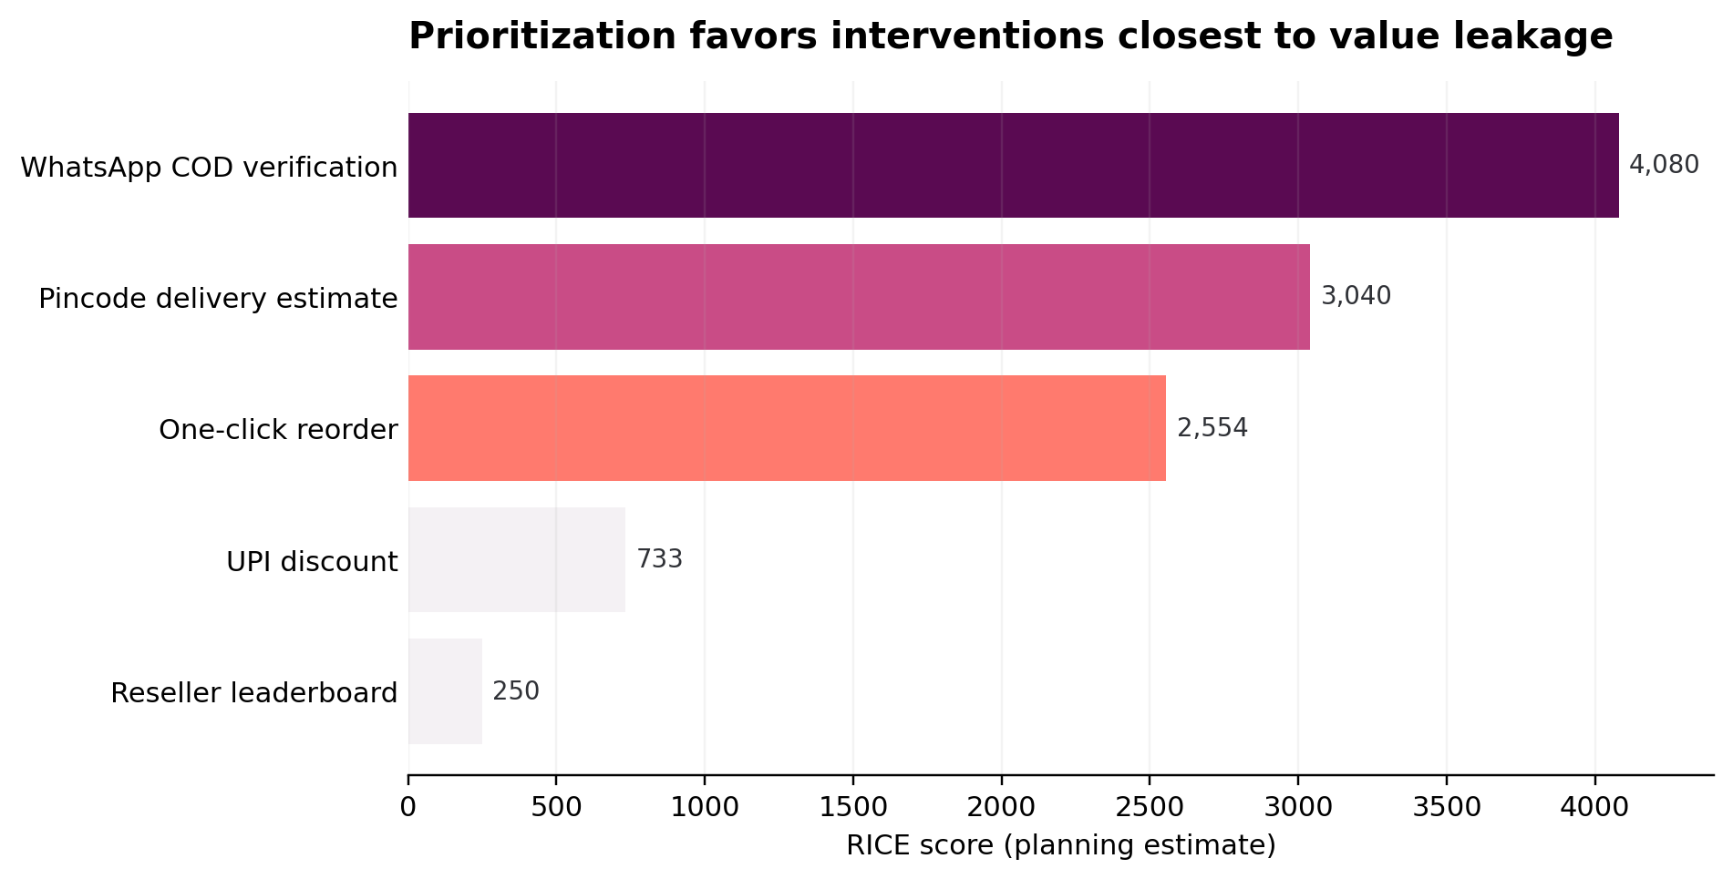
PRIORITISATION
The roadmap starts with interventions nearest to the measured value leaks.
RICE scores in the project are planning estimates, not observed business outcomes.
TOP 3 ROADMAP BETS
#1
WhatsApp COD verification
4,080
#2
Pincode delivery estimate
3,040
#3
One-click reorder
2,554
RICE = Reach × Impact × Confidence / Effort
The scoring framework creates a transparent way to discuss trade-offs with Product, Growth and Operations.

Slide 22
3-QUARTER ROADMAP
Sequence the work: instrument → reduce leakage → improve repeat purchase → scale.
A staged plan preserves measurement and avoids shipping the full intervention before the baseline is trustworthy.
Q1
S1–S6
Q2
S7–S12
Q3
S13–S18
01
Pincode validation + AQI
01
UPI incentive test
01
Reseller sharing / attribution
02
WhatsApp COD verification
02
One-click reorder
02
Smart-Confirm v2 risk scoring
03
Pre-checkout fee / ETA
03
Fee transparency experiments
03
Ops dashboard + monitoring
Measurement principle
Every release gets a baseline, a target KPI, a holdout / test design where practical, and an owner.

Slide 23
MEASUREMENT FRAMEWORK
Success is not “feature shipped”; success is a measurable shift in the business funnel.
Use guardrail metrics alongside the target metric to avoid fixing one KPI by damaging another.
RTO REDUCTION
CHECKOUT RECOVERY
Primary: RTO rate
Guardrails: COD conversion, cancellation, support contacts
Primary: cart→checkout drop
Guardrails: AOV, margin, payment mix
REPEAT PURCHASE
CUSTOMER VALUE
Primary: repeat-order share
Guardrails: discount cost, retention by segment
Primary: monetary value / CLV proxy
Guardrails: CAC, margin, service cost
EXPERIMENT LOOP
Baseline
Hypothesis
A/B or holdout
Impact readout

Slide 24
TECHNICAL DELIVERY
The project is end-to-end: data model, SQL, Python, Power BI, business artefacts and a natural-language analyst.
The AI layer is deliberately last — analytics must remain traceable to governed data.
01
DATA
CSV + synthetic event files
AI BUSINESS ANALYST ASSISTANT
02
WAREHOUSE
SQLite + analytical SQL
Ask a business question
in plain language.
“What is our RTO rate?”
Python / Pandas / RFM / cohorts
“Which categories have the weakest margin?”
03
ANALYTICS
04
BI
Power BI / 46+ measures / DAX
“What is the cart abandonment rate?”
05
DECISION
BRD / PRD / RICE / roadmap
Question → SQL / analytics layer → finding → business context → recommendation
Design principle
Natural-language output should cite a defined KPI and surface the data basis — not invent a narrative.

Slide 25
PORTFOLIO STORY
From dashboard to
business decision.
This project demonstrates how a Business Analyst / Product Analyst can move from raw marketplace data to a traceable product recommendation.
DATA
INSIGHT
DECISION
ACTION
50k orders · 10k customers
RTO · margin · retention
3 bottlenecks
Smart-Confirm + roadmap
Suggested portfolio headline
“Built a Customer 360° & Product Growth Intelligence Platform using SQL, Python and Power BI to quantify marketplace leakage, segment customers and translate findings into product priorities.”
Note: This is a Meesho marketplace-inspired case study; customer-level data is synthetic and should not be represented as proprietary Meesho data.

Slide 26
SOURCES & NOTES
Research references and project artefacts used in the deck.
Public context is separated from the synthetic case-study dataset.
PUBLIC CONTEXT
PROJECT ARTEFACTS
Meesho Investor Relations — company overview / Q1 FY27
https://investor.meesho.com/
•
README.md — project narrative & headline metrics
•
meesho_sales_flat_analytics.csv — order-line fact table
Meesho RHP / prospectus — marketplace, sellers, logistics, content commerce context
https://investor.meesho.com/ipo-disclosures
•
meesho_customers.csv — customer base
•
meesho_products.csv — 500 SKUs
•
meesho_feature_events.csv — 150k feature events
Public statistics shown: 274M+ annual transacting users, 1.04M+ annual transacting sellers, 2.83B+ placed orders (LTM ended 30 Jun 2026).
•
rfm_customer_segments.csv — customer segmentation
•
cohort_retention_matrix.csv — cohort retention
Accessed: 03 Oct 2026
•
Meesho_EcomAI_Dashboard_Build_Guide.docx — Power BI build plan
•
Meesho_Phases_13-17_Documentation.docx — BA / PM / QA artefacts

