Slide 1
YouTube Trending Videos: Prediction and Analysis
Analyzing factors influencing trending videos and predicting trends using machine learning

Slide 2
Introduction
- Objective:
Understand what makes a video trend on YouTube and predict trends.
- Scope:
Data analysis and feature engineering.
Building predictive models.
- Importance:
Insights for content creators and marketers.

Slide 3
Problem Statement
- Videos often go viral unpredictably, leaving creators uncertain.
- Need for a data-driven approach to analyze and predict trends.

Slide 4
Dataset Overview
- Source: YouTube Trending Videos Dataset (Kaggle).
- Key Features:
Title, Thumbnail, Likes, Comments, Views, Video Length, Tags.
- Size: 20000 entries across 5 categories.

Slide 5
Features Considered
- Likes and Comments: Indicators of engagement.
- Thumbnail: Visual appeal.
- Video Length: Optimal duration for engagement.
- Tags: Relevance to trending topics.
- Upload Time: Impact of timing on trends.

Slide 6
Data Analysis and Visualization
- Insights:
Distribution of likes, comments, and views.
Correlation between features (e.g., views vs. likes).
Trends in upload timings and their impact.

Slide 7
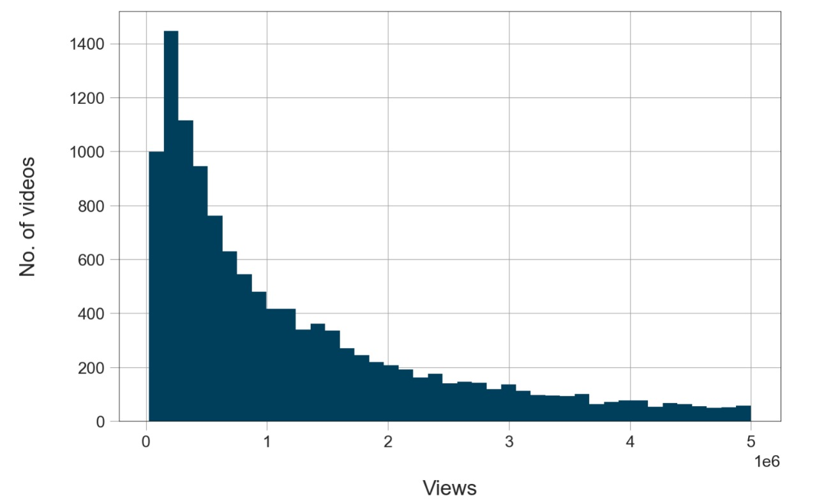
Video vs views

Slide 8
Predictive Model
- Model Used:
Logistic Regression / Decision Tree / Random Forest.
- Target: Predict if a video will trend (Yes/No).
- Evaluation Metrics: Accuracy, Precision, Recall, F1-Score.

Slide 9
Model Results
- Performance:
Accuracy: XX%
Precision: XX%
Recall: XX%
F1-Score: XX%
- Visualizations: Confusion matrix, ROC curve (optional).

Slide 10
Challenges
- Missing or inconsistent data.
- Subjectivity in defining 'trending'.
- Balancing overfitting and underfitting in models.

Slide 11
Conclusion
- Findings:
Strong predictors: Likes, Comments, and Video Length.
Trends influenced by engagement metrics and timing.
- Impact:
Useful insights for creators and marketers.
- Future Work:
Include more features like captions, regional trends, etc.
Experiment with advanced models like neural networks.

Slide 12
Thank You!

