Slide 1
Viva Connections – Create Adaptive Card Extensions (ACE) with the SharePoint Framework

Slide 2
Adaptive Card Extensions (ACEs)
View types
Card types
Creating ACEs
Configurable properties with ACEs
ACE component state

Slide 3
Introducing Adaptive Card Extensions (ACEs)

Slide 4
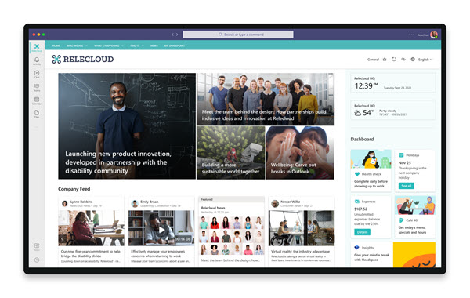
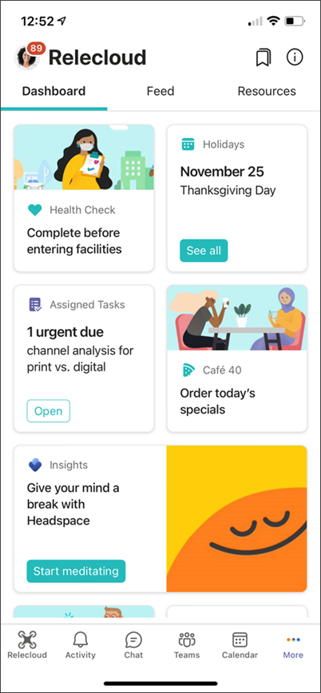
Viva Connections Adaptive Card Extensions
Customize the Viva Connections desktop and mobile experience with Adaptive Card Extensions (ACEs)
Enable users to:
quickly consume information at a glace
Interactive cards focused on mobile friendly experience
Create ACE’s with the SharePoint Framework (SPFx)

Slide 5
ACE Card Types

Slide 6
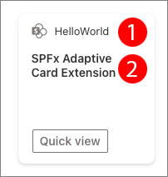
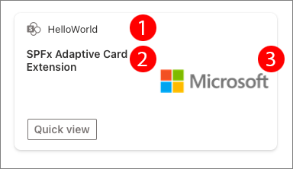
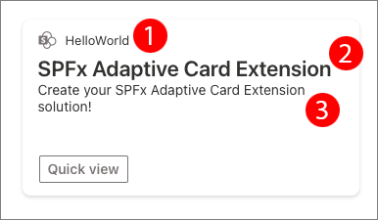
ACE Card Types
Basic Card
Image Card
Primary Text Card
Title
Primary text
Title
Primary text
Image URL
Title
Primary text
Description

Slide 7
ACE View Types

Slide 8
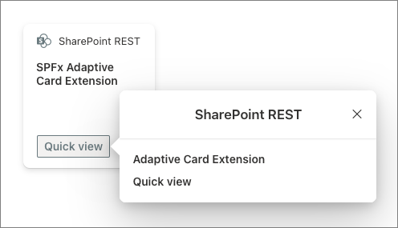
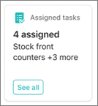
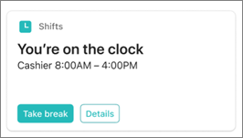
ACE View Types
CardView
QuickView
Default rendering on dashboards & mobile
Two size options: medium & large
Can include 0 | 1 | 2 buttons
Card templates influence options
Rendered based on interaction with CardView or other QuickViews
Implemented with class & Adaptive Card JSON

Slide 9
Developing Adaptive Card Extensions

Slide 10
Developing Adaptive Card Extensions
Create ACEs with the SharePoint Framework (SPFx)
Structure of an ACEs is very similar to an SPFx web part
Create new project using Yeoman Generator for SharePoint
Core component *AdaptiveCardExtension.ts defines the ACE
Initialize the ACE
Register all CardViews and QuickViews
Implement customizable properties with the property pane

Slide 11
HelloWorldAdaptiveCardExtension.ts
export default class HelloWorldAdaptiveCardExtension extends BaseAdaptiveCardExtension<
IHelloWorldAdaptiveCardExtensionProps,
IHelloWorldAdaptiveCardExtensionState
> {
private _deferredPropertyPane: HelloWorldPropertyPane | undefined;
public onInit(): Promise<void> { .. }
protected renderCard(): string | undefined { .. }
protected loadPropertyPaneResources(): Promise<void> { .. }
protected getPropertyPaneConfiguration(): IPropertyPaneConfiguration { .. }
}
}

Slide 12
ACE initialization
public onInit(): Promise<void> {
this.state = { };
this.cardNavigator.register( CARD_VIEW_REGISTRY_ID, () => new CardView());
this.quickViewNavigator.register( QUICK_VIEW_REGISTRY_ID, () => new QuickView());
return Promise.resolve();
}

Slide 13
ACE property panes
protected loadPropertyPaneResources(): Promise<void> {
return import(
/* webpackChunkName: 'HelloWorld-property-pane'*/
'./HelloWorldPropertyPane'
)
.then(
(component) => {
this._deferredPropertyPane = new component.HelloWorldPropertyPane();
}
);
}
protected getPropertyPaneConfiguration(): IPropertyPaneConfiguration {
return this._deferredPropertyPane?.getPropertyPaneConfiguration();
}

Slide 14
ACE render CardView
protected renderCard(): string | undefined {
return CARD_VIEW_REGISTRY_ID;
}

Slide 15
ACE CardView Class
export class CardView extends BasePrimaryTextCardView< IHelloWorldAdaptiveCardExtensionProps, IHelloWorldAdaptiveCardExtensionState> {
public get cardButtons():
[ICardButton] | [ICardButton, ICardButton] | undefined { .. }
public get data(): IPrimaryTextCardParameters { .. }
public get onCardSelection():
IQuickViewCardAction | IExternalLinkCardAction | undefined { .. }
}

Slide 16
ACE configurable properties
ACEs have public properties editors can set using using the property pane
These are defined, and work, the exact same way as web parts:
Defined in an interface
Default values can be set in the component’s manifest file
Modified by users with appropriate permissions via the property pane
Differ from web parts in that the property pane is implemented in a mobile-first experience
Deferred loading of the property pane only when activated

Slide 17
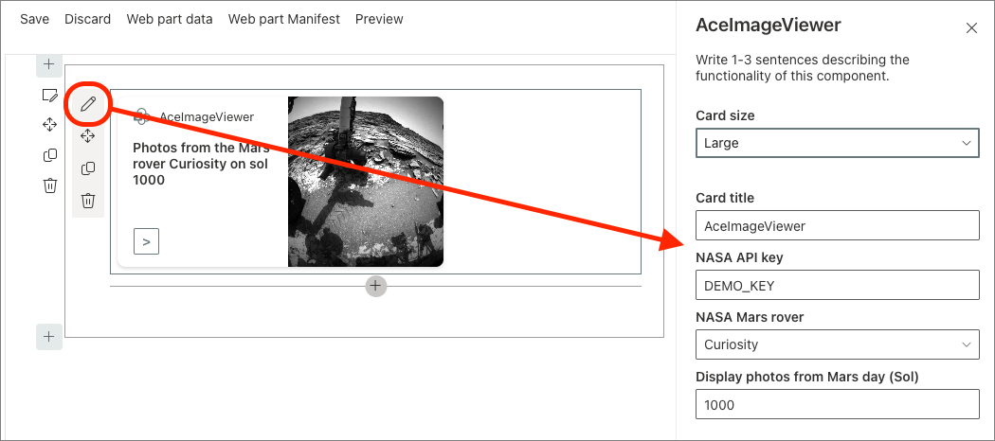
ACE configurable properties

Slide 18
ACE component state
All ACEs have a state that’s managed in the core ACE component and shared across all views
ACE state works the same way as a React component state:
When state changes, triggers the re-rendering of the current view
Implemented with an interface
Initialized in the ACE’s onInit() method
Set using the ACE’s setState() method

Slide 19
DEMO
Create SPFx Basic Card ACE showing SharePoint list data

Slide 20
Exploring QuickView
ACE view navigators
Deferred loading of QuickViews

Slide 21
ACE QuickViews

Slide 22
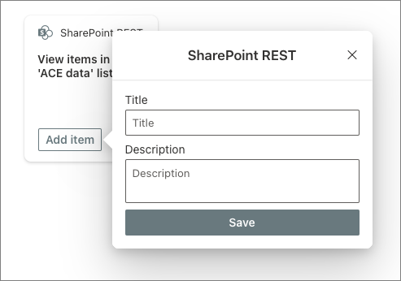
ACE QuickViews
QuickViews aren’t initially visible when the ACE is rendered
The CardView defines the initial rendering of the ACE on the Viva Connections desktop & mobile dashboards
QuickViews are displayed based on user interaction
User selects the CardView
User selects a button on the CardView (or another QuickView)

Slide 23
Activating QuickViews from CardViews
export class CardView extends BasePrimaryTextCardView<..> {
public get cardButtons(): [ICardButton] | [ICardButton, ICardButton] | undefined {
return [{
title: strings.QuickViewButton,
action: {
type: 'QuickView’, parameters: { view: QUICK_VIEW_REGISTRY_ID }
}
}];
}
public get onCardSelection(): IQuickViewCardAction | IExternalLinkCardAction | undefined {
return {
type: 'QuickView’, parameters: { view: QUICK_VIEW_REGISTRY_ID }
}
}
}

Slide 24
ACE QuickView
export class QuickView extends BaseAdaptiveCardView<
IHelloWorldAdaptiveCardExtensionProps,
IHelloWorldAdaptiveCardExtensionState,
IQuickViewData
> {
public get data(): IQuickViewData { .. }
public get template(): ISPFxAdaptiveCard { .. }
public onAction(action: ISelectMediaActionArguments): void { .. }
}

Slide 25
View Navigators

Slide 26
View navigators
CardViews & QuickViews must first be registered with their respective navigators before they can be used
Registration involves setting the view’s ID & an object that implements the view
Once registered, the rendering engine can retrieve views by their ID to render them

Slide 27
Registering views with view navigators
import { CardView } from './cardView/CardView';
import { QuickView } from './quickView/QuickView';
const CARD_VIEW_REGISTRY_ID: string = 'SharePointRest_CARD_VIEW';
export const QUICK_VIEW_REGISTRY_ID: string = 'SharePointRest_QUICK_VIEW';
export default class SharePointRestAdaptiveCardExtension extends BaseAdaptiveCardExtension<..> {
public async onInit(): Promise<void> {
this.cardNavigator.register(CARD_VIEW_REGISTRY_ID, () => new CardView());
this.quickViewNavigator.register(QUICK_VIEW_REGISTRY_ID, () => new QuickView());
}
}

Slide 28
Controlling views with view navigators
View navigators are stacks, or arrays
Either the top-most view on the stack is rendered, or the specified view (via it’s ID) is rendered
Use familiar array methods to control the stack:
.push()
.pop()
Special methods control the QuickView
.replace()
.close()

Slide 29
Deferred loading of QuickViews

Slide 30
Deferred loading of QuickViews
Developers can create complex QuickViews for sophisticated user interactions
In a mobile-first approach, no need to load & initialize views that may not be used; instead, load & initialize on-demand
// import { QuickView } from './quickView/QuickView';
public async onInit(): Promise<void> {
// this.quickViewNavigator.register(QUICK_VIEW_REGISTRY_ID, () => new QuickView());
this.quickViewNavigator.register(
QUICK_VIEW_REGISTRY_ID,
() => import('./quickView/QuickView').then((c) => new c.QuickView())
);
}

Slide 31
DEMO
Create an SPFx Image Card ACE displaying image carousel

Slide 32
Special Viva Connections actions
Select & upload media
Show location
Get location

Slide 33
Viva Connections specific actions
Adaptive Card Extensions support multiple types of actions available in the Adaptive Card schema:
Open a URL in a browser
Show another Adaptive Card as a subform on an existing card
Submit an action
Viva Connections includes two additional types of actions:
Select & upload media files (images)
Get or show location details on a map (via GPS coordinates

Slide 34
Action: Select Media
Enable users to select a single, or multiple, images to upload to the Adaptive Card Extension
"actions": [
{
"type": "VivaAction.SelectMedia",
"id": "Select Media",
"title": "Select Files",
"parameters": { "mediaType": "MediaType.Image” }
}
]

Slide 35
Handling the media selection action
Handle the media selection action just like other actions – use the view’s onAction() event handler
Image data included in action argument as Base64 string
public onAction(action: ISelectedMediaActionArguments): void {
this.setState({
uploadedImageName: action.media[0].fileName,
uploadedImageContent: action.media[0].content // base64
});
}

Slide 36
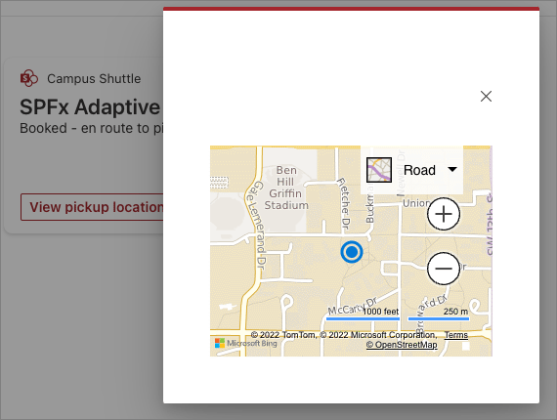
Action: Show Location
Show a specific location on a map with it’s coordinates
"actions": [{
"id": "originLocation",
"title": "View dropoff location",
"action": {
"type": "VivaAction.ShowLocation",
"parameters": {
"locationCoordinates": {
"latitude": this.state.trip.destination.latitude,
"longitude": this.state.trip.destination.longitude
}}
}
}]

Slide 37
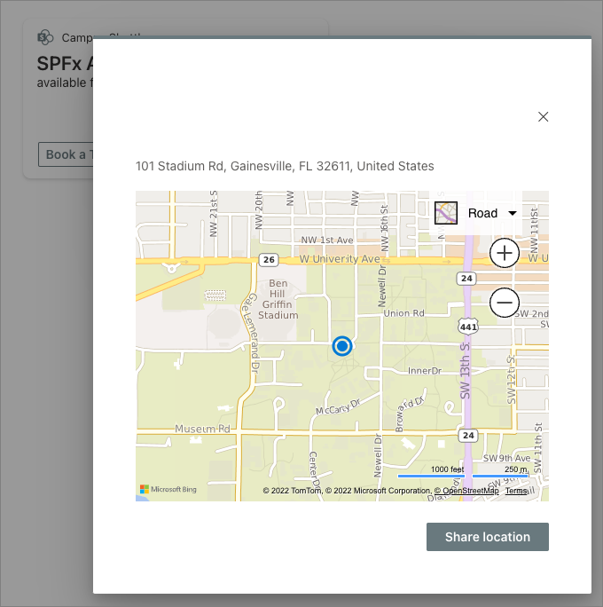
Action: Get Location
Enable users to select a location on the map
Get the coordinate of the selection location

Slide 38
Action: Get Location
"actions": [{
"id": "destinationLocation",
"type": "VivaAction.GetLocation",
"title": "Select location on map",
"parameters": { "chooseLocationOnMap": true }
}]
public onAction(action: IGetLocationActionArguments): void {
const currentTrip = this.state.trip;
if (action.type === 'VivaAction.GetLocation') {
trip.Destination = <ILocation>{
latitude: action.location.latitude,
longitude: action.location.longitude
};
}}

Slide 39
DEMO
Create an SPFx ACE with geo-location capabilities

