Slide 1
Deploying SharePoint Framework Components to Production
Updating SharePoint Framework Solutions

Slide 2

Updating SharePoint Framework Solutions
Updating SharePoint Package Versions
Updating Component Versions
Notes:
In this unit, you'll learn how versioning works in SharePoint Framework solutions and how to upgrade existing components.

Slide 3
Understanding Version Numbers in SPFx Projects
Three things can be versioned in SPFx projects:
Components (web parts & extensions)
Features
Package (*.sppkg)
Not required to increment version when code changes
Deploying updated SharePoint packages without changing the version will update existing code
Component version used for documentation
Package version used for documentation and to trigger SharePoint’s app upgrade process
Notes:
SharePoint Framework projects have three things that you can version. You can assign a version to the each component, such as a web part or an extension, in the package. You can assign a version to the Features in the package. And you can assign a version the package itself.
Versioning of components is exclusively used for documentation purposes. Versioning of Features and the package is also used for documentation purposes, however there are scenarios where you may be required to increment the version number for one or more Features and/or the package version number to see the effects of your changes.
When you change the code for a SharePoint Framework component, you'll need to rebuild, bundle, package, and redeploy the solution to SharePoint. When the package is redeployed, all existing code files are automatically overwritten with the new files regardless of whether the package version number changed or not.
When you add new web parts to a SharePoint Framework project, you'll need to rebuild, bundle, package, and redeploy the solution to SharePoint. When the package is redeployed, the new web parts will be immediately available regardless of whether the package version number changed or not.
When you add new extensions to a SharePoint Framework project, you don't need to increment any version numbers for the new extensions to be available after you rebuild, bundle, package, and redeploy the solution to SharePoint.
If you don't enable tenant wide deployment you'll need to increment both the package version and the version number of the Feature or Features that provision resources associated with the extensions. Then you need to rebuild, bundle, package, and redeploy the solution to SharePoint. Incrementing the package version enables you to update the app in site collections where it's been added. Incrementing the Feature version indicates to SharePoint that the Feature needs to be upated during the app update process.

Slide 4
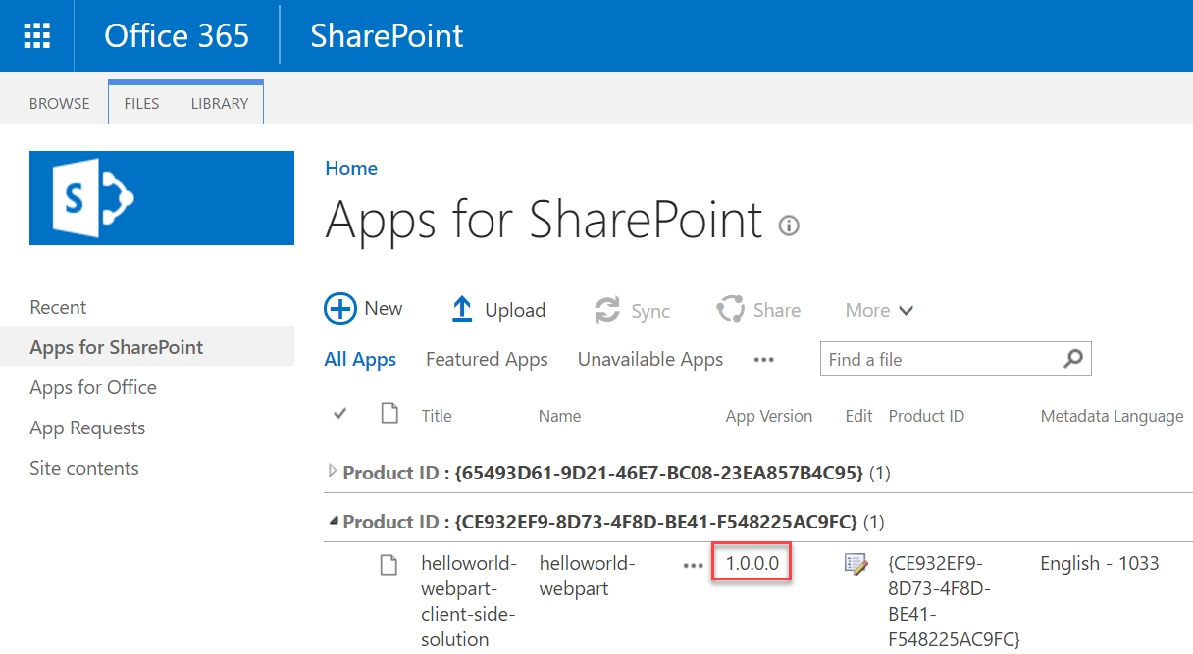
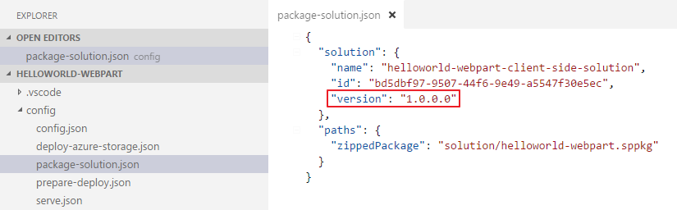
Update the version in the package-solution.json file
Sets the version for the *.sppkg package
Version is displayed in the tenant / site collection app catalog
Triggers the SharePoint app upgrade process
Will reactivate / upgrade any features
Notes:
The version number for the package is defined in the **./config/package-solution.json** file. SharePoint package version is displayed in the tenant or site collection App Catalog:
If you deploy an updated SharePoint package without changing the version numbers, SharePoint will still update the existing deployed component runtime files, including the JavaScript bundles.
The package version is used for documentation and to trigger the SharePoint app upgrade process. The app upgrade process may be required when new components are added to a project

Slide 5
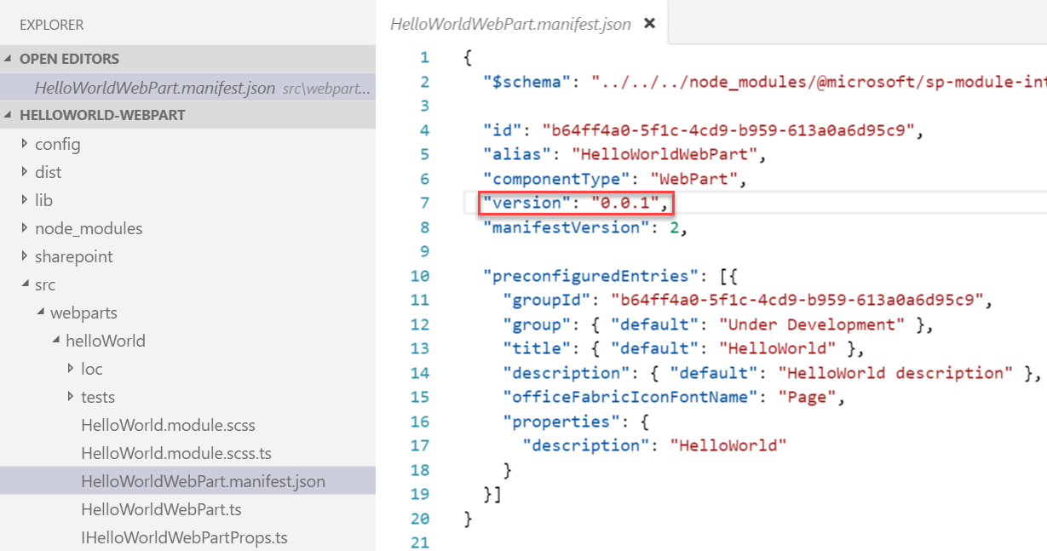
Update SPFx components and incrementing versions
Update the code or configuration for your web part
Increment the version in the <web part name>.manifest.json file
This sets the version for the web part
Multiple components in the same project may be versioned independently
Notes:
The version number of components is set in the component's manifest file. The `version` property is set to a string as shown in the following figure:
If this value is set to `*`, the `version` property from the project's **package.json** file is used.
By setting the version number in each component manifest, different components in the resulting SharePoint package can each share the same version number or they can have unique version numbers.

Slide 6
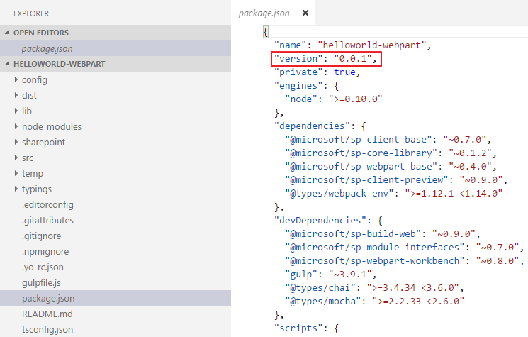
Update the version in the package.json file
Change the component version every time the package changes
Notes:
The last version number to look at in a SharePoint Framework project is the one that's listed in the project's **package.json** file. The only time the value of the `version` property in this file is used is when you have set the `version` property in a component's manifest file to `*` instead of a specific value.
The value of the **package.json**'s `version` property doesn't have any impact on the component other than documentation. Neither the behavior of the component, package, or SharePoint is impacted by changing the `version` property.
While it's only used for documentation, it's still recommended to increment this version whenever you make changes to your components.

Slide 7
Demo Updating SharePoint Framework Component & Package Versions

Slide 8

Summary
Updating Component Versions
Updating SharePoint Package Versions

Slide 9
Reading further
SharePoint Framework
https://docs.microsoft.com/sharepoint/dev/spfx/sharepoint-framework-overview

Slide 10
Thank you.

