Slide 1
Deploying SharePoint Framework Components to Production
Updating SharePoint Framework Solutions

Slide 2

Updating SharePoint Framework Solutions
Updating Component Versions
Updating SharePoint Package Versions
Notes:
In this unit, you'll learn how versioning works in SharePoint Framework solutions and how to upgrade existing components.

Slide 3
Understanding Version Numbers in SPFx Projects
Two things can be versioned in SPFx projects:
Components (web parts & extensions)
Package (*.sppkg)
Not required to increment version when code changes
Deploying updated SharePoint packages without changing the version will update existing code
Component version used for documentation
Package version used for documentation & to trigger SharePoint’s app upgrade process
Notes:
SharePoint Framework projects have two different things that you can version.
In a SharePoint Framework project, you can assign a version to the component itself, such as a web part or an extension. You can also version the entire SharePoint Framework package.
When updating a component or package, it is not required to increment the version numbers. Versioning is mostly used for documentation purposes but there are some scenarios that require you to increment the versions of packages and components.
When you change the code for a SharePoint Framework component, you'll need to rebuild, bundle, package and redeploy the solution to SharePoint. When the package is redeployed, all existing code files are automatically overwritten with the new files regardless if the version number changed or not.
The only time a version number can impact updating a SharePoint package or component is when you increment the package version. When SharePoint detects a new version number for an updated package, it will trigger SharePoint's app upgrade process. Nothing happens automatically, but the app can now be upgraded.

Slide 4
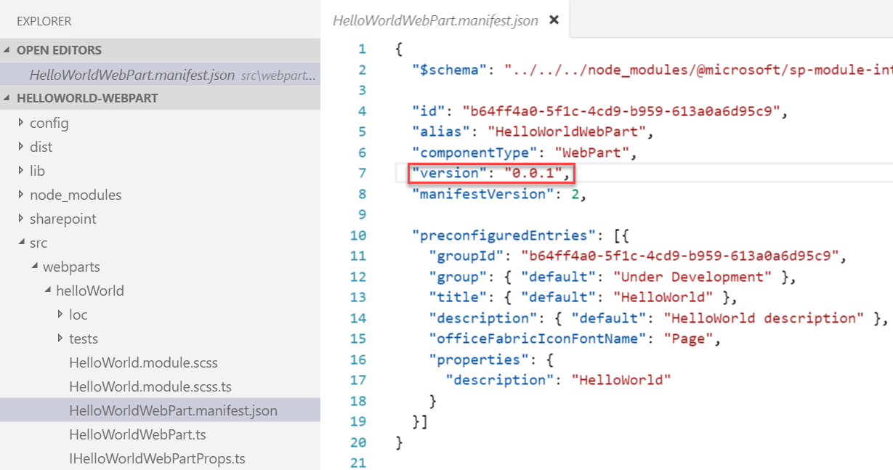
Update SPFx components & incrementing versions
Update the code or configuration for your web part
Increment the version in the <web part name>.manifest.json file
This sets the version for the web part
Multiple web parts in the same solution may be versioned independently
Notes:
The version number of components is set in the component's manifest file. The `version` property is set to a string as shown in the following figure:
If this value is set to `*`, the `version` property from the project's **package.json** file is used.
By setting the version number in each component manifest, different components in the resulting SharePoint package can each share the same version number or they can have unique version numbers.

Slide 5
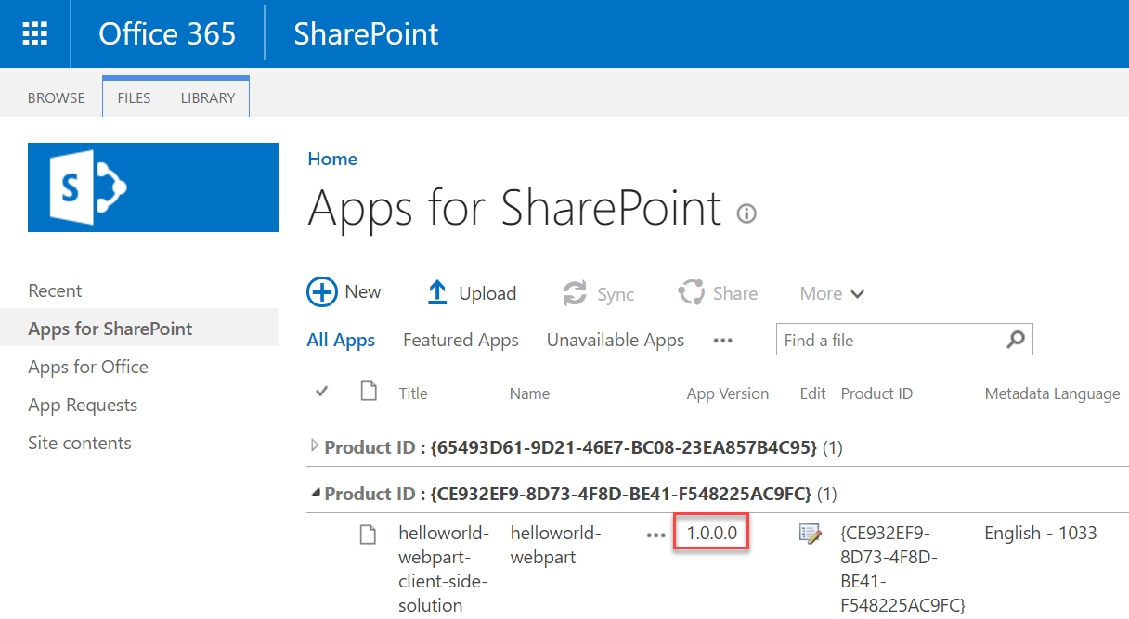
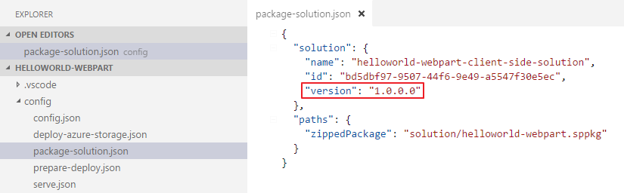
Update the version in the package-solution.json file
Sets the version for the *.sppkg package
Version is displayed in the tenant / site collection App Catalog
Triggers the SharePoint app upgrade process
Will reactivate / upgrade any features
Notes:
The version number for the package is defined in the **./config/package-solution.json** file. SharePoint package version is displayed in the tenant or site collection App Catalog:
![Screenshot of the SharePoint package version](../media/06-package-version.png)
If you deploy an updated SharePoint package without changing the version numbers, SharePoint will still update the existing deployed component runtime files, including the JavaScript bundles.
The package version is used for documentation and to trigger the SharePoint app upgrade process. The app upgrade process is required when you want to add a new component to your project.
Consider the following example of a **./config/package-solution.json** file:
The package is version 1.0.0.0. If I added a new SharePoint Framework component to this package, I would need to increment this version for SharePoint to give site owners the ability to upgrade any existing app instances of this package. Otherwise, the SharePoint feature that provisions the new web part's definition file to the Web Part Gallery can't get re-activated.

Slide 6
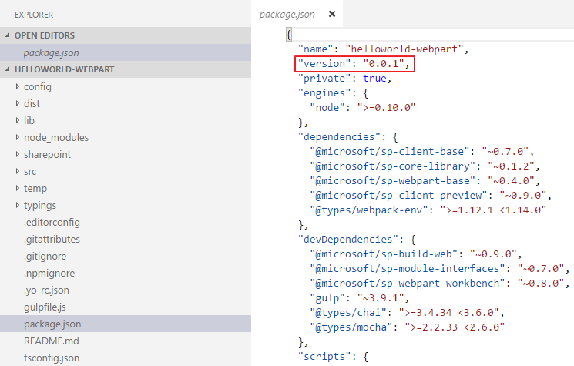
Update the version in the package.json file
Change the component version every time the package changes
Notes:
The last version number to look at in a SharePoint Framework project is the one that's listed in the project's **package.json** file. The only time the value of the `version` property in this file is used is when you have set the `version` property in a component's manifest file to `*` instead of a specific value.
The value of the **package.json**'s `version` property doesn't have any impact on the component other than documentation. Neither the behavior of the component, package, or SharePoint is impacted by changing the `version` property.
While it's only used for documentation, its recommended to increment this version whenever you make changes to your components strictly for documentation purposes.

Slide 7
Demo Updating SharePoint Framework Component & Package Versions

Slide 8

Summary
Updating Component Versions
Updating SharePoint Package Versions

Slide 9
Reading further
SharePoint Framework
https://docs.microsoft.com/sharepoint/dev/spfx/sharepoint-framework-overview

Slide 10
Thank you.

