Slide 1
Deploying SharePoint Framework Components to Production
Overview

Slide 2

Overview
Objects & Files involved in Deployment
Build, Bundle & Ship
Deploying SharePoint Assets
Deployment Steps

Slide 3
SharePoint Framework Deployment Artifacts
Installation & registration files
Included in SharePoint package deployed to SharePoint app catalogs
Makes SharePoint aware of components
Includes:
App manifest
Feature framework files
etc.
Component runtime files & dependencies
Optionally included in SharePoint package or deployed to another location (CDN)
Referenced by SharePoint when components are loaded on pages
Includes:
JavaScript bundles
Images
CSS
etc.

Slide 4
Build, Bundle & Package Solution
Build
gulp build
Transpiles TypeScript to JavaScript
Generates TypeScript type declarations
Transpiles SCSS to CSS
Bundle
gulp bundle [--ship | -p]
Generates JavaScript bundle(s)
Generates component manifest(s)
Files added to /dist folder
Package Solution
gulp package-solution [--ship | -p]
Generates all files needed for deployment to SharePoint
Generates all files needed to run components
Creates *.sppkg file
Files added to /temp & /sharepoint folder
Files added to /lib folder

Slide 5
Different Build / Packaging Modes: Debug & Production
Debug
All generated files are left un-minified
JavaScript source map files included in transpilation process
Built files assumed to be loaded from local webserver (https://localhost:4321)
Production
All files minified
No JavaScript source map files generated
Built files assumed to be loaded from ultimate production locations (CDN)

Slide 6
Deploying SharePoint Assets
SharePoint package (*.sppkg) always deployed to SharePoint App Catalog
Tenant-scoped App Catalog
Site Collection-scoped App Catalog
Component executable files deployed to hosting location
Must be accessible to all users of the site
Multiple manual options:
Office 365 CDN
Azure CDN
Public / internal URL
Leverage the includeClientAssets in the project’s package-solution.json file
Includes executable files in the *.sppkg
Automatically deployed to Office 365 tenant’s CDN’s

Slide 7
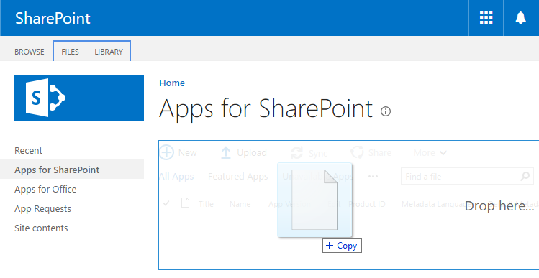
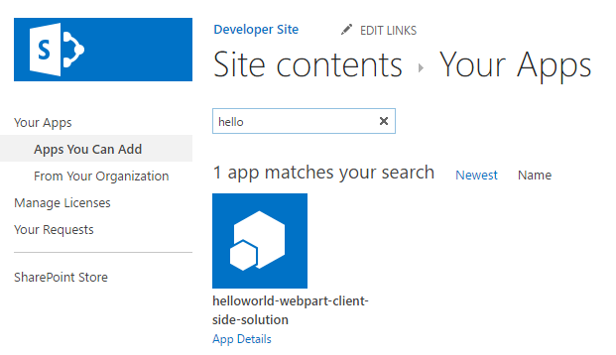
Deployment & Installation Steps
Build the project
gulp build
Generate the bundle & manifests
gulp bundle --ship
Generate the SharePoint package
gulp package-solution –ship
Upload the package (*.sppkg) to the app catalog
Install the app from the site collection’s Site Contents page

Slide 8
Demo Build, Bundle, Package, Deploy & Install a SharePoint Framework Solution

Slide 9

Summary
Objects & Files involved in Deployment
Build, Bundle & Ship
Deploying SharePoint Assets
Deployment Steps

Slide 10
Reading further
SharePoint Framework
https://docs.microsoft.com/en-us/sharepoint/dev/spfx/sharepoint-framework-overview
Deploy your client-side web part to a SharePoint page
https://docs.microsoft.com/sharepoint/dev/spfx/web-parts/get-started/serve-your-web-part-in-a-sharepoint-page

Slide 11
Thank you.

