Slide 1
Deploying SharePoint Framework Components to Production
Updating SharePoint Framework Solutions

Slide 2

Updating SharePoint Framework Solutions
Updating Component Versions
Updating SharePoint Package Versions

Slide 3
Understanding Version Numbers in SPFx Projects
Two things can be versioned in SPFx projects:
Components (web parts & extensions)
Package (*.sppkg)
Not required to increment version when code changes
Deploying updated SharePoint packages without changing the version will update existing code
Component version used for documentation
Package version used for documentation & to trigger SharePoint’s app upgrade process

Slide 4
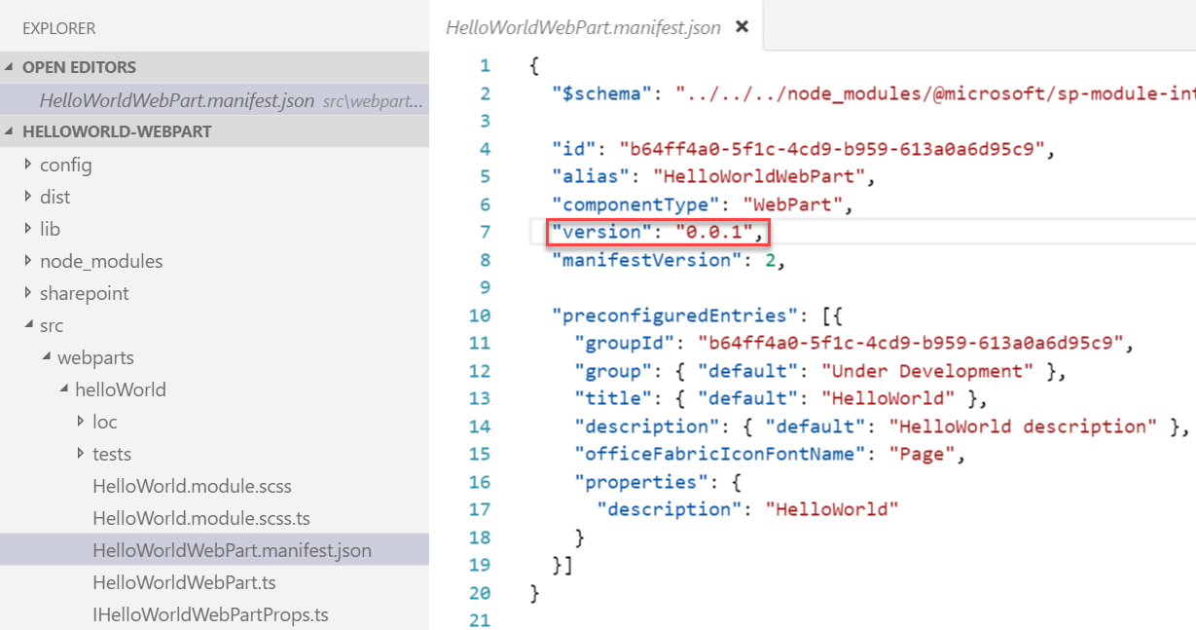
Update SPFx components & incrementing versions
Update the code or configuration for your web part
Increment the version in the <web part name>.manifest.json file
This sets the version for the web part
Multiple web parts in the same solution may be versioned independently

Slide 5
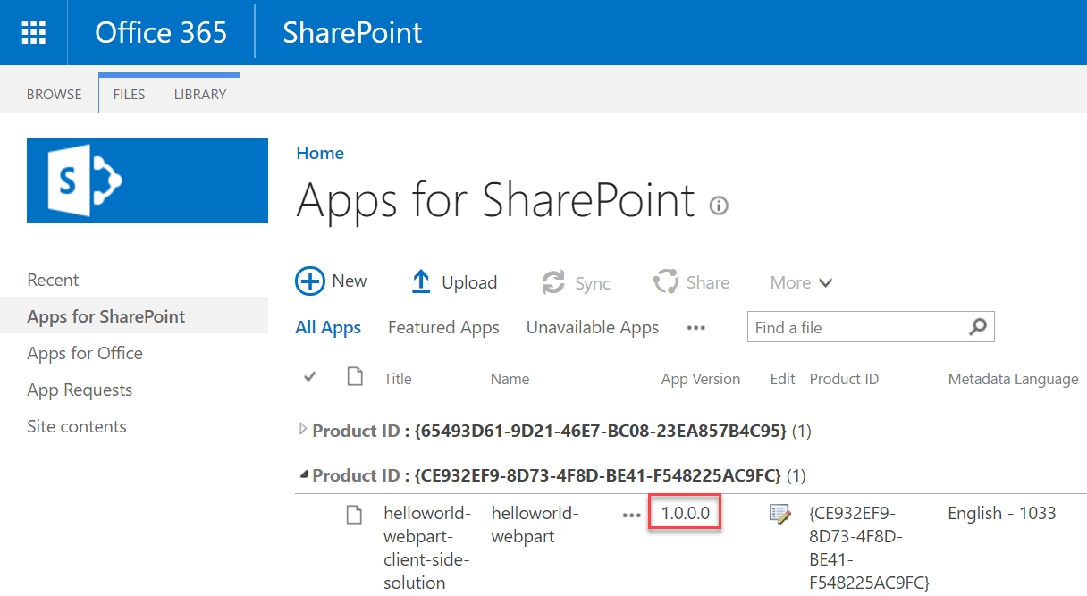
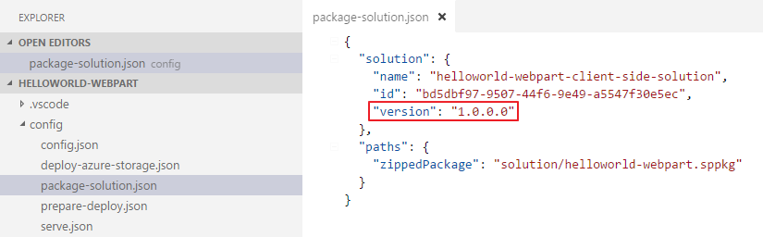
Update the version in the package-solution.json file
Sets the version for the *.sppkg package
Version is displayed in the tenant / site collection App Catalog
Triggers the SharePoint app upgrade process
Will reactivate / upgrade any features

Slide 6
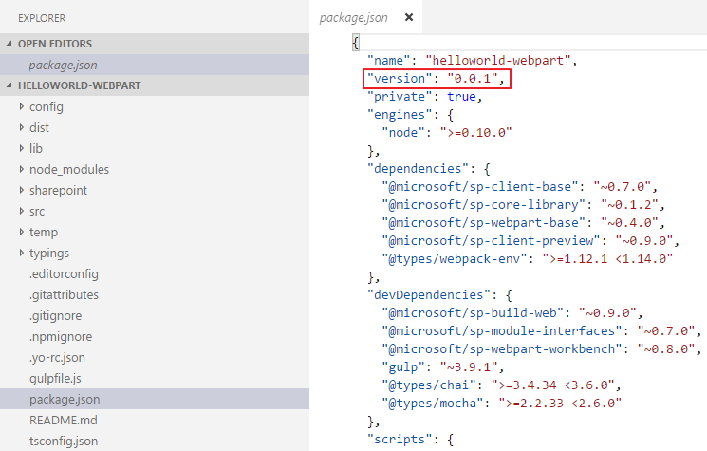
Update the version in the package.json file
Change the component version every time the package changes

Slide 7
Demo Updating SharePoint Framework Component & Package Versions

Slide 8

Summary
Updating Component Versions
Updating SharePoint Package Versions

Slide 9
Reading further
SharePoint Framework
https://docs.microsoft.com/sharepoint/dev/spfx/sharepoint-framework-overview

Slide 10
Thank you.

