Slide 1
Build Microsoft Teams customization using SharePoint Framework
Configuration

Slide 2

Overview
Custom Microsoft Teams Tab Configuration Options
Configure Once at Install
Edit Configuration in the Future
Notes:
In this unit, you'll learn how to configure your SharePoint Framework client-side web part's settings when its used as a tab in Microsoft Teams.

Slide 3
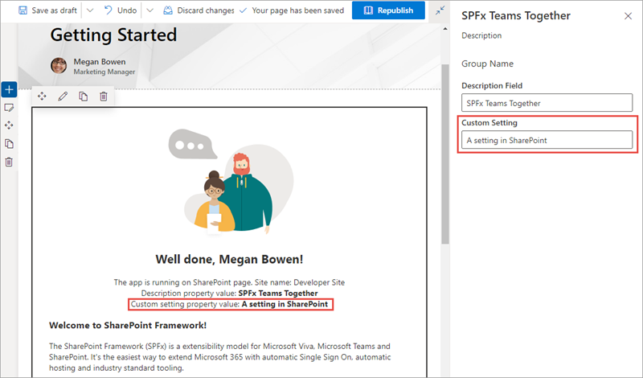
Custom Microsoft Teams Tab Configuration Options
SharePoint Framework web parts have public properties
Public properties can be made editable via the property pane
SharePoint page must be in edit mode to edit properties
User must have edit rights to the page to access the property pane
Notes:
SharePoint client-side web parts can have public properties. Developers can expose these properties to form controls within the SharePoint property pane for users to edit.
The property pane is only available when the page is in edit mode and only after a user has selected the edit control on the web part. The current user must also have access to edit the page in order to modify the settings on the web part.

Slide 4
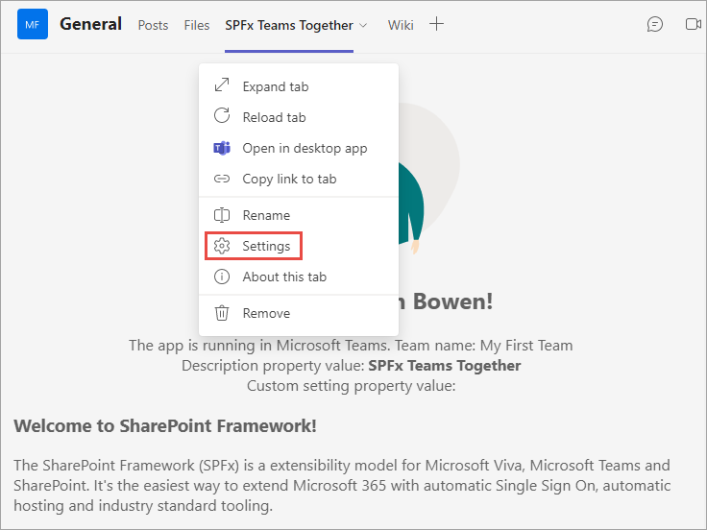
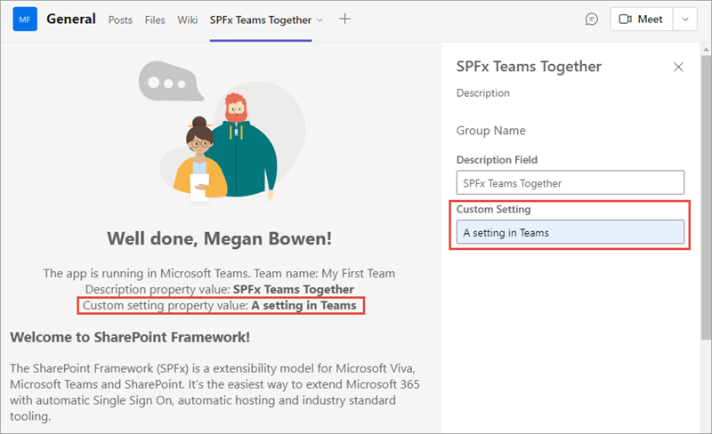
Property Pane Exposed in Microsoft Teams
Web Part property pane displayed when SPFx web part installed as a tab in a Microsoft Teams team
Accessible via the tab context menu Settings option
Notes:
The properties, called *settings*, on a tab in Microsoft Teams can also be modified by a user. To modify a tab's settings, select the tab's context menu and select the **Settings** option.
When the **Settings** menu option is selected, Microsoft Teams tabs launch a dialog that the tab that the developer implements.
However, when a web part is used as a Microsoft Teams tab, the tab is loading a SharePoint page that's hosting the client-side web part. When the **Settings** menu item is selected in teams, instead of opening a dialog, Microsoft Teams notifies SharePoint the page is now in edit mode. SharePoint's native property pane experience is then used to display edit the web part's public properties:

Slide 5
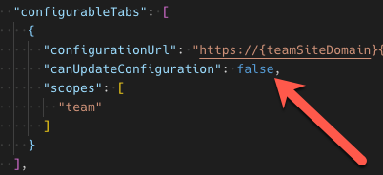
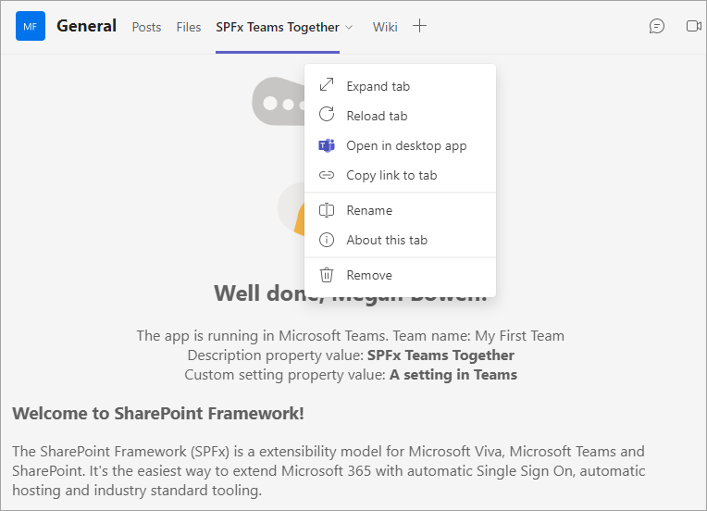
Configure Settings – Edit Only on Install
Developers optionally set property in Microsoft Teams app manifest to only allow SPFx web part properties to be set when tabs installed
Notes:
Users who have the necessary permissions can always edit SharePoint Framework client-side web parts, including immediately after they are added to the page and any point in the future.
Microsoft Teams tabs differ from web parts in that the settings experience is displayed once when the tab is added to a channel and optionally in the future. This enables someone who has access to add a tab to a channel to modify the settings, but can optionally block tab users from modifying the settings at a later date.
Developers can control this setting for the tab in the Microsoft Teams app manifest file.
The tab's `canUpdateConfiguration` property is set to `true` by default, but you can override this and set it to `false`.
When set to `false`, the settings page is only displayed immediately before the tab is added to the channel. In this scenario, the **Settings** button is not present on the tab's context menu:

Slide 6
Demo Configuring SPFx Web Parts as Microsoft Teams tabs

Slide 7

Summary
Custom Microsoft Teams Tab Configuration Options
Configure Once at Install
Edit Configuration in the Future

Slide 8
Reading further
SharePoint Framework
https://docs.microsoft.com/sharepoint/dev/spfx/sharepoint-framework-overview
Building Microsoft Teams Tabs using SharePoint Framework
https://docs.microsoft.com/sharepoint/dev/spfx/integrate-with-teams-introduction

Slide 9
Thank you.

