Slide 1
Developing with the SharePoint Framework: Web Parts
Testing the Web Part in the Local & Hosted Workbench

Slide 2

Exploring a SharePoint Framework Project
Local Workbench
Hosted Workbench
Different modes of the gulp serve task

Slide 3
SPFx Utilities
SPFx includes many utility libraries that make developing SPFx components easier for developers
To use the utilities
Import the appropriate utility library (if necessary)
Call methods in the libraries

Slide 4
Status Renderers
Use when a web part is loading information from SharePoint or to display errors if a web part runs into issues that could prevent it from working properly
Available via the web part context property
Use the entire web part UX
Loading indicators
Useful when you are initializing or loading any content in your web part.
Error indicators
Used to display error messages.

Slide 5
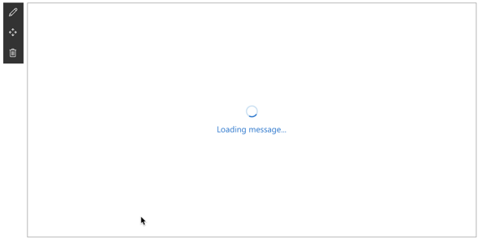
Loading Indicator
Display the loading indicator: displayLoadingIndicator()
Clear the loading indicator: clearLoadingIndicator()
this.context.statusRenderer.clearLoadingIndicator(this.domElement);
this.context.statusRenderer.displayLoadingIndicator(this.domElement, "message");

Slide 6
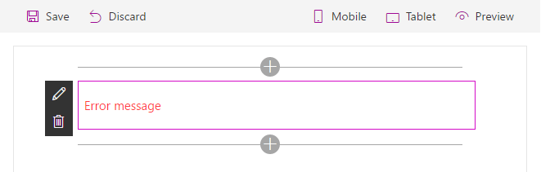
Error Indicator
Show an error, call renderError
Clear an error, call clearError
this.context.statusRenderer.renderError(this.domElement, err);
this.context.statusRenderer.clearError(this.domElement);

Slide 7
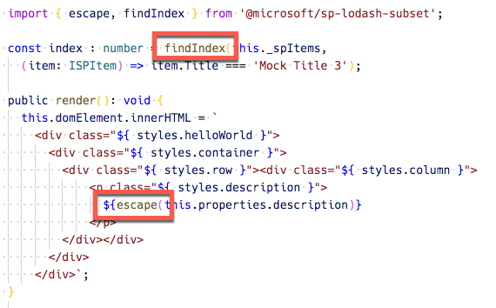
Lodash Utility Library
Use to perform operations on various objects like arrays, numbers, strings etc.
SharePoint Framework includes a subset of the lodash utility library:
https://lodash.com & https://www.npmjs.com/package/@microsoft/sp-lodash-subset
Notes:
Lodash is a great JavaScript utility library that you can use to perform operations on various objects like arrays, numbers, strings etc., SharePoint Framework includes the lodash utility library for use with SharePoint Framework out-of-the-box so you do not need to install it separately. To improve run-time performance, it only includes a subset of the most essential lodash functions.

Slide 8
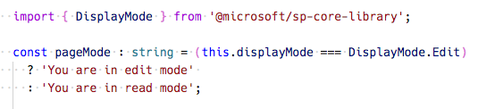
Page Display Modes
Classic Pages
Page and web part can be in different modes
Modern Pages
Page and web part are always in the same mode
Notes:
SharePoint pages have display modes which indicate in which mode that page and/or its contents (e.g. text and web parts) are displayed. In the classic server-side SharePoint page, the web page and the web part can be in different modes. For example, the web page can be in edit mode while the web part is not in edit mode. In the modern client-side SharePoint page, both the page and/or its contents are in the same mode.

Slide 9
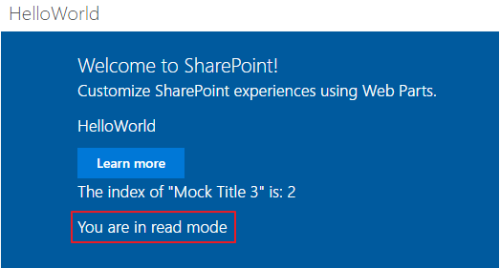
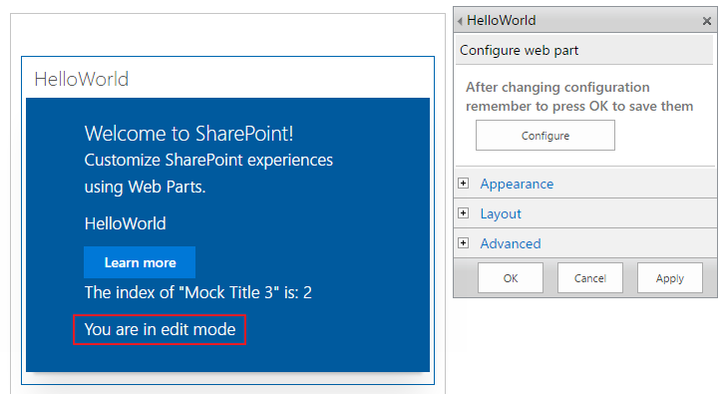
Page Display Modes – Classic Page
Page is not in Edit mode
Page is in Edit mode and the web part is in Edit mode
Page is in Edit mode and the web part is not in Edit mode

Slide 10
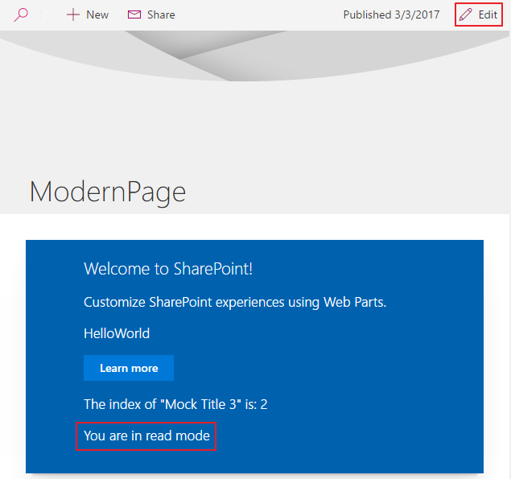
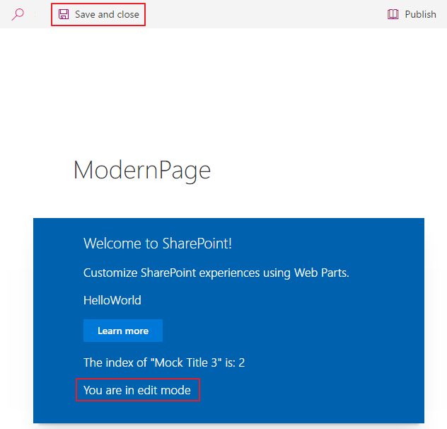
Page Display Modes – Modern Page

Slide 11
Page Context
Available with mock data in local Workbench
Fully available in SharePoint Workbench
Accessible Properties
Web title
Web absolute URL
Web server-relative URL
User login name
this.context.pageContext.web.title
Notes:
When the SharePoint workbench is hosted locally, you do not have the SharePoint page context. However, you can still test your web part in many different ways. For example, you can build the web part's UX and use mock data to simulate SharePoint interaction when you don't have the SharePoint context. However, when the workbench is hosted in SharePoint, you get access to the page context which provides various key properties, such as: - Web title - Web absolute URL - Web server-relative URL - User login name

Slide 12
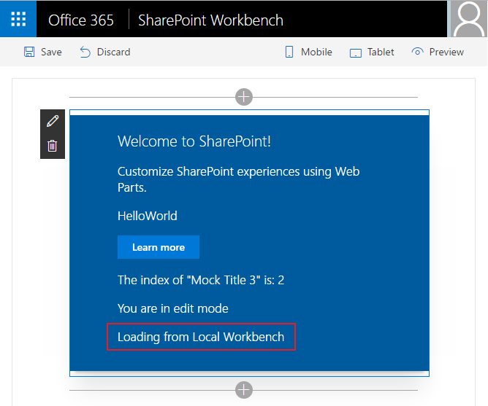
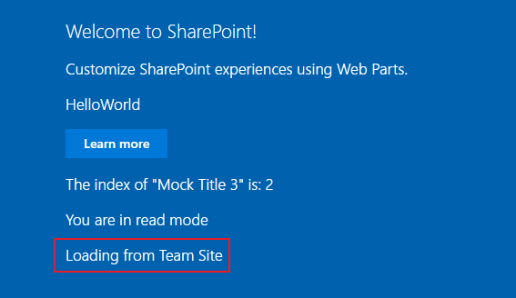
Page Context
web part running in the local Workbench
web part in the SharePoint Workbench, a modern, or a classic page

Slide 13
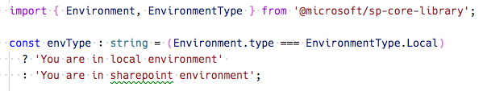
Environment Type
Use to determine where a web part is running
Local environment (aka: local workbench)
Real SharePoint environment (aka: hosted workbench)
Notes:
The SharePoint workbench gives you the flexibility to test web parts in your local environment and from a SharePoint site. The EnvironmentType module is used to determine which environment your web part is running in.

Slide 14
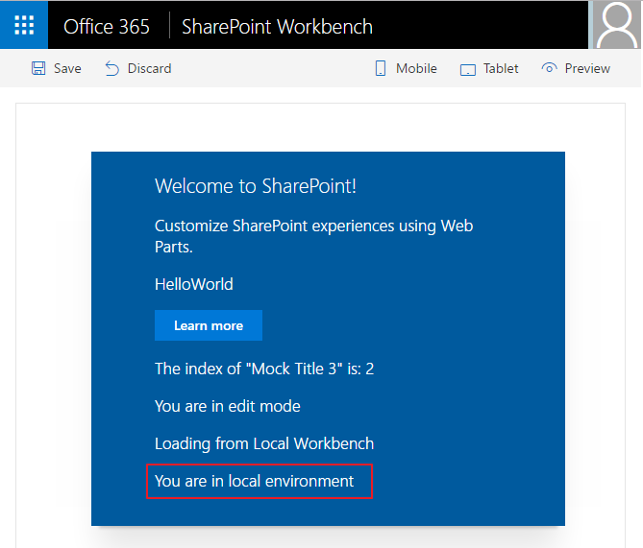
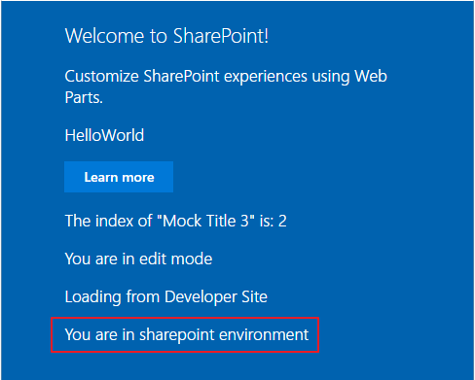
Environment Type
web part running in the local Workbench
web part running in the SharePoint Workbench in an Office 365 developer
Notes:
The SharePoint workbench gives you the flexibility to test web parts in your local environment and from a SharePoint site. The EnvironmentType module is used to determine which environment your web part is running in.

Slide 15
Logging
SPFx includes a built-in logging mechanism
All logging is output to the JavaScript console
Four static logging methods available
info : log information
warn : log warnings
error : log errors
verbose : log everything
The logging methods share the same signature
source: the source of the logging information (max 20 characters), such as the method or the class name
message: the actual message to log (max 100 characters)
scope: an optional service scope
The error method takes an Error object instead of a message string
Notes:
Logging is a very convenient and easy way to keep track of events happening in the web part, instead of having breakpoints, or alerts in JavaScript. The SharePoint Framework has a built-in logging mechanism.
Note: The Log class contains four static methods for logging:
info : log information
warn : log warnings
error : log errors
verbose : log everything
In the SharePoint Framework all logging is done to the JavaScript console and you can see the logging using the developer tools in a web browser.
All static methods have the same signature, except the error method - they take three arguments:
source: the source of the logging information (max 20 characters), such as the method or the class name
message: the actual message to log (max 100 characters)
scope: an optional service scope
The error method takes an Error object instead of the message string, otherwise they are the same.

Slide 16
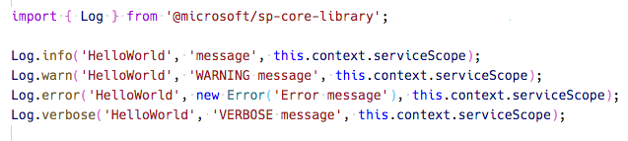
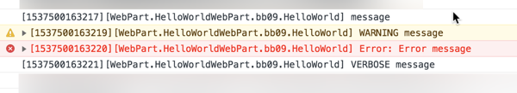
Logging
Notes:
Logging is a very convenient and easy way to keep track of events happening in the web part, instead of having breakpoints, or alerts in JavaScript. The SharePoint Framework has a built-in logging mechanism.
Note: The Log class contains four static methods for logging:
info : log information
warn : log warnings
error : log errors
verbose : log everything
In the SharePoint Framework all logging is done to the JavaScript console and you can see the logging using the developer tools in a web browser.
All static methods have the same signature, except the error method - they take three arguments:
source: the source of the logging information (max 20 characters), such as the method or the class name
message: the actual message to log (max 100 characters)
scope: an optional service scope
The error method takes an Error object instead of the message string, otherwise they are the same.

Slide 17
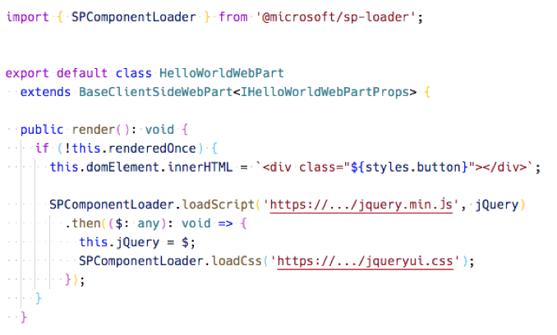
Loading scripts using SPComponentLoader
Notes:
Notice how the SPComponentLoader is wrapped in the if (!this.renderedOnce) clause. The render function of Client-Side Web Parts is called initially whenever a web part is added to the page, but also every time a web part property is changed in the Property Pane. Because we only want to load the scripts with the SPComponentLoader one time, we use the renderedOnce property to verify that the Web Part is rendering initially and then load the required modules.
When loading jQuery using the SPComponentLoader we load it as a global script associated with the jQuery variable. Also, as we're loading the Simple Weather jQuery plugin we need the global variable which the plugin is using to add itself to jQuery. Because the plugin is not an AMD module, the jQuery variable must be available in the global scope.
Also note, that after loading jQuery and before loading the Simple Weather plugin, we store the reference to jQuery in the this.jQuery variable. We we will need it in our custom renderContents function to instantiate the Simple Weather plugin in the Web Part.

Slide 18
Demo Exploring the SharePoint Framework API

Slide 19

Summary
Page Status
Environment Type
Logging
Loading Indicators

Slide 20
Thank you.

