Slide 1
Developing with the SharePoint Framework: Web Parts
Exploring a SharePoint Framework Project

Slide 2

Exploring a SharePoint Framework Project
Anatomy of a SharePoint Framework Project
Solution Lifecycle
Creating Client-Side Web Parts

Slide 3
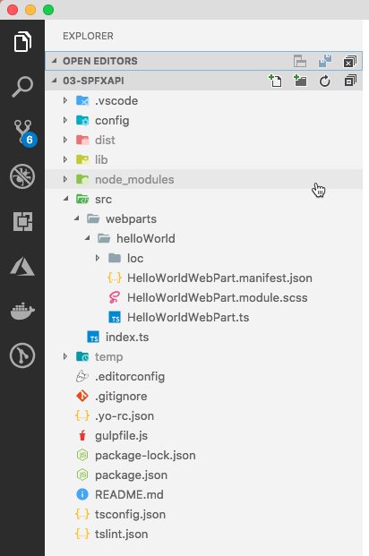
Project Structure
.vscode: includes Visual Studio Code integration files
config: includes all config files
dist: created automatically on builds – contains out from bundle process
lib: created automatically on builds – contains pre-bundled built files
node_modules: created automatically when installing all package dependencies with a package manager
src: this is the main folder of the project, it includes the web part, styles, and a test file
temp: created automatically on builds - contains local dev webserver files

Slide 4
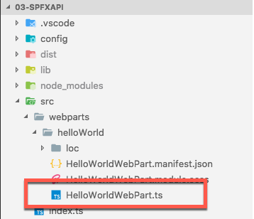
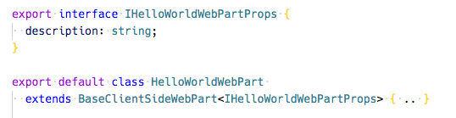
Key Files – web part class
Defines the main entry point for the web part
Extends the BaseClientSideWebPart
All client-side web parts must extend the BaseClientSideWebPart class in order to be defined as a valid web part
Notes:
BaseClientSideWebPart implements the minimal functionality that is required to build a web part. This class also provides many parameters to validate and access to read-only properties such as displayMode, web part properties, web part context, the web part instanceId, the web part domElement and much more.
Notice that the web part class is defined to accept a property type IHelloWorldWebPartProps.
The property type is defined as an interface:
export interface IHelloWorldWebPartProps { description: string; }

Slide 5

Key Files – web part properties class
Interface that defines the non-standard public properties on the web part
Persisted when the web part is saved / published from edit mode

Slide 6
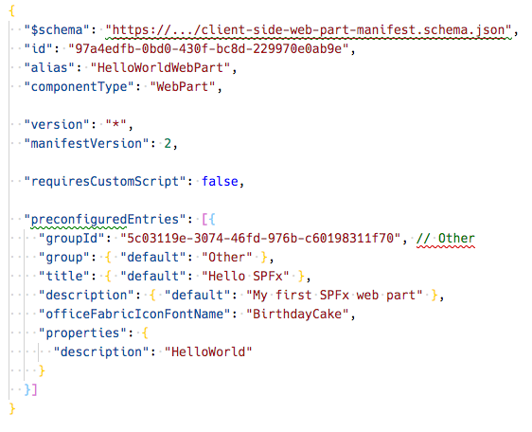
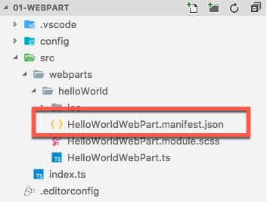
Key Files – web part manifest
Defines the web part metadata
Notes:
Defines the web part metadata such as version, id, componentType, manifestVersion, and description. Every web part must contain this manifest.

Slide 7
CSS Modules
https://github.com/css-modules/css-modules
All CSS classes are locally scoped
.helloWorld {} => .helloWorld_da83fer {}
SPFx’s build toolchain handles the complexities
Rules
*.module.scss - HelloWorldWebPart.module.scss
Use camelCasing; not kebab-casing
Reference classes in components as styles.helloWorldButton

Slide 8
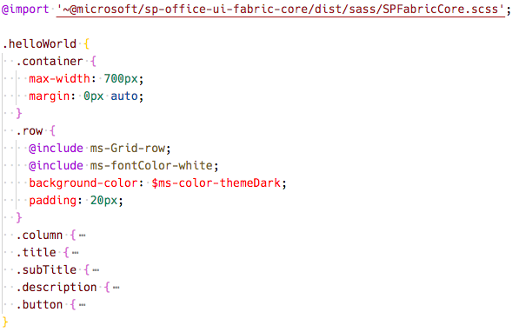
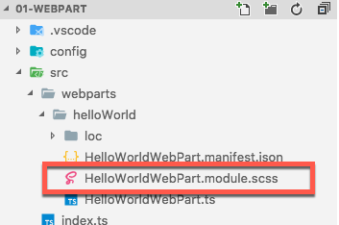
Key Files – SCSS file
Defines the web part styles
Notes:
When the project is built & compiled, the SharePoint Framework build process will do two things with this file.
First, it will compile the SCSS => CSS for use in the browser.
Then, it will generate two additional files.
One is a JavaScript file that exports a single object with the name/value properties will have the CSS module local unique names as the values for the class names that are the properties. The other file is a TypeScript declaration file that contains an interface of this file. Using these two files you can import them into your web part and reference the friendly class names rather than the generated CSS local module names.

Slide 9
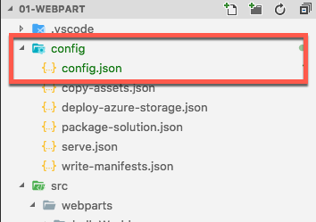
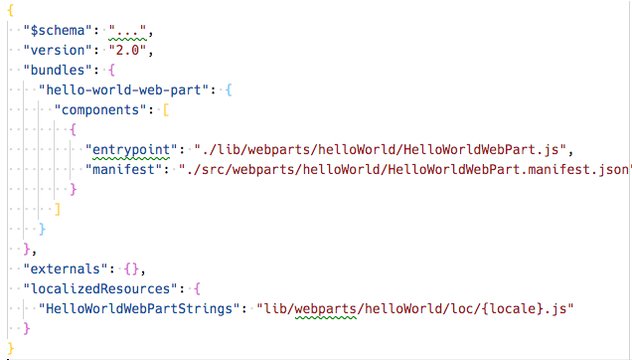
Key Files – config file
Contains information about your bundle(s), any external dependencies, localized resources
Specifies the AMD script libraries used in the web part
Notes:
This file contains information about your bundle(s) and any external dependencies and localized resources.
- The entries section contains the default bundle information.
- The externals section contains the libraries that are not bundled with the default bundle.

Slide 10
Client-side Web Part Build Flow
npm install @Microsoft/generator-sharepoint -g
gulp serve
gulp bundle --ship
Install SharePoint Generator
Test
Package/Deploy
yo @microsoft/sharepoint
workbench
gulp package-solution --ship
Scaffold SharePoint Web Part Project
Local or Hosted
Package/Deploy
Code .
manual upload of the app
Build Web Part Code
UAT / Pre-production
Release using app catalog*
Ship?
Available on Classic and Modern Pages

Slide 11
What the Gulp tasks do
clean: deletes temp folders created by build process (ie: dist, lib, temp)
build: build the project
default: equivalent to bundle
bundle: build, localize, and bundle the project
dev-deploy: deploy the current project to a development Azure CDN for sharing builds with colleagues
deploy-azure-storage: upload the assets to a Azure storage container
package-solution: package the project into a SPPKG
test: build, localize, and bundle the project and run tests, and verify the coverage
serve: build and bundle the project and run the development server
trust-dev-cert & untrust-dev-cert: trusts / untrusts the development SSL certificate in the local machine’s trusted root authority (self-hosted HTTPS site)

Slide 12
Solution Packaging
Gulp tasks package solutions
Package contents are put into an .sppkg file
JavaScript files, CSS and other assets are not packaged, they must be deployed to an external location such as a CDN*
“includeClientAssets: true” changed this default behavior to include components in the *.sppkg file
> gulp package-solution
Notes:
The package-solution task uses a SharePoint Feature to package your web part. By default, the gulp task creates a feature for your web part.
You can view the raw package contents in the sharepoint folder.
The contents are then packaged into a .sppkg file. The package format is very similar to a SharePoint Add-in package and uses the Microsoft Open Packaging Conventions to package your solution.

Slide 13
SharePoint client-side web parts
Configurable, reusable, purpose-built components
Add functionality to SharePoint experiences
Web Parts
Framework for connecting related components
Context aware parts
Notes:
Main point: Keep light on vision, more on outline for today and why we are investing in our innovation areas influenced by where we are seeing the most usage (outside circle), consistently influenced by our productivity pillars (inside circle)

Slide 14
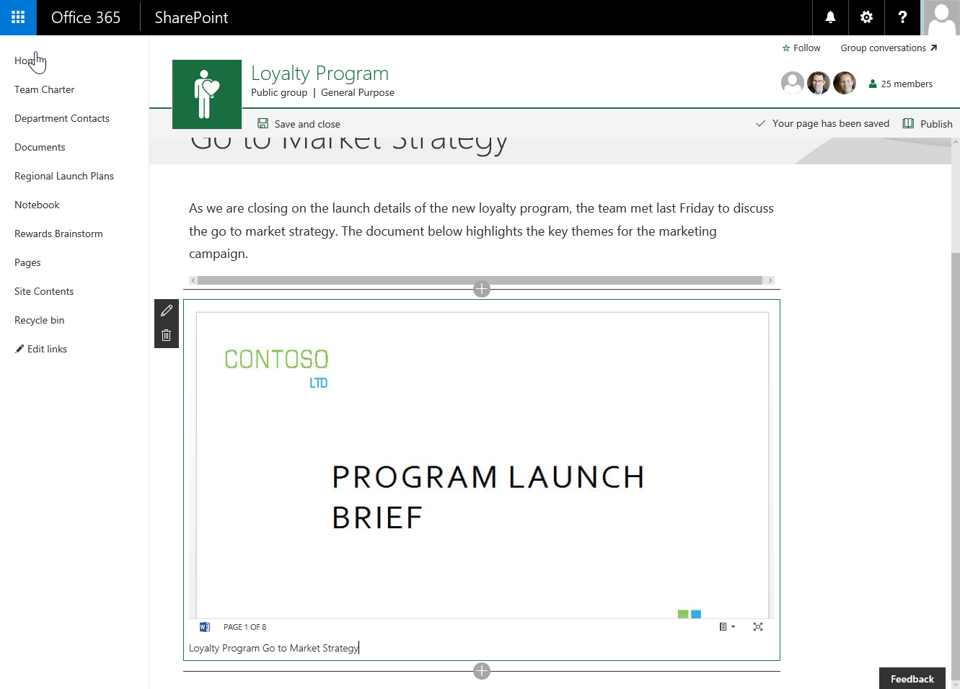
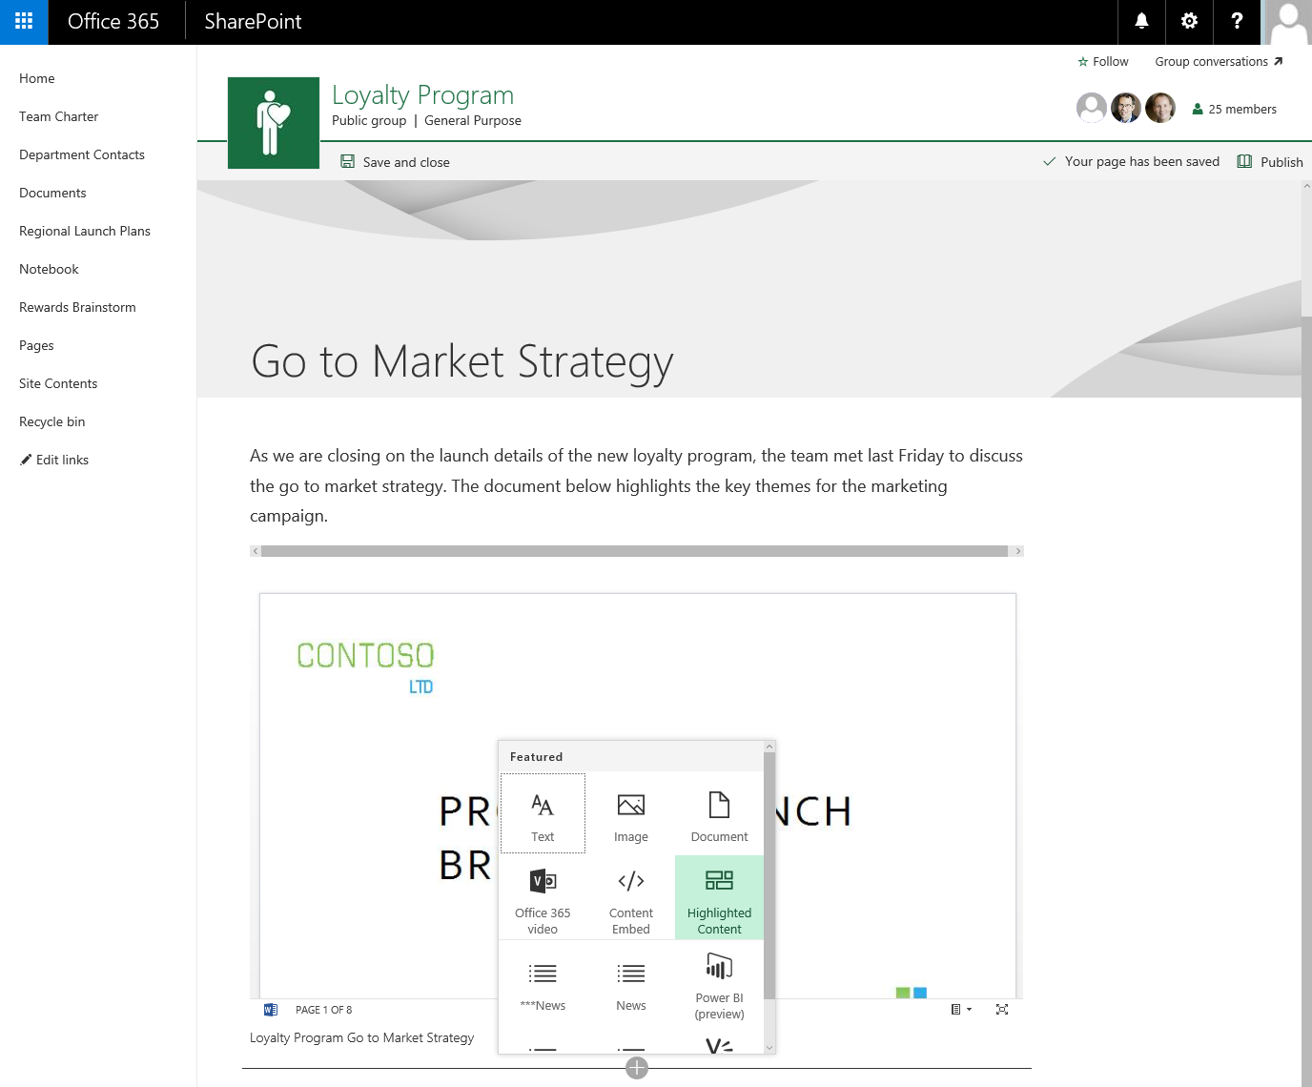
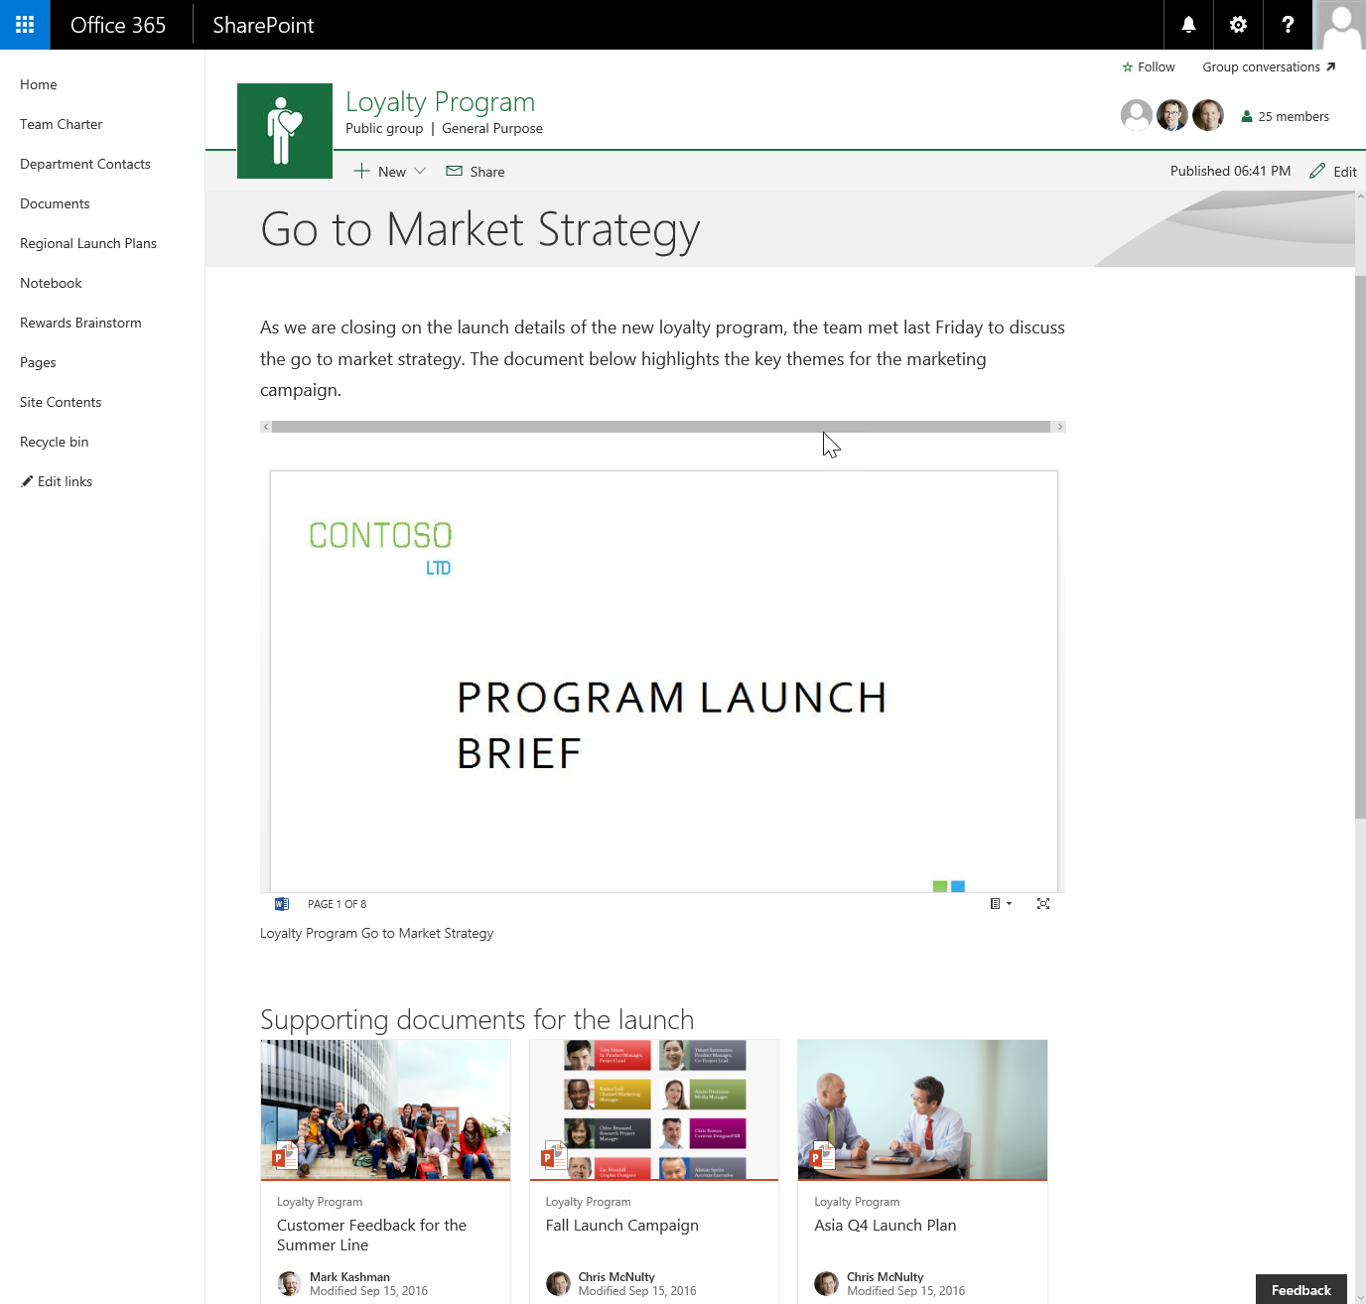
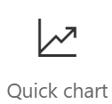
Client-side web parts
They are still web parts!
Built for the modern, JavaScript-driven web
Runs directly inside a SharePoint Page

Slide 15
Demo Creating SharePoint Framework Client-Side Web Parts

Slide 16

Summary
Anatomy of a SharePoint Framework Project
Solution Lifecycle
Creating Client-Side Web Parts

Slide 17
Reading further
SharePoint Framework
https://docs.microsoft.com/en-us/sharepoint/dev/spfx/sharepoint-framework-overview
Overview of SharePoint client-side web parts
https://docs.microsoft.com/sharepoint/dev/spfx/web-parts/overview-client-side-web-parts

Slide 18
Thank you.

