Slide 1
Developing with the SharePoint Framework: Web Parts
Testing the Web Part in the SharePoint-hosted Workbench

Slide 2

Testing SharePoint Framework Web Parts
Local Workbench
Hosted Workbench
Different modes of the gulp serve task
Notes:
In this unit, you'll learn how to test custom web parts using the SharePoint-hosted workbench.

Slide 3
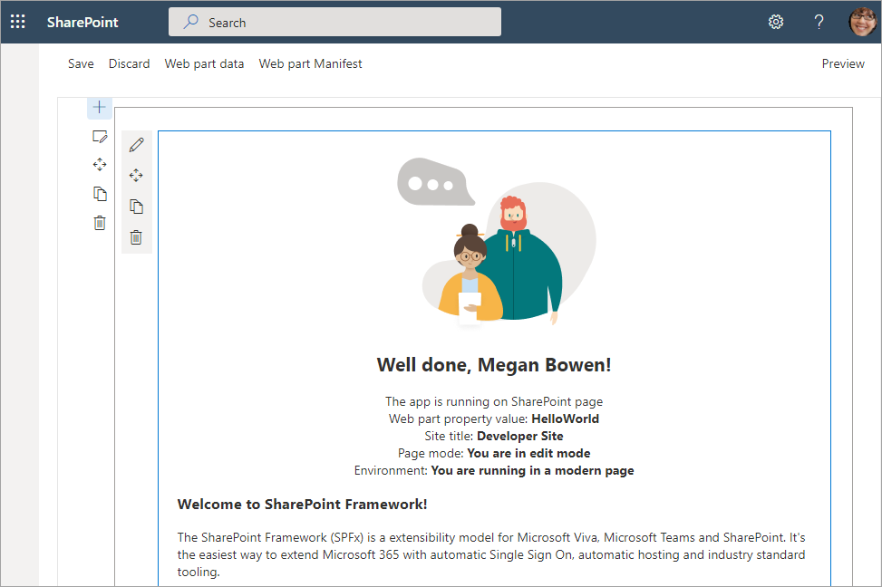
SharePoint Workbench
Local development time experience
Test your changes immediately
Notes:
Microsoft provides developers page to test SharePoint Framework projects. The workbench is a special SharePoint page that contains a single canvas to which developers can add their web parts.

Slide 4
Local Workbench vs. SharePoint Workbench
Local
Included with the SharePoint Framework version 1.12.1 and earlier
Runs on https://localhost
Has no SharePoint Context
Developers can leverage uses mock data
SharePoint-hosted
Runs on a real SharePoint Site
https://<your-sharepoint-site>/_layouts/workbench.aspx
Has SharePoint Context
Uses SharePoint data
Notes:
### Local workbench
The local workbench is included with the SharePoint Framework version 1.12.1 and earlier. It runs on https://localhost that has no SharePoint context. It's simply an HTML page that loads the SharePoint Framework in the browser.
The local workbench is not included with current versions of the SharePoint Framework, thus it is not covered in the modules in this learning path.
### SharePoint-hosted workbench
The SharePoint-hosted workbench is located at **https://{your-sharepoint-site}/_layouts/workbench.aspx**. Because this workbench is hosted by a real SharePoint site, it has SharePoint context. This means that your web part can access data in SharePoint lists and libraries in the same site as the hosted workbench.
Even though the gulp **serve** task will monitor your project and rebuild it when changes are made, it won't automatically refresh the browser containing the hosted workbench. To see the changes, you'll need to manually refresh the browser where the workbench is loaded.

Slide 5
Debugging
Build and run solution on local server and automatically launch the SharePoint Workbench
Build and run solution on local server
> gulp serve
> gulp serve --nobrowser
Notes:
The gulp **serve** task used to start the local web server monitors your SharePoint Framework project's codebase while you're testing web parts in the workbench. When a file is changed and saved, the gulp task will rebuild the project.
While hosted in a real SharePoint site, the SharePoint-hosted workbench is still intended to be a local development test environment that allows you to test your code changes immediately.
The hosted workbench requires you to start the local web server that will serve the workbench the SharePoint component's manifest and JavaScript bundle. To do this, execute the following command at the command line from the root of your project:
```console
gulp serve
```
This command will run the **build** and **bundle** tasks, start the local web server, launch the default browser, and load the workbench page at the URL configured in **serve.json**. If you don't want it to launch the browser automatically, include the **--nobrowser** switch:
```console
gulp serve --nobrowser
```

Slide 6



Mapping Files Making Debugging Easier
SPFx web parts are authored in TypeScript
The build process transpiles the TypeScript into JavaScript, then bundles it all into a single file
As a result, it can be hard to debug the resulting JavaScript bundle
Source code mapping files make it possible to debug the original unbundled TypeScript code
Notes:
SharePoint Framework projects is authored with TypeScript and the build process transpiles the TypeScript into JavaScript. It then bundles the built files into a single file. As a result of this transpiling & bundling process, it can be hard to debug the JavaScript that's generated in the build process and map it back to the TypeScript you wrote.
Source code mapping files make it possible to debug the original TypeScript code from the running JavaScript code. Mapping files map each line in the generated JavaScript code back to the TypeScript code it was generated from. When you set a breakpoint in JavaScript, a tool such browser development tools or editors like Visual Studio Code, will show you the TypeScript when your breakpoint is hit, even though it's the JavaScript that's running.

Slide 7
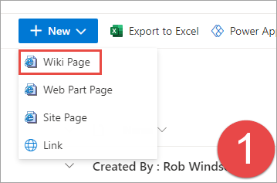
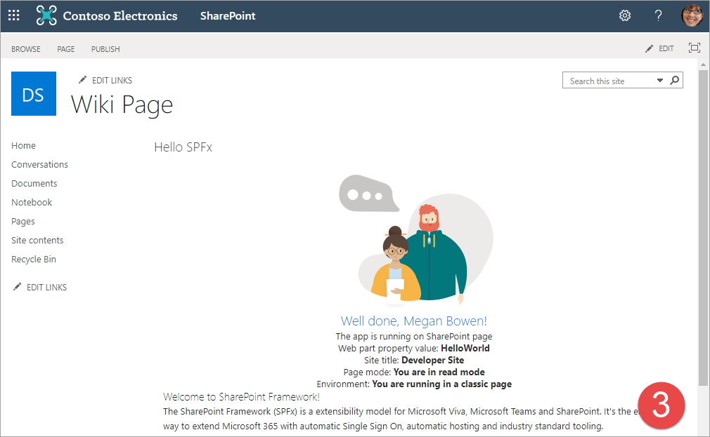
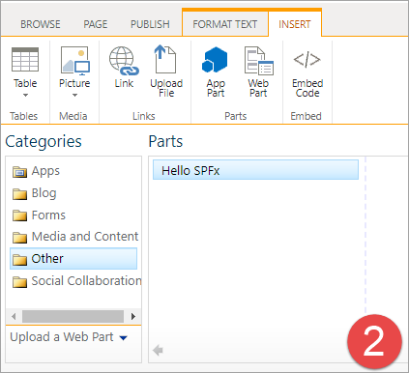
Classic Page
Notes:
SharePoint Framework web parts can run on both classic and modern pages. To test a web part on a classic page, you first put the page into edit mode and add the web part using the **Insert** tab in the ribbon, the same way you add server-side web parts.
Select the web part from the gallery to add it to the page.
Select the **Save and Publish** button in the ribbon to put the page back into read mode.
Put the page back into edit mode. Notice that even though the page is in edit mode, the web part is still in read mode.
Select **Edit web part** from the web part's context menu. Notice that the web part is now in edit mode.

Slide 8
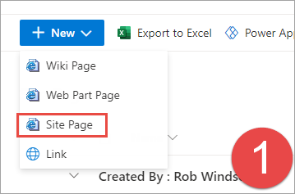
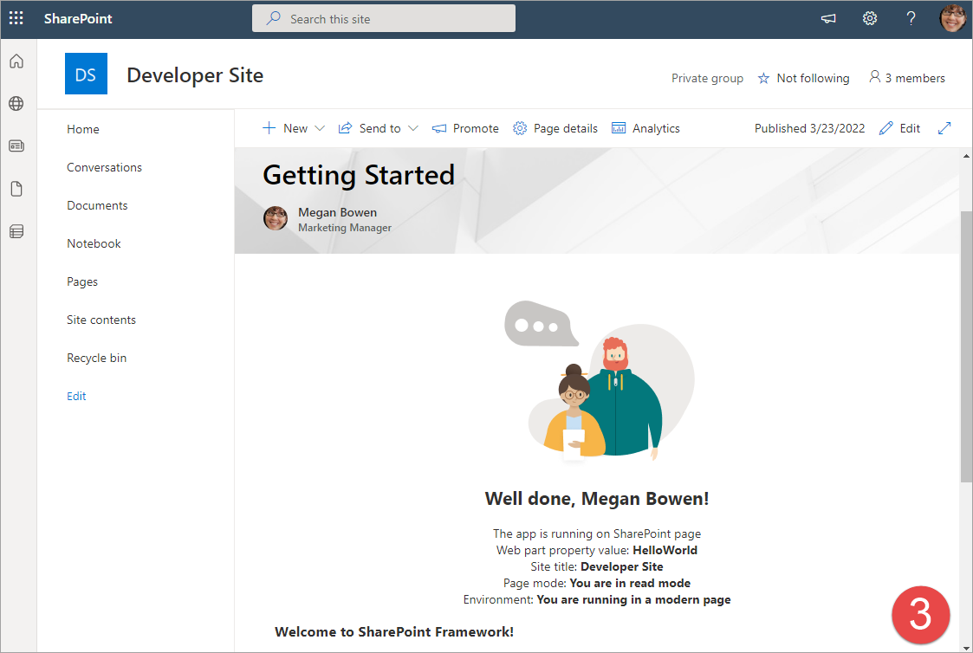
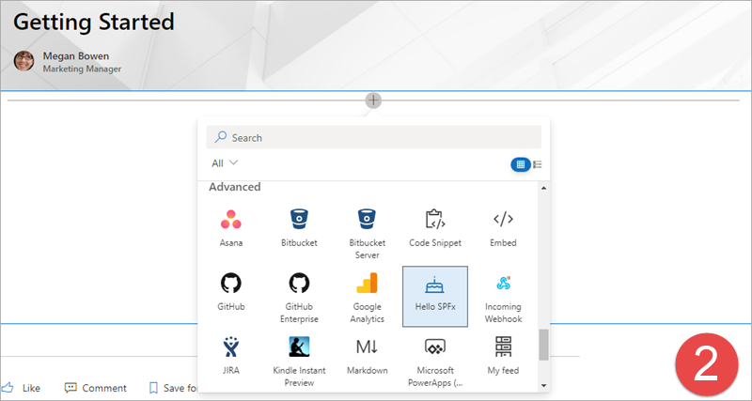
Modern Page
Notes:
There are small differences between a classic and modern pages when testing web parts.
Similar to the classic experience, create a new page or edit an existing one. Modern pages have a horizontal line with a + image that you use to open the web part toolbox.
Select the **Publish** or **Reublish** button to put the page back into read mode.
Put the page back into edit mode. Unlike the classic experience, the web part's mode always matches the mode of the page. If the page is in edit mode, so is the web part.

Slide 9
Demo Testing the Web Part in the SharePoint-hosted Workbench

Slide 10

Summary
Local Workbench
Hosted Workbench
Different modes of the gulp serve task

Slide 11
Reading further
Debugging SharePoint Framework solutions in Visual Studio Code
https://learn.microsoft.com/sharepoint/dev/spfx/debug-in-vscode
Debug SharePoint Framework solutions on modern SharePoint pages
https://learn.microsoft.com/sharepoint/dev/spfx/debug-modern-pages
Use the developer dashboard
https://learn.microsoft.com/sharepoint/dev/spfx/use-developer-dashboard

Slide 12
Thank you.

