Slide 1
Developing with the SharePoint Framework: Web Parts
Exploring the SharePoint Framework API

Slide 2

Exploring the SharePoint Framework API
SharePoint Framework utilities, indicators and libraries
Page modes
Page context
Environment types
Logging
Programmatically loading libraries
Notes:
In this unit, you'll learn about some of the features included in the SharePoint Framework API.

Slide 3
SPFx Utilities
SPFx includes many utility libraries that make developing SPFx components easier for developers
To use the utilities
Import the appropriate utility library (if necessary)
Call methods in the libraries
Notes:
The SharePoint Framework includes many utility APIs and libraries that make developing SharePoint Framework components easier. These utilities are available from the Framework API and from external libraries.

Slide 4
Status Renderers
Use when a web part is loading information from SharePoint or to display errors if a web part runs into issues that could prevent it from working properly
Available via the web part context property
Use the entire web part UX
Loading indicators
Useful when you are initializing or loading any content in your web part.
Error indicators
Used to display error messages.
Notes:
The first utility we'll cover is the status renderers. These indicators are ideal for use when you have an error to display or when your component is doing a long-running asynchronous operation.
The status renderers are available from the web part's `context` property so there's nothing to import or add to your project to use them. When used, the status renderer will take up the entire web part user experience. There are two types of renderers available to developers:
- **loading indicators**: used when initializing or loading content in your web part
- **error indicator**: used to display error messages

Slide 5
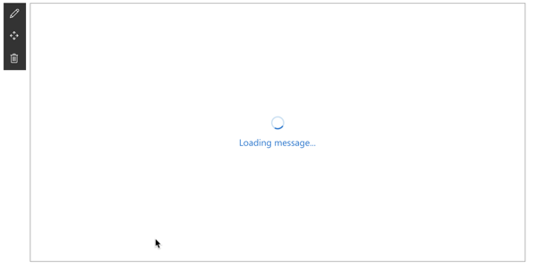
Loading Indicator
Display the loading indicator: displayLoadingIndicator()
Clear the loading indicator: clearLoadingIndicator()
this.context.statusRenderer.clearLoadingIndicator(this.domElement);
this.context.statusRenderer.displayLoadingIndicator(this.domElement, "message");
Notes:
Loading indicators are used when you need to initialize your web part and you want to provide some feedback to the user that something is happening. For example, a loading indicator can be shown when a web part is first added to the page, but needs to fetch information from Microsoft Graph, a remote API, when it first loads.
Instead of the user seeing a blank box on the page with no feedback that something is happening, you can show a loading indicator with an animated image and the message "Loading data.." to to user.
The two methods you'll use to control the indicator are `displayLoadingIndicator()` and `clearLoadingIndicator()`. Both methods are available from the `context` property on the web part.
The first parameter of both methods is the DOM element where the indicator should be placed. In this case, the indicator is taking up the entire area reserved for rendering the web part on the page.

Slide 6
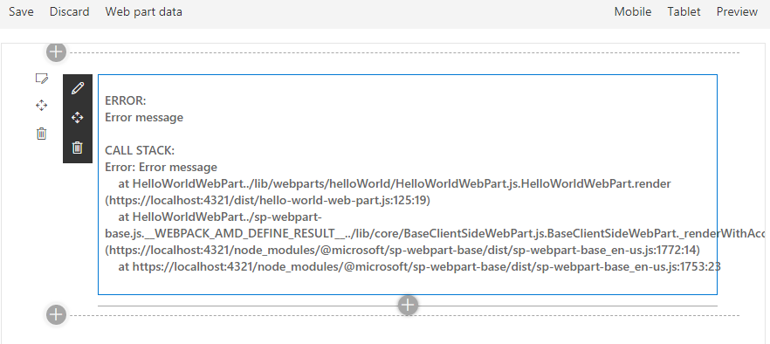
Error Indicator
Show an error, call renderError()
Clear an error, call clearError()
this.context.statusRenderer.renderError(this.domElement, err);
this.context.statusRenderer.clearError(this.domElement);
Notes:
Error indicators are used when you need to display errors to your users. They work the same way as loading indicators and are available from the `context` property on the web part.
Like the loading indicator, the first parameter of both methods is the DOM element where the indicator should be placed.

Slide 7
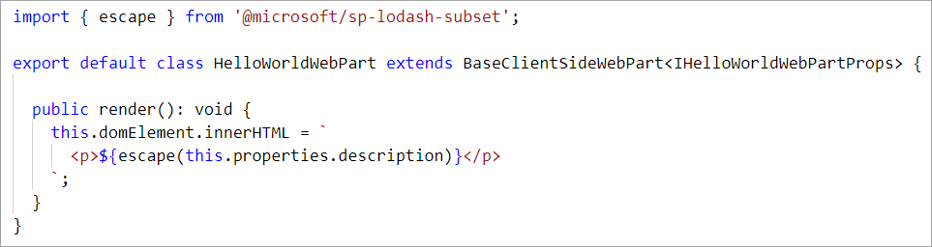
Lodash Utility Library
Use to perform operations on various objects like arrays, numbers, strings etc.
SharePoint Framework includes a subset of the lodash utility library:
https://lodash.com & https://www.npmjs.com/package/@microsoft/sp-lodash-subset
Notes:
Lodash is a great JavaScript utility library that you can use to perform operations on various objects such as arrays, numbers, and strings.
SharePoint Framework includes a repackage version of the the Lodash utility library that contains a subset of the most common and essential functions from larger Lodash to improve performance.
To use functions from the library, make sure you only import those functions that you will use in the current file. This will ensure you load only the minimally required code and not the entire Lodash subset library on the page:

Slide 8
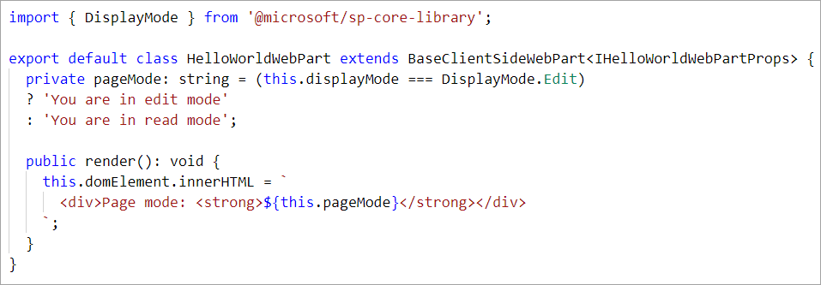
Page Display Modes
Classic Pages
Page and web part can be in different modes
Modern Pages
Page and web part are always in the same mode
Notes:
The SharePoint Framework API offers developers a way to determine the current display mode of a page. You can use this information to display a different experience for your users if the page is in read mode or edit mode.
To do this, use the `displayMode` property on the current component and compare it to one of the options on the enumeration `DisplayMode` available from the **@microsoft/sp-core-library** package:
> [!IMPORTANT]
> In a classic server-side SharePoint page, the web page and the web part can be in different modes. For example, the web page can be in edit mode while the web part is not in edit mode. In the modern client-side SharePoint page, both the page and/or its contents are in the same mode.

Slide 9
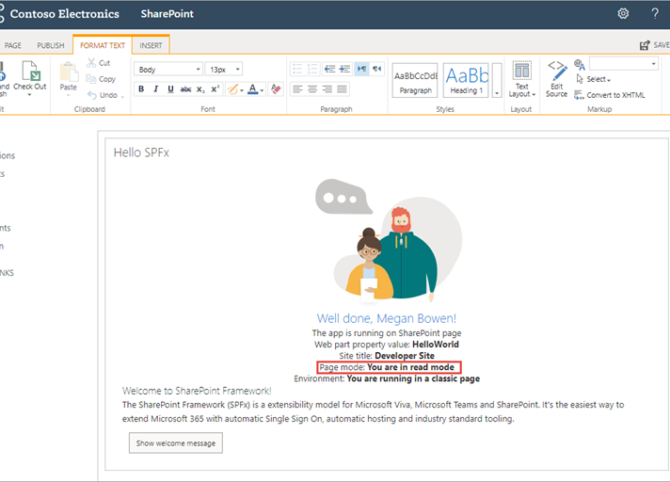
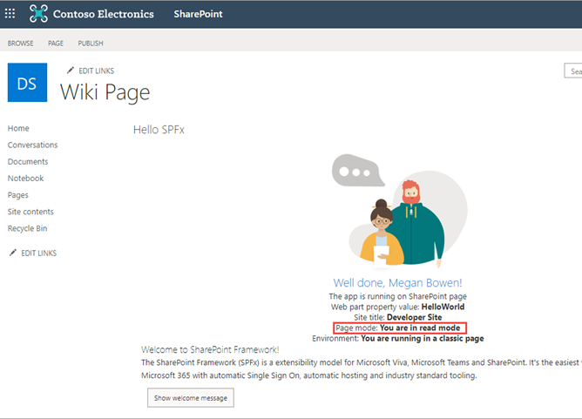
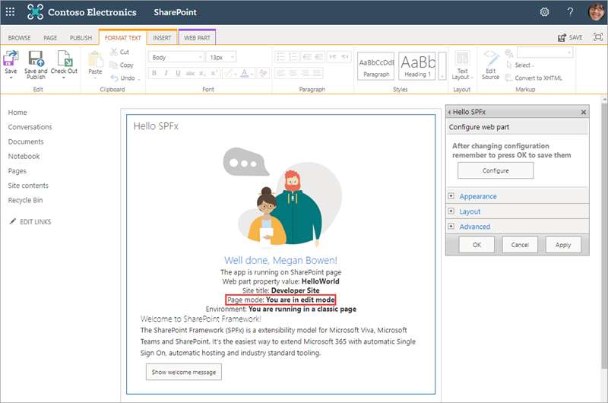
Page Display Modes – Classic Page
Page is not in edit mode
Page is in edit mode and the web part is not in edit mode
Page is in edit mode and the web part is in edit mode
Notes:
Here you can see the difference between the different page modes when the previous code runs on a web part. In this example, the web part has been added to a classic page. Notice how the page's and web part's display mode don't always match up. This is because a web part can be in read or edit mode when the page is also in edit mode:

Slide 10
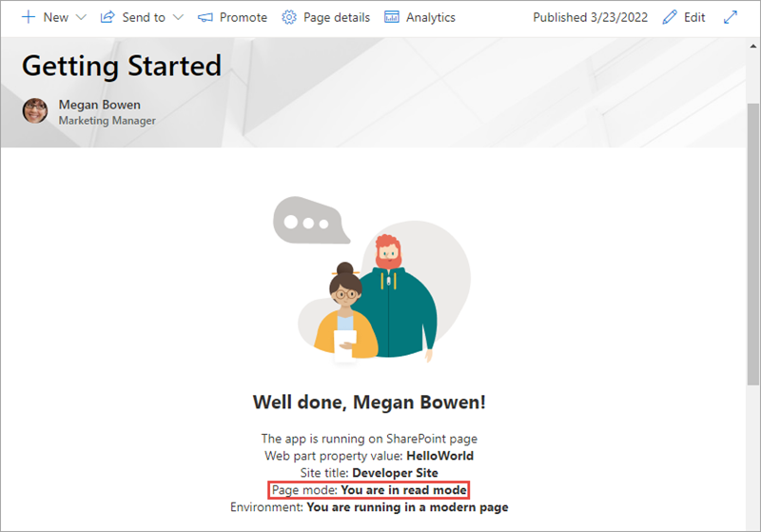
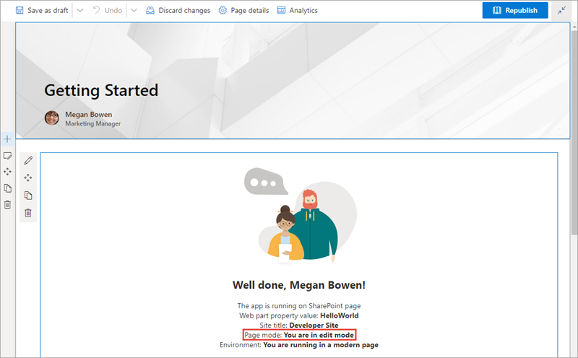
Page Display Modes – Modern Page
Notes:
While on a modern page, the display mode of the web part follows the same mode as the page.

Slide 11
Page Context
Fully available in SharePoint Workbench
Accessible Properties
Web title
Web absolute URL
Web server-relative URL
User login name
const siteTitle: string = this.context.pageContext.web.title;
Notes:
The SharePoint Framework API includes a reference to the context of the current page where the component is running. Use the `context` object, available from the component's base class, to access the page context:
Custom components can access the following properties on the page context:
- web title
- web absolute URL
- web server-relative URL
- current user login name

Slide 12
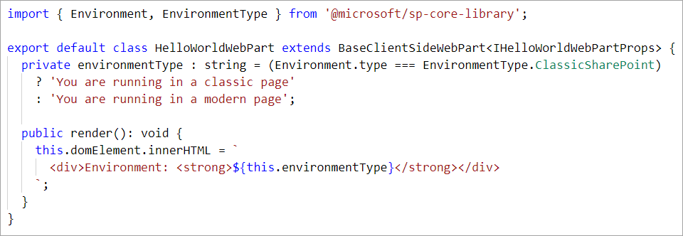
Environment Type
Use to determine where a web part is running
Classic page
Modern page
Test harness
Notes:
The SharePoint Framework API provides a mechanism you can use to detect the current environment. For example, to check if your web part is running in a classic or a modern page. To determine the current environment, import the Environment object and the EnvironmentType enumeration from the @microsoft/sp-core-library package:
The `EnvironmentType` enumeration has the following options:
- **Local**: (deprecated after SPFx v1.12.1) indicates the component is running in the local workbench
- **ClassicSharePoint**: indicates the component is running on a classic page
- **SharePoint**: indicates the component is running on a modern page (*includes the SharePoint-hosted workbench*)
- **Test**: indicates the component is running in a test harness

Slide 13
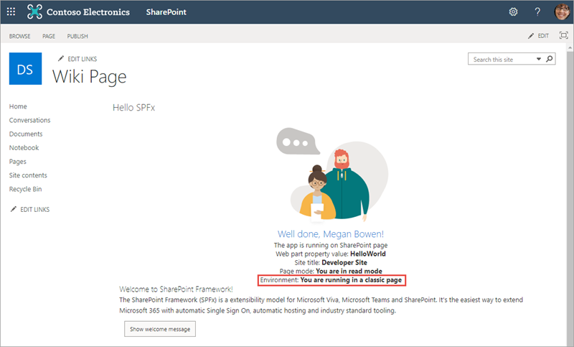
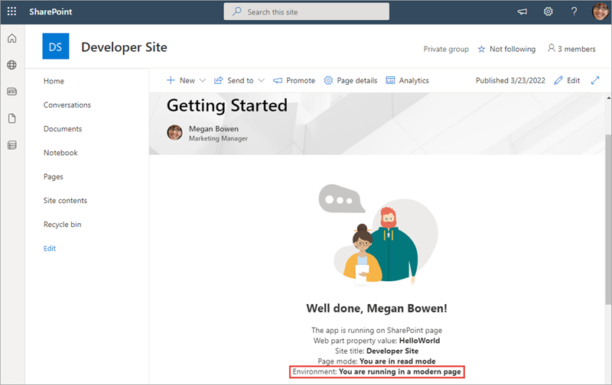
Environment Type
Web part running in a classic page
Web part running in a modern page
Notes:
The following figures show a web part running in a classic page and in a modern page:

Slide 14
Logging
SPFx includes a built-in logging mechanism
All logging is output to the developer dashboard
Four static logging methods available
info : log information
warn : log warnings
error : log errors
verbose : log everything
The logging methods share the same signature
source: the source of the logging information (max 20 characters), such as the method or the class name
message: the actual message to log (max 100 characters)
scope: an optional service scope
The error method takes an Error object instead of a message string
Notes:
Logging is a very convenient and easy way to keep track of events happening in the web part. The SharePoint Framework has a built-in logging mechanism.
The `Log` class contains four static methods for logging:
- **info**: log information
- **warn**: log warnings
- **error**: log errors
- **verbose**: log everything
In the SharePoint Framework, all logging is written to the developer dashboard.
All static methods have the same signature, except the error method - they take three arguments:
- **source**: the source of the logging information (*max 20 characters*), such as the method or the class name
- **message**: the actual message to log (*max 100 characters*)
- **scope**: an optional service scope
The error method takes an `Error` object instead of the message string, otherwise they are the same.

Slide 15
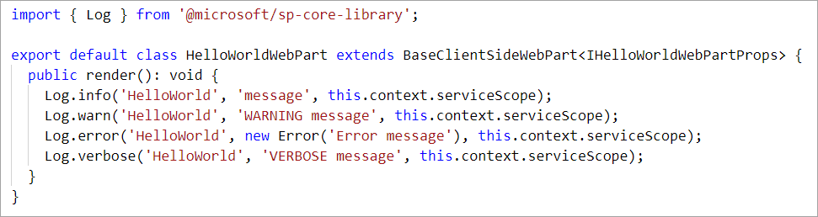
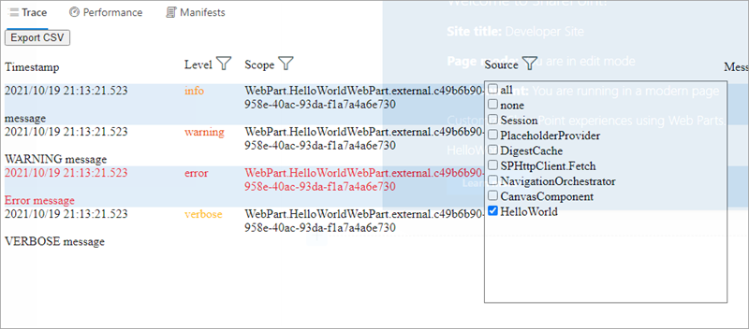
Logging
Notes:
To use the SharePoint Framework logging infrastructure, import the `Log` object from the **@microsoft/sp-core-library** package. Each of the methods will write a different type of logging message to the JavaScript console, as you can see here:

Slide 16
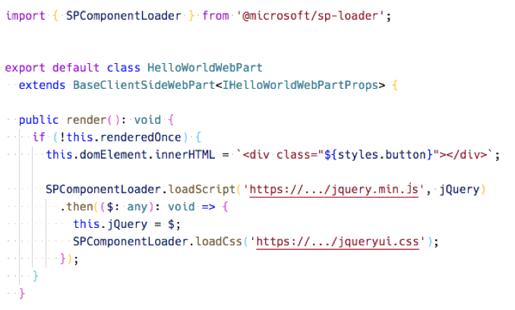
Loading scripts using SPComponentLoader
Notes:
When your component needs to programmatically load an external JavaScript or CSS file, you can use the `SPComponentLoader` object. This object can be found in the **@microsoft/sp-loader** package.
`SPComponentLoader` contains two methods: `loadScript()` and `loadCss()`. Both methods accept a string parameter of the URL of the file to load and return a JavaScript promise once the file has been loaded.
The `loadScript()` method accepts a second parameter that you can use to specify the object that the script should be assigned to when it is exported.
Notice how the `SPComponentLoader` is wrapped in the `if (!this.renderedOnce)` clause. The `render` function of client-side web parts is called initially whenever a web part is added to the page, but also every time a web part property is changed in the property pane. Because we only want to load the scripts with the `SPComponentLoader` one time, we use the `renderedOnce` property to verify that the web part is rendering initially and then load the required modules.
When loading jQuery using the `SPComponentLoader`, we load it as a global script associated with the `jQuery` variable.
Notice that after loading the jQuery library and before loading a CSS file for the jQuery UI project, we store the reference to jQuery in the `this.jQuery` variable.

Slide 17
Demo Exploring the SharePoint Framework API

Slide 18

Summary
Page Status
Environment Type
Logging
Loading Indicators

Slide 19
Thank you.

