Slide 1
Developing with the SharePoint Framework: Web Parts
Testing the Web Part in the Local & Hosted Workbench

Slide 2

Testing SharePoint Framework Web Parts
Local Workbench
Hosted Workbench
Different modes of the gulp serve task
Notes:
In this unit, you'll learn how to test custom web parts using both local and Office 365 hosted workbench.

Slide 3
Local Workbench vs. SharePoint Workbench
Local
Runs on https://localhost
Has no SharePoint Context
Developers can leverage uses mock data
SharePoint (Hosted)
Runs on a real SharePoint Site
https://<your-sharepoint-site>/_layouts/workbench.aspx
Has SharePoint Context
Uses SharePoint data
Notes:
Microsoft provides developers two options to test SharePoint Framework projects. The *workbench* is a special SharePoint page that contains a single canvas that developers can add their web parts to. There are two different workbench options: local & hosted.
### Local workbench
The local workbench is served up from executing the gulp **serve** task. It runs on https://localhost that has no SharePoint context. Its simply an HTML page that loads the SharePoint Framework in the browser.
The local workbench is a great option for developers develop and test web parts that don't require an instance of SharePoint. For web parts that need SharePoint context or work with live SharePoint data, you will need to mock data requests to test your web part in the local workbench.
### SharePoint-hosted workbench
The SharePoint-hosted workbench is hosted by a real SharePoint site, located at https://{your-sharepoint-site}/_layouts/workbench.aspx. The hosted workbench is unlike the local workbench in that because it is hosted by a real SharePoint site, it has SharePoint context. This means that your web part can access data in SharePoint lists and libraries in the same site as the hosted workbench.

Slide 4
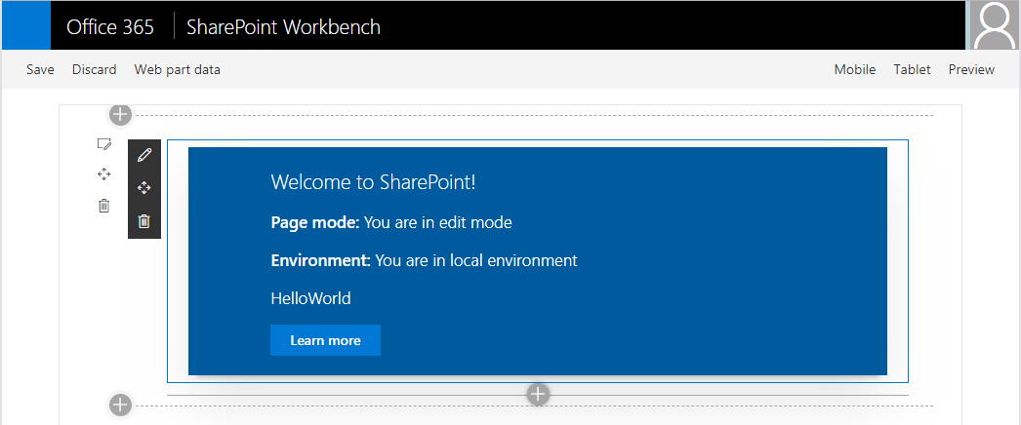
SharePoint Workbench
Local development time experience
Test your changes immediately even in offline mode
Notes:
The SharePoint-hosted workbench is hosted by a real SharePoint site, located at https://{your-sharepoint-site}/_layouts/workbench.aspx. The hosted workbench is unlike the local workbench in that because it is hosted by a real SharePoint site, it has SharePoint context. This means that your web part can access data in SharePoint lists and libraries in the same site as the hosted workbench.
While hosted in a real SharePoint site, the SharePoint-hosted workbench is still intended to be a local development test environment that allows you to test your code changes immediately.

Slide 5
Debugging
Build and run on local server and automatically launch local SharePoint Workbench
Build and run solution on local server
> gulp serve
> gulp serve --nobrowser
Notes:
The gulp **serve** task used to start the local web server monitors your SharePoint Framework project's codebase while you are testing web parts in the local workbench. When a file is changed and saved, the gulp task will rebuild the project and reload the local workbench in the browser, offering immediate feedback of you changes.
While hosted in a real SharePoint site, the SharePoint-hosted workbench is still intended to be a local development test environment that allows you to test your code changes immediately.
Both the local and hosted workbenches require you to start the local web server that will serve each workbench the SharePoint component's manifest and JavaScript bundle. To do this, execute the following command at the command line from the root of your project:
```shell
gulp serve
```
This command will run the **build** and **bundle** tasks, start the local web server, launch the default browser, and load the workbench page. If you don't want it to launch the browser automatically, include the `--nobrowser` switch:
```shell
gulp serve --nobrowser
```

Slide 6



Mapping Files Making Debugging Easier
SPFx web parts are authored in TypeScript
The build process transpiles the TypeScript into JavaScript, then bundles it all into a single file
As a result, it can be hard to debug the resulting JavaScript bundle
Source code mapping files make it possible to debug the original unbundled TypeScript code
Notes:
SharePoint Framework projects is authored with TypeScript and the build process transpiles the TypeScript into JavaScript. It then bundles the built files into a single file. As a result of this transpiling & bundling process, it can be hard to debug the JavaScript that's generated in the build process and map it back to the TypeScript you wrote.
Source code mapping files make it possible to debug the original TypeScript code from the running JavaScript code. Mapping files map each line in the generated JavaScript code back to the TypeScript code it was generated from. When you set a breakpoint in JavaScript, a tool such browser development tools or editors like Visual Studio Code, will show you the TypeScript when your breakpoint is hit, even though it's the JavaScript that's running.

Slide 7
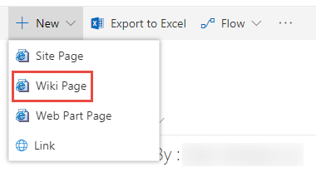
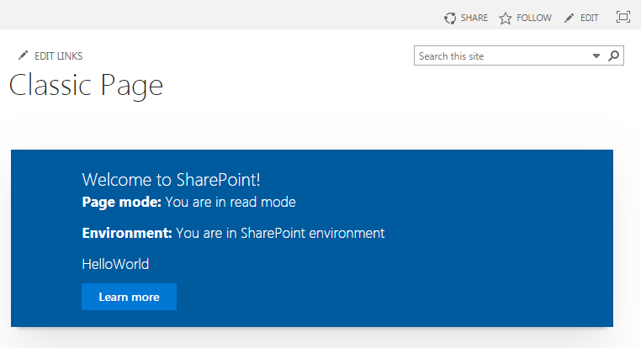
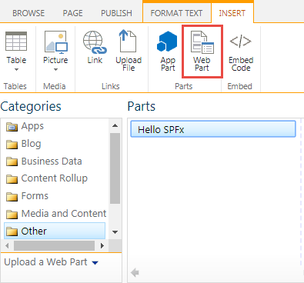
Classic Page
1
3
2
Notes:
SharePoint Framework web parts can run on both classic and modern pages. To test a web part on a classic page, you first put the page into edit mode and add the web part using the **Insert** tab in the ribbon, the same way you add server-side web parts.
Select the web part from the tool box to add it to the page.
To edit the web part's properties, you must select the web part and then select **Edit web part** from the ribbon while the page is in edit mode. This means that while a classic page can be in edit mode, the web part can be in either presentation or edit mode.

Slide 8
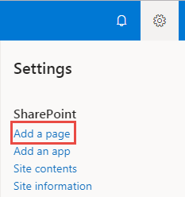
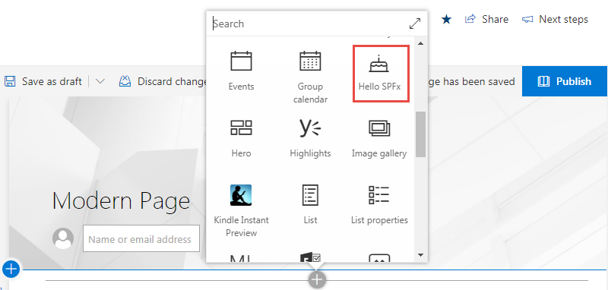
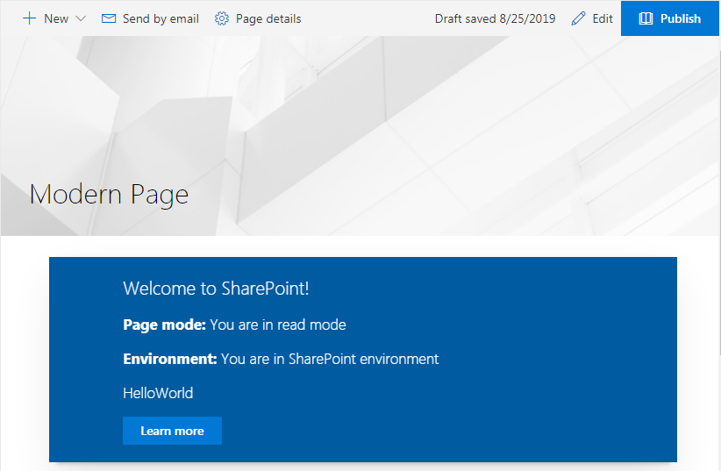
Modern Page
1
2
3
Notes:
There are small differences between a classic and modern pages when testing web parts.
Similar to the classic experience, create a new page or edit an existing one. Modern pages have a horizontal line with a **+** image that you use to open the web part toolbox.
To open the web part's property pane, select the **pencil** edit icon to the left of the web part when you hover the mouse of the web part.
Unlike the classic experience, the web part's mode always matches the mode of the page. If the page is in edit mode, so is the web part.

Slide 9
Demo Testing the Web Part in the Local & Hosted Workbench

Slide 10

Summary
Local Workbench
Hosted Workbench
Different modes of the gulp serve task

Slide 11
Reading further
Debugging SharePoint Framework solutions in Visual Studio Code
https://docs.microsoft.com/sharepoint/dev/spfx/debug-in-vscode
Debug SharePoint Framework solutions on modern SharePoint pages
https://docs.microsoft.com/sharepoint/dev/spfx/debug-modern-pages
Use the developer dashboard
https://docs.microsoft.com/sharepoint/dev/spfx/use-developer-dashboard

Slide 12
Thank you.

