Slide 1

Sentiment Analysis
By
Sharfaraz Mahmood
Trainee, FTFL - AI ML Training program
Giga Tech Limited

Slide 2
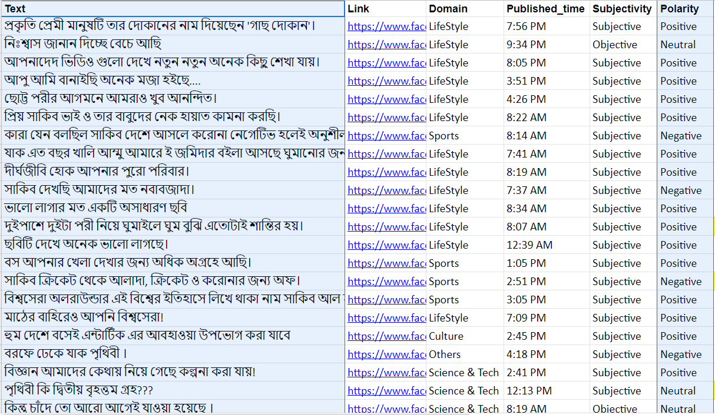
Data Collection
Data for the Sentiment analysis was collected from :
Facebook - Annotated by the trainees.
Kaggle - Pre Annotated Data.
In total 8544 texts were collected.
This is a THREE class classification problem:
Positive sentiment
Neutral sentiment
Negative sentiment
Link: https://docs.google.com/spreadsheets/d/1woz-2Zahf_3eSnwCxciopjsQqjxTX288IGwV1SvvlT0/edit#gid=0

Slide 3
Data Cleaning
Data collected from facebook contained some characters, emojis etc which needed to be cleaned. Following image shows an example,
13 texts were not annotated, these were discarded during the cleaning process.
Total data : 8531 annotated texts.
Train Validation test split
Data splitting was on the raition of 0.75: 12.5: 12.5 for the training, test and validation respectively. Resulting in : 6398 instances for training
1066 instances for validation
1067 instances for testing

Slide 4
Embedding
To apply a machine learning model on text data, texts need to be embedded. Here, two approaches were taken,
Using no embedding vectors in the embedding layer of the model
Word2vec embedding model generated vectors in the embedding layer.
Embedding with 100 dimensions is used for all the models.
ML Model
GRU neural network with different units and layer, and LSTM neural network were used for the learning process.

Slide 5
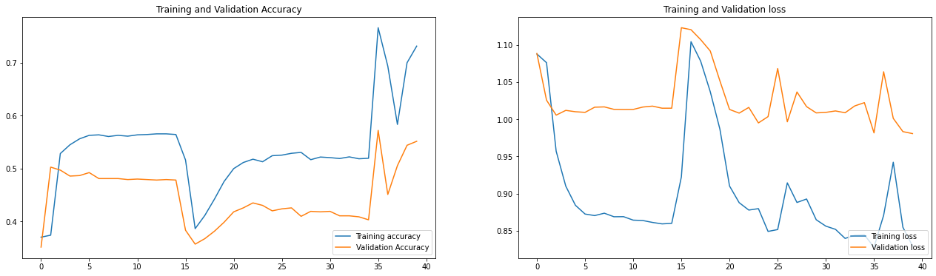
Results cont’d
Without Word2vec embeddings
LSTM 16 units with 1 hidden layer,
Dropout 0.2,
Epochs 40,
Batch size 64

Slide 6
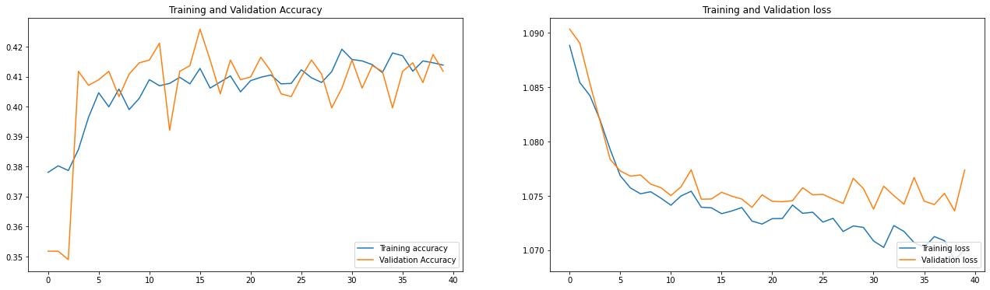
Results cont’d
With Word2vec embeddings
LSTM 16 units with 1 hidden layer,
Dropout 0.2,
Epochs 40,
Batch size 64

Slide 7
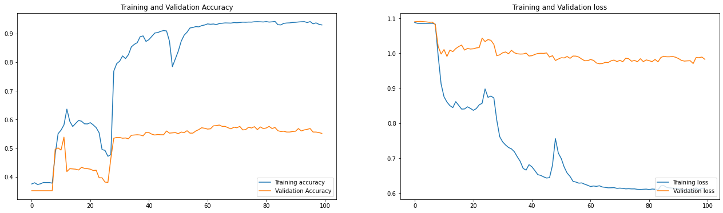
Results
Without Word2vec embeddings
GRU 32 units with 1 hidden layer,
Dropout 0.2,
Epochs 100,
Batch size 64

Slide 8
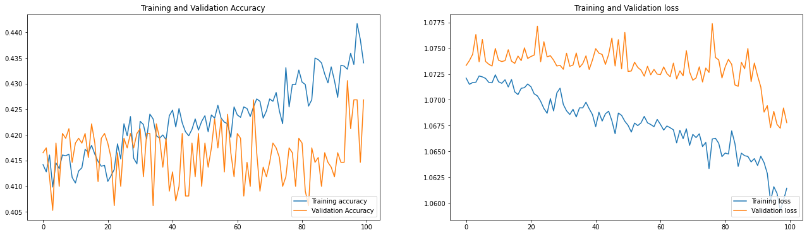
Results cont’d
With Word2vec embeddings
GRU 32 units with 1 hidden layer,
Dropout 0.2,
Epochs 100,
Batch size 64

Slide 9
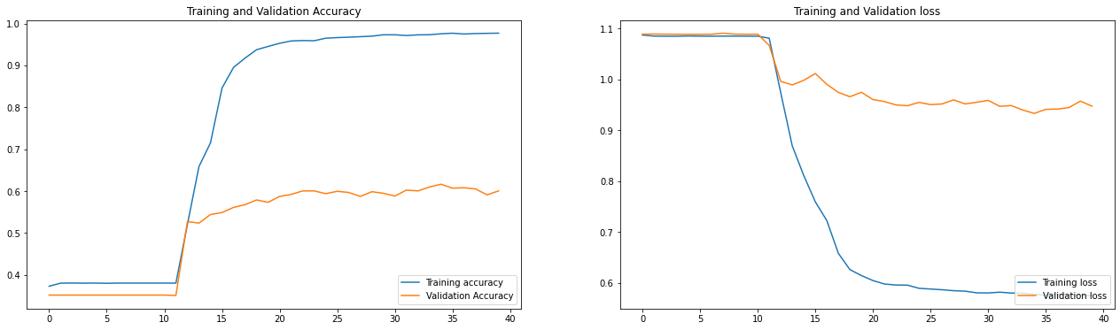
Results cont’d
Without Word2vec embeddings
GRU 16 units with 1 hidden layer,
Dropout 0.2,
Epochs 40,
Batch size 64

Slide 10
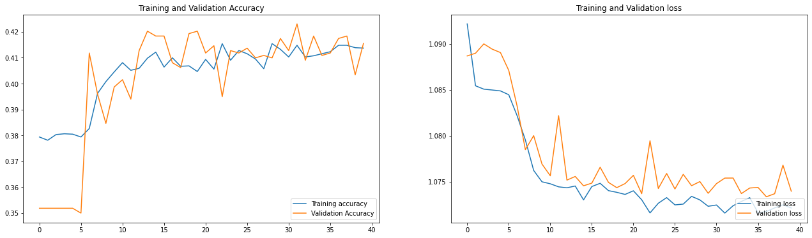
Results cont’d
With Word2vec embeddings
GRU 16 units with 1 hidden layer,
Dropout 0.2,
Epochs 40,
Batch size 64

Slide 11
Results cont’d
With Word2vec embeddings
GRU 32 & 16 units with 2 hidden layer,
Dropout 0.2,
Epochs 100,
Batch size 64

Slide 12
Findings
With Word2vec embeddings
Overfiits during the training with
accuracy around,
0.9 in training and 0.56 in testing for GRUs,
0.7 in training and 0.53 in testing for LSTM
With Word2vec embeddings
Did not overfit the model with accuracy around,
0.55 in training and 0.52 in testing for GRUs,
0.43 in training and 0.44 in testing for LSTM
Increasing the complexity of the model also introduces overfitting in the training.
While different embeddings produced different results in the model training, the validation and test results were similar.
GRU performed better then the LSTM model.

