Slide 1
Login App for Ezra.AI
Sharhad Bashar

Slide 2
What to expect in the next few slides
App overview
Different pages
MongoDB
Error messages
Re routing
Things I can improve on
App location: github link

Slide 3
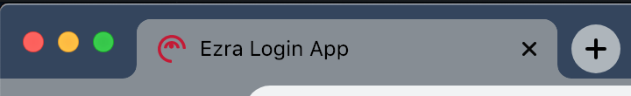
Hope you guys don’t mind, I used the Ezra logo to make it more personalized

Slide 4
App overview

Slide 5
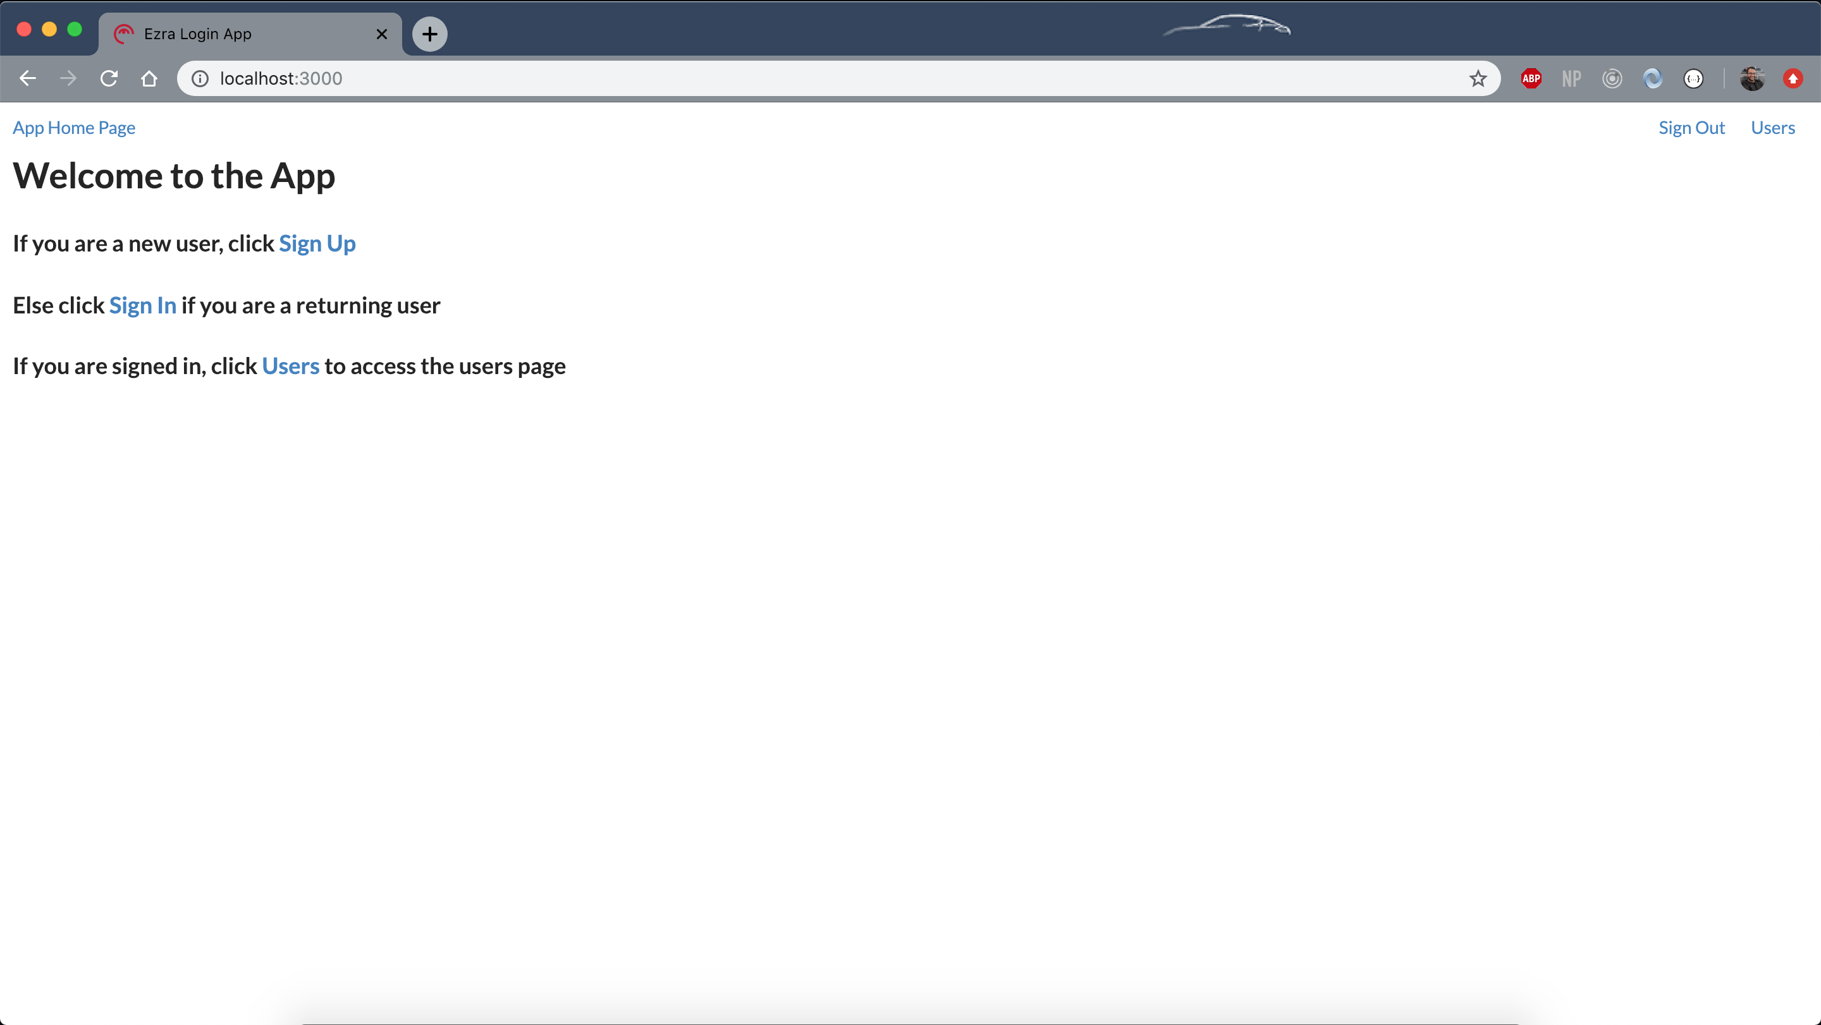
Landing page: http://localhost:3000/

Slide 6
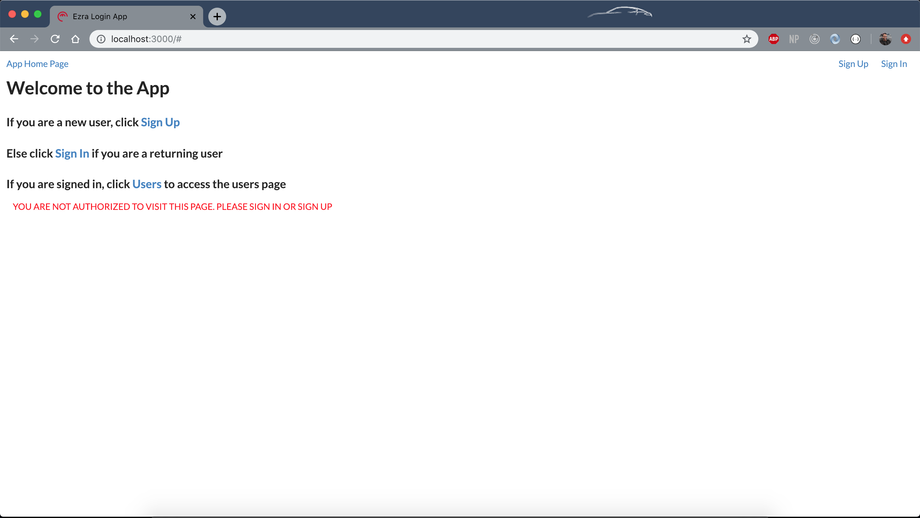
Landing page error
Notes:
If you are not signed in and try to access the users page, you will get this error

Slide 7
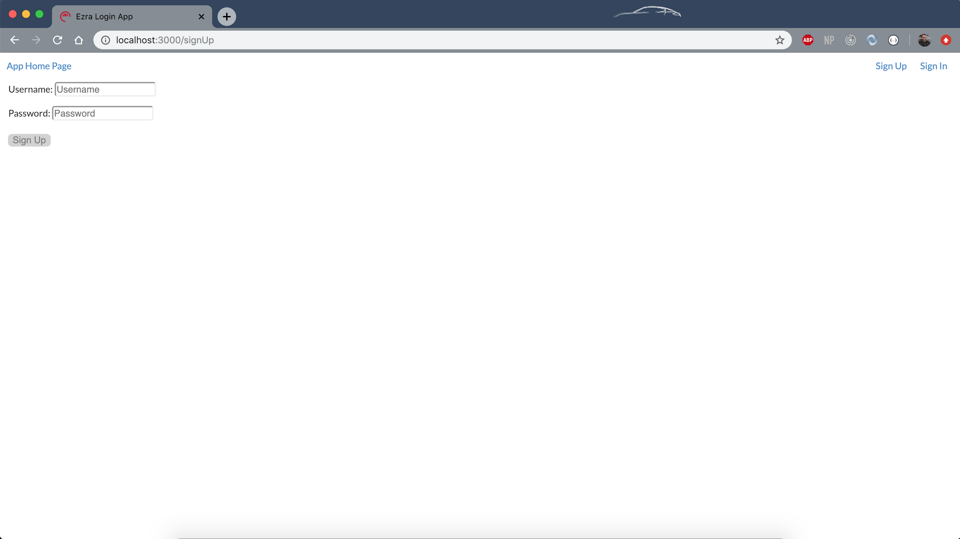
Sign up: http://localhost:3000/signUp
Notes:
This is the sign up page. Notice that the button is disabled and greyed in, unless both username and password fields are populated

Slide 8
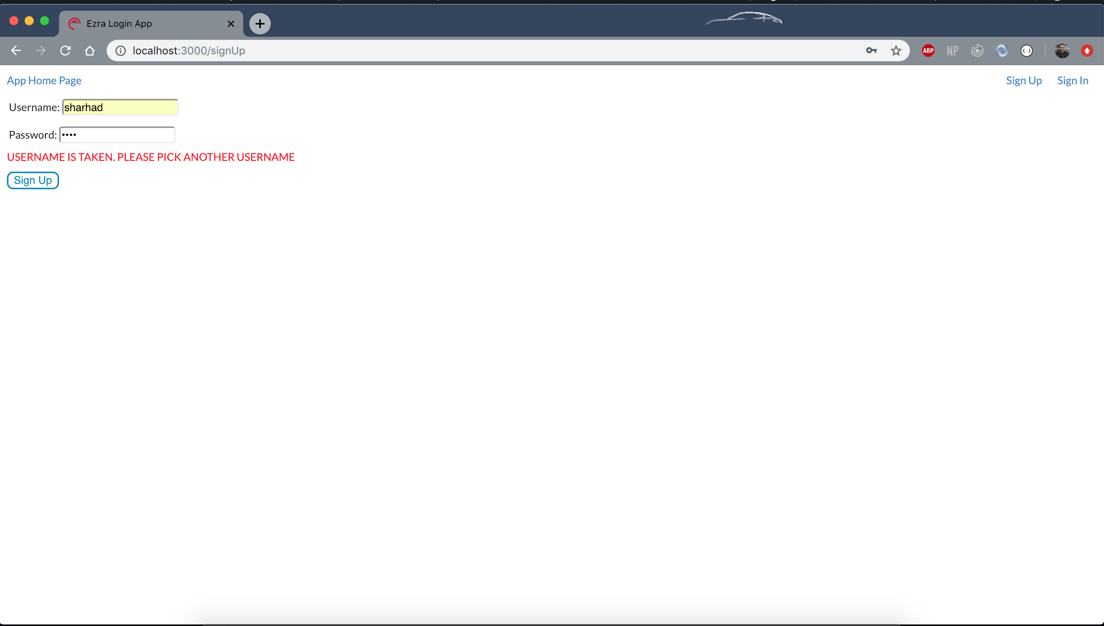
Sign up error
Notes:
Notice the button is now activated

Slide 9
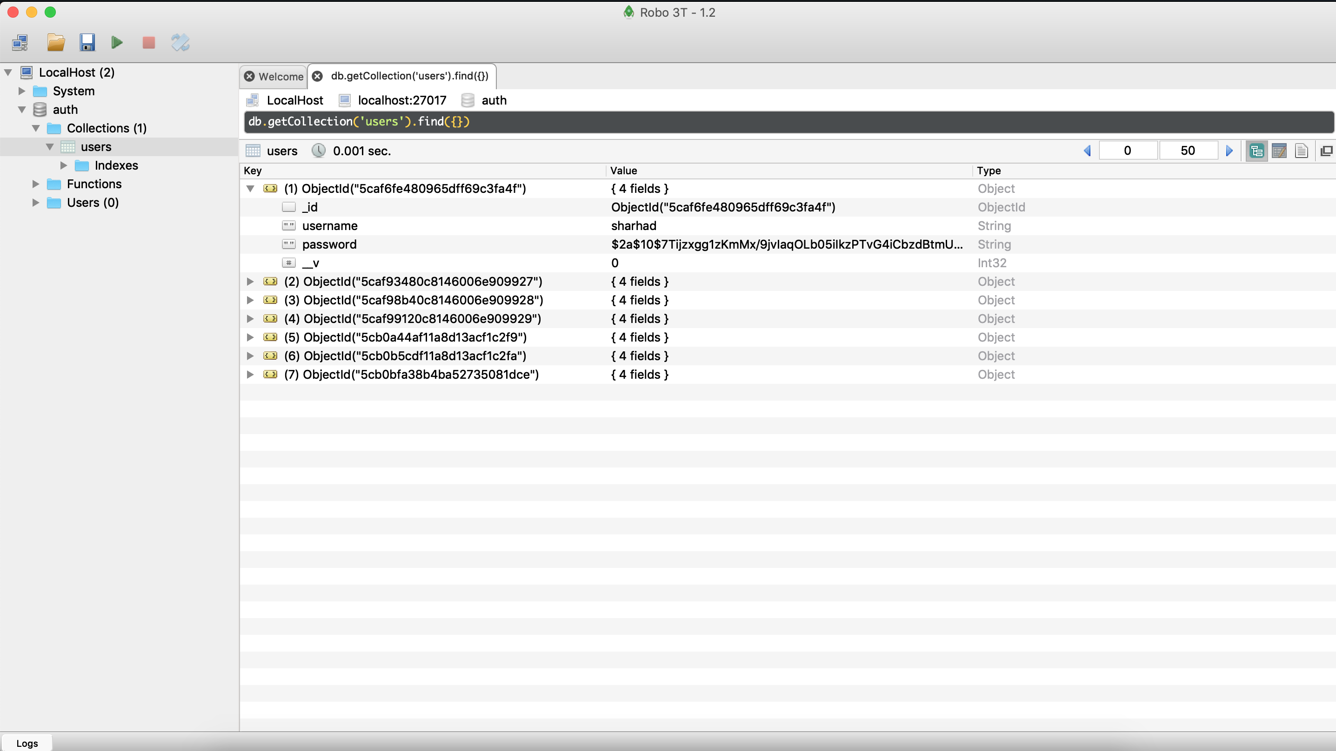
Mongo DB entry
Notes:
Username and password for a user in the data base

Slide 10
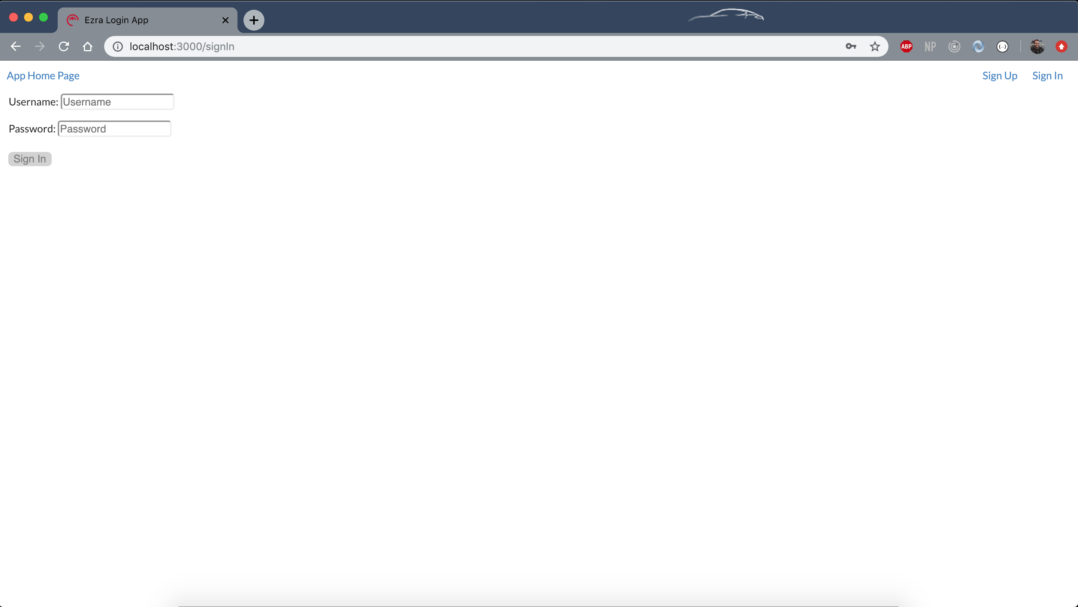
Sign in: http://localhost:3000/signIn
Notes:
The sign in page
Notice that the button is disabled

Slide 11
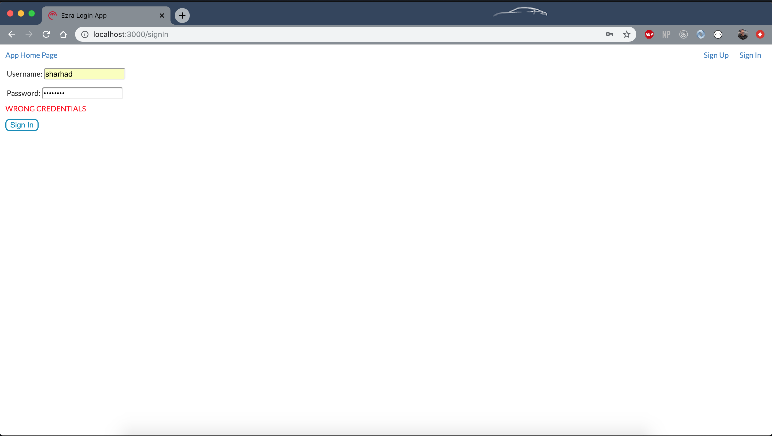
Sign in error
Notes:
The error you get when you put in the wrong credentials

Slide 12
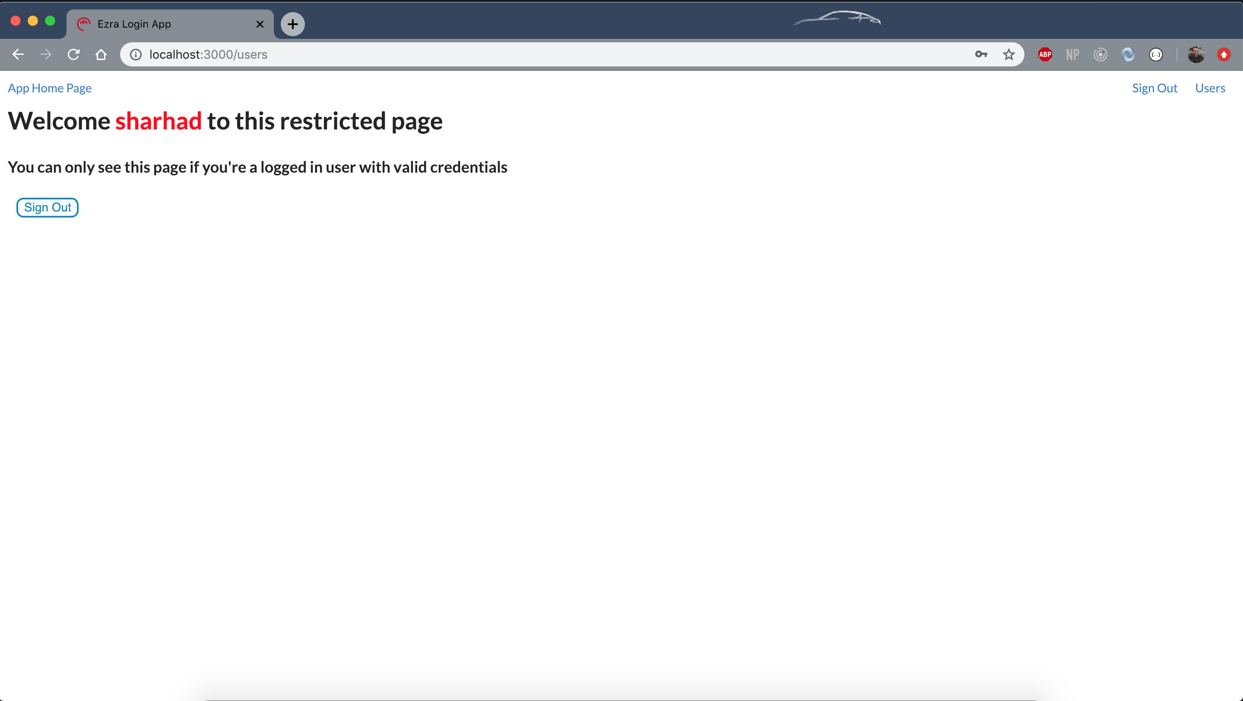
Users page: http://localhost:3000/users
Notes:
Users page that can only be viewed one you are logged in
Notice the header on the right corner, the links have now changed
We can see the username in this page

Slide 13
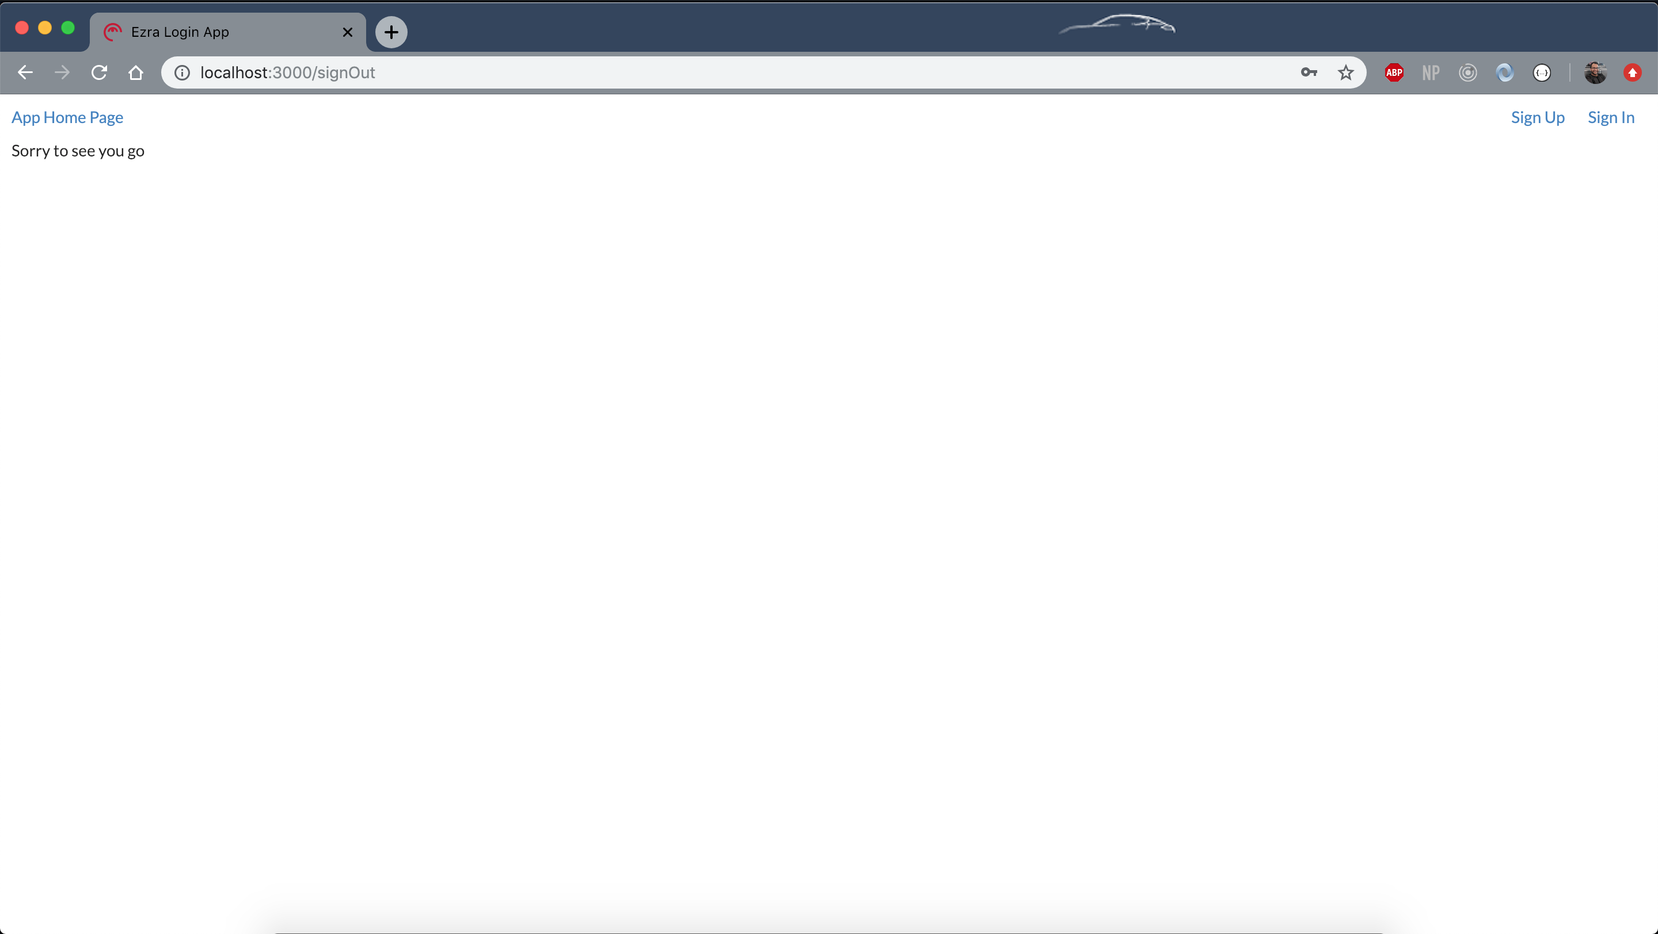
Sign out: http://localhost:3000/signOut
Notes:
Page you are redirected to once you log out

Slide 14
Additional info
If you are not signed in, and you try to access http://localhost:3000/users, from the link, you will be redirected to the landing page
If you try to access the page from the link in the landing site, and you are not signed in, you will see an error
If you are signed in and you try to access the sign in or sign up page, you will be redirected to the users page
Usernames are not case sensitive, but need to be unique
Buttons are deactivated, but once activated, have hover and on click effects
If you are signed in, the links on the header are different from if you are not logged in
Back end was tested using postman before creating front end

Slide 15
Things to improve on
Make the Sign In and Sign Out one single component instead of two
Better way to handle previous error (in map state to props in sign in and sign out)
Add more unit tests

