Slide 1
CSE 445 · SECTION 7 · MSRB SUMMER 2026
Dynamic Social Media
Trend Detection
An online clustering engine that watches a stream of social media posts and flags emerging topics as they burst — not after the fact.
GROUP 9
Machine Learning Project
Sharia Sakib
2021270642
Tasneem Abdullah Aurnobb
2111752642
Md. Asikur Rahman Asif
2211704042
Shaira Aktar Shova
21221796
Notes:
CSE 445 Section 7, MSRB, Summer 2026 - Group 9. Hook: we do not cluster the archive after the fact; each post is processed once, as it arrives, so topics are flagged while they are still bursting. 13 content slides plus a live dashboard demo after the results.

Slide 2
PROBLEM STATEMENT
What we were asked to build
“Collect a diverse dataset of public social media posts from various platforms. Develop a dynamic clustering model that identifies emerging trends and topics in these posts.”
Two deliverables — restated as the two questions this talk answers with numbers:
01
02
Is the dataset actually diverse?
Does it actually detect emerging trends?
Multiple platforms, multiple topics, spread over time — and honest about where that diversity breaks down.
Not a claim that it “works” — a detection rate and a latency, measured against a brute-force baseline.
Answered on slide 4
Answered on slides 9–11
2
Notes:
Read the prompt verbatim, then convert it into two testable questions. Everything after this slide is evidence for one of the two.

Slide 3
MOTIVATION
Why “dynamic” is the hard part
Static clustering
Online micro-clustering
HDBSCAN once, over everything
Each post processed once, as it arrives
Sees the whole corpus at once
Every post revisited on every run
No notion of time — cannot separate “trending now” from “trending last month”
A live stream means re-clustering from scratch
One pass, arrival order, no lookahead
Cluster weights decay with time
“Now” is built into the model, not bolted on
New posts extend the state — nothing is recomputed
Both stay in the pipeline. The static baseline is a sanity check on cluster quality — it tells us the embeddings and the similarity threshold are sane. The dynamic engine is the actual contribution. This is complementary, not either/or.
3
Notes:
The point of this slide: static clustering is not wrong, it just cannot answer a time-indexed question. That gap is what the dynamic engine fills.

Slide 4
DATASET
Diversity across platforms — and its limits
Platform | Posts | Time window
Reddit | 9,982 | Jul 27 – Aug 24, 2024
Twitter / X | 11,020 | Dec 2020 – Nov 2021
YouTube | 23,751 | 2014 – 2026
Bluesky | loader pending | —
Total | 44,753 | 3 platforms
Coverage on a shared timeline
YouTube
Twitter / X
Reddit
dev sample — replace with df[“platform”].value_counts() and platform_windows(df) from your Kaggle run (notebook §3)
2014
2017
2020
2023
2026
Say this out loud, don't hide it.
The platforms barely overlap in time as collected, so a genuine cross-platform trend cannot co-occur in this corpus. Reddit is a four-week slice; Twitter sits three years earlier. We report per-platform results and revisit this on the limitations slide — it is a collection limitation we own, not a bug we missed.
4
Notes:
Figures 01_platform_breakdown.png and 02_posts_over_time.png back this slide. The timeline bars are the honest version of that second figure — point at the Reddit sliver.

Slide 5
SYSTEM
Pipeline: six stages, one pass
Ingest
Embed
Cluster
Score
Evaluate
Serve
Loaders per platform → one normalised frame
all-MiniLM-L6-v2, 384-d sentence vectors
Static: UMAP+HDBSCAN
Dynamic: online micro-clusters
Decayed weight, growth rate, burst z-score
ARI / NMI / silhouette + burst injection
Streamlit dashboard reads the artifacts
→
→
→
→
→
Runs once on Kaggle · GPU (T4) · ~20 min end-to-end
Local, instant
Why the split matters. Embedding, clustering and evaluation are the GPU-heavy stages, so they run once on Kaggle and write a self-contained artifact bundle — embeddings, cluster assignments, trend scores, evaluation tables and figures. The dashboard never recomputes anything: it loads that bundle in “Precomputed” mode and renders instantly, which is exactly what makes a live demo safe to give.
5
Notes:
Keep this at the architecture level — no code. The one thing to emphasise is the artifact bundle boundary between Kaggle and the local dashboard.

Slide 6
METHOD — PART 1
Static baseline: embed → reduce → cluster
1
all-MiniLM-L6-v2
Sentence-transformer embeddings
384 dimensions per post
↓
2
UMAP → 5D
03_umap_scatter.png
Non-linear reduction that preserves
local neighbourhood structure
Drop the UMAP scatter here, coloured by HDBSCAN cluster —
from data/artifacts/figures/ after the Kaggle run.
Use it big: it is the most visually convincing slide in the deck.
↓
3
HDBSCAN
Density-based clustering, variable
cluster count, explicit noise label
Scored against the source column — subreddit or YouTube topic — as a free pseudo-label. Not a claim of ground truth; a useful signal.
Why UMAP first: HDBSCAN needs density structure, which is far easier to find in 5 dimensions than in 384 raw ones.
6
Notes:
One sentence per stage is enough. The honest caveat: source labels are a convenience label, not verified ground truth — it comes back on the limitations slide.

Slide 7
METHOD — PART 2
The dynamic engine: one post, one pass
For each incoming post, in arrival order:
01
02
03
Decay
Match
Merge or spawn
Every live cluster's weight decays by the time elapsed since it was last touched — forgetting applied before anything else.
Cosine similarity between the post's embedding and every live cluster centroid; take the nearest one.
Above the similarity threshold → absorb the post and update the centroid. Below → spawn a new micro-cluster.
The key design choice. A cluster's decayed weight is a recency-weighted measure of how much a topic is still being talked about — not a raw post count. A thread with 500 posts last March weighs less than one with 30 posts this hour.
No re-clustering
No lookahead
O(1) per post, amortised
State grows, never rebuilds
7
Notes:
Four bullets, no maths — the maths is the next slide. Emphasise the ordering: decay happens before matching, so an abandoned cluster cannot silently keep winning matches.

Slide 8
THE DIFFERENTIATOR
The half-life trick: a scale-free growth rate
w(t) = w₀ · 2 ^ ( − Δt / t½ )
growth = Δw / w per half-life
In plain language: a cluster receiving no new posts loses exactly half its weight every half-life — by construction, not by tuning.
Dimensionless. The same number means the same thing whether the corpus spans 48 hours or 8 months — so thresholds transfer across platforms.
What the number means
−0.5
< 0
≈ 0
> 0
Dormant
Declining
Steady
Rising / Trending
no new posts at all
arriving slower than decay
holding its own
real reinforcement
Why this mattered. An earlier version sampled cluster weight only when a cluster received a post, so decay between posts was invisible. On real data that produced 0 trending clusters out of 2,616, with exactly one ever marked declining. Sampling on a regular time grid instead, and switching to this growth rate, made all four states — dormant, rising, trending, declining — actually reachable.
8
Notes:
Do not cut this slide for time. It is the strongest evidence that we diagnosed a real modelling bug rather than just calling library functions. The 0-of-2,616 number is the hook.

Slide 9
EVALUATION
Two questions, two protocols
01
02
Are the clusters any good?
Does it catch a trend — and how fast?
Intrinsic + extrinsic quality
Synthetic burst injection
ARI and NMI against the source pseudo-labels (subreddit / YouTube topic)
Silhouette on the reduced embedding space
Static and dynamic scored the same way, so the comparison is fair
Paraphrased burst topics injected into real background posts at known timestamps
Measure detection latency, precision and recall against those timestamps
Same protocol run against the sliding-window baseline
src/evaluation/metrics.py
src/evaluation/injection.py + burst_benchmark.py
Why injection instead of hand-labelling real bursts? Nobody agrees on exactly when a real trend “started,” so hand labels would be arguable and the evaluation would be about our labelling, not our model. Injected timestamps are ground truth by construction.
9
Notes:
Keep this conceptual — no numbers yet. Expect a question on whether injected bursts are realistic; answer that they are paraphrases of real topics dropped into real background traffic, not synthetic text.

Slide 10
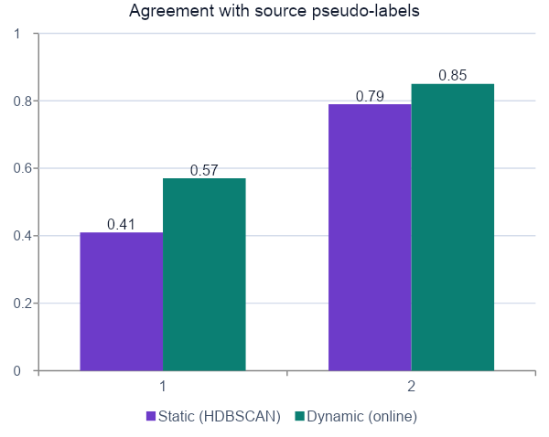
RESULTS — PART 1
Cluster quality: static vs. dynamic
Method | ARI | NMI | Silhouette
Static (HDBSCAN, one-shot) | 0.41 | 0.79 | 0.37
Dynamic (online, one pass) | 0.57 | 0.85 | —
dev sample, 1,500-post real subset — replace with the full-corpus numbers from evaluation.json (static / dynamic) in the artifact bundle
Reading this honestly.
The dynamic engine's per-post assignments agreed with the pseudo-labels more closely than the one-shot static baseline on this subset — and it did so in a single pass, with no re-clustering and no lookahead. Silhouette is not reported for the dynamic engine because its clusters live in the raw 384-d embedding space, not the UMAP space the static score is computed in; the two numbers would not be comparable.
10
Notes:
Do not oversell: this is one subset and the labels are pseudo-labels. The defensible claim is 'comparable or better, at a fraction of the work'.

Slide 11
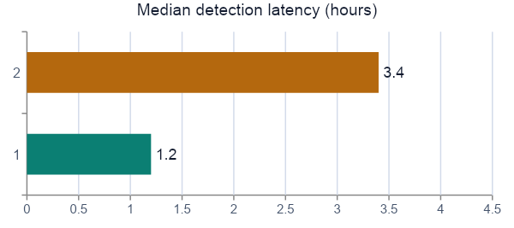
RESULTS — PART 2
Burst detection: the headline result
100%
2.8×
3.6×
Detection rate
Faster to detect
Less compute
6 of 6 injected bursts, both methods
1.2 h vs. 3.4 h median latency
2,860 posts vs. 10,284 processed
Method | Detection | Median latency | Posts processed
Dynamic engine (online) | 100% | 1.2 h | 2,860 (once each)
Sliding-window HDBSCAN | 100% | 3.4 h | 10,284 (3.6× the corpus)
dev sample, 6 injected bursts on a 2,860-post real Reddit slice — replace with eval_bursts.csv / eval_bursts_sliding_window.csv from your Kaggle run
The message: both methods catch every injected burst — the online engine simply gets there roughly three times sooner, at a fraction of the compute. That is the actual case for “dynamic,” not merely that it works in isolation.
11
Notes:
Figures 09_burst_latency.png and 10_dynamic_vs_sliding_window.png belong here if you have room. The baseline is a fair one: periodically re-clustering a trailing window is the natural brute-force alternative, and we ran it on the same slice.

Slide 12
LIVE DEMO
The dashboard, in Precomputed mode
streamlit run src/dashboard/app.py
1
2
3
Overview
Trending Now
Evaluation
Platform breakdown and the honest time-window table — the same numbers as slide 4, generated live from the artifact bundle.
Two or three real trend cards. Read the growth rate and burst z-score straight off the card, and name the actual topic behind it.
The ARI / NMI table and the burst-detection comparison from slides 10 and 11, rendered from the same evaluation artifacts.
Fallback plan. Precomputed mode loads instantly because nothing is recomputed — but if the room has no reliable network or screen share, present the three screenshots taken beforehand instead. A failed live demo should never eat the time slot.
12
Notes:
Budget 2-3 minutes. Rehearse the click path once so you are not navigating tabs live. Have the screenshots open in a second window as insurance.

Slide 13
LIMITATIONS
What this does not show
Platform windows barely overlap
Twitter/X is effectively single-topic
Reddit covers four weeks of 2024, Twitter sits in 2020–21, YouTube spans a decade. No genuine cross-platform co-occurrence is possible in this corpus as collected — slide 4's timeline is the proof.
The Twitter slice is COVID-vaccine discourse. It contributes volume and a second writing style, but not topic diversity — and it inflates any corpus-level cluster-quality score.
Source labels are not ground truth
Burst precision is low untuned
Subreddit and YouTube topic are a free, convenient pseudo-label. A post can sit in the right subreddit and the wrong topic; ARI and NMI against them are a signal, not a verdict.
At default thresholds the burst benchmark trades precision for recall. The parameter sweep in sweeps.py exists precisely because the right threshold depends on the corpus — it is not a single universal constant.
One slide, stated plainly, is worth more than a Q&A ambush.
13
Notes:
Deliver this at a steady pace and do not apologise. Owning the collection limitation up front usually converts a hostile question into a design discussion.

Slide 14
CONCLUSION
Both questions, answered
01
Is the dataset diverse?
What's next
Three platforms and 44,753 posts across Reddit, Twitter/X and YouTube, with a Bluesky loader in place — and an explicit, unhidden caveat about the non-overlapping time windows.
An aligned-timeline cross-platform demo, scored honestly rather than assumed
Richer LLM-based trend summarisation beyond the offline TF-IDF fallback
A genuinely live Reddit stream feeding the dashboard, instead of a historical replay
02
Does it detect emerging trends?
Every injected burst detected, at roughly 2.8× lower median latency and 3.6× less compute than periodic re-clustering, at comparable or better cluster quality.
Thank you!
Dynamic Social Media Trend Detection · CSE 445 · Code, notebook and dashboard available in the project repository
14
Notes:
Close by restating the two questions from slide 2 and the one number that answers each. Then invite questions — you have already pre-empted the obvious ones on the limitations slide.

