Slide 1

Computer Networks Laboratory Course code : CSE 324
Project Title : Smart University
Group Members : 1) Mohammad Al-Shariar
ID : 011 151 007
2) Sumaiya Mahmud
ID : 011 151 028

Slide 2
Index
Introduction
Objective
Problem Statement
Motivation
Project Features
Project Components
Simple Diagram
Project Implementation
Advantages
Future Work
Conclusion

Slide 3
Introduction
Smart University is a “university which enhances the education, research, and work experience of stakeholders by incorporating digital, innovative, and internet-based technologies for the betterment of the society at-large.”
A “Smart University” is not a destination, or a milestone. It is rather a continuation of the journey of progress of Universities’ role to serve humanity.
A smart University focuses on Smart Campus, Smart People, Smart Education, Smart Research, Smart Governance , Smart Influence.

Slide 4
Objective
The objective of Smart University is to provide conducive environment to the students and researchers helping them in their research and learning opportunities to keep pace with 21st century.

Slide 5
Problem Statements
To avoid the wastage of Electricity
Sometimes we forget to switch off of AC, Fan Lights.
To minimize the chances of fire accidents
To solve the university parking places problems
To ensure the use of internet everywhere
To provide automated and smart education environment
To minimize disruption of concentration in activities
To improve the security system of University.

Slide 6
Motivation
Smart university and smart education are emerging and rapidly growing areas that represent an integration of
smart and intelligent systems, smart objects and smart environments,
smart technologies, various branches of computer science and computer engineering,
state-of-the-art smart educational software and/or hardware systems, agents and tools, and
innovative pedagogy and advanced technology-based teaching strategies and learning methodologies.

Slide 7
Project Features
Smoke and Fire detection system.
Human presence detection system using motion sensor.
Smart security system where solar panel is used.
Smart parking system using RFID.
Smart university campus where internet is everywhere.
Smart class room and lab.

Slide 8
Project Components
Sensors:
Temperature sensor, Smoke sensor, IR sensor, Motion detection sensors, furnace , Humidity sensors
IT Components:
Trip sensor, Camera, Light, Alarm, Door, RFID Reader, Window, Fan, Fire Monitor, Fire Alarm, AC, Street Lamp, Wind Detector.
Others :
MCU, SBC, Router, Switch, Home Gateway, Home Router, Cell Tower, Central-office Server
Actuators:
Air Cooler, Alarm
Languages: JavaScript, Virtual Blocky ,Python

Slide 9
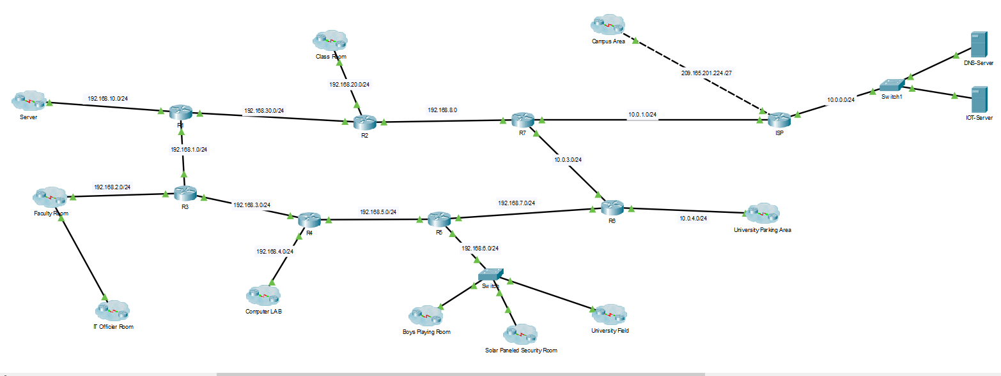
Simple diagram

Slide 10
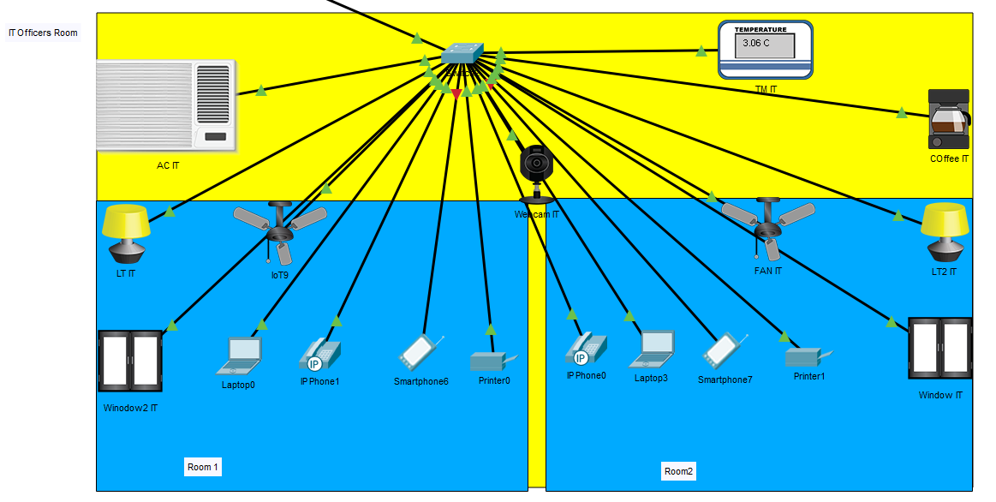
Officials Room

Slide 11
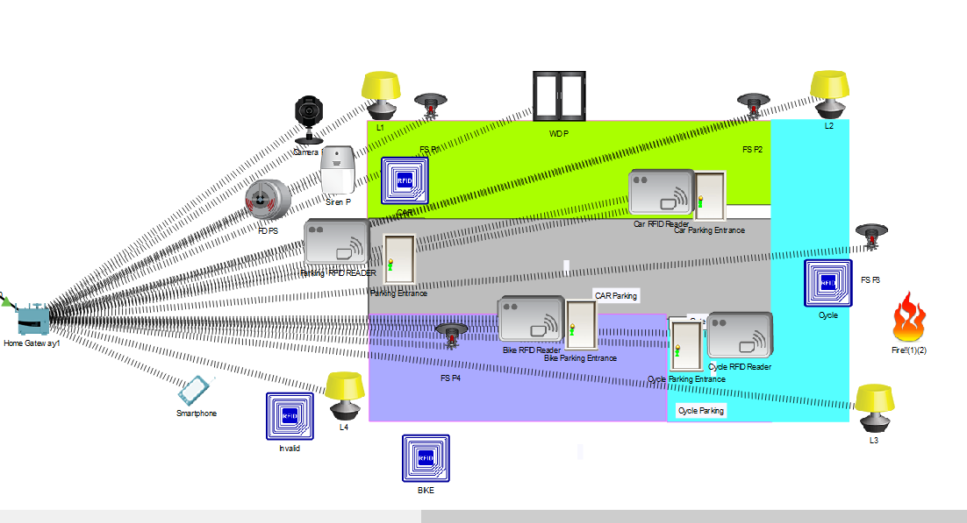
University Parking System

Slide 12
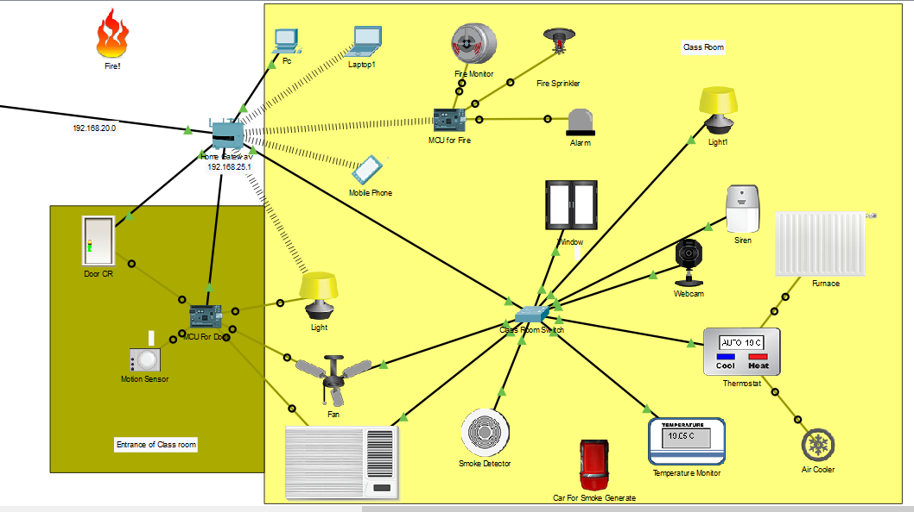
Smart Class Room

Slide 13
Project Implementation
Setting up Registration Server
Connect a wireless router and complete routing configuration
Connect the necessary sensors with the MCU and SBC
Necessary coding implementation
Connect the MCU and other IoT components with the router
Provide necessary condition on the registration server for having IoT devices interconnectivity

Slide 14
Start
Collect data from sensors
Send data to MCU
Process data
Check condition
Send to IoT devices
True
Send to Registration Server for inspection
False
Discard calculation
Override by operator
Update IoT output
No
Yes
Fig: Flow chart

Slide 15
Advantages
Cost-effective
Automated system
Immediate actions against fire accidents
Saving human resource and time
Technical-LEVEL management is easier than ground-level management

Slide 16
Future Work
Real-life implementation
Alert nearest fire brigade
Automated system in management levels

Slide 17
Conclusion
Project is simple, efficient and user-demanding
High possibility to be built and implemented at various levels.
Sold as a blueprint in the software market

Slide 18
Thank You

Slide 19
Demonstration

