Slide 1

VoxCeleb Competition
Ali Majlesi
Date: 1400/05/14

Slide 2
DKU-DukeECE Team Report
competition | rank | DCF | ERR | Best DCF | Best ERR
The VoxCeleb Speaker Recognition Challenge 2020 - Track 1 (Verification fully supervised, closed) | 9 | 0.2041 | 3.962 | 0.167 | 3.187
The VoxCeleb Speaker Recognition Challenge 2020 - Track 2 (Verification fully supervised, open) | 5 | 0.2045 | 4.301 | 0.1667 | 3.104
The VoxCeleb Speaker Recognition Challenge 2020 - Track 3 (Verification self supervised, closed) | 2 | 0.5976 | 12.415 | 0.3447 | 7.205
The VoxCeleb Speaker Recognition Challenge 2020 - Track 4 (Diarisation, open) | 9 | 9.7879 | 20.6747(JER) | 6.2308 | 18.3487

Slide 3
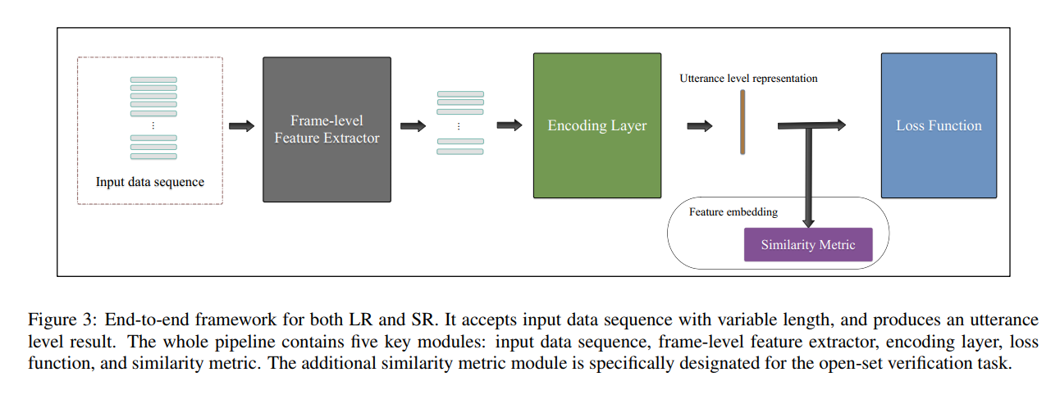
End-to-end framework for speech recognition
Exploring the Encoding Layer and Loss Function in End-to-End Speaker and Language Recognition System ,
Weicheng Cai2, Jinkun Chen2 and Ming Li

Slide 4
1. System Descriptions for Track 1
1.1. Data training Data: VoxCeleb2
test : Voxceleb 1-E test set
Voxceleb 1-H test set

Slide 5
1.2. Data Augmentation
MUSAN Dataset
ambient noise
music
television (one music file and one speech file )
babble noise (mixing three to eight speech file )
reverberation (convolution with room response MUSAN )
peed perturbation using sox by 0.9 or 1.1 times ( new speaker generation)
online data augmentation
On-the-Fly Data Loader
a frequency-domain data augmentation can be performed directly on the extracted feature sequence

Slide 6
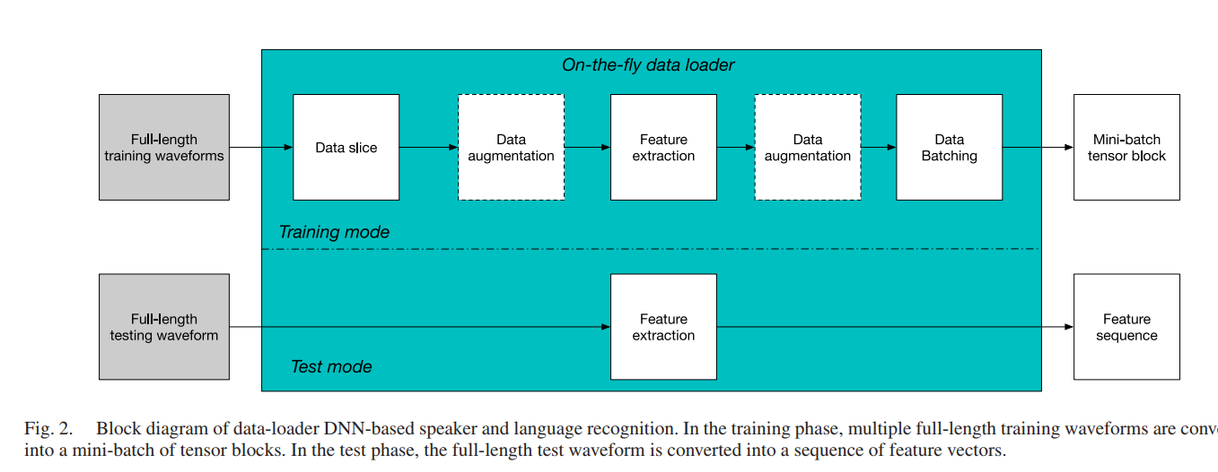
On-the-Fly Data Loader and Utterance-Level Aggregation for Speaker and Language Recognition Weicheng Cai, Student Member, IEEE, Jinkun Chen, Jun Zhang, and Ming Li

Slide 7
1.3. Deep Speaker Embedding Model
three different speaker verification systems :
ResNet
ResNet-BAM
ECAPA-TDNN

Slide 8
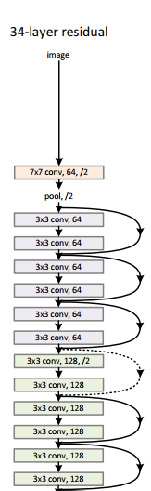
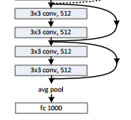
ResNet34
widths (number of channels) of residual blocks are {32, 64, 128, 256}
global statistical pooling (GSP)(mean and standard) – for fixed length feature
ArcFace pooling layer

Slide 9
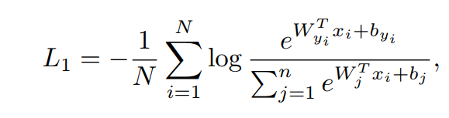
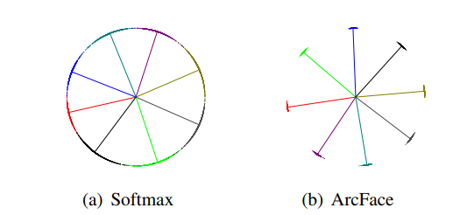
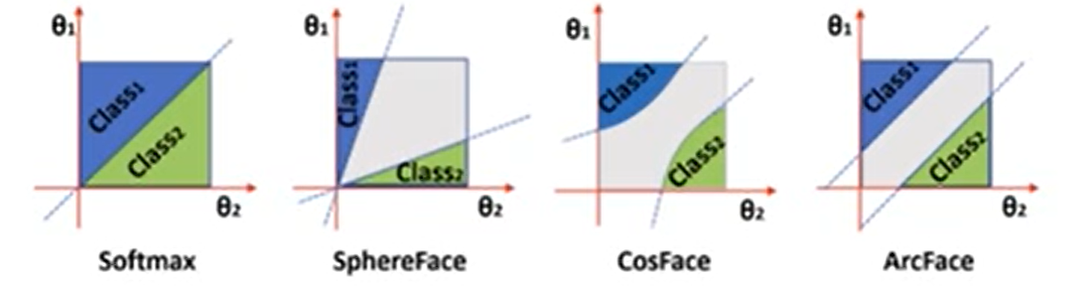
ArcFace pooling layer
Soft max:

Slide 10

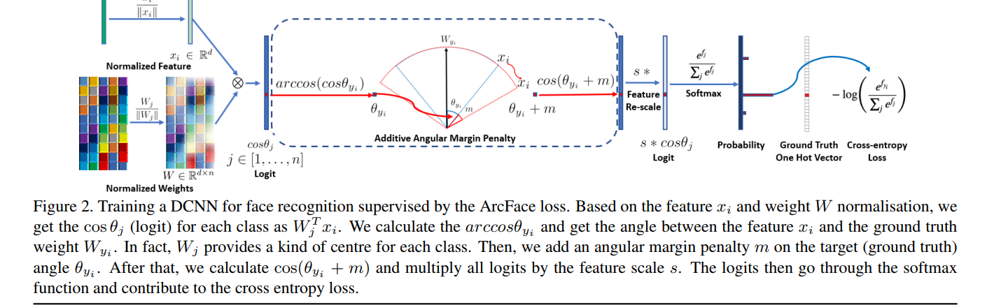
ArcFace pooling layer

Slide 11
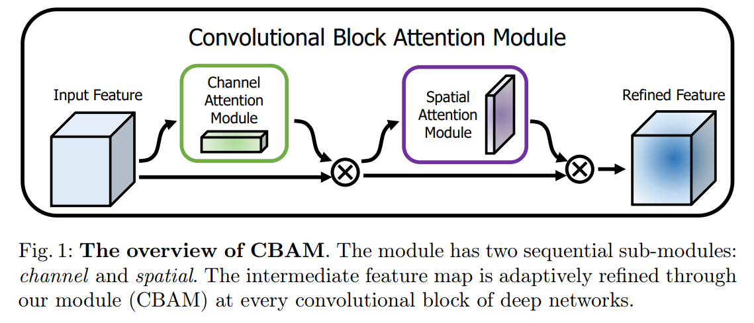
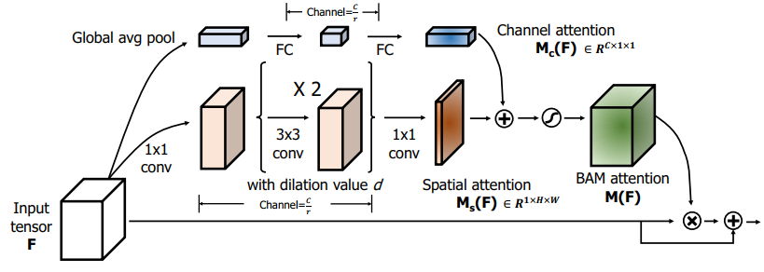
1.3.2. ResNet with BAM (Bottleneck Attention Module )
:BAM

Slide 12
1.3.3. ECAPA-TDNN
1024 feature channels
The dimension of the bottleneck in the SE-Block is set to 256.
attentive statistics pooling (ASP)

