Slide 1
Cascade Correlation
By Maryam Majlesi

Slide 2
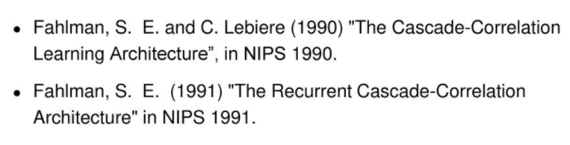
Cascore network

Slide 3
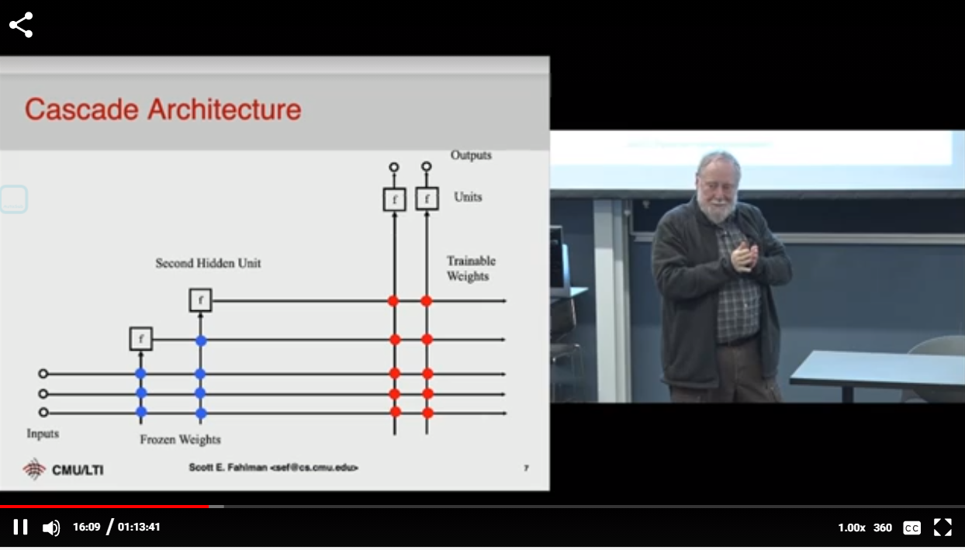
Video link
https://www.youtube.com/watch?v=k2mPEUZH978

Slide 4
Cascore
output unit
Learn
Input unit

Slide 5
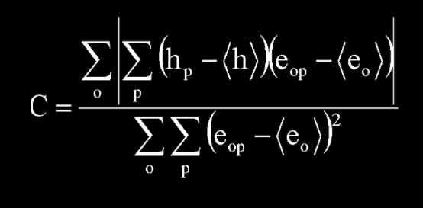
Cascore
e
h
Learn
Train these weights
Loss function:
h correlated with error

Slide 6
Cascore
e
Train these weights
h
Learn
Loss function: normal loss Function

Slide 7
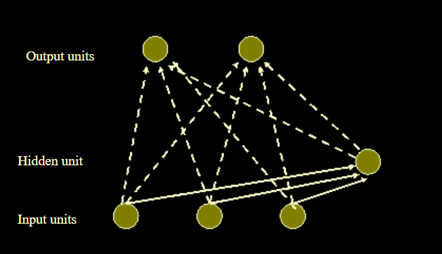
Cascore
Learn
Second output phase

Slide 8
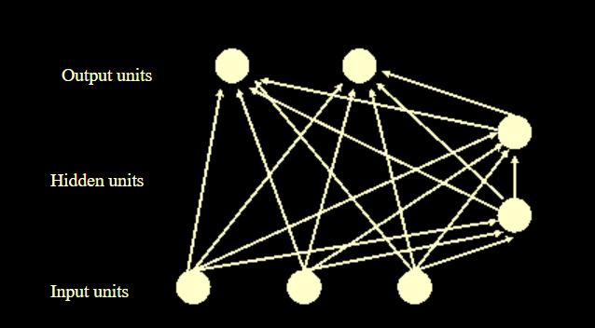
Cascore
test

Slide 9
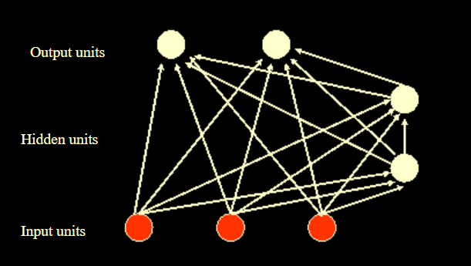
Cascore
test

Slide 10
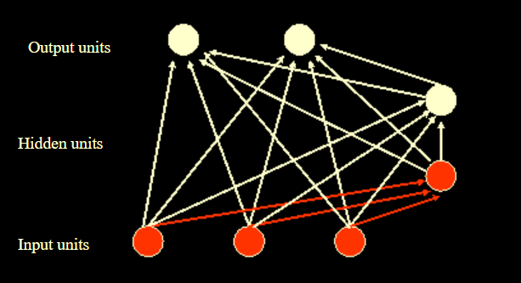
Cascore
test

Slide 11
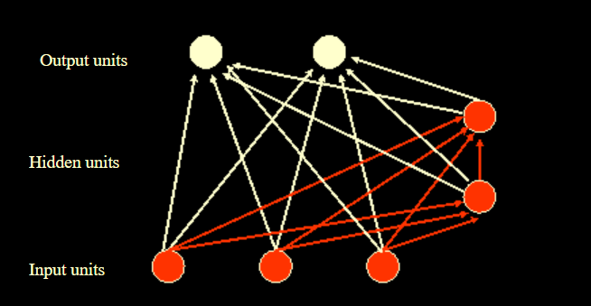
Cascore
test

Slide 12
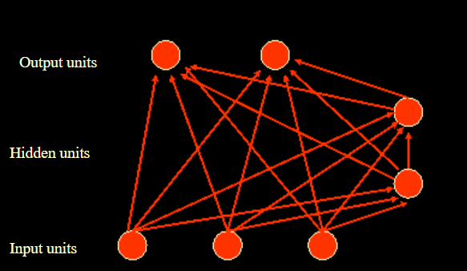
Cascore
test

