Slide 1

SATA
Pouria
Ghafouri

Slide 2
Table of Contents
01
Introduction
05
Link Layer
Overview of SATA, its role in storage connectivity
Encoding, Flow Control, Error Detection
02
Evolution & Overview of SATA
06
Transport Layer – FIS Structures
History, Versions (SATA I, II, II)
FIS types, NCQ
03
SATA Architecture
07
Message flow and command
Layered model: Physical, Link, Transport, Application
SATA controllers
04
Physical Layer
08
Summary
Signaling, connector/cable design

Slide 3
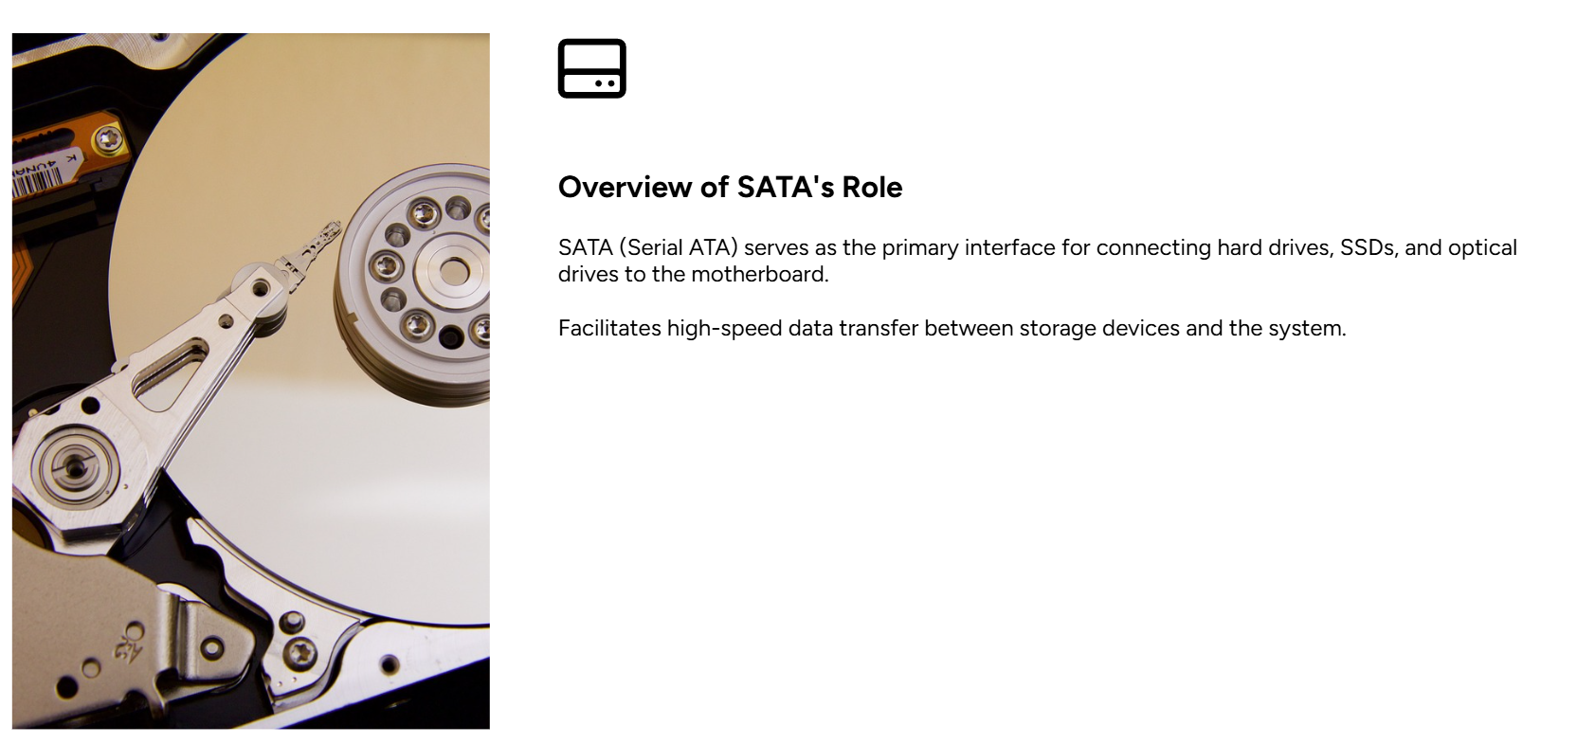
Introduction
What is SATA?
Stands for Serial Advanced Technology Attachment
A Serial Interface Standard
Connects Storage to a computer’s motherboard
Replaces the older parallel ATA (PATA)

Slide 4
Introduction
Key Features
Serial Communication: Better than PATA
Hot-Plugging
No Timing Skew
Point-to-Point Technology

Slide 5
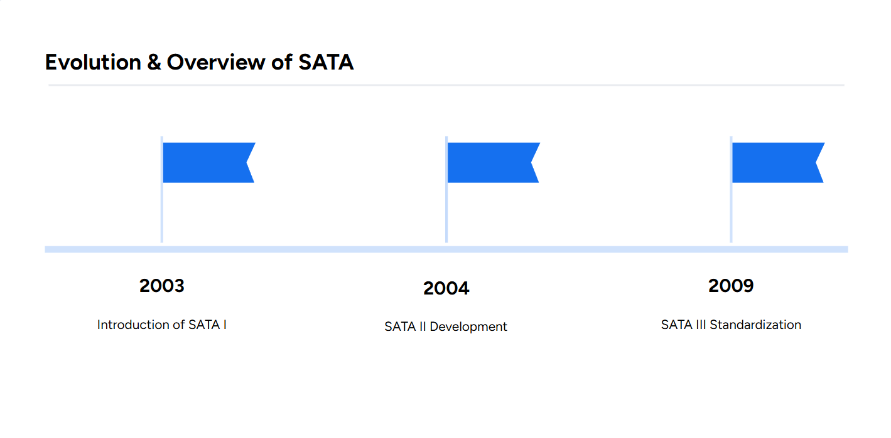
Pre-SATA Era
Parallel ATA (PATA) dominate storage interfaces until the early 2000s
Limitations of PATA (More wires, Slower Speed max 133 MB/s)
SATA Introduction
Developed by the SATA-IO consortium (Serial ATA International Organization) in 2000
Replace PATA with a faster, simpler and more scalable interface
First released in 2003 as SATA 1.0

Slide 6
SATA 1.0 2003
1.5 Gb/s
First-generation serial Interface
Add Optional NCQ (Native Command Queuing)
SATA 2.0 2004
3 Gb/s
Mandatory NCQ
Hot-plugging support
SATA 3.0 2009
6 Gb/s
Improved NCQ for deeper queues
Enhanced power management

Slide 7
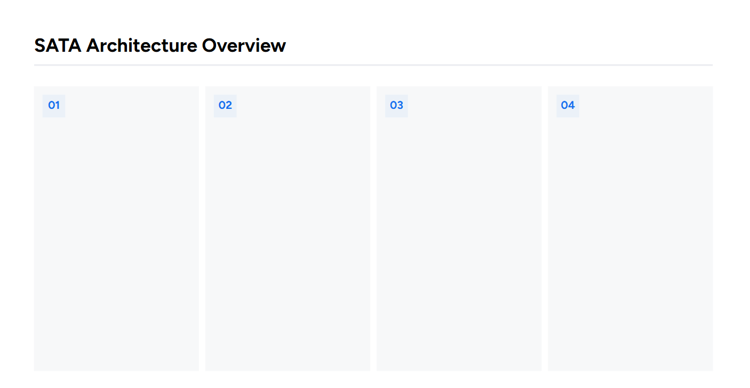
Physical Layer
Link Layer
Transport Layer
Application Layer
Electrical and physical connection between the SATA controller and the drive
Differential signaling with TX and RX
Point-to-Point topology
Utilize OOB (Out-of-Band) signaling
Uses 8b/10b encoding
Controls flow control
Error Detection using CRC
Handles Link Power Management (LPM) to reduce power consumption
Organizes data into frames called FIS (Frame Information Structure)
Implements commands such as DMA
Features like NCQ
Implements ATA command sets (read, write, flush, ...)
Supports features like TRIM (for SSDs)
SMART (self-Monitoring, Analysis and Reporting Technology)

Slide 8
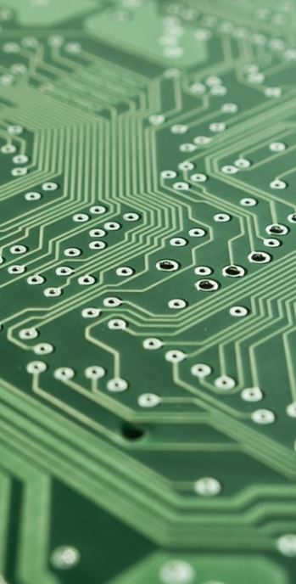
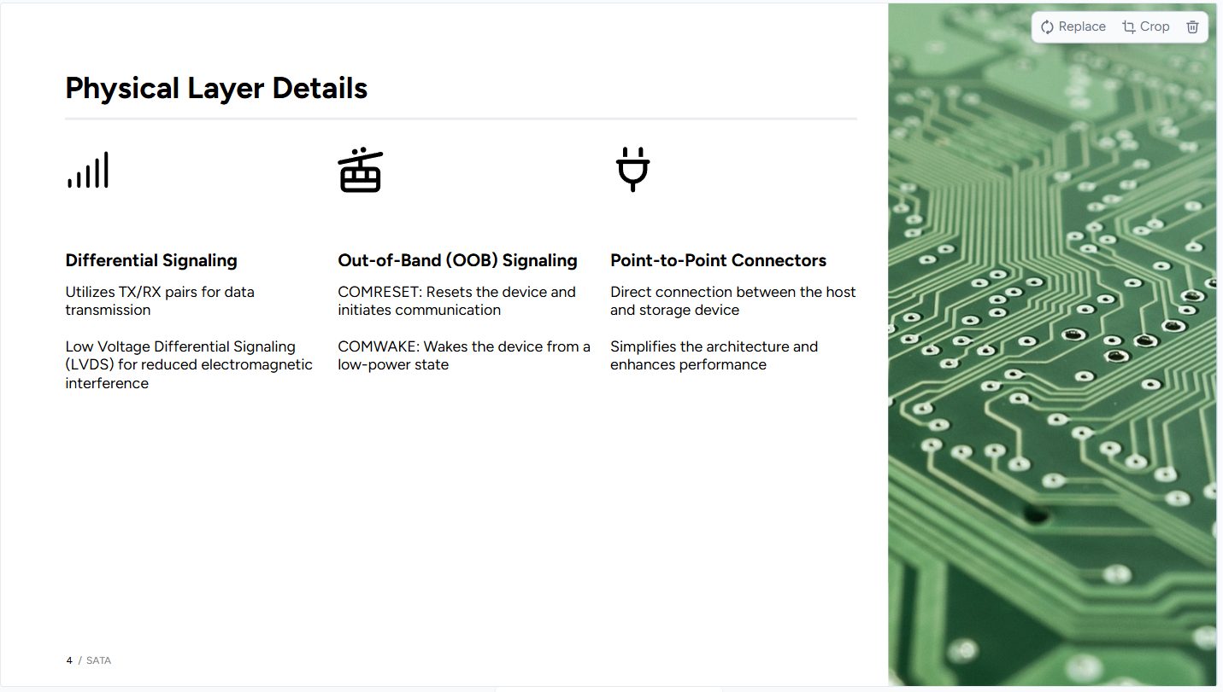

Slide 9
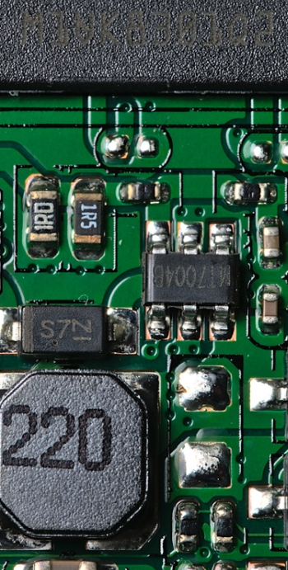
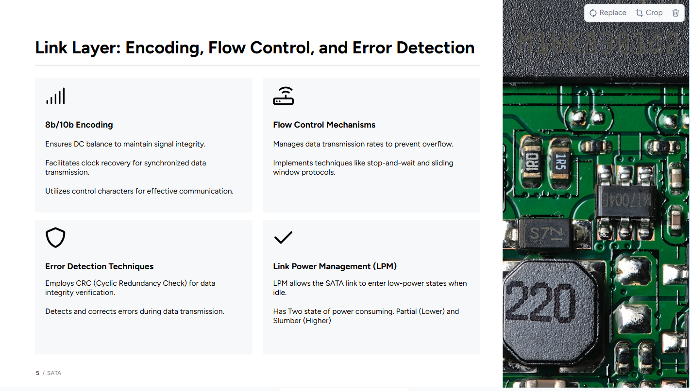

Slide 10
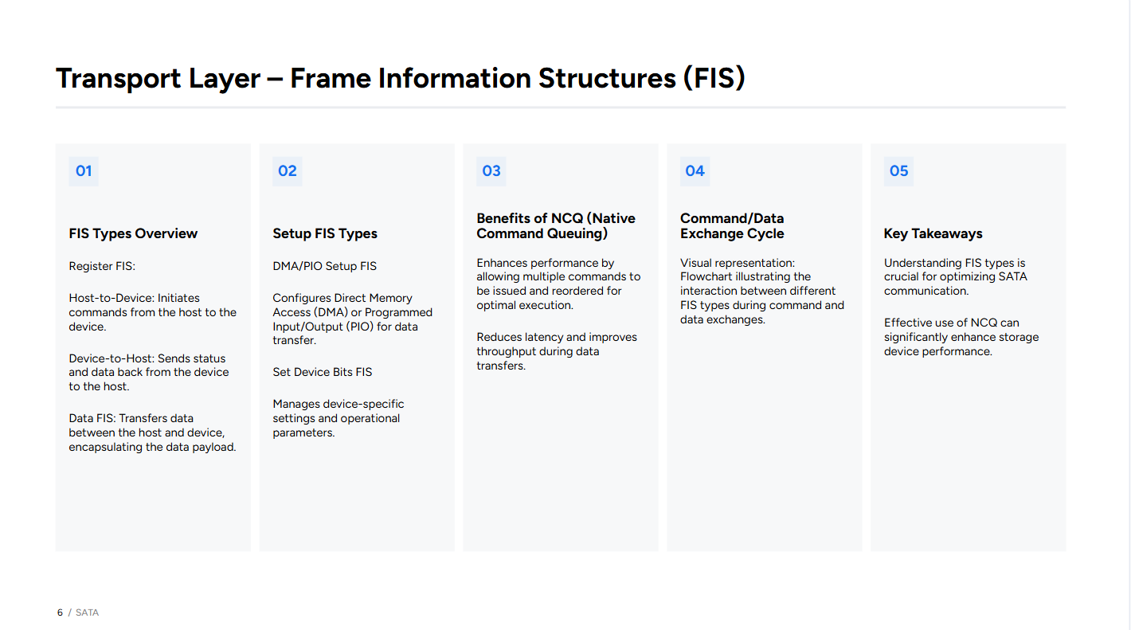

FIS (Frame Information Structure)
FIS is the fundamental data packet used by SATA to communicate between the host and storage device
Structure:
Header: Specifies FIS type, direction, and control flags. (1 Byte)
Payload: Contains command parameters, sector addresses or actual data. (4 to 32 bytes)
CRC: 32-bit checksum for error detection
FIS
FIS

Slide 11
FIS
FIS
Register FIS H2D
Register FIS D2H
Transmit ATA commands (READ, WRITE) and parameters to the device
Returns status updates (command completion, errors)
DMA Activate FIS
Data FIS
Initiates DMA transfers by specifting memory addresses for data exchange
Carries payload data during read/write operations

Slide 12
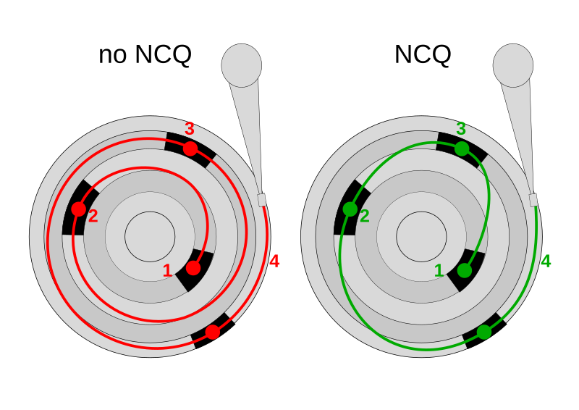
NCQ (Native Command Queuing)
Optimize commands to minimize delays (Mechanical delays HDDs, Latency SSDs)
Supported in SATA II and later (in SATA I was optional)
FIS
FIS

Slide 13
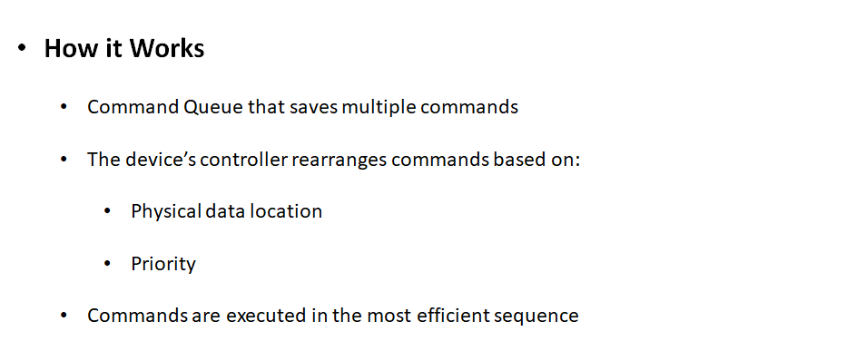
FIS
FIS

Slide 14
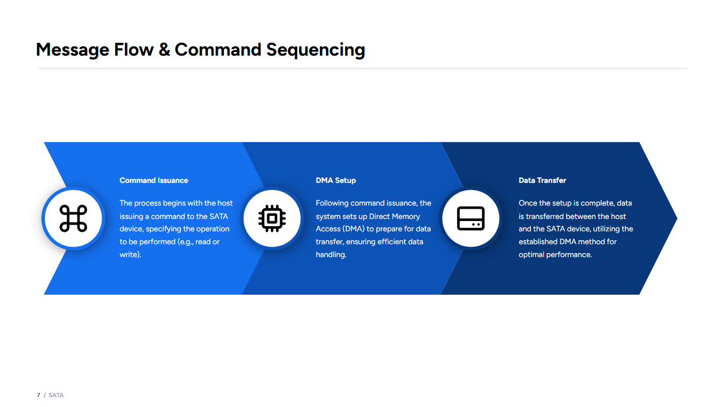

Slide 15
