Slide 1





OpenFlow Architecture & Usage
ICD Course, Dr. Foshati, Fall 2024

Slide 2
Topics covered
Introduction
Basics & Architecture
Implementation & Communication with Controller
Usages, Advantages & Challenges
Conclusion & Future of OpenFlow

Slide 3
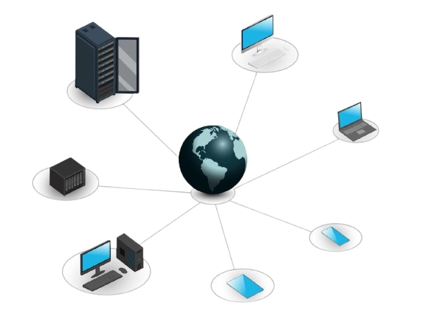
Introduction to OpenFlow
Traditional networks
static configurations & decentralized control
rigid and difficult to manage
Software-Defined Networking (SDN)
separating the control plane from the data plane
OpenFlow
first and most widely adopted SDN protocol
direct control of network switches via a centralized controller
flexibility, programmability, and dynamic traffic management

Slide 4





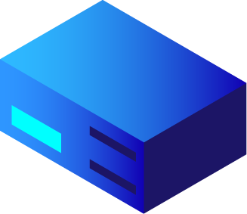



Basic concept & Architecture

Slide 5
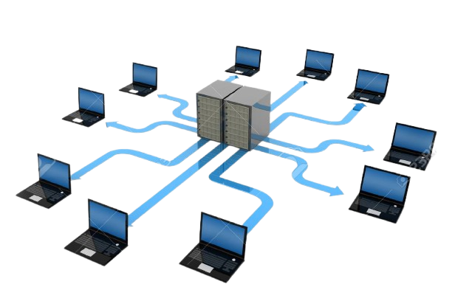
Challenges of Traditional Networks
Decentralized Control: independent switch/routers leading to complexity.
Static Configuration: manually defined rules & limiting flexibility
Difficult Traffic Management: complex configurations for Optimizing network performance
Slow Adaptation to Change: Modifying network policies is time-consuming and error-prone

Slide 6

What is OpenFlow?
direct communication between network devices and a centralized SDN controller
introduced by Stanford University (2008)
standardized by Open Networking Foundation (ONF)
dynamic control and modification of network traffic flows without changing physical hardware
datacenters, enterprise networks, cloud providers, and research labs

Slide 7
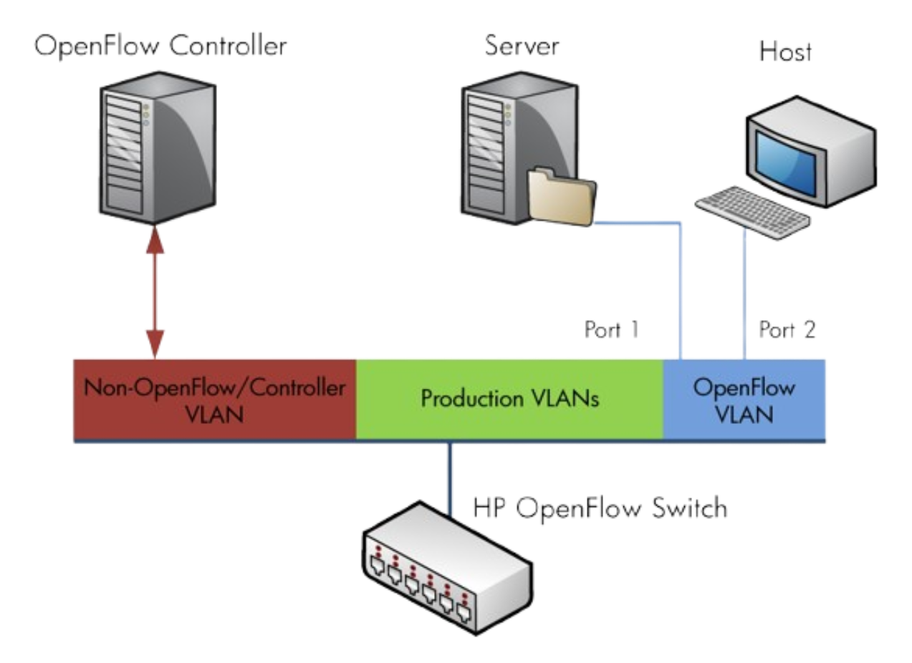
OpenFlow Architecture
SDN Controller:
Centralized intelligence
decides how packets are forwarded.
Examples: ONOS, Ryu, Floodlight.
OpenFlow Switch:
Implements the rules provided by the controller
Contains Flow Tables to manage traffic forwarding.
OpenFlow Protocol:
Standardized communication channel between the controller and switches.

Slide 8
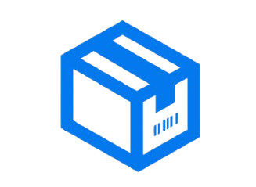
OpenFlow Packet Processing
A new packet arrives at the switch.
Switch checks its Flow Table:
If a matching rule exists → Apply the action (forward, drop, modify, etc.).
If no match → Send the packet to the controller (Packet-In message).
Controller makes a decision:
Installs a new rule in the switch (Flow-Mod message).
Sends a direct action (Packet-Out message).
Switch follows the new instructions and processes future packets accordingly.

Slide 9
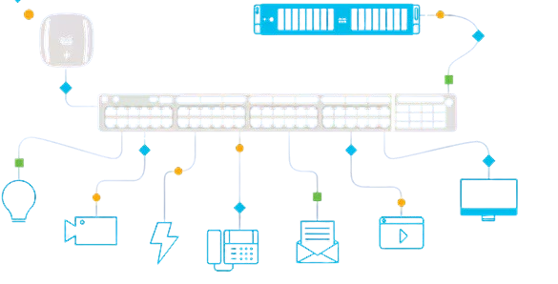
Key Components of Switch
Flow Table
Stores rules for packet forwarding.
Matches fields like IP, MAC, VLAN, and TCP/UDP ports.
Pipeline Processing
Multiple flow tables can process packets in stages.
Secure Channel
Establishes a TLS or TCP connection between the switch and the controller.
OpenFlow Protocol
Defines the messages used for communication.

Slide 10

Flow Tables in OpenFlow
Match Fields: Identifies which packets the rule applies to (IP, MAC, Port, VLAN)
Priority: rule precedence if multiple matches exist
Actions: what to do with the matched packets (Forward, Drop, Modify, etc.)
Counters: Tracks statistics (e.g., number of packets matched)
Timeouts: Rules can be removed after a certain time

Slide 11
Controller’s Decision Process
A. Rule Matching
policy or rule for this type of traffic
matches packet headers (e.g., MAC, IP, TCP/UDP ports) with predefined flow rules.
B. Dynamic Traffic Analysis
network monitoring to check traffic patterns, congestion, or security threats
if a link is overloaded, the controller might reroute traffic
C. Custom Applications & Algorithms
custom SDN applications for load balancing, security, or quality of service (QoS)

Slide 12

implementation & communication with the controller

Slide 13
Types of OpenFlow Messages
Controller-to-Switch Messages
Feature Request/Response – Controller queries switch capabilities.
Flow-Mod – Controller modifies switch Flow Table.
Packet-Out – Controller instructs switch to forward a packet.
Asynchronous Messages
Packet-In – Switch sends a new (unknown) packet to the controller.
Flow-Removed – Informs controller when a flow entry expires.
Port Status – Notifies controller of port changes (up/down).
Symmetric Messages
Hello – Establishes connection between switch and controller.
Echo Request/Reply – Checks connectivity and latency.

Slide 14
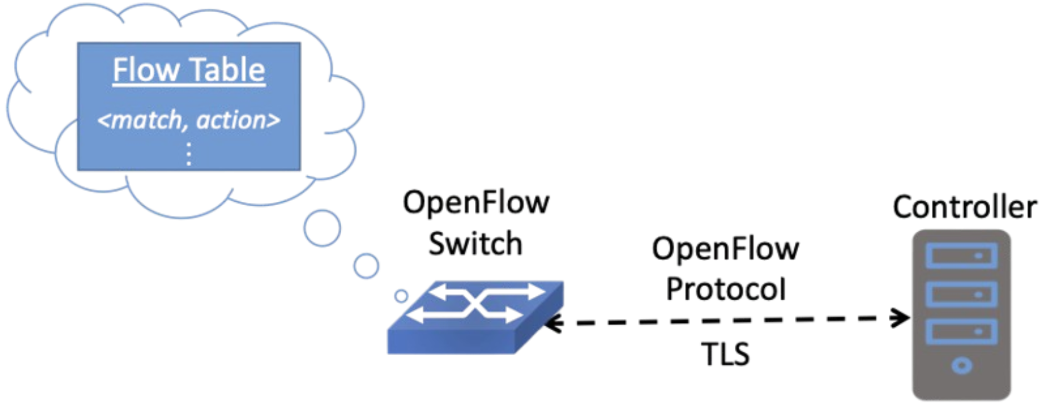
OpenFlow Control Communication Flow
OpenFlow switches connect to an SDN Controller via a Secure Channel (TLS or TCP)
The controller
monitors the network
modifies traffic rules
dynamically installs new policies.
The communication follows these steps:
switch sends a "Hello" message to establish communication
controller queries switch capabilities (Feature Request/Response)
Switch forwards unknown packets to the controller (Packet-In messages)
The controller installs new rules and updates the switch (Flow-Mod messages)
The switch follows these rules to process future packets

Slide 15
OpenFlow vs. Traditional
Feature | Traditional Networks | OpenFlow (SDN)
Control Plane | Distributed | Centralized
Traffic Management | Static, manually configured | Dynamic, programmable
Adaptability | Limited (hardware-dependent) | High (software-based control)
Complexity | High (manual updates, multiple protocols) | Lower (centralized updates, unified protocol)
Network Efficiency | Lower (fixed routing, inefficient use of resources) | Higher (optimized, software-defined traffic control)

Slide 16
Applications, Benefits, Limitations, Use cases

Slide 17

Benefits of OpenFlow
Centralized Network Control
network visibility
simplify management
Dynamic Traffic Management
real-time network adjustments and optimizations
Reduced Hardware Dependency
Works with commodity switches, lowering costs
Faster Network Innovation
rapid deployment of new networking protocols and services
Enhanced Security & Automation
programmable security policies
automatic responses to threats

Slide 18

Challenges & Limitations
Scalability Issues
performance bottlenecks in Large-scale networks
Complex Deployment
Transitioning from traditional networking requires new tools and expertise
Security Concerns
The controller could becomes a single point of failure
Limited Hardware Support
Not all switches support OpenFlow

Slide 19
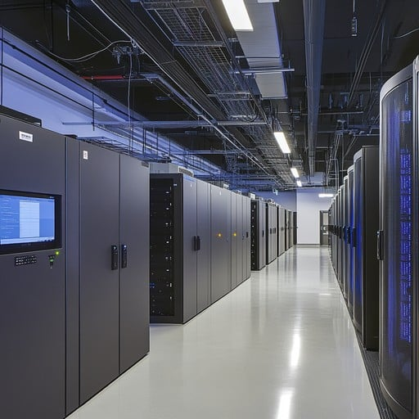
Applications of OpenFlow
Data Centers
Automates network management and optimizes resource allocation.
Enables dynamic traffic engineering for cloud providers.
Enterprise Networks
Simplifies network policy enforcement and security.
Reduces hardware dependency and operational costs.
Telecom & 5G Networks
Enables software-defined 5G network slicing and traffic optimization.
Supports dynamic Quality of Service (QoS) adjustments.
Research & Academia
Used in network simulations and SDN testbeds.
Powers experimental network architectures.

Slide 20

Real-World Deployments
Google B4 Network
Google’s global SDN backbone for inter-data center traffic
efficient bandwidth utilization and traffic engineering
Facebook’s Data Centers
OpenFlow-based SDN to optimize large-scale cloud infrastructure
AT&T SDN Strategy
OpenFlow for dynamic traffic routing and 5G network management
GENI & Internet2 Research Networks
OpenFlow-based experimental platforms for next-gen networking research

Slide 21

Conclusion & Future OF OpenFlow

Slide 22
The Future of OpenFlow & SDN
Integration with AI & Machine Learning
AI-driven network automation for predictive traffic management and security
Enhanced Security Mechanisms
More robust encryption and anomaly detection for protecting the SDN controller.
Support for 5G & Edge Computing
OpenFlow helps optimize low-latency networks for IoT, 5G, and cloud-edge architectures.
Shift Towards P4 & Intent-Based Networking
OpenFlow is evolving, and new technologies like P4 (Programmable Data Plane) are emerging.

Slide 23
Conclusion
OpenFlow revolutionized networking by enabling SDN and centralized traffic control.
It provides flexibility, automation, and cost efficiency, making networks smarter.
OpenFlow is used in data centers, 5G, cloud computing, and research.
Challenges remain in scalability, security, and hardware adoption.
The future of OpenFlow includes AI-driven networking, P4, etc.

Slide 24

Questions

Slide 25
References
Open Networking Foundation (ONF)
Google’s B4 SDN Paper
OpenFlow Specification (ONF Docs)
WIKIPEDIA
Software Defined Networking: Design and Deployment – Jim Doherty
SDN: Software Defined Networks – Thomas D. Nadeau & Ken Gray

Slide 26
Thanks for Attention Yousef Sadidi 401170597

