Slide 1
Thunderbolt Protocol
Rozhin Taghizadegan
Interface Circuit Design – February 2025

Slide 2
Overview of Thunderbolt
Thunderbolt is a high-speed data transfer and display technology developed by Intel in collaboration with Apple. It combines multiple protocols, including PCIe, DisplayPort, and USB, over a single high-bandwidth connection.
It also supports power delivery, making it ideal for connecting high-performance peripherals.

Slide 3
Generations of Thunderbolt
Generation | Max Speed | PCIe Version | DisplayPort Version | Connector Type
Thunderbolt 1 | 10 Gbps | PCIe 2.0 | DP 1.1 | Mini DisplayPort
Thunderbolt 2 | 20 Gbps | PCIe 2.0 | DP 1.2 | Mini DisplayPort
Thunderbolt 3 | 40 Gbps | PCIe 3.0 | DP 1.2 | USB-C
Thunderbolt 4 | 40 Gbps | PCIe 3.0 | DP 1.4 | USB-C

Slide 4
Key Features of Thunderbolt
High-Speed Data Transfer
Daisy-Chaining
Multiple Protocols
External GPU (eGPU) Support
Power Delivery (PD)
Backward Compatibility

Slide 5
Thunderbolt Physical Layer Blocks
Transceivers (TX/RX): Convert digital data into electrical signals and vice versa
Differential Signaling Circuit: Uses Low Voltage Differential Signaling (LVDS) to reduce noise
Multiplexers/Demultiplexers (MUX/DEMUX): Switch between PCIe, DisplayPort, and USB signals
Clock Management Unit: Provides timing for accurate data transmission
Power Delivery Circuitry: Manages power supply (up to 100W for charging)
Encoding/Decoding Units: Convert data into a format suitable for transmission.

Slide 6
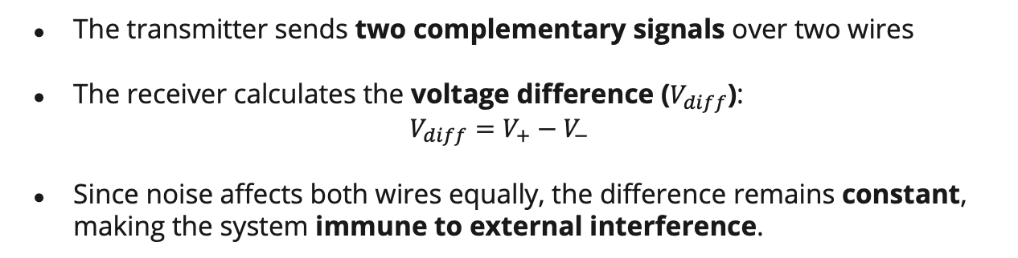
Differential Signaling in Thunderbolt
The transmitter sends two complementary signals over two wires
The receiver calculates the voltage difference ($V_{diff}$):
$$V_{diff}=V_{+}−V_{−}$$
​Since noise affects both wires equally, the difference remains constant, making the system immune to external interference.
Thunderbolt Version | Encoding Scheme | Efficiency
Thunderbolt 1 & 2 | 8b/10b Encoding | 80%
Thunderbolt 3 | 128b/130b Encoding | 98%
Thunderbolt 4 | PAM-3 (Pulse Amplitude Modulation) | ~100%

Slide 7
Essential Connections in Thunderbolt
Pin | Function
TX+ / TX- | Differential data transmission
RX+ / RX- | Differential data reception
GND (Ground) | Power return path
Vbus (Power Delivery) | Up to 100W for charging
CC (Configuration Channel) | Manages device connection
SBU (Sideband Use) | Auxiliary signal for DisplayPort

Slide 8
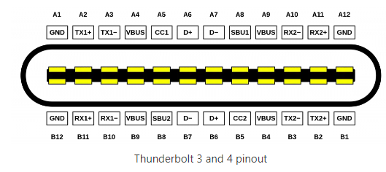

Slide 9
Lane-Based Data Transmission
Thunderbolt transmits data over multiple lanes, with each lane operating independently.
Thunderbolt 1 & 2:
Uses two lanes of 10 Gbps each (20 Gbps total).
Each lane carries either PCIe or DisplayPort.
Thunderbolt 3 & 4:
Uses four lanes of 10 Gbps each (40 Gbps total).
Can dynamically switch between PCIe and DisplayPort based on requirements.
Key Advantage: If DisplayPort needs more bandwidth, Thunderbolt dynamically allocates lanes accordingly.

Slide 10
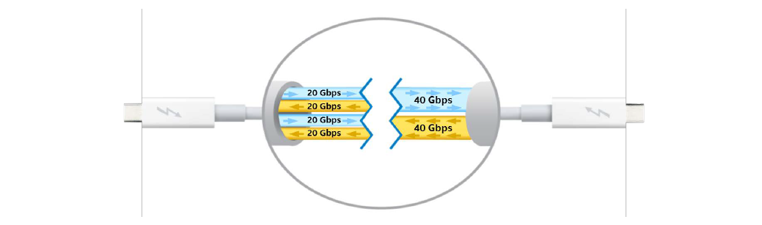

Slide 11
Thunderbolt Bus Communication: Serial or Parallel?
Thunderbolt uses a serial communication method rather than parallel. It transmits data in a high-speed, serialized format over differential pairs, which reduces electromagnetic interference (EMI) and allows for longer cable distances.

Slide 12
Why Serial and Not Parallel?
Serial communication is faster and more efficient at high data rates
Parallel transmission suffers from clock skew and crosstalk, making it unsuitable for high-speed protocols like Thunderbolt
Thunderbolt employs multiplexing, allowing multiple data streams (PCIe, DisplayPort) to be sent simultaneously over a single serial link.

Slide 13
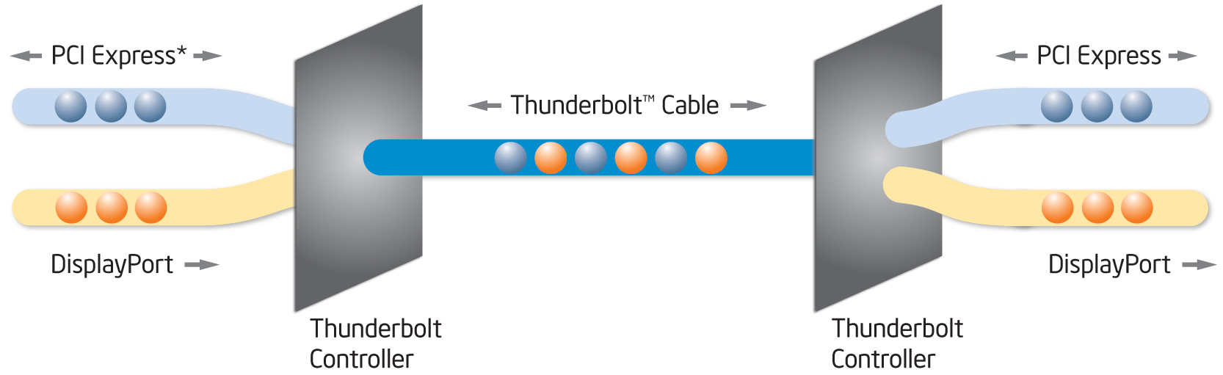

Slide 14
Is Thunderbolt Synchronous or Asynchronous?
Thunderbolt Uses Synchronous Transmission
Thunderbolt operates using a shared clock signal for precise synchronization.
Data packets are aligned with a timing reference, ensuring minimal delays.
Thunderbolt's PCIe tunneling and DisplayPort streams rely on synchronized packet transfers.
Why Synchronous?
Ensures low-latency and real-time data delivery.
Avoids timing mismatches in high-speed data transmission.
Essential for daisy-chained devices, where multiple devices rely on a common clock.

Slide 15
Multi-Device Connectivity in Thunderbolt
The Thunderbolt protocol supports multiple device connections. It allows multiple peripherals (such as external GPUs, storage devices, and displays) to be connected in two ways:
Daisy-Chaining
Hub-Based Connection

Slide 16
Daisy-Chaining in Thunderbolt
Thunderbolt natively supports daisy-chaining.
Up to 6 devices can be connected in a chain using a single Thunderbolt port.
Devices are connected serially, meaning each device acts as a relay for the next.
A single cable carries both PCIe and DisplayPort signals.

Slide 17
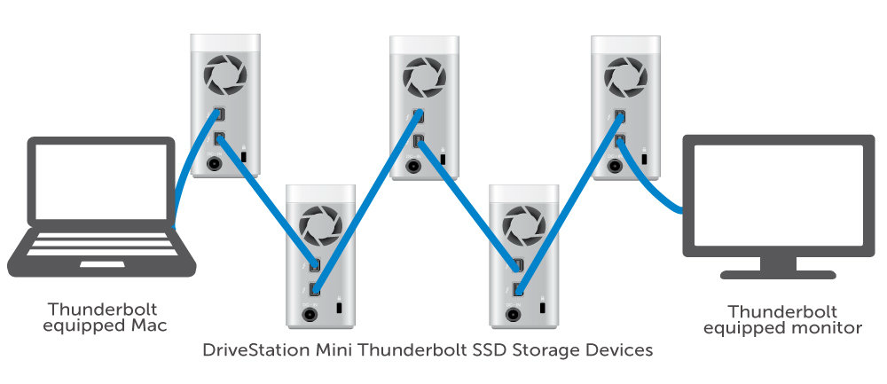
How Daisy-Chaining Works:

Slide 18
Thunderbolt Daisy-Chaining
How daisy-chaining works:
The host device (computer) has a Thunderbolt controller.
The first device connects to the host using a Thunderbolt cable.
Each additional device is connected to the previous device rather than the host.
The last device in the chain does not need to support Thunderbolt output.
Daisy-Chaining limitations:
Not all devices support daisy-chaining (e.g., some USB-C devices).
If a device in the middle of the chain fails, all devices connected after it lose connection.
Bandwidth is shared among all devices, potentially limiting performance.

Slide 19
Thunderbolt Hub-Based Connection
With Thunderbolt 4, multi-device connection is more efficient using a Thunderbolt hub.
Unlike daisy-chaining, each device connects directly to a central hub.
All devices receive full bandwidth without relying on the previous device.

Slide 20
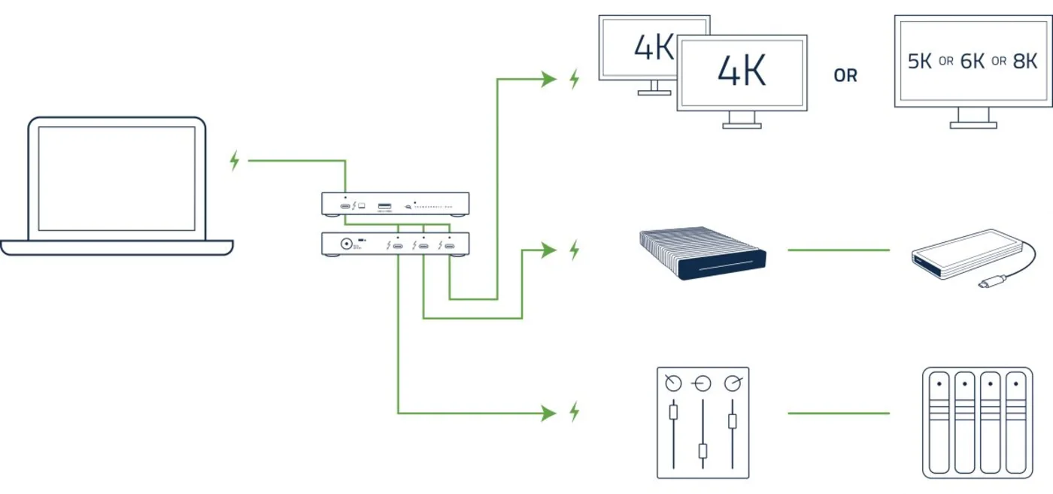

Slide 21
Thunderbolt Hub-Based Connection
Advantages of Hub-Based Connection
More reliable (a failure in one device does not affect others).
No need for Thunderbolt pass-through support in connected devices.
Better bandwidth allocation since each device gets a dedicated connection.

Slide 22
Collision Management in Thunderbolt
Since Thunderbolt allows multiple devices to communicate over a single data link, there must be an efficient method to handle data collisions and bandwidth allocation.
Thunderbolt uses a time-division multiplexing (TDM) approach for handling multiple data streams without collisions.
Thunderbolt Controller manages data traffic using a centralized arbitration system.
Each device gets a dedicated time slot, preventing simultaneous data transmission collisions.
Devices request bandwidth dynamically, and the controller assigns it based on priority.

Slide 23
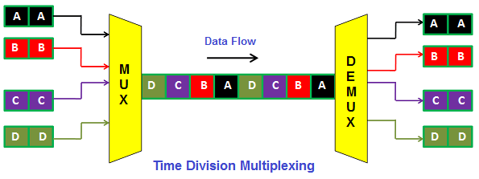

Slide 24
Flow Control in Thunderbolt
Thunderbolt flow control is managed through three main techniques:
Time-Division Multiplexing (TDM) for Bandwidth Allocation
Credit-Based Flow Control for PCIe Tunneling
Frame Buffering for DisplayPort Streams
These mechanisms ensure that different types of traffic can share the Thunderbolt link efficiently without overwhelming the system.

Slide 25
Error Detection in Thunderbolt Protocol
Thunderbolt, like many high-speed communication protocols, incorporates error detection and correction mechanisms across multiple layers to ensure data integrity. These mechanisms exist in:
Physical Layer (Bit-Level Error Detection)
Data Link Layer (Frame-Level Error Detection)
Transport & Protocol Layers (Higher-Level Error Detection)
Each layer has specific techniques to detect and correct transmission errors, ensuring reliability across PCIe, DisplayPort, and USB tunneling.

Slide 26
Error Detection in the Physical Layer
8B/10B Encoding (Thunderbolt 1 & 2) / 128B/130B Encoding (Thunderbolt 3 & 4)
Adds redundant bits for detecting invalid bit patterns.
Ensures signal synchronization and bit recovery.
CRC (Cyclic Redundancy Check) for Physical Frames
Each transmitted block has a CRC checksum.
The receiver recalculates the CRC and checks for mismatches.
Error Handling
If an error is detected, the receiver requests retransmission or drops the corrupted data.

Slide 27
Error Detection in the Data Link Layer
CRC for Data Packets
Thunderbolt packets include a CRC field that protects against transmission errors.
If a CRC mismatch occurs, the frame is discarded and retransmitted.
Flow Control to Prevent Data Loss
Credit-based flow control ensures that data is only sent when buffer space is available.
This reduces buffer overflows that can cause packet corruption.

Slide 28
Error Detection Mechanism in Higher Layers
PCIe Error Detection and Correction
Uses End-to-End CRC to check for errors in PCIe packets.
Implements Automatic Retransmission Requests (ARQ) if errors are detected.
DisplayPort Frame Buffering & Error Checking
Uses frame buffering to detect dropped frames.
Monitors video stream consistency to detect frame errors.
USB Protocol Error Checking
USB tunneling uses error-checking codes at the transport layer.
If an error is detected, USB requests retransmission or drops corrupt data.

Slide 29
Types of Messages in Thunderbolt Protocol
Thunderbolt communication involves several types of messages, each serving a distinct function within the system. These messages are transmitted across different layers, including:
Physical Layer
Data Link Layer
Transport Layer.
The types of messages can be grouped into:
Control Messages
Data Messages
Error Handling Messages.

Slide 30
Control Messages
Control messages are used for management and configuration of the Thunderbolt link. They include handshakes, link initialization, and link maintenance.
Message Types:
Link Initialization Messages: Used during the establishment of the connection to configure the link.
Link Maintenance Messages: Used to manage the state of the link (e.g., link up, link down).
Hot Plug Events: Notifications when a new device is inserted or removed.
Power Management Messages: Control the power state of devices.
Message Type (8 bits)
Message Length (8 bits)
Message Data (Variable)
Checksum (32 bits)

Slide 31
Data Messages
Data messages carry user data across the Thunderbolt connection, such as files or streaming video. These messages are often transmitted using tunneling protocols such as PCIe, DisplayPort, and USB.
Message Types:
PCIe Data Messages: Used to transport data from the host to peripheral devices and vice versa.
DisplayPort Data Messages: Carry video signals.
USB Data Messages: Carry USB data packets.
Isochronous Data: Used for time-sensitive data streams like video or audio.
Header (32 bits)
Payload (Variable)
Checksum (32 bits)

Slide 32
Error Handling Messages
Error handling messages are used to manage errors in the system, such as data corruption or transmission failures. These messages ensure that the system can recover from issues by requesting retransmissions or adjusting configurations.
Message Types:
Error Detection: Messages indicating errors, such as corrupted frames or invalid packets.
Error Recovery: Messages requesting retransmission of corrupted or lost data.
Flow Control: Messages that manage the flow of data to avoid congestion and prevent errors.
Error Type (8 bits)
Error Details (Variable)
Action (8 bits)

Slide 33
References
https://www.intel.com/content/dam/doc/technology-brief/thunderbolt-technology-brief.pdf
https://www.thunderbolttechnology.net/sites/default/files/Thunderbolt3_TechBrief_FINAL.pdf
https://www.intel.com/content/www/us/en/gaming/resources/upgrade-gaming-accessories-thunderbolt-4.html
https://www.thunderbolttechnology.net/sites/default/files/Thunderbolt_3_Overview_Brief_FINAL.pdf
https://www.erpublications.com/uploaded_files/download/download_01_04_2014_11_41_43.pdf
https://www.ti.com.cn/cn/lit/ds/symlink/hd3ss0001.pdf?ts=1738578627921&ref_url=https%253A%252F%252Fwww.google.com%252F

Slide 34
Thank you for your attention

