Slide 1
Zigbee protocol
Raya Rezaie

Slide 2
What is Zigbee?
Zigbee is a low-power, wireless communication protocol primarily designed for short-range, low-data-rate communication.
Zigbee features
Low Power Consumption
Short-Range Communication
Mesh Networking
Low Data Rate
Secure Communication

Slide 3
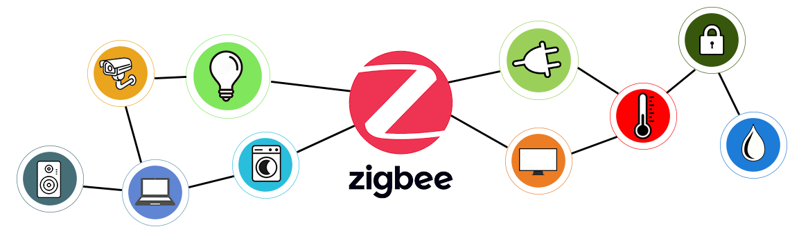
What It's Used For?
Smart Home Devices
Industrial IoT
Healthcare
Low Data Rate
Consumer Electronics

Slide 4
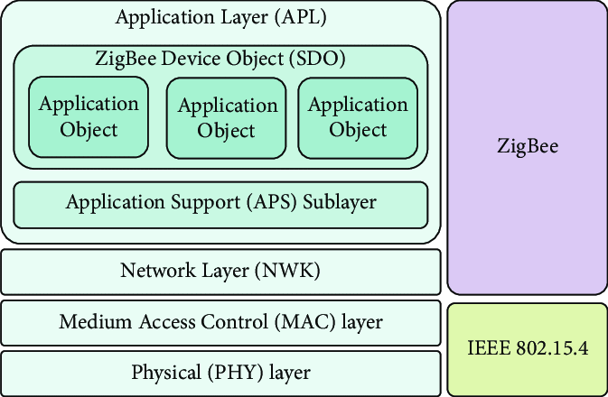
Zigbee stack layers
Physical layer (PHY)
Media Access control (MAC)
Network layer
Application Support layer (ASL)
Application layer (AL)

Slide 5
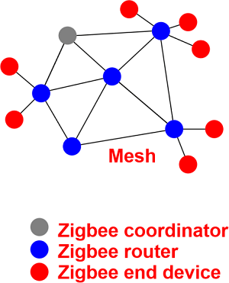
How are the connections?
Zigbee connections are typically established using a mesh network topology.
Types of devices is in Zigbee
coordinator(ZC)
Router (ZR)
End devices (ZED)

Slide 6
Addressing in Zigbee
Zigbee uses 16-bit and 64-bit addresses to identify devices in a network.
64-bit Extended Address:
Unique for each device in global network
Manufacturer sets in for each device
16-bit Network Address
Unique for each device in a network
Coordinator gives it to each device

Slide 7
Routing in Zigbee (Mesh Routing)
Zigbee devices communicate via a multi-hop system, where messages can be passed through multiple devices to reach their destination.
Types of Routing Algorithms:
Ad-hoc On-demand Distance Vector (AODV) Routing:
Route discover process
Route maintenance
Sequence Number
Flooding mechanism
Cluster three Routing:
Hierarchical Parent-Child
Limited Scalability
Predefined Routing Paths

Slide 8
Flow Control Mechanisms in Zigbee
PHY Layer
Modulation & Error Detection
Clear Channel Assessment (CCA)
b) MAC Layer
CSMA-CA
ACK
.
c) Network layer
Routing Buffering
Route request
Duplicate packet filtering
d) Application Layer
Polling Mechanism
Command Flow Management
Security Handshaking

Slide 9
Error Detection Mechanisms
PHY Layer
Signal Integrity
Modulation Errors
Carrier Sense
b) MAC Layer
Frame Check Sequence (FCS)
ACK
Duplicate Detection
.
c) Network layer
Routing Errors
Duplicate Packet detection
Link Status Monitoring:
d) Application Layer
Service Request Validity
Security Error Detection
Timeout Mechanism:

