Slide 1


Mohammad Alizadeh
Winter 2025

Slide 2
Timeline
Introduction
How to Use
Protocol
Overview
1

Slide 3
Introduction

Slide 4
Introduction
MAVLink
Micro Air Vehicle Communication Protocol
Enables communication between drones, ground stations, and other components
Efficient, extensible, and interoperable
widespread use in open-source projects like ArduPilot and PX4
Point to Point, Broadcast
3

Slide 5
Overview

Slide 6
Overview
Physical layer
Serial
Radio
Wi-Fi
5

Slide 7
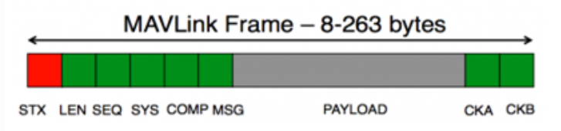
Overview
Data layer (MAVLink V1.0)
V2.0 has more bits, containing bits for sign and compatibility
6

Slide 8
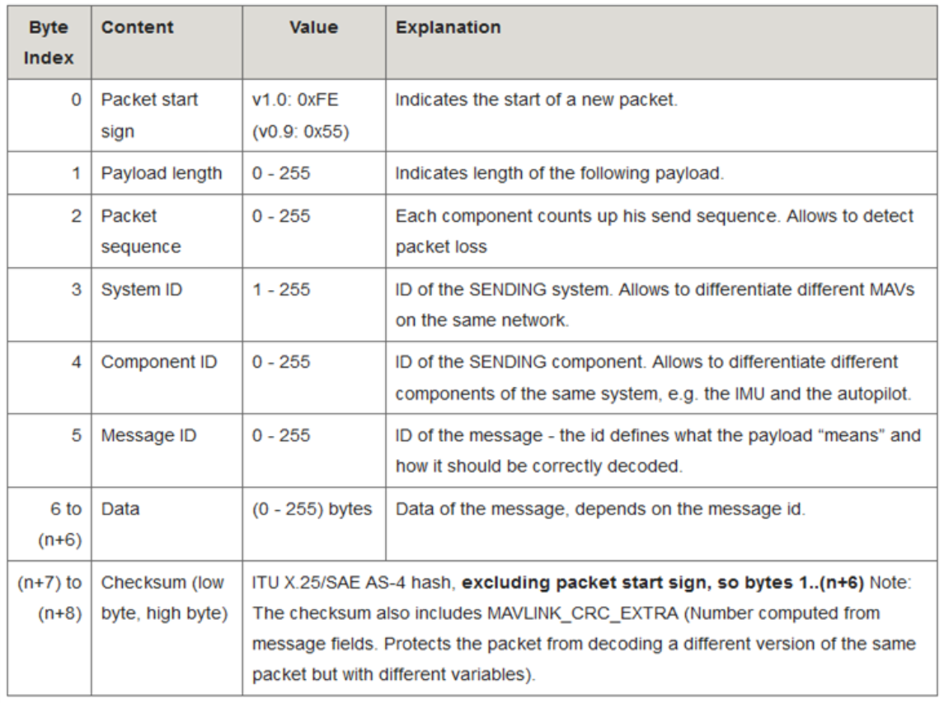
Overview
Data layer (MAVLink V1.0)
7

Slide 9
Overview
Network layer
System ID
Component ID
8

Slide 10
Overview
Application layer
System status
HEARTBEAT
SYS_STATUS
Position & Navigation
GLOBAL_POSITION_INT
ATTITUDE
Mission and commands
MISSION_ITEM
COMMAND_LONG
9

Slide 11
How to use

Slide 12
How to use
Change your xml file and add your new message or enum structure
Compile and create relevant code
Use the provided code to communicate
11

Slide 13
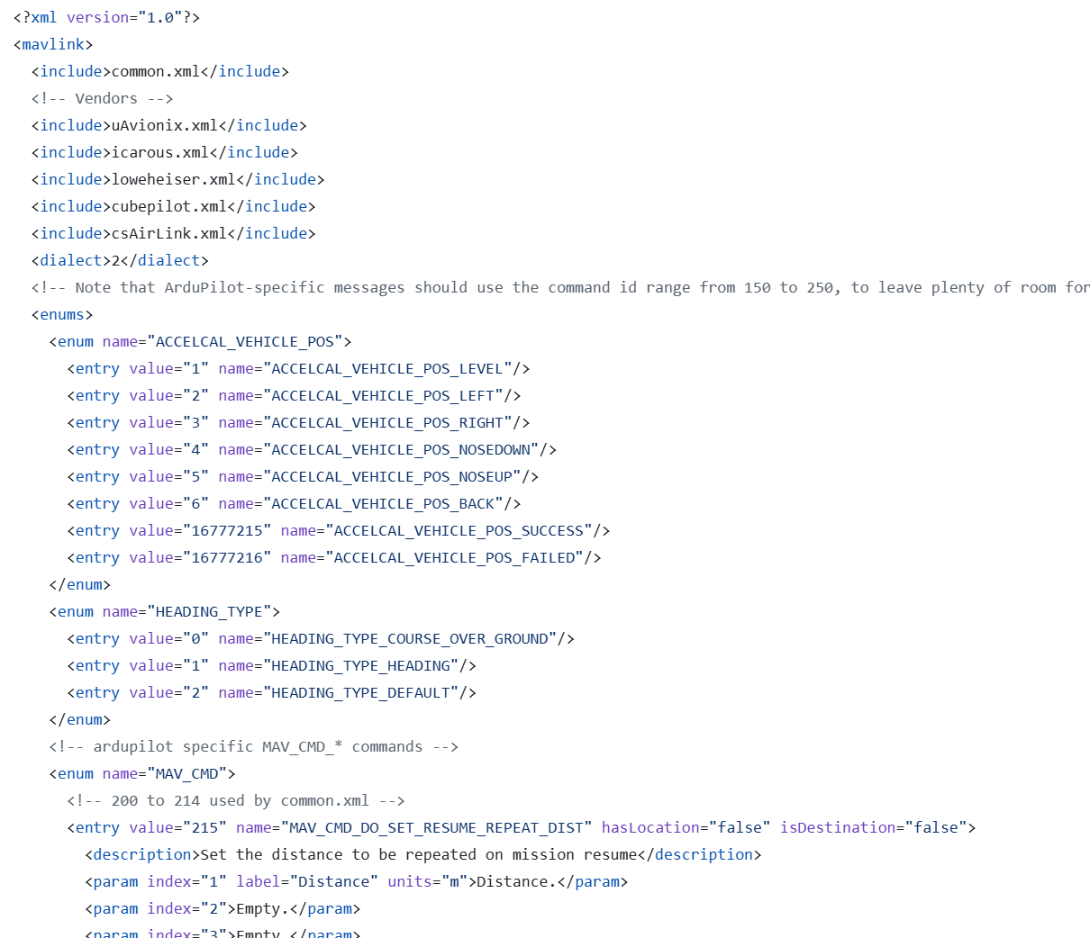
How to use
common.xml
12

Slide 14
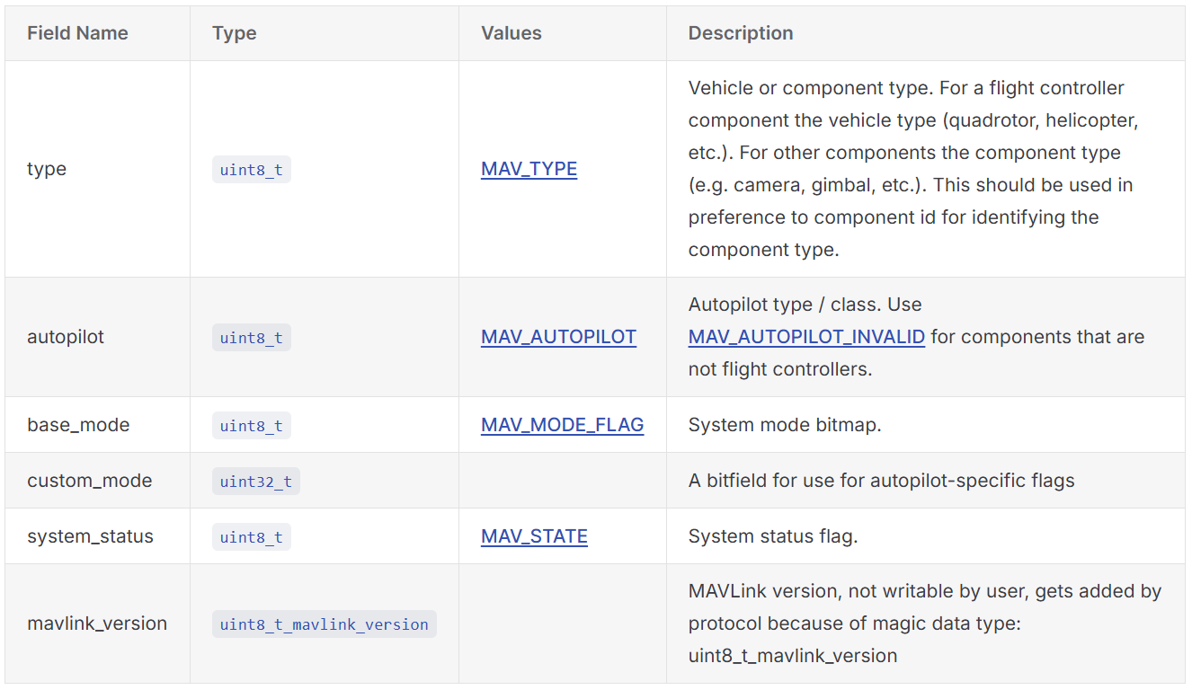
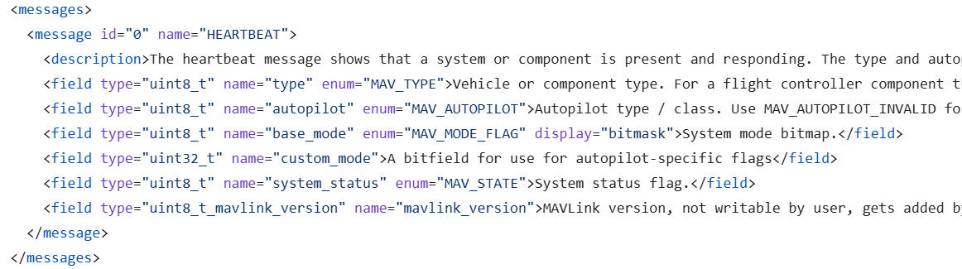
How to use
Heartbeat message
Message
xml structure
13

Slide 15
References

Slide 16
References
ArduPilot/mavlink: MAVLink micro air vehicle marshalling / communication library
mavlink/message_definitions/v1.0 at master · ArduPilot/mavlink
MAVLink Developer Guide | MAVLink Guide
MAVLink-Standard Definitions | MAVLink Guide

