Slide 1

ICD Course SUT
Instructor: Dr. Foshati
TCP PROTOCOL
Amirkasra Ahmadi
1

Slide 2
What is TCP
Stands for Transmission Control Protocol
One of the core Internet protocols (part of TCP/IP suite)
Ensures reliable, ordered, and error-checked data delivery between applications
2

Slide 3

TCP was developed in the early 1970s by Vinton Cerf and Robert Kahn to address the need for reliable communication across large-scale and heterogeneous networks, such as the Internet.
Why was TCP Developed?
It was designed to ensure reliable data transmission by incorporating mechanisms for error correction, congestion control, and flow control, making it a fundamental protocol for modern network communication.
3

Slide 4



TCP Characteristics
Connection-Oriented: Establishes a connection before transmitting data
Reliable: Guarantees that data arrives intact and in order
Full-Duplex: Allows simultaneous data transfer in both directions
Stream-Based: Transfers a continuous stream of bytes rather than fixed-sized packets
4

Slide 5
SYN
SYN-ACK
ACK
choose init seq num, x
send TCP SYN msg
choose init seq num, y
send TCP SYNACK
msg, acking SYN
SYNbit=1, Seq=x
received SYNACK(x)
indicates server is live;
send ACK for SYNACK;
this segment may contain
client-to-server data
SYNbit=1, Seq=y
ACKbit=1; ACKnum=x+1
ACKbit=1, ACKnum=y+1
received ACK(y)
indicates client is live
Sent By Client to say connection is established.
Request Initiate Connection
Respond to SYN
TCP Three-Way Handshake
5

Slide 6
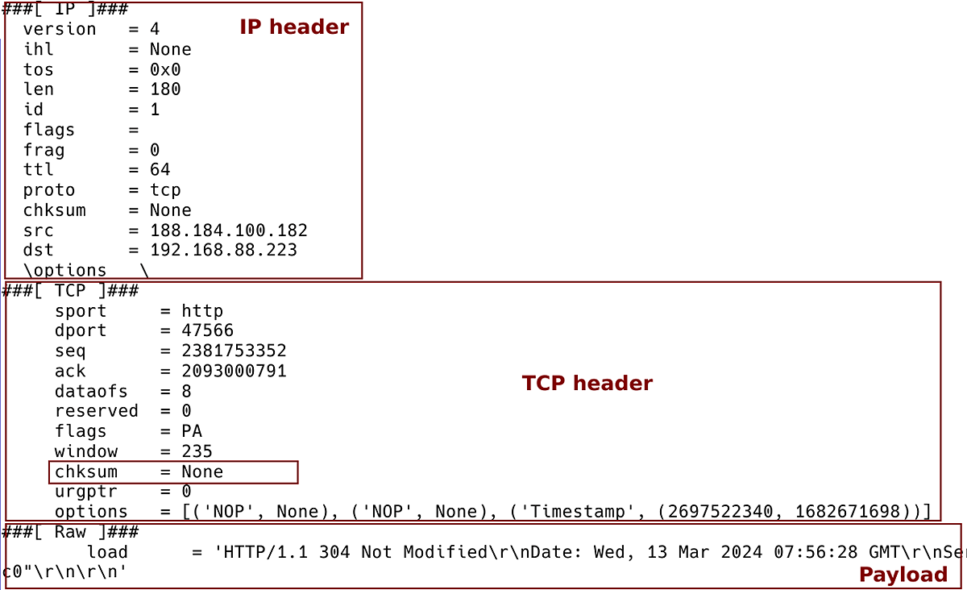
Error DETECTION IN TCP
Sender calculates and includes the checksum in the segment.
Receiver recalculates the checksum and verifies integrity.
6

Slide 7


Error Correction in TCP
Drops
Retransmission
Acknowledgment
Uses acknowledgment numbers to confirm received data
Drops the corrupted segment
Requests retransmission
7

Slide 8

client state
server state
ESTAB
ESTAB
clientSocket.close()
FIN_WAIT_1
can no longer
send but can
receive data
FINbit=1, seq=x
CLOSE_WAIT
ACKbit=1; ACKnum=x+1
can still
send data
FIN_WAIT_2
wait for server
close
LAST_ACK
FINbit=1, seq=y
TIMED_WAIT
can no longer
send data
ACKbit=1; ACKnum=y+1
timed wait
for 2*max
segment lifetime
CLOSED
CLOSED
Closing a TCP connection
8

Slide 9

Port numbers identify specific applications or services on a device
application
application
P4
P5
P6
application
P1
P2
P3
transport
transport
network
transport
Each TCP connection uses:
Source Port and Destination Port.
Example: HTTP uses port 80, FTP uses port 21.
network
link
network
link
physical
link
physical
server: IP address B
physical
host: IP address A
source IP,port: B,80
dest IP,port: A,9157
host: IP address C
source IP,port: C,5775
dest IP,port: B,80
source IP,port: A,9157
dest IP, port: B,80
source IP,port: C,9157
dest IP,port: B,80
Role of Port Numbers in TCP
9

Slide 10
outgoing segment from sender
source port #
dest port #
sequence number
How Does TCP Handle Data Transmission in a Network
acknowledgement number
rwnd
checksum
urg pointer
window size
N
Sequence Number
Each segment has a unique sequence number
sender sequence number space
sent
ACKed
sent, not-yet ACKed
(“in-flight”)
usable
but not
yet sent
not
usable
The receiver sends back an ACK for each segment.
ACK
outgoing segment from receiver
source port #
dest port #
sequence number
acknowledgement number
10
A
rwnd
checksum
urg pointer

Slide 11
32 bits
source port #
dest port #
segment seq #: counting bytes of data into bytestream (not segments!)
ACK: seq # of next expected byte; A bit: this is an ACK
sequence number
TCP Segment Structure
acknowledgement number
length (of TCP header)
head
len
not
used
A
P
S
receive window
flow control: # bytes receiver willing to accept
C
E
U
R
F
Internet checksum
checksum
Urg data pointer
C, E: congestion notification
options (variable length)
TCP options
application
data
(variable length)
data sent by application into TCP socket
RST, SYN, FIN: connection management
11

Slide 12
Uses a Sliding Window Mechanism
Receiver informs sender of available buffer size (Window Size field)
Prevents buffer overflow at the receiver
Flow Control in TCP
to application process
RcvBuffer
buffered data
receive window
flow control: # bytes receiver willing to accept
rwnd
free buffer space
TCP segment payloads
TCP receiver-side buffering
12

Slide 13
Congestion Avoidance in TCP
Congestion Avoidance
Fast Recovery
Slow Start
Gradually increases transmission rate
Reduces rate when congestion is detected
Quickly recovers from packet loss
13

Slide 14


New
ACK!
New
ACK!
.
duplicate ACK
new ACK
dupACKcount++
new ACK
cwnd = cwnd + MSS (MSS/cwnd)
dupACKcount = 0
transmit new segment(s), as allowed
cwnd = cwnd+MSS
dupACKcount = 0
transmit new segment(s), as allowed
Λ
cwnd = 1 MSS
ssthresh = 64 KB
dupACKcount = 0
cwnd > ssthresh
slow
start
Λ
congestion
avoidance
TCP Congestion Control
timeout
ssthresh = cwnd/2
cwnd = 1 MSS
dupACKcount = 0
retransmit missing segment
duplicate ACK
timeout
dupACKcount++
ssthresh = cwnd/2
cwnd = 1 MSS
dupACKcount = 0
retransmit missing segment
timeout
New
ACK!
ssthresh = cwnd/2
cwnd = 1
dupACKcount = 0
retransmit missing segment
New ACK
dupACKcount == 3
cwnd = ssthresh
dupACKcount = 0
dupACKcount == 3
ssthresh= cwnd/2
cwnd = ssthresh + 3
retransmit missing segment
ssthresh= cwnd/2
cwnd = ssthresh + 3
retransmit missing segment
fast
recovery
duplicate ACK
cwnd = cwnd + MSS
transmit new segment(s), as allowed
14

Slide 15
TCP Congestion Control
TCP AIMD
TCP CUBIC
Additive Increase
Multiplicative Decrease
increase sending rate by 1 maximum segment size every RTT until loss detected
cut sending rate in half at each loss event
W_{max}
TCP Reno
TCP CUBIC
TCP sender Sending rate
TCP
sending
rate
time
t₀
t₁
t₂
t₃
t₄
15
time

Slide 16
THANKS FOR YOUR ATTENTION
16

