Slide 1
Introduction to InfiniBand (IB)
Presented by: Mohammad Parsa Bashari
Interface Circuits (Fall 2024)

Slide 2

What is InfiniBand?
InfiniBand is an industry standard, channel-based, switched fabric interconnect architecture for server and storage connectivity (Used in HPC, AI, and cloud data centers).
It is used both for inter- and intra-computer communication.
InfiniBand offers high data transfer rates, ranging from 10 to 400Gb/s.
Most of the world’s fastest supercomputers leverage InfiniBand, connecting 63 of the top 100 supercomputers on the TOP500 list.
It implements RDMA (Remote DMA).
InfiniBand is a layered protocol.

Slide 3
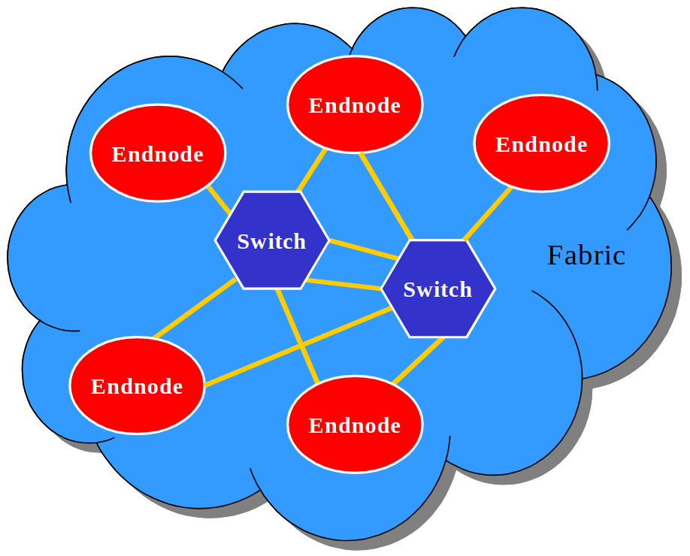
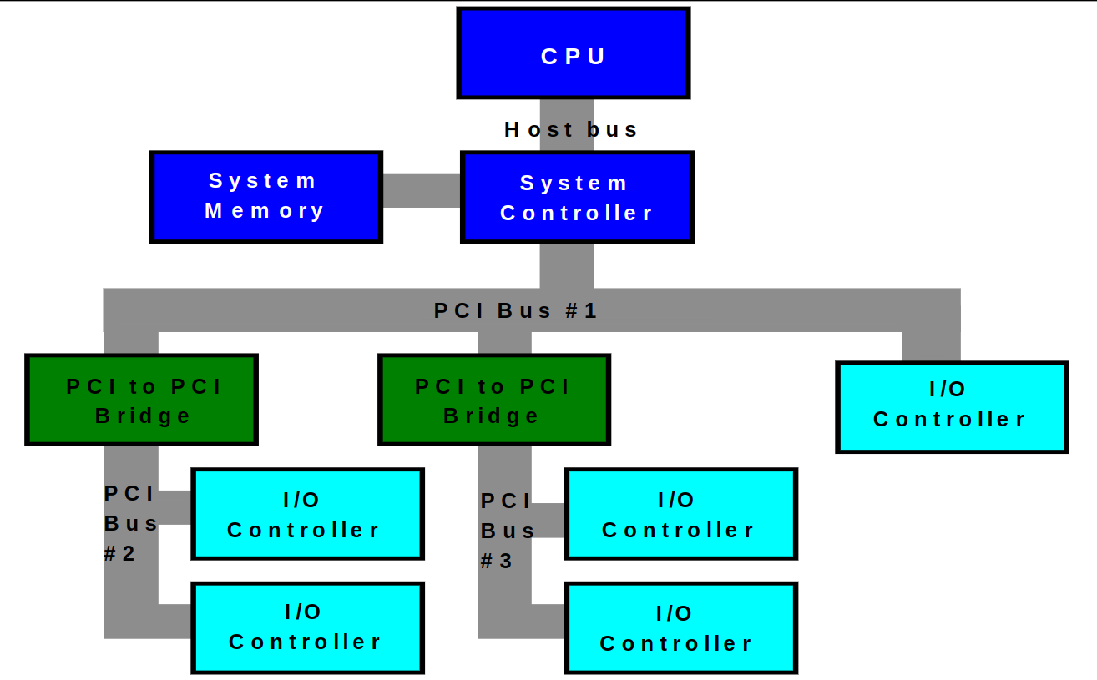
InfiniBand Architecture
Shared Bus Architecture vs. Switched Fabric

Slide 4
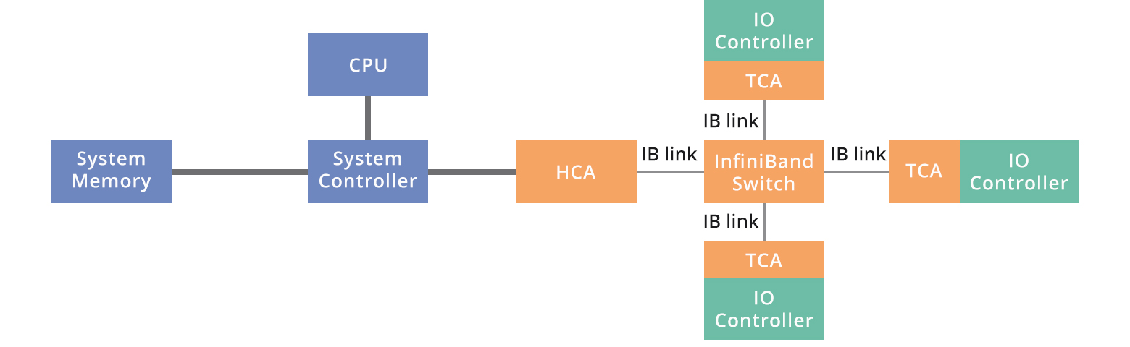
InfiniBand Architecture (cont.)
HCA (connects host to InfiniBand)
TCA (connects I/O controller to InfiniBand)

Slide 5
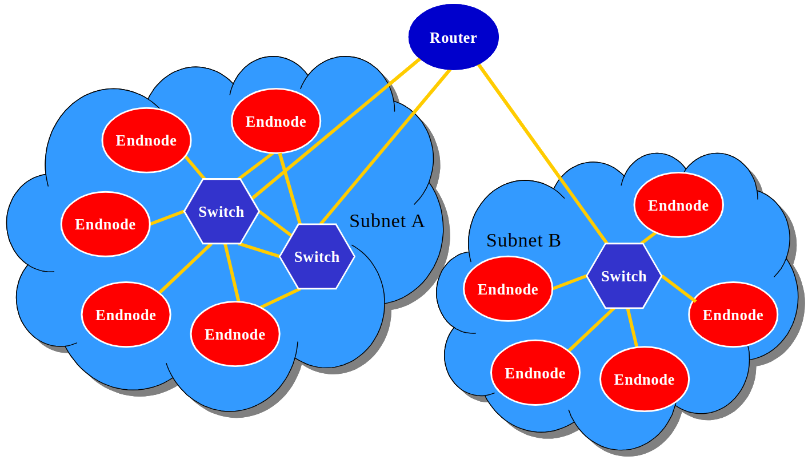
InfiniBand Architecture (cont.)
HCA
TCA
Switch
Router

Slide 6
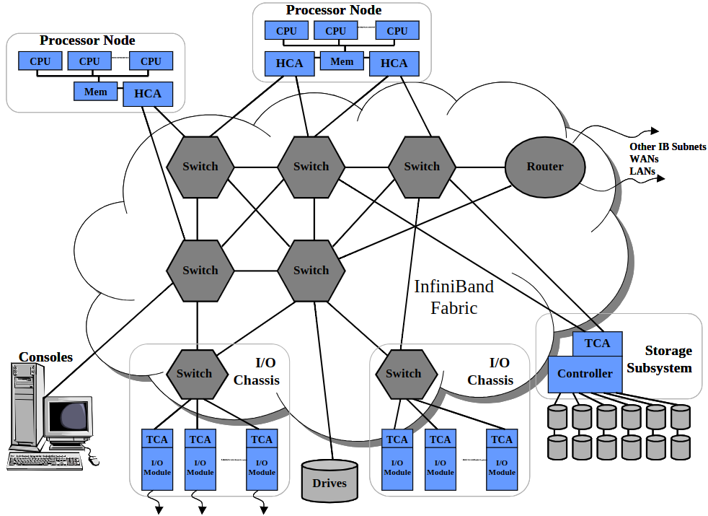
InfiniBand Architecture (cont.)

Slide 7
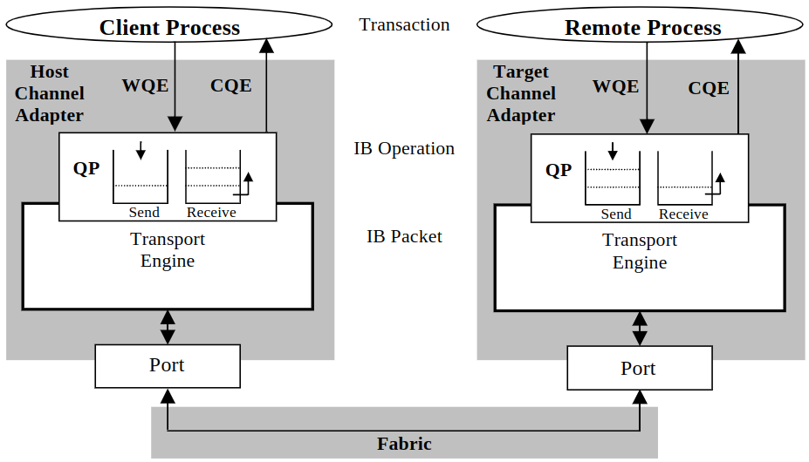
InfiniBand Architecture (cont.)

Slide 8
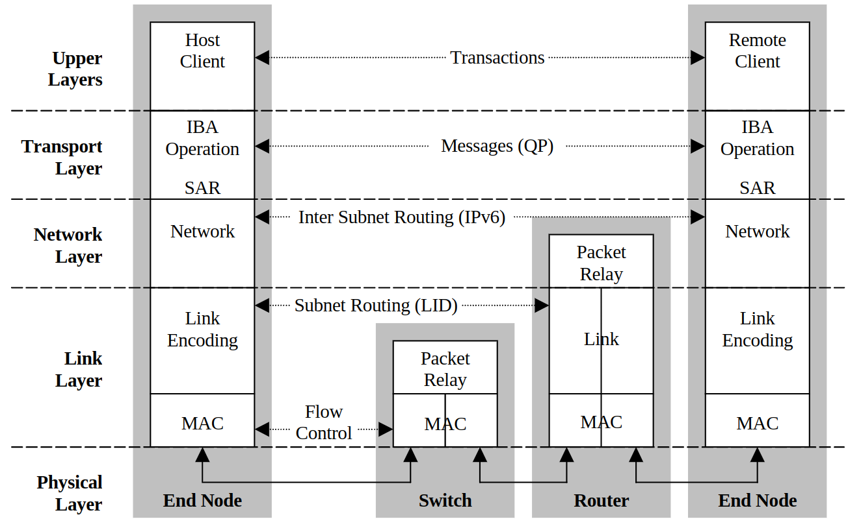
InfiniBand Protocol Stack

Slide 9
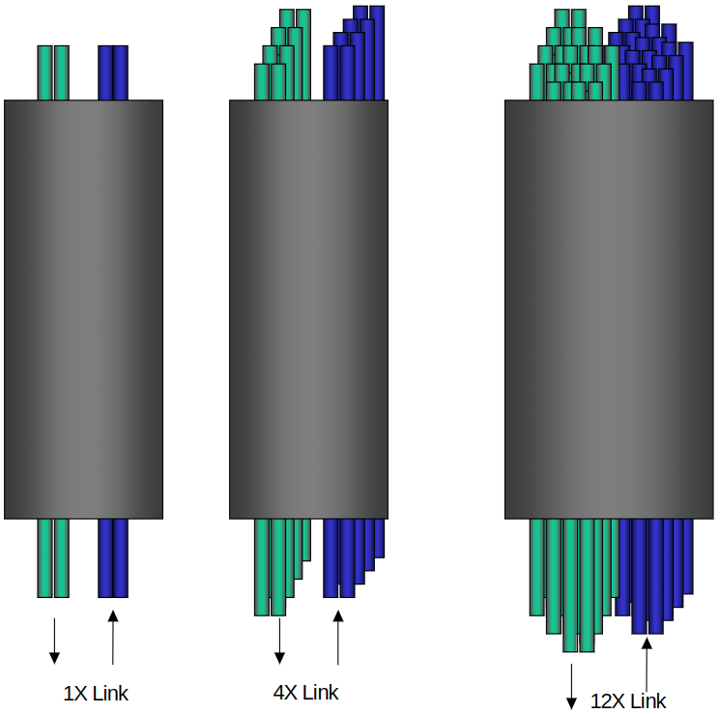
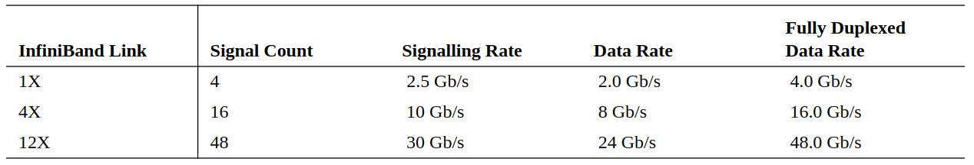
InfiniBand Protocol Stack (cont.)
Physical Layer: InfiniBand defines three link speeds at the physical layer, 1X, 4X, 12X. Each individual link is a four wire serial differential connection (two wires in each direction) that provide a full duplex connection at 2.5 Gb/s.

Slide 10
InfiniBand Protocol Stack (cont.)
Link Layer:
Packets:
Type 1) Management Packets
Type 2) Data Packets (up to 4K bytes)
Switching:
All devices within a subnet have a 16 bit Local ID (LID).
All packets sent within a subnet use the LID for addressing.
Flow Control:
Credit-based
Data Integrity:
Two CRCs per packet: (1) Variant CRC and (2) Invariant CRC.

Slide 11
InfiniBand Protocol Stack (cont.)
Network Layer (between subnets):
Packets that are sent between subnets contain a Global Route Header (GRH) which is a 128 bit IPv6 address.
The packets are forwarded between subnets through a router based on each device’s 64 bit globally unique ID (GUID).
The router modifies the LRH with the proper local address within each subnet.
Therefore the last router in the path replaces the LID in the LRH with the LID of the destination port.
Transport Layer: Based on the Maximum Transfer Unit (MTU) of the path, the transport layer divides the data into packets of the proper size and the receiver reassembles the packets.
Note: In transport layer of InfiniBand, all functions are implemented in hardware.

Slide 12
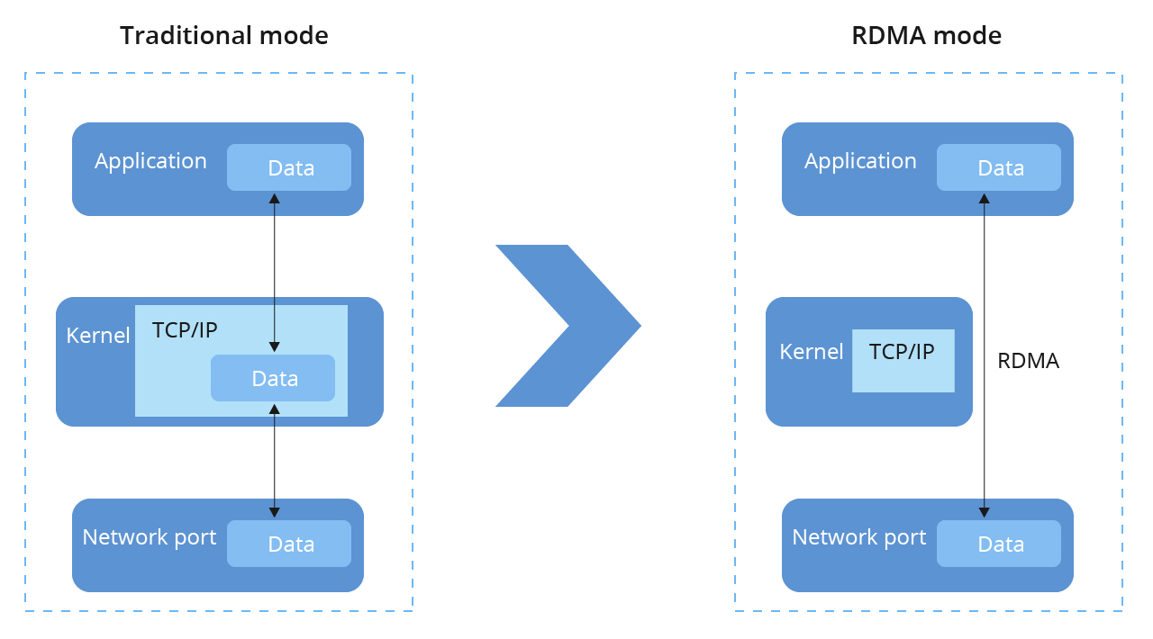
Remote Direct Memory Access

Slide 13
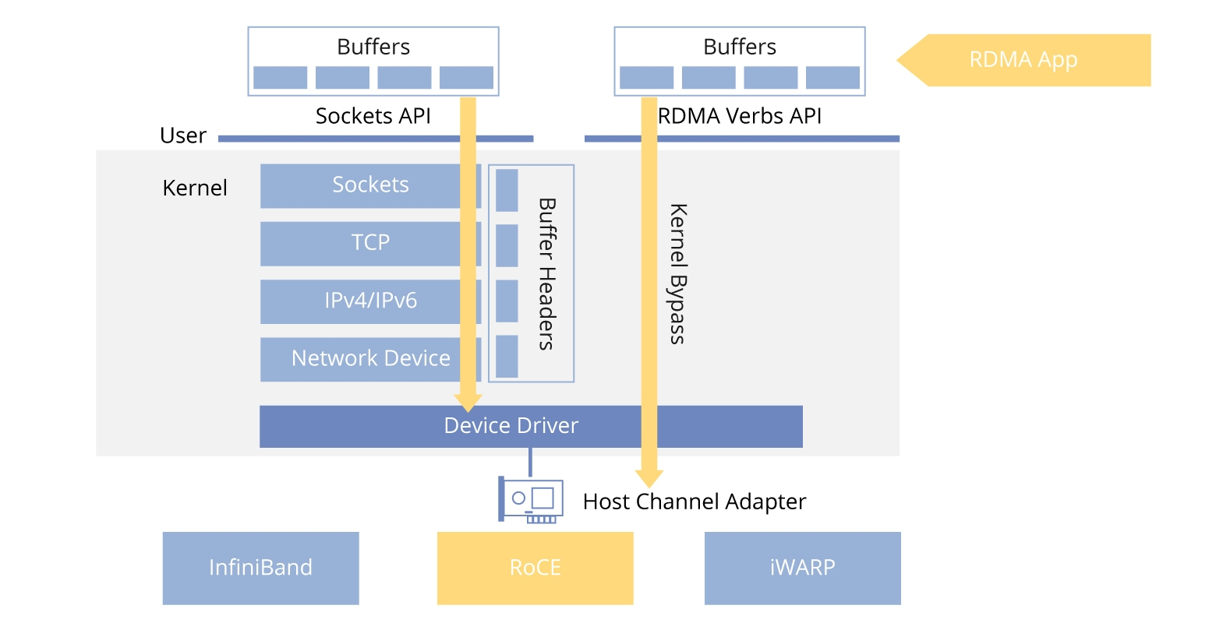
Remote Direct Memory Access (cont.)

Slide 14
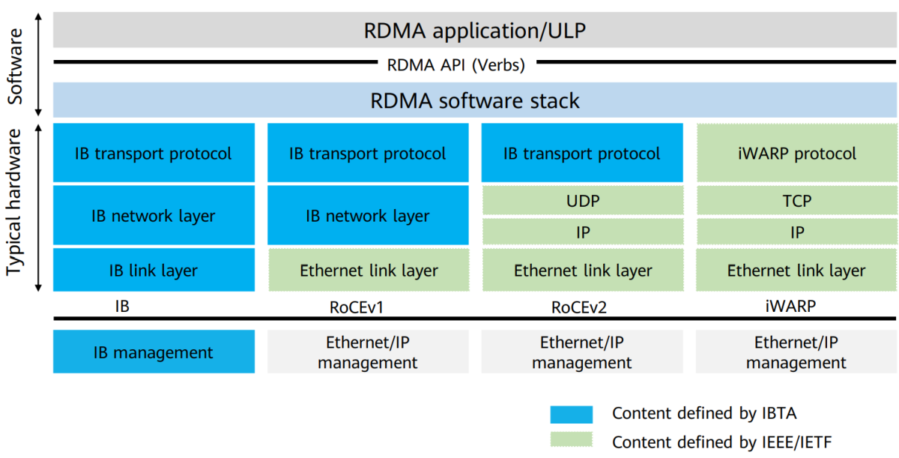
Remote Direct Memory Access (cont.)

Slide 15
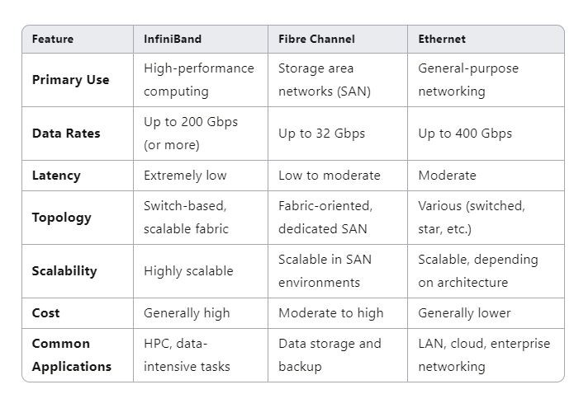
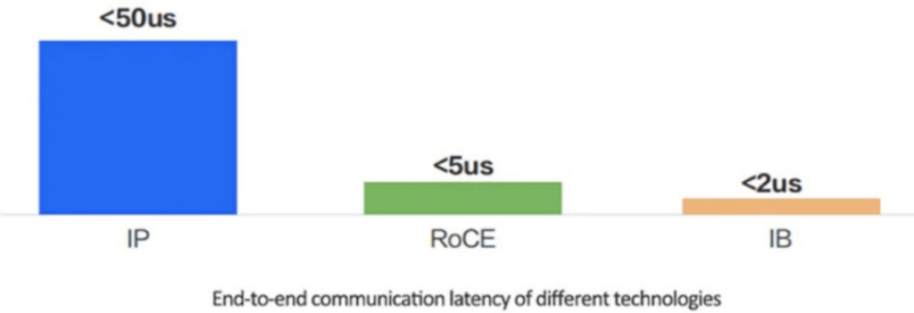
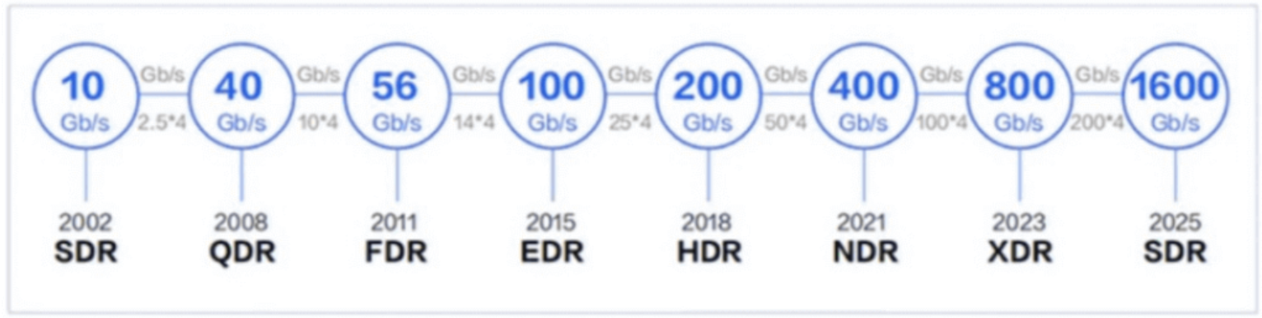
Comparison to Ethernet

Slide 16
Resources
Nvidia white paper: https://network.nvidia.com/pdf/whitepapers/IB_Intro_WP_190.pdf
https://www.fs.com/blog/infiniband-what-exactly-is-it-7714.html
InfiniBand Trade Association website: https://www.infinibandta.org/
Wikipedia: https://en.wikipedia.org/wiki/InfiniBand
https://community.fs.com/encyclopedia/remote-direct-memory-access-rdma.html
https://www.fibermall.com/blog/how-to-choose-between-infiniband-and-roce.htm
LinkedIn Post by Pawan Sharma: https://www.linkedin.com/pulse/infiniband-vs-fiber-channel-ethernet-pawan-sharma-9qhtc

Slide 17
Thank you for your attention!

