Slide 1
PCIe6
Amirmohammad Kooshky
400109673

Slide 2
PCIe through versions
We are already familiar with PCIe3 and elements of PCIe5 from course lectures.
We will now turn to PCIe6.

Slide 3
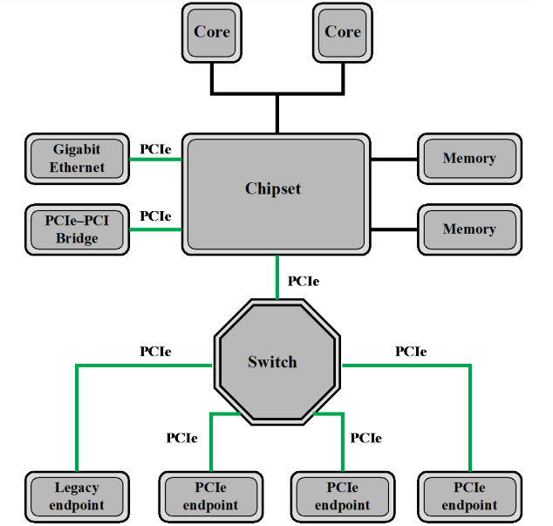
Connection Schema

Slide 4
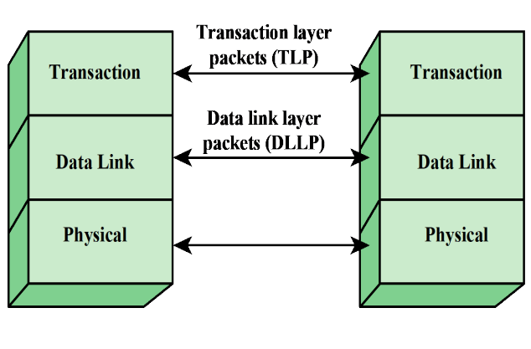

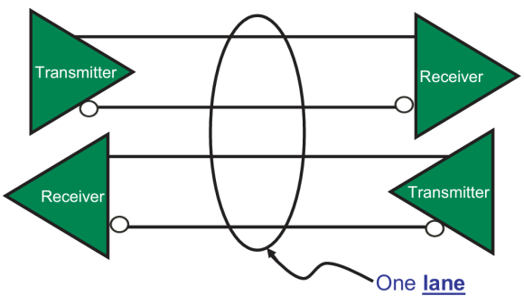
PCIe Layering

Slide 5
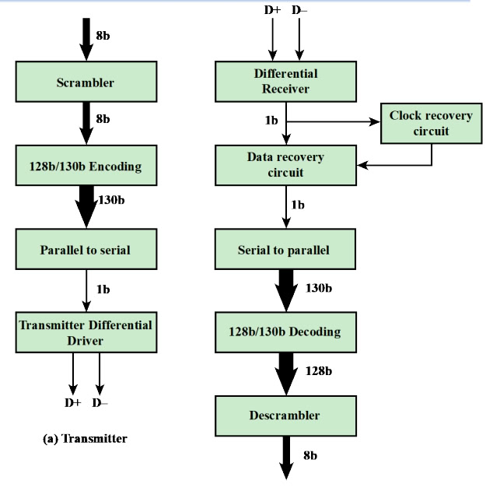
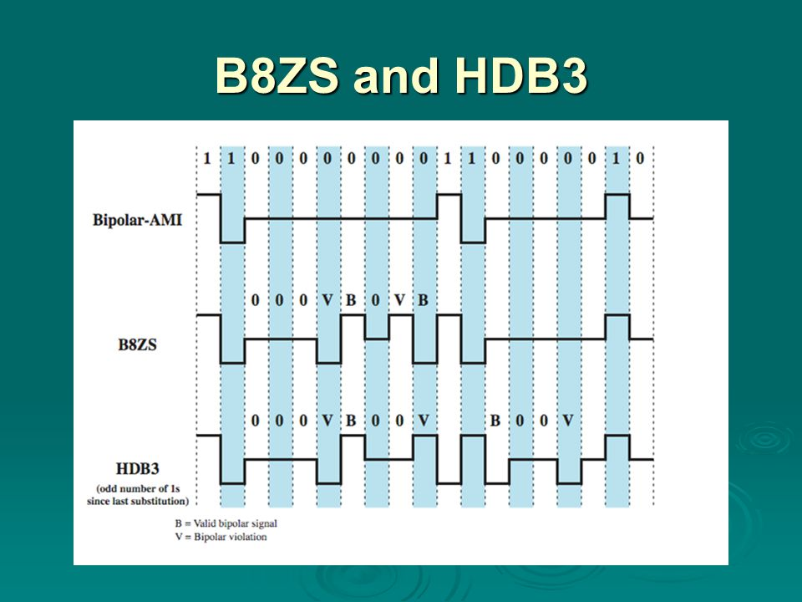
Older Versions Physical Encoding

Slide 6
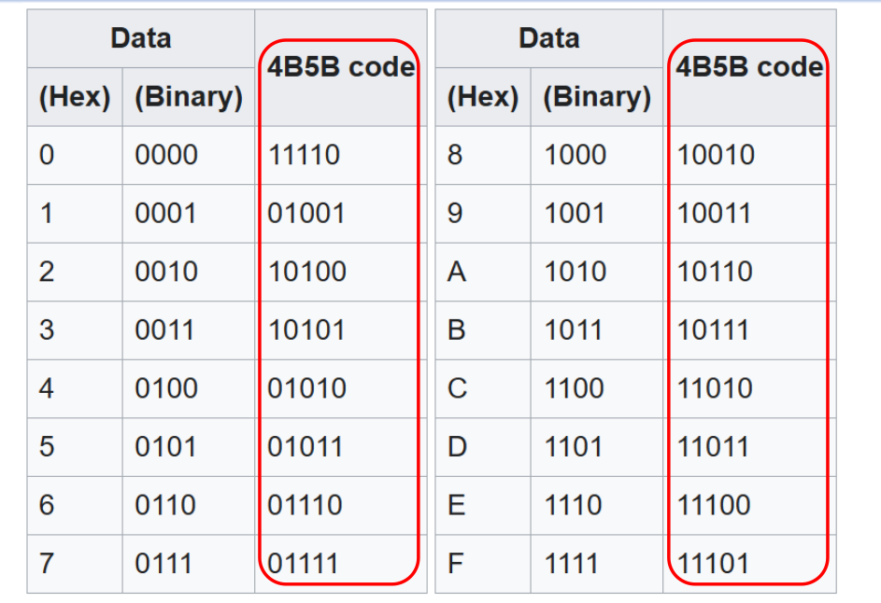
Older Versions Physical Encoding

Slide 7
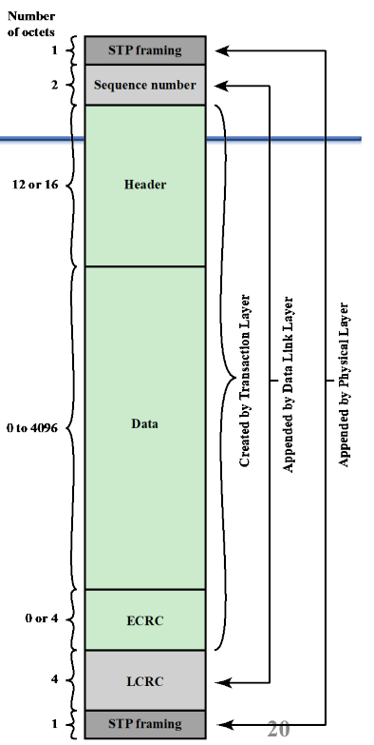
Packet Structure in Older Versions

Slide 8
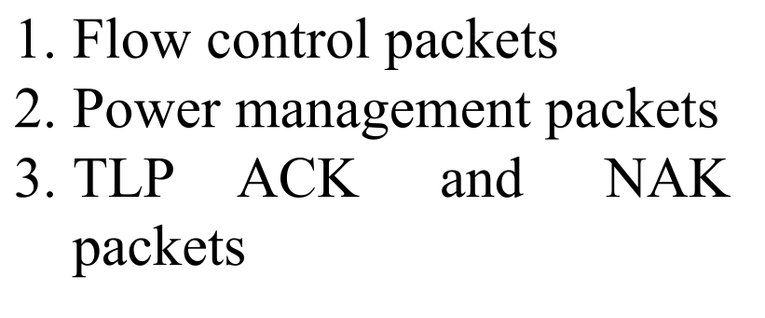
Older Versions Data Link Layer

Slide 9
PCIe6 Advantages over PCIe5
2× Higher Bandwidth – 64 GT/s per lane (vs. 32 GT/s in PCIe 5.0), 256 GB/s bidirectional in x16 configuration.
More Efficient Encoding – Uses PAM-4 (4-level signaling) instead of NRZ, doubling data rate without increasing frequency.
Improved Error Correction – FEC + CRC ensures reliable high-speed data transfer, reducing retransmissions.
Lower Latency – FLIT (Flow Control Unit) encoding reduces protocol overhead and improves efficiency.
Better Power Efficiency – Dynamic Voltage and Frequency Scaling (DVFS) and L0p low-power mode reduce energy consumption.
Backward Compatibility – Fully supports PCIe 5.0, 4.0, and earlier devices.
Higher Reliability – Advanced signal integrity techniques handle the challenges of 64 GT/s speeds.

Slide 10
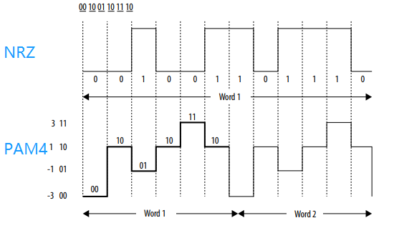
What Factors Enable Such Improvement?
Do not confuse PAM with ASK. PAM is a digital encoding scheme.

Slide 11
The Enabler: Flit Mode
All data-link packets are of fixed size (256B) and called Flits
This enables better error correction and flow management
TLP’s and Flits do not have a one-to-one relationship
DLPs have a special slot in each Flit and can be inserted
Flits help manage congestion more effectively, especially in high-speed links.

Slide 12
Robust Error Correction
LDPC-based (Low-Density Parity-Check) FEC (Forward Error Checking) is used at the physical and data-link layers.
Robust CRC (Cyclic Redundancy Check) is used at both physical and data-link layers to make sure Flits arrive correctly.
Replays are employed if FEC fails error correction and CRC detects it.
This error checking allows safe increase of bandwidth in terms of T/s (perpendicular to encoding density).
What enables FEC that was absent in previous versions? Fixed-length DLLPs called Flits! FEC is only feasible on fixed-length packets.

Slide 13
Power Efficiency
L0p is a low-power state for the entire PCIe link.
It reduces power consumption during idle periods.
Applies to all lanes in the link, not just individual ones.
Enables fast wake-up to full power (L0) when data transfer resumes.

Slide 14
Power Efficiency
Dynamic Voltage and Frequency Scaling (DVFS) adjusts voltage and frequency based on workload.
Low load → Lower frequency & voltage for power savings.
High load → Higher frequency & voltage for required performance.
Benefits:
Power efficiency
Thermal management
Improved battery life in mobile devices
Challenges:
Lower voltage can increase noise susceptibility.
PCIe 6.0 uses DVFS alongside error correction (e.g., FEC) to ensure reliable data transmission.

