Slide 1
A proactive anti phishing tool using fuzzy logic and ripper data mining classification algorithm
For our project:
Fuzzy Logic e-mail classification
Peter Heemskerk
Jim Kamans
Stefan Schenk
December 2017

Slide 2
Goal
Phishing: sending emails falsely claiming to be a business establishment to scam or trick the user.
Classify phishing emails using Fuzzy Logic based on:
  non-content (URL data features)
  content (wording in the email
The “ proactive” part was that this procedure also aims inform administrators from hosting parties to get the phishing website removed.

Slide 3
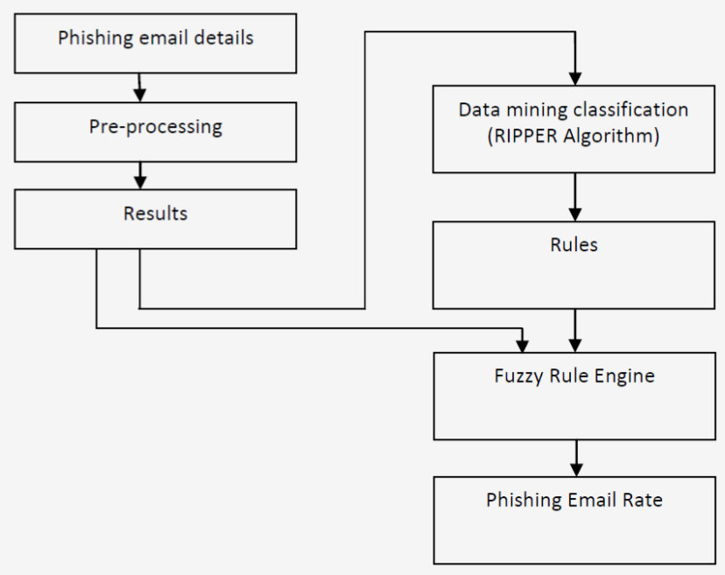
Method (1)
Rule Learner: Repeated Incremental Pruning to Produce Error Reduction
(1995)

Slide 4
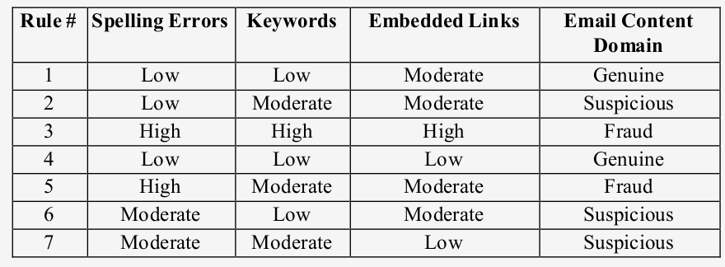
Method (2)
Spelling Errors, KeyWords, Embedded Links were used as Fuzzy Logic
variables to predict whether the email was Genuine, Suspicious or Fraud.

Slide 5
Conclusion
Achievements:
  With 1000 “Phishtank” examples the process reached 85,4% correctly classified
What we can learn from it
  Use tool to generate rules (like Ripper)
  Examples of Membership functions

