Slide 1

Advanced Java Programming
Topic: Streams and Filters
By
Arvind Kumar
Asst. Professor, LPU

Slide 2
Contents
Describing the Stream interface
Filtering a collection using lambda expressions
Chaining multiple methods together
Defining pipelines in terms of lambdas and collections

Slide 3
Stream

Slide 4
Stream
Suppose we want to iterate over a list of integers and find out sum of all the integers greater than 10.
static int sumIterator(List<Integer> list)
{ Iterator<Integer> it = list.iterator();
int sum = 0;
while (it.hasNext())
{
int num = it.next();
if (num > 10) { sum += num; }
}
return sum; }

Slide 5
Problems in previous code
We just want to know the sum of integers but we would also have to provide how the iteration will take place, this is also called external iteration because client program is handling the algorithm to iterate over the list.
The program is sequential in nature, there is no way we can do this in parallel easily.
There is a lot of code to do even a simple task.

Slide 6
Blank

Slide 7
Stream
Stream is a sequence of elements(Objects) from a source supporting sequential and parallel aggregate operations.
The common aggregate operations are filter, map, reduce, find, sort.
The source refers to a Collection (e.g. java.util.List, java.util.Set) or an array which provides data to a Stream.
The Stream keeps the order of the data as it is in the source.

Slide 8
Blank

Slide 9
Stream Vs Collection
A Collection (source) is an in-memory data structure to hold values and before we start using Collection, all the values should have been populated.
A Stream is a data structure that is computed on-demand.
Stream does not store data, it operates on the source data structure (Collection or array) and produce pipelined data that we can use and perform specific operations.
For example, we can create a Stream from a java.util.List and filter it based on certain condition.

Slide 10
Blank

Slide 11
Stream API
The stream API defines several stream interfaces, which are packaged in java.util.stream.
At the foundation is BaseStream.
BaseStream extends the AutoCloseable interface; thus, a stream can be managed in a try-with-resources statement.
Note: Only those streams whose data source requires closing (such as those connected to a file) will need to be closed.

Slide 12
Blank

Slide 13
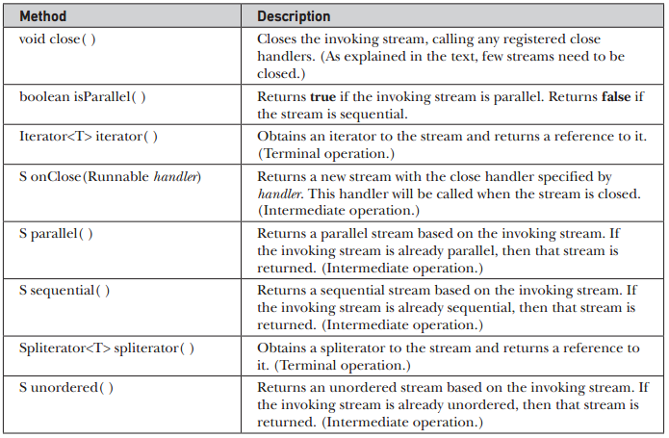
BaseStream’s Methods
Notes:
The unordered() operation doesn't do any actions to explicitly unorder the stream. it removes the constraint on the stream that it must remain ordered, thereby allowing subsequent operations to use optimizations that don't have to take ordering into consideration.

Slide 14
Blank

Slide 15
Stream Interfaces
From BaseStream are derived several types of stream interfaces. The most general of these is Stream. It is declared as shown here:
interface Stream<T>
Here, T specifies the type of the elements in the stream. Because it is generic, Stream is used for all reference types.

Slide 16
Blank

Slide 17
Creating Java Streams
We can use Stream.of() to create a stream from similar type of data.
Stream<Integer> stream = Stream.of(1,2,3,4);
We can use Stream.of() with an array of Objects to return the stream.
Stream<Integer> stream = Stream.of(new Integer[]{1,2,3,4});

Slide 18
Blank

Slide 19
Creating Java Streams
We can use Collection’s stream() to create sequential stream and parallelStream() to create parallel stream.
List<Integer> myList = new ArrayList<>();
for(int i=0; i<100; i++)
myList.add(i);
Stream<Integer> sequentialStream = myList.stream();
Stream<Integer> parallelStream = myList.parallelStream();

Slide 20
Blank

Slide 21
Creating Java Streams
Using Arrays.stream() and String.chars() methods.
LongStream is = Arrays.stream(new long[]{1,2,3,4}); IntStream is2 = "abc".chars();

Slide 22
Blank

Slide 23
Stream Interface Methods

Slide 24
Blank

Slide 25
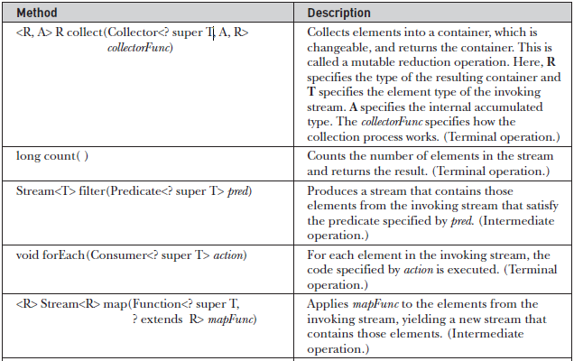

Slide 26
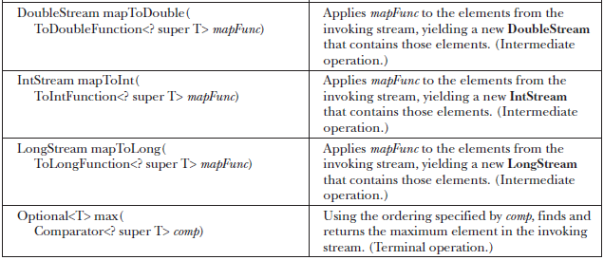

Slide 27
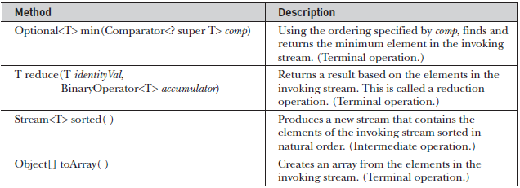

Slide 28
Blank

Slide 29
Stream Interface Methods
A terminal operation consumes the stream.
Terminal operation used to produce a result or to execute some action.
Once a stream has been consumed, it cannot be reused.
Intermediate operations produce another stream. Thus, intermediate operations can be used to create a pipeline that performs a sequence of actions.
Intermediate operations do not take place immediately. Instead, the specified action is performed when a terminal operation is executed on the new stream created by an intermediate operation.

Slide 30
Anatomy of the Stream Pipeline
Intermediate Methods
map, mapToDouble, mapToInt, mapToLong, filter, sorted, sequential, parallel, onClose, unordered
Terminal Methods
forEach, toArray, reduce, collect, min, max, count, iterator, spliterator

Slide 31
Blank

Slide 32
Stream Interface Methods
Some intermediate operations are stateless and some are stateful.
In a stateless operation, each element is processed independently of the others.
In a stateful operation, the processing of an element may depend on aspects of the other elements.
The difference between stateless and stateful operations is especially important when parallel processing of a stream is desired because a stateful operation may require more than one pass to complete.

Slide 33
Blank

Slide 34
Stream Interface Methods
Because Stream operates on object references, it can’t operate directly on primitive types. To handle primitive type streams, the stream API defines the following interfaces:
DoubleStream, IntStream, LongStream
These streams all extend BaseStream and have capabilities similar to Stream except that they operate on primitive types rather than reference types.

Slide 35
Blank

Slide 36
Let’s Do It
WAP to find all the words from list of words which are started from ‘a’ and ended with suffix ‘g’ by using stream. Also display these words in dictionary order.
WAP to filter only those Employee who are working in CSE department of LPU organization from list of Employees by using stream.

Slide 37
java.util.Optional class
Java Optional is a container object which may or may not contain a non-null value.
The Optional class includes methods to explicitly deal with the cases where a value is present or absent.
The advantage compared to null references is that the Optional class forces you to think about the case when the value is not present. As a consequence, you can prevent unintended null pointer exceptions.
The intention of the Optional class is to that by just reading the signature of a method, you can tell whether you can expect an optional value.

Slide 38
java.util.Optional class
If a value is present, isPresent() will return true and get() will return the value.
Stream terminal operations return Optional object.
Some of the Stream’s methods which return Optional are:
Optional<T> reduce(BinaryOperator<T> accumulator)
Optional<T> min(Comparator<? super T> comparator)
Optional<T> max(Comparator<? super T> comparator)

Slide 39
Blank

Slide 40
Let’s Do It
WAP to find maximum and minimum salaried employee from list of employees.

Slide 41
Blank

Slide 42
BinaryOperator Funtional Interface
BinaryOperator is a functional interface declared in java.util.function that extends the BiFunction functional interface.
BiFunction defines this abstract method:
R apply(T val, U val2)
BinaryOperator specifies the same type for all the type parameters.
In BinaryOperator, apply( ) looks like this:
T apply(T val, T val2)

Slide 43
Blank

Slide 44
Reduction Operations
Reduction operations are used to reduces the stream to a single value.
reduce( ) can return a value from a stream based on any arbitrary criteria
Optional<T> reduce(BinaryOperator<T> accumulator)
T reduce(T identityVal, BinaryOperator<T> accumulator)
<U> U reduce(U identityVal, BiFunction<U, ? super T, U> accumulator , BinaryOperator<U> combiner)

Slide 45
Reduction Operations
It is important to understand that the accumulator operation must satisfy three constraints:
Stateless means that the operation does not rely on any state information.
Non-interfering means that the data source is not modified by the operation.
Associative is used in its normal, arithmetic sense, which means that, given an associative operator used in a sequence of operations, it does not matter which pair of operands are processed first.

Slide 46
Blank

Slide 47
Let’s Do It
WAP to calculate sum of all the even numbers from the stream.
WAP to calculate multiplication of square roots of each elements in stream.

Slide 48
Blank

Slide 49
Mapping
It is used to apply some transformation to the elements in a stream.
It is useful to map the elements of one stream to another.
<R> Stream<R> map(Function<? super T, ? extends R> mapFunc)
The mapFunc must be stateless and non-interfering.

Slide 50
Blank

Slide 51
Let’s Do It
WAP to map only names and phone numbers to a new stream of NamePhone objects from the original stream contains objects of type NamePhoneEmail.

Slide 52
Blank

Slide 53
Mapping
Three other versions of map( ) are:
IntStream mapToInt(ToIntFunction<? super T> mapFunc)
Note: ToIntFunction interface’s abstract method is:
  int applyAsInt(T val )
LongStream mapToLong(ToLongFunction<? super T> mapFunc)
Note: ToLongFunction interface’s abstract method is:
  long applyAsLong(T val )

Slide 54
Mapping
Three other versions of map( ) are:
DoubleStream mapToDouble(ToDoubleFunction<? super T> mapFunc)
Note: ToDoubleFunction interface abstract’s method is:
  double applyAsDouble(T val )

Slide 55
Blank

Slide 56
Collecting
It is used to obtain a collection from a stream.
<R, A> R collect(Collector<? super T, A, R> collectorFunc)
<R> R collect(Supplier<R> target, BiConsumer<R, ? super T> accumulator, BiConsumer <R, R> combiner)
Here,
  target specifies how the object that holds the result is created.
  The accumulator function adds an element to the result and
  combiner combines two partial results.
  For both, they must be stateless, non-interfering and associative.

Slide 57
Collector Interface
Collector interface is declared in java.util.stream
interface Collector<T, A, R>
The Collectors class defines a number of static collector methods that you can use as-is.
static <T> Collector<T, ?, List<T>> toList( )
static <T> Collector<T, ?, Set<T>> toSet( )

Slide 58
Blank

Slide 59
Collectors Class
Collectors implements many useful reduction operations.
//Collecting in a List
List<String> word = letters.stream().map(s -> s.toUpperCase()).collect(Collectors.toList());
//Collecting in a Set
Set <String> word= letters.stream().map(s -> s.toUpperCase()).collect(Collectors.toSet());

Slide 60
Blank

Slide 61
Collectors Class
groupingBy(Function<? super T,? extends K> classifier)
A "group by" operation on input elements of type T, grouping elements according to a classification function, and returning the results in a map
partitioningBy(Predicate<? super T> predicate)
Partitions the input elements according to a Predicate

Slide 62
Grouping and Partitioning
Using Collectors
// Group by starting letter
Map<String, List<String>> grouped = letters.stream() .collect(Collectors.groupingBy(s->s.substring(0,1)));
// Partition letters into uppercase and lowercase
Map<Boolean, List<String>> upperLower = letters.stream().collect(Collectors.partitioningBy(s -> Character.isUpperCase(s.codePointAt(0))));
Notes:
public static <T, K> Collector<T, ?, Map<K, List<T>>> groupingBy(Function<? super T, ? extends K> classifier)
public static <T, K, A, D> Collector<T, ?, Map<K, D>> groupingBy(Function<? super T, ? extends K> classifier, Collector<? super T, A, D> downstream)
public static <T> Collector<T, ?, Map<Boolean, List<T>>> partitioningBy(Predicate<? super T> predicate)
public static <T, D, A> Collector<T, ?, Map<Boolean, D>> partitioningBy(Predicate<? super T> predicate, Collector<? super T, A, D> downstream)

Slide 63
Blank

Slide 64
Let’s Do Something…
WAP to create a class Employee having attributes name, gender, id and salary. Store the 5 Employee objects in an ArrayList.
Use Streams to -
Display the names of all the Male employees having salary less than 25000 in descending order of their id.
Group the Employees on the basis of salary with range 10-20K, 20-30K and 30-40K.

Slide 65
Blank

Slide 66
Spliterator
Spliterator offers an alternative to Iterator, especially when parallel processing is involved.
Methods:
tryAdvance
forEachRemaining
trySplit

Slide 67
Spliterator
tryAdvance( ) performs an action on the next element and then advances the iterator.
boolean tryAdvance(Consumer<? super T> action)
It give us to perform some action on each element collectively, rather than one at a time by using:
default void forEachRemaining(Consumer<? super T> action)
trySplit( ) splits the elements being iterated in two, returning a new Spliterator to one of the partitions.
Spliterator<T> trySplit( )

Slide 68
Blank

Slide 69
Parallel Streams and Performance
Only if the operations are
performed on a significantly large number of elements,
computationally expensive, and
the data structures are efficiently splittable,
you will see performance improvements with parallel streams; otherwise, execution with a parallel stream may be slower than with sequential streams!

Slide 70
Blank

Slide 71


Slide 72
Blank

